Slide 1


Pay Gap Report – Gender, Ethnicity & Disability
Snapshot Date: 31 March 2025
Features: ESR data on 31/03/2025 (extracted on 30 April 2025)
Published: 31 March 2026
By: Workforce Systems & Intelligence and Equality, Diversity and Inclusion teams

Slide 2

Gender Pay Gap Report
Snapshot Date: 31 March 2025
Features: ESR data on 31/03/2025 (extracted on 30 April 2025)
Published: 31 March 2026
By: Workforce Systems and Intelligence / Equality, Diversity and Inclusion

Slide 3
Gender Pay Gap
Executive Summary
This report sets out the Gender Pay Gap position for St George’s University Hospitals NHS Foundation Trust and Epsom (STG) and St Helier University Hospitals NHS Trust (ESTH) as at 31 March 2025. The reported gaps continue to reflect workforce composition and national pay structures rather than unequal pay for equal work. Both organisations remain predominantly female, particularly across Agenda for Change roles, while male representation is proportionately higher within senior medical and consultant grades.
At STG, the overall mean and median gender pay gaps have increased slightly compared to the previous year. At ESTH, the mean gap has widened and the median has shifted from favouring female staff to favouring male staff. These movements are primarily driven by the distribution of staff across grades and the impact of consultant earnings, rather than changes to pay rates within roles.
Key Themes
Workforce profile and grade distribution Across both organisations, women represent the majority of the workforce. However, there are higher proportions of men in senior medical roles, which attract higher average earnings. This distribution continues to influence headline pay gap calculations.
Agenda for Change position When isolating Agenda for Change (AfC) staff, including Very Senior Managers, the pay gap position is neutral or in favour of female staff across both organisations. This demonstrates that within structured national pay bands, there is no systemic pay inequality. The headline gap is therefore largely attributable to workforce mix rather than pay policy.
Consultant and senior medical impact Consultants sit outside AfC pay structures and have access to additional earnings elements, including programmed activities and award schemes. As this is a comparatively small but high-earning group, changes in representation or earnings within this cohort materially affect overall pay gap outcomes.
Clinical Excellence Awards and Bonus-Like Payments
Bonus payments in both organisations relate exclusively to consultants. In 2025, there was a substantial reduction in the number of consultants receiving bonus payments compared to 2024, reflecting national reform of the consultant pay framework and changes to award structures and eligibility criteria.
The proportion of male consultants receiving bonuses remains significantly higher than female consultants in both organisations. At STG, both the mean and median bonus gaps increased in favour of male consultants. At ESTH, the mean bonus gap narrowed significantly, and the median shifted in favour of female consultants, demonstrating the variability that can arise when award volumes reduce, and recipient numbers are small.
Given that bonus payments are concentrated within a limited and highly paid professional group, relatively small changes in participation or award values can produce notable shifts in reported bonus gaps year on year. This sensitivity reinforces the need to interpret bonus data within the context of consultant reward reform and workforce composition.
Conclusion
The 2025 results continue to demonstrate that the Gender Pay Gap across both organisations is primarily structural in nature. The AfC workforce shows parity or advantage for female staff, while senior medical representation and consultant bonus participation remain the principal drivers of the headline gap.
National changes to consultant reward arrangements have significantly reduced bonus participation and introduced greater year-on-year variability. Future progress will therefore depend not only on award processes, but on sustained improvement in representation and progression within senior clinical and leadership roles. This would apply to representation of gender, ethnicity and disability.
For detailed information on how the pay gap is calculated please see Appendix A.

Slide 4
Gender Pay Gap
Introduction
The Equality Act 2010 (Gender Pay Gap Information) Regulations 2017 require all organisations with over 250 employees to report on and publish their gender pay gap on a yearly basis. This is based on a snapshot from 31st March each year, and organisations are required to publish this information on their public website. This report captures data as of 31st March 2025.
The NHS has issued guidance on how to calculate the gender pay gap, and that guidance is followed here (see Appendix 1). At the time of writing, St George's, Epsom and St Helier University Hospitals and Health Group (gesh) employs 18,147 employees. By Trust, this is broken down as 10,826 employees at St George's University Hospitals (STG) and 7,321 employees at Epsom and St Helier Hospitals (ESTH).
All staff at St George's University Hospitals, except for medical and Very Senior Management (VSM) are on Agenda for Change (AfC) pay scales, which provide a structured and transparent approach to pay that supports gender neutrality. In addition to Medical, Very Senior Management (VSM) and Agenda for Change (AfC), Epsom and St Helier Hospitals also employs 570 Estates & Facilities staff on locally agreed pay scales. Non-Executive Directors have been excluded due to the nature of their employment terms and the impact this is having on pay gap disparities.
What is the gender pay gap?
The Gender Pay Gap (GPG) reflects the difference in average hourly earnings between women and men across the organisation.
For example, if an organisation’s workforce is predominantly female yet the majority of higher paid roles are held by men, the average female salary would be lower than the average male salary.
It is important to note that the Gender Pay Gap is not the same as equal pay, which is focused on ensuring that men and women earn equal pay for the same or similar jobs, or for work of equal value. It is unlawful to pay people unequally because of their gender.
What do we have to report on?
The statutory requirements of the Gender Pay Gap legislation mandate that each organisation must calculate the following:
Mean basic gender pay gap
Median basic gender pay gap
Proportion of males and females in each quartile pay band
Mean bonus gender pay gap
Median bonus gender pay gap
Proportion of both males and females receiving a bonus payment.
Who is included?
All staff who were employed across the gesh Group on full pay as of 31st March 2025, with the exception of Non-Executive Directors. Bank staff who worked a shift on the snapshot date are included, as are Consultant Additional Programmed Activities.
Excluded categories include:
Employees on half or nil pay due to absence or maternity leave
Hosted staff (e.g. GP Trainees)
Agency staff
General overtime pay and expenses
What pay is covered?
The report covers both basic pay and bonus pay. Bonus pay is defined as any remuneration that is in the form of money, vouchers, securities or options and relates to profit sharing, productivity, performance, incentive or commission. This includes Clinical Excellence Awards and Distinction Awards.
Recruitment & retention payments (RRPs) are only included if they are one-off payments at the start of recruitment. Ongoing RRPs are excluded. Workplace vouchers paid in addition to basic salary are included, unless provided via salary sacrifice arrangements.
For detailed information on how the pay gap is calculated please see Appendix A.

Slide 5










Gender Pay Gap
Site Overview
St George’s University Hospital (STG)
Epsom and St Helier Hospitals (ESTH)
Substantive Staff
Substantive Staff
Key:
Green +/- 0-3%
Amber +/-3-5%
Red +/- 5% & above
Pay Gap
Pay Gap
12.2%
Mean Pay Gap
9.0%
Median Pay Gap
15.0%
Mean Pay Gap
2.6%
Median Pay Gap
$↑$ (+0.6% from 2024)
$↑$ (+0.4% from 2024)
$↑$ (+1.4% from 2024)
$↑$ (+4.5% / shift from 2024)

Slide 6
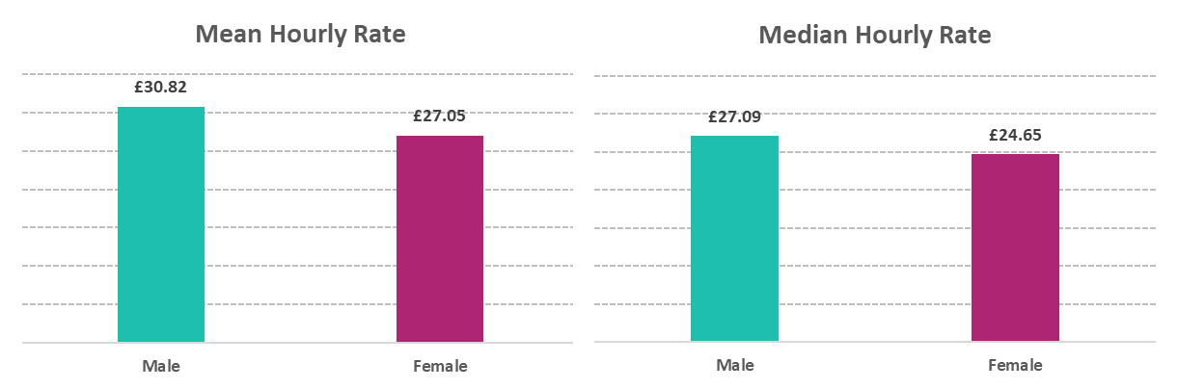
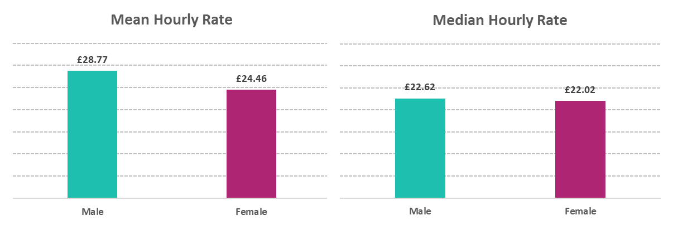
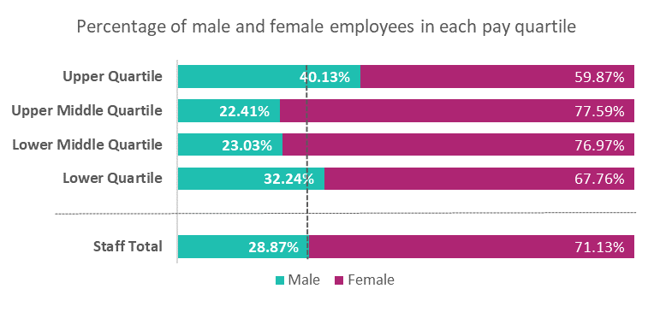
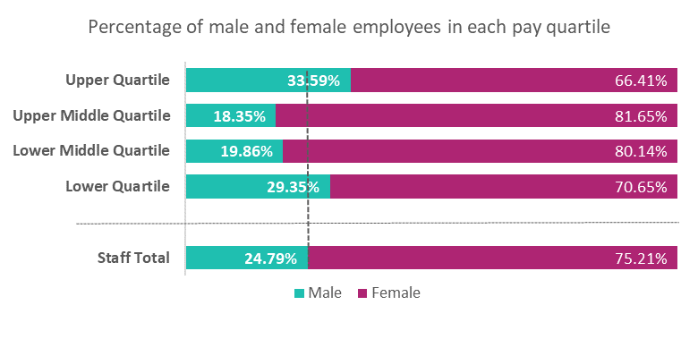
Gender Pay Gap
Definitions of Pay Gap
The mean pay gap is the difference between the average pay of all male employees and the average pay of all female employees.
The median pay gap is the difference between the pay of the middle male and middle female, when all male employees and then all female employees are listed from the highest to the lowest paid.
Basic Pay – Mean and Median Gap
St George’s University Hospital (STG)
Epsom and St Helier Hospitals (ESTH)
On 31st March 2025 STG employed 10,826 staff - 7,700 (71%) were female and 3,126 (29%) were male. The mean hourly pay for males was £3.77 higher than that of females, which is a gap of 12.2% (an increase from 11.6% in the previous year). Male median rate was £2.44 higher than females, which is a gap of 9.0% (an increase from 8.6% in the previous year).
For AfC (including VSM) staff, the average hourly rate for females was £0.54 higher than for males (-2.3% pay gap), an increase from -1.2% in the previous year. The median hourly rate for females is £1.52 higher, resulting in a pay gap of -7.1%, which is a slight improvement from -7.9% last year.
On 31st March 2025 ESTH employed 7.321 staff - 5,506 (75%) were female and 1,815 (25%) were male. The mean hourly pay for males is £4.31 higher than that of females, which is a gap of 15.0% (an increase from 13.6% in the previous year). Male median rate was £0.60 higher than females, which is a gap of 2.6% (a shift from -1.9% in the previous year).
For AfC (including VSM) staff, the average hourly rate for males was £0.06 higher than for females (0.3% pay gap), an increase from 0.2% in the previous year. The median hourly rate for females is £0.42 higher, resulting in a pay gap of -1.9%, which is an improvement from -5.8% last year.

Slide 7
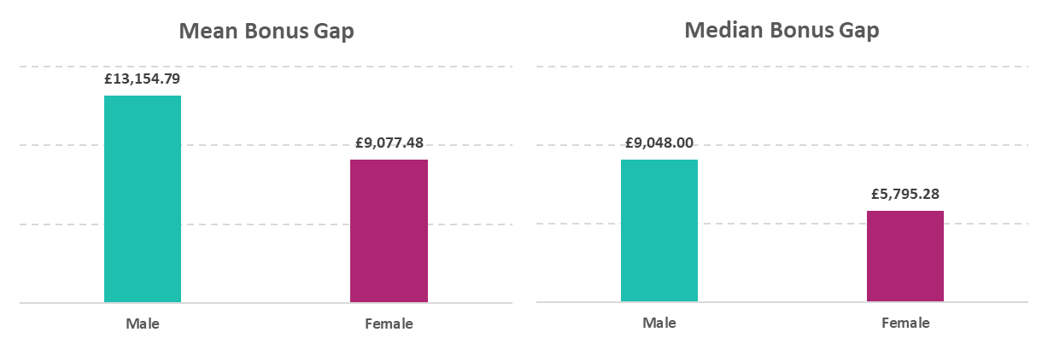
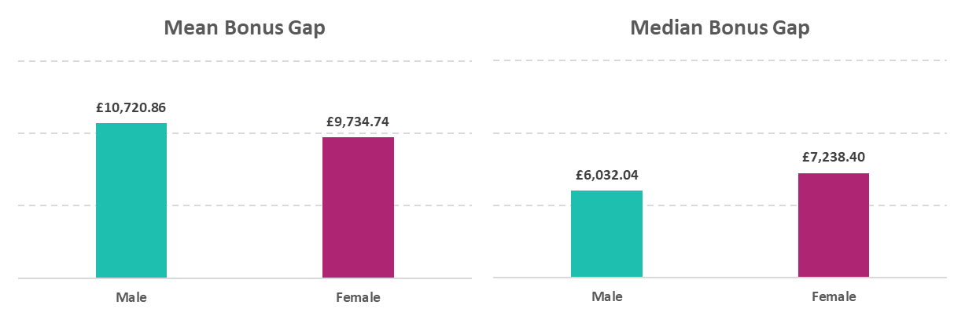
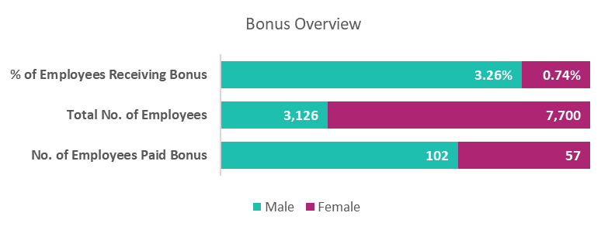
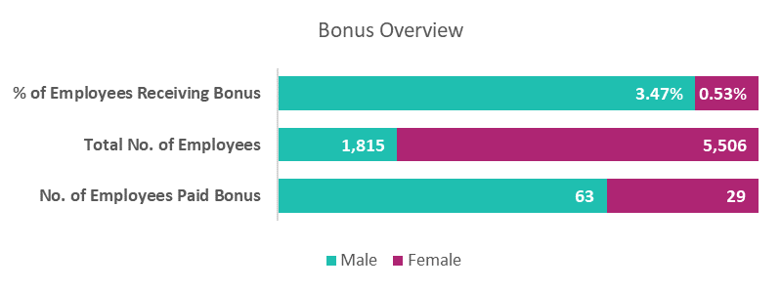
Gender Pay Gap
Definitions of Bonus Pay Gap
Mean Bonus Gap: The difference between the average bonus received by all male employees and the average bonus received by all female employees.
Median Bonus Gap: The difference between the bonus received by the middle-ranking male and the middle-ranking female when all eligible employees of each gender are listed in order from highest to lowest bonus received.
Bonus Pay – Mean and Median Gap
St George’s University Hospital (STG)
Epsom and St Helier Hospitals (ESTH)
A total of 159 staff received a bonus payment during this reporting period, all of whom were consultants. Of these, 57 were female (representing 0.74% of the female workforce) and 102 were male (representing 3.26% of the male workforce).
The mean bonus pay for male staff was £4,077.31 higher than for females, resulting in a 31.0% gap - up from 23.6% in 2024. The median bonus gap was £3,252.72 (resulting in a 35.9% gap), up from 0% in the previous year. Both mean and median pay gaps increased in favour of male consultants. In 2024, 618 staff received a bonus – 335 males and 283 females.
A total of 92 staff received a bonus payment during this reporting period, all of whom were consultants. Of these, 29 were female (representing 0.53% of the female workforce) and 63 were male (representing 3.47% of the male workforce).
The mean bonus pay for male staff was £986.12 higher than for females, resulting in a 9.2% gap - down from 16.7% in 2024. The median bonus gap was £1,206.36 in favour of females (resulting in a -20.0% pay gap), marking a shift from 0% in the previous year. Mean gap significantly narrowed, while the median now favours female consultants. In 2024, 299 staff received a bonus – 183 males and 116 females.

Slide 8
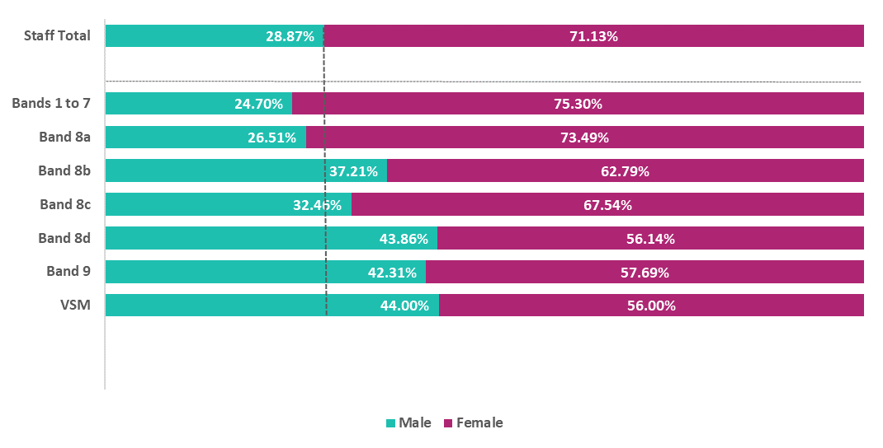
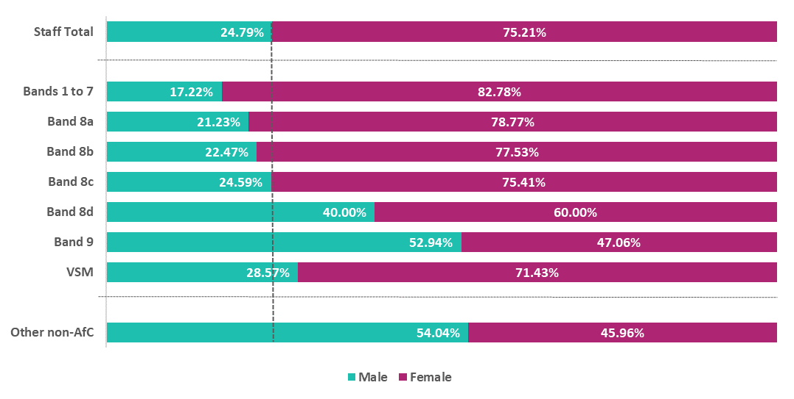
Gender Pay Gap
Spotlight on AfC (and local contracts)
St George’s University Hospital (STG)
Epsom and St Helier Hospitals (ESTH)
As an organisation, female staff make up 71% of the workforce. The workforce composition is within range of representative at bands 3, 4 and 8a (68% to 74%). There is an over representation of female staff at bands 5 to 7 (75% and above).
From band 8b and above, female representation reduces, and we see a higher proportion of male staff. Female representation is lowest at VSM at 56% (a 6% increase to 2024). Band 9 saw a significant increase, from 35% female representation in 2024 to 58% in 2025.
Male staff represent 29% of the STG workforce overall; the highest representation is 44% at VSM and 44% at band 8d.
The largest mean pay gap was observed in Estates and Ancillary, at 15.1%, representing an increase from 10.6% in the previous year. This was followed by Administrative and Clerical, with a mean pay gap of 10.7%, marking a decrease from 12.0% in 2024.
As an organisation, female staff make up 75% of the ESTH workforce. The workforce composition is within range of representative at bands 2, 8b and 8c (72% to 78%). There is an over representation of female staff at bands 3-8a (79% and above).
From band 8d and above, female representation reduces, and we see a higher proportion of male staff. Female representation is lowest at band 9 at 47%, followed by Facilities. Other non-AfC representation is also low at 46%.
Male staff represent 25% of the ESTH workforce overall; the highest representation is 54% within the Facilities staff on local contracts.
The largest mean pay gap was observed in Administrative and Clerical, with a mean pay gap of 14.8%, marking a decrease from 13.9% in 2024.

Slide 9
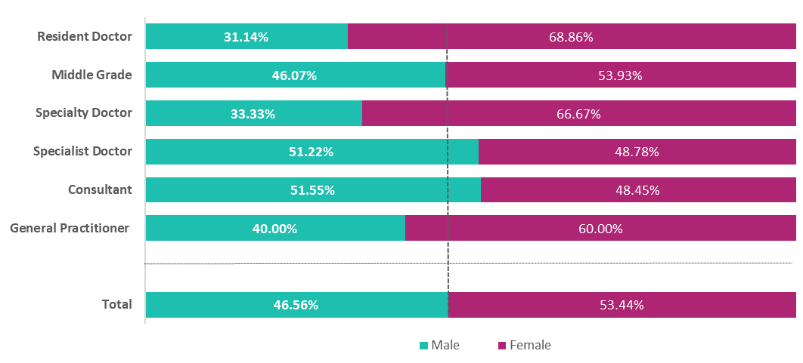
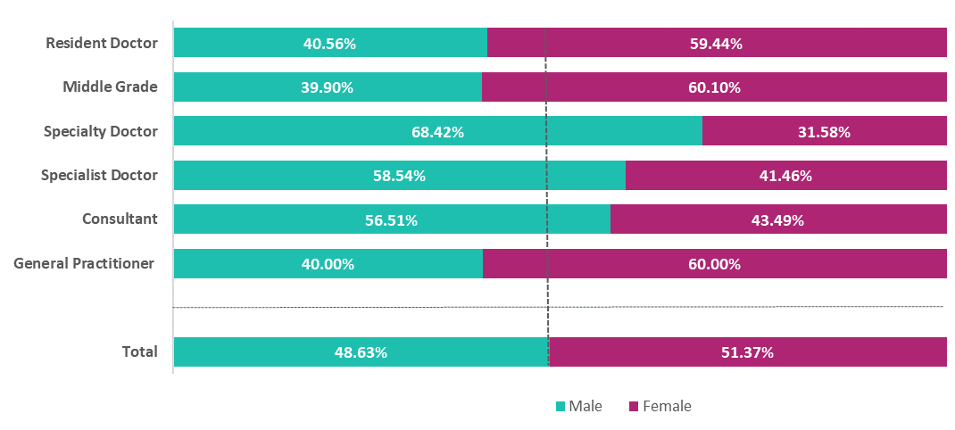
Gender Pay Gap
Spotlight on Medical Staff
St George’s University Hospital (STG)
Epsom and St Helier Hospitals (ESTH)
The Medical Staff group includes all ‘Doctor in Training’ through to ‘Consultant’ roles.
The proportion of male to female staff is 47% to 53%.
The mean hourly pay for males is £4.26 higher than that of females, which is a gap of 8.6% (an increase from 4.7% in the previous year). Male median pay is £5.26 higher than females, which is a gap of 11.1% (an increase from 6.3% in the previous year).
While the Medical Staff group continues to show disparity, the consultant subgroup has seen a modest narrowing of the pay gap. In 2025, male consultants earned £2.01 more per hour than female consultants, down slightly from £2.11 in the previous year, resulting in a 3.1% gap.
The Medical Staff group includes all ‘Doctor in Training’ through to ‘Consultant’ roles.
The proportion of male to female staff is 49% to 51%.
The mean hourly pay for males is £5.30 higher than that of females, which is a gap of 10.8% (a decrease from 16.6% in the previous year). Male median pay is £9.37 higher than females, which is a gap of 19.3% (a decrease from 24.6% in the previous year).
While the wider Medical Staff group continues to show the largest disparity, consultants have seen a narrowing of the gap. In 2025, male consultants earned £1.32 more per hour than their female counterparts, down from £2.26 in the previous year, resulting in a 2.0% gap.

Slide 10
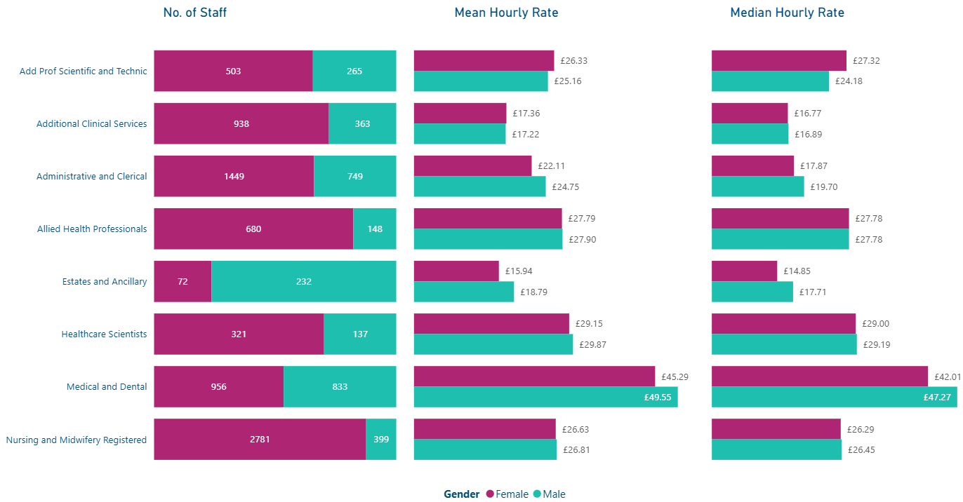
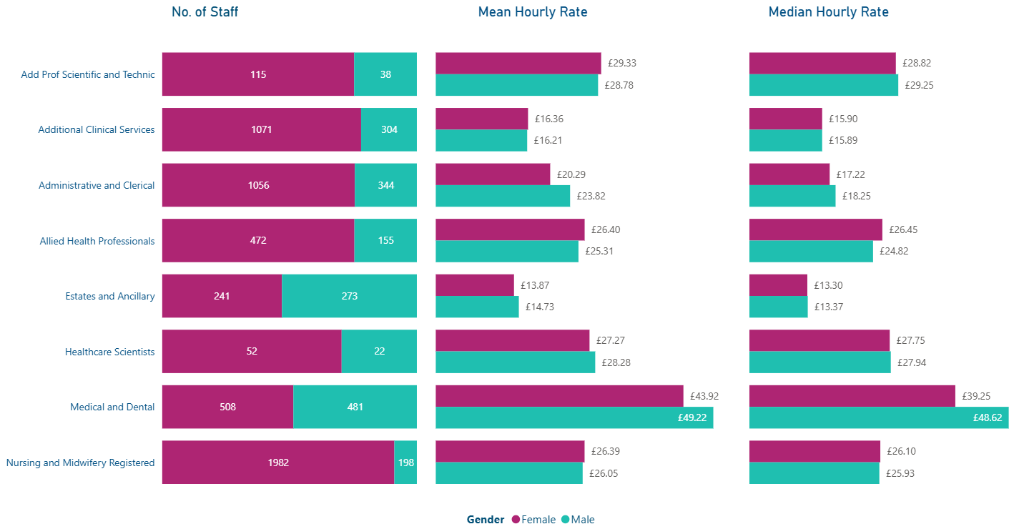
Gender Pay Gap
Spotlight on Staff Group (excluding Medical and Dental)
St George’s University Hospital (STG)
Epsom and St Helier Hospitals (ESTH)
The largest pay gap in favour of male staff was seen within Estates and Ancillary roles, with a mean gap of 15.1% (up from 10.6% in 2024) and a median gap of 16.2% (up from 13.7%). Admin and Clerical roles followed, with a mean gap of 10.7%. Smaller mean gaps were reported in Healthcare Scientists (2.4%), Qualified Nursing staff (0.7%) and Allied Health Professionals (0.4%).
In contrast, pay gaps in favour of female staff was seen within Additional Professional Scientific and Technical, with a mean gap of -4.6% and median gap of -13.0%. Additional Clinical Services also showed a small gap in favour of female staff, at -0.8% mean and 0.7% median.
The largest pay gap in favour of male staff was observed within Admin and Clerical roles, with a mean gap of 14.8% (up from 13.9% in 2024) and a median gap of 5.7% (up from 2.5%). Smaller gaps in favour of male staff were seen in Estates and Ancillary (5.8%) and Healthcare Scientists (3.6%).
In contrast, pay gaps in favour of female staff were recorded among Allied Health Professionals, with a mean gap of -4.3% and median of -6.6%, followed by Additional Professional Scientific and Technical (-1.9% mean), Qualified Nursing staff (-1.3% mean) and Additional Clinical Services (-0.9%).

Slide 11
Gender Pay Gap
Site Trend 2020 - 2025
St George’s University Hospital (STG)
Epsom and St Helier Hospitals (ESTH)
The mean pay gap widened by 0.6% in 2025
The median pay gap widened by 0.4% in 2025
The mean bonus gap widened by 7.4% in 2025
The median bonus gap significantly increased to 35.9%
The % of males receiving a bonus reduced to 3.3%
The % of females receiving bonus reduced to 0.7%
The mean pay gap widened by 1.4% in 2025
The median pay gap shifted in favour of men, now at 2.4%
The mean bonus gap reduced by 7.5% in 2025
The median bonus gap decreased by 20%
The % of males receiving a bonus reduced to 3.5%
The % of females receiving bonus reduced to 0.5%
In 2025, national changes to the consultant pay framework led to a significant reduction in the number of consultants eligible for bonus payments, including adjustments to the structure and criteria for clinical excellence awards. This has impacted the distribution of bonus pay across the workforce, and as such, direct comparisons with previous years should be approached with caution. In 2024 at STG, 618 consultants received a bonus, compared to 159 in 2025. At ESTH during 2024, 299 consultants received a bonus, compared to 92 in 2025.

Slide 12

Ethnicity Pay Gap Report
Snapshot Date: 31 March 2025
Features: ESR data on 31/03/2025 (extracted on 30 April 2025)
Published: 31 March 2026
By: Workforce Systems and Intelligence / Equality, Diversity and Inclusion

Slide 13
Ethnicity Pay Gap
Introduction
While public sector organisations are legally required to report and publish their gender pay gap annually under the Equality Act 2010 and Gender Pay Gap Information Regulations 2017, there is currently no mandatory requirement to report on the ethnicity pay gap.
Despite this, St George’s, Epsom and St Helier University Hospitals and Health Group (gesh) has chosen to examine pay disparities between employees who have declared their ethnicity using a snapshot data from 31 March 2025. This voluntary analysis reflects our commitment to equity, transparency, and better understanding workforce experiences.
As of the snapshot date, the Group employed 18,147 staff, with 10,826 at St George’s University Hospitals (STG) and 7,321 at Epsom and St Helier Hospitals (ESTH).
At STG, all staff excluding Medical and Very Senior Management (VSM) roles are on Agenda for Change (AfC) pay scales. At ESTH, in addition to Medical, VSM and AfC staff, 570 Estates and Facilities staff are employed on locally agreed pay frameworks. Non-Executive Directors have been excluded from this analysis due to the nature of their roles and impact on comparative averages.
What is the ethnicity pay gap?
The Ethnicity Pay Gap reflects differences in average hourly earnings between White employees and BME employees.
For instance, if BME employees are underrepresented in higher-paid roles, or more frequently work in part-time or lower-banded positions, their average hourly earnings may be lower.
It is important to note that the Ethnicity Pay Gap is not the same as equal pay. Equal pay ensures that employees doing the same or similar jobs receive equal pay, regardless of ethnicity. It is unlawful to pay someone differently because of their ethnicity.
What do we have to report on?
Unlike the statutory requirements for Gender Pay Gap reporting, there is currently no legal obligation for public sector organisations to report on the Ethnicity Pay Gap. However, gesh has voluntarily undertaken this analysis, focusing on pay differences between staff who have declared their ethnicity as White and those who have declared a Black or Minority Ethnic (BME) background. This reflects our commitment to transparency, workforce equity, and a clearer understanding of staff experience across ethnic groups.
The mean basic ethnicity pay gap
The median basic ethnicity pay gap
Proportion of White and BME staff in each pay quartile
The mean bonus ethnicity pay gap
The median bonus ethnicity pay gap
Proportion of White and BME staff receiving a bonus payment
Who is included?
All staff who were employed across the gesh Group on full pay as of 31st March 2025, with the exception of Non-Executive Directors. Bank staff who worked a shift on the snapshot date are included, as are Consultant Additional Programmed Activities. Excluded categories include:
Employees on half or nil pay due to absence or maternity leave
Hosted staff (e.g. GP Trainees)
Agency staff
General overtime pay and expenses
What pay is covered?
The report covers both basic pay and bonus pay. Bonus pay is defined as any remuneration that is in the form of money, vouchers, securities or options and relates to profit sharing, productivity, performance, incentive or commission. This includes Clinical Excellence Awards and Distinction Awards. Recruitment & retention payments (RRPs) are only included if they are one-off payments at the start of recruitment. Ongoing RRPs are excluded. Workplace vouchers paid in addition to basic salary are included, unless provided via salary sacrifice arrangements. For detailed information on how the pay gap is calculated please see Appendix A.

Slide 14




Ethnicity Pay Gap
Site Overview
St George’s University Hospital (STG)
Epsom and St Helier Hospitals (ESTH)
Substantive Staff
Substantive Staff
Key:
Green +/- 0-3%
Amber +/-3-5%
Red +/- 5% & above
Pay Gap
Pay Gap
14.6%
Mean Pay Gap
17.2%
Median Pay Gap
-4.3%
Mean Pay Gap
-4.2%
Median Pay Gap
$↓$ (-0.3% from 2024)
$↓$ (-0.3% from 2024)
$↓$ (-2.4% from 2024)
$↓$ (-1.9% from 2024)

Slide 15
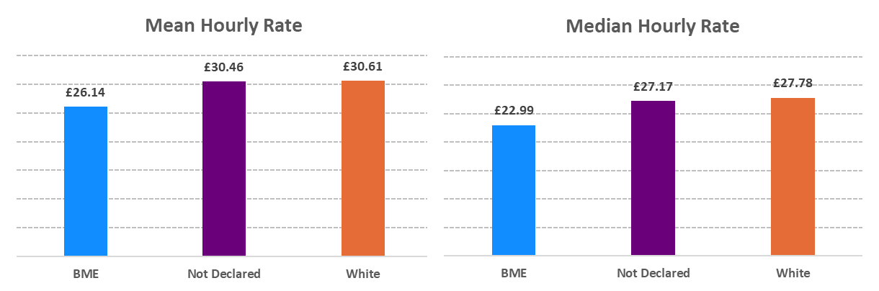
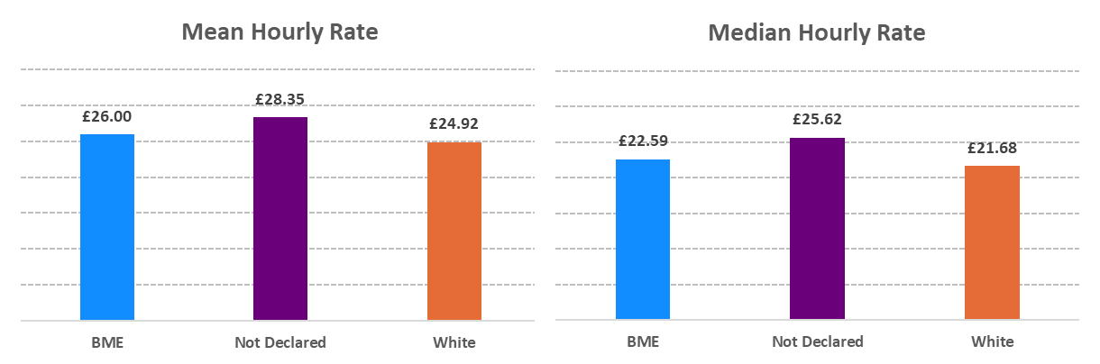
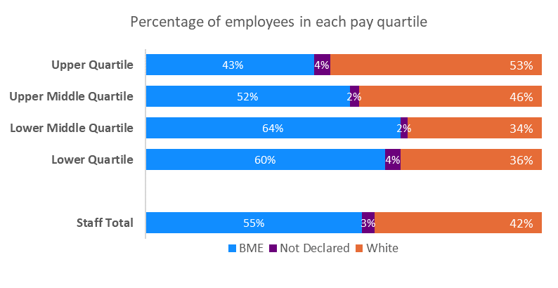
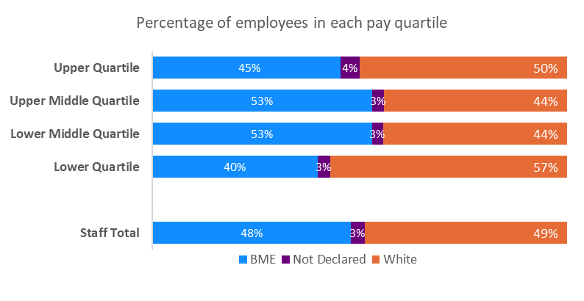
Ethnicity Pay Gap
Definitions of Pay Gap
The Mean ethnicity pay gap: The difference between the average hourly pay of all staff who identify as Black and Minority Ethnic (BME) and the average hourly pay of staff who identify as white.
The Median ethnicity pay gap: The difference between the hourly rate of the middle-paid BME staff member and the middle-paid white staff member, when each group is listed separately from highest to lowest paid.
Basic Pay – Mean and Median Gap
St George’s University Hospital (STG)
Epsom and St Helier Hospitals (ESTH)
On 31st March 2025 STG employed 10,826 staff – 5,921 (55%) BME staff, 4,573 (42%) white staff and 332 (3%) not declared. The mean hourly pay for BME staff was £4.47 lower than white staff, representing a pay gap of 14.6% - a slight improvement from 14.9% the previous year. The median hourly rate was £4.79 lower for BME staff, resulting in a gap of 17.2%, down from 17.5% last year.
For AfC (including VSM) staff, the average hourly rate for BME staff was £3.11 lower than white staff (11.9% pay gap), a decrease from 12.1% in the previous year. The median hourly rate for BME staff is £3.55 lower, resulting in a pay gap of 13.8%, and an improvement from 15.4% last year.
On 31st March 2025 ESTH employed 7,321 staff – 3,501 (48%) BME staff, 3,573 (49%) white staff and 247 (3%) not declared. The mean hourly pay for BME staff was £1.08 higher than white staff, representing a pay gap of -4.3% - a further widening from -1.9% in the previous year. The median hourly rate was £0.91 higher for BME staff, resulting in a gap of -4.2%, down from -2.3% last year.
For AfC (including VSM) staff, the average hourly rate for BME staff was £0.42 lower than white staff (1.8% pay gap), an increase from 1.5% in the previous year. The median hourly rate for BME staff is £0.34 higher, resulting in a pay gap of -1.6%, and a decrease from 0% last year.

Slide 16
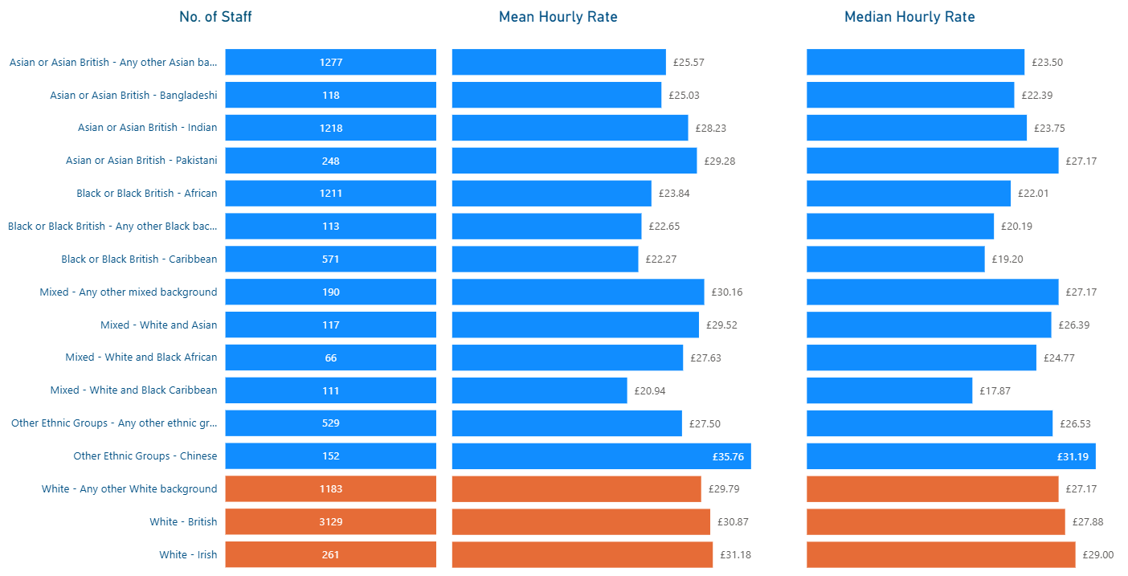
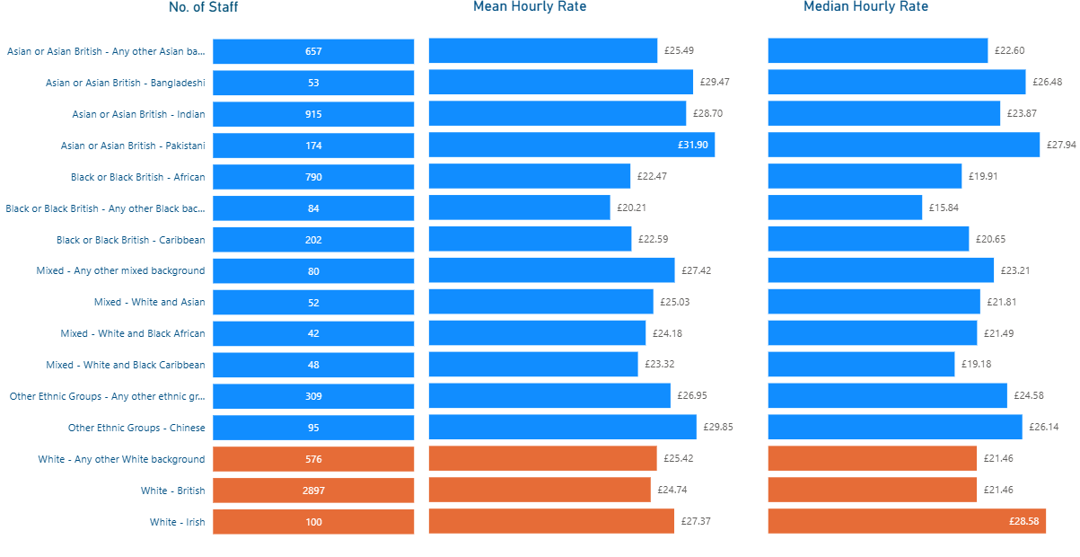
Ethnicity Pay Gap
Definitions of Pay Gap
The Mean ethnicity pay gap: The difference between the average hourly pay of all staff who identify as Black and Minority Ethnic (BME) and the average hourly pay of staff who identify as white.
The Median ethnicity pay gap: The difference between the hourly rate of the middle-paid BME staff member and the middle-paid white staff member, when each group is listed separately from highest to lowest paid.
Basic Pay – Mean and Median Gap (Detail)
St George’s University Hospital (STG)
Epsom and St Helier Hospitals (ESTH)
STG employs 3,129 White – British staff, earning an average of £30.87 per hour. This figure is higher than all other ethnic groups, except for Chinese staff, who earn £4.89 more per hour, and White – Irish staff, whose average pay is £0.31 higher.
The lowest average hourly rates were observed among Mixed – White and Black Caribbean staff (£20.94), Black British – Caribbean staff (£22.27), and Any Other Black Background staff (£22.65).
ESTH employs 2,897 White – British staff, earning an average of £24.74 per hour. Across the workforce, all Asian ethnic groups saw a higher average hourly rate than White – British staff, both in terms of mean and median pay.
In contrast, Black staff are earning less than White – British colleagues, with Black or Black British – Caribbean earning £20.59 per hour and Black or Black British – African earning £22.47 per hour.

Slide 17
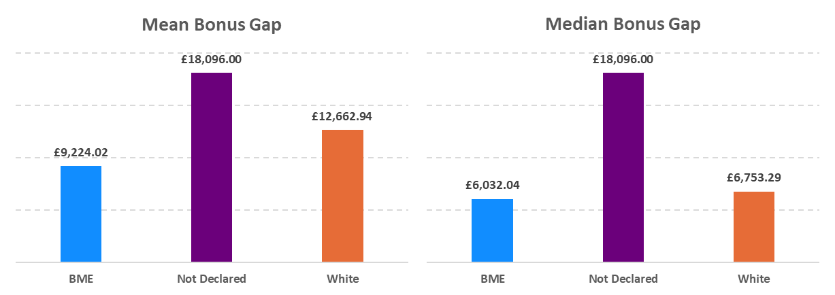
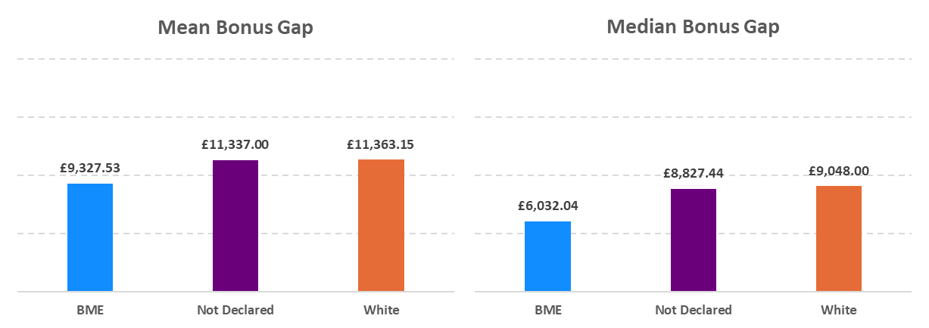
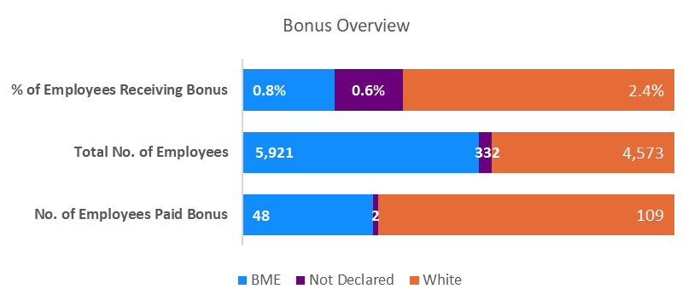
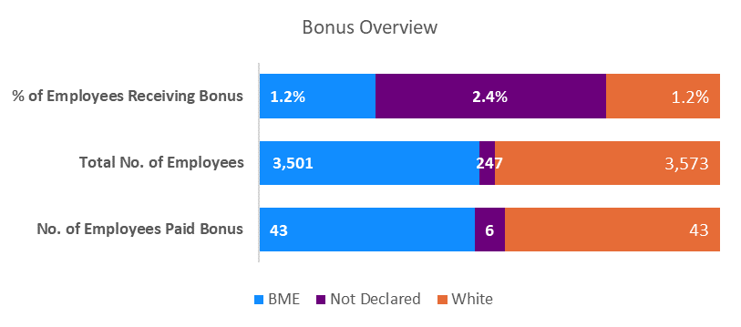
Ethnicity Pay Gap
Definitions of Bonus Pay Gap
The Mean ethnicity bonus gap: The difference between the average bonus paid to all staff who identify as Black and Minority Ethnic (BME), and the average bonus paid to those who identify as white.
The Median ethnicity bonus gap: The difference between the bonus received by the middle-paid BME staff member and the middle-paid white staff member, when each group is ordered separately from highest to lowest bonus.
Bonus Pay – Mean and Median Gap
St George’s University Hospital (STG)
Epsom and St Helier Hospitals (ESTH)
A total of 159 staff received a bonus payment during this reporting period, all of whom were consultants. Of these, 48 were BME (representing 0.8% of the BME workforce), 109 were white (representing 2.4% of the white workforce) and 2 had not declared (representing 0.6% of the not declared workforce).
The mean bonus pay for BME staff was £3,438.92 lower than white staff, resulting in a 27.2% gap - up from 21.8% in 2024. The median bonus gap was £721.25 (resulting in a 10.7% gap). Mean and median bonus gap widened significantly. In 2024, 618 staff received a bonus – 230 BME, 351 white and 37 not declared.
A total of 92 staff received a bonus payment during this reporting period, all of whom were consultants. Of these, 43 were BME (representing 1.2% of the BME workforce), 43 were white (representing 1.2% of the white workforce) and 6 had not declared (representing 2.4% of the not declared workforce).
The mean bonus pay for BME staff was £2,035.62 lower than white staff, resulting in a 17.9% gap - down from 24.8% in 2024. The median bonus gap was £3,015.96 (resulting in a 33.3% gap). Mean bonus gap decreased, while the median increased. In 2024, 299 staff received a bonus – 158 BME, 121 white and 20 not declared.

Slide 18
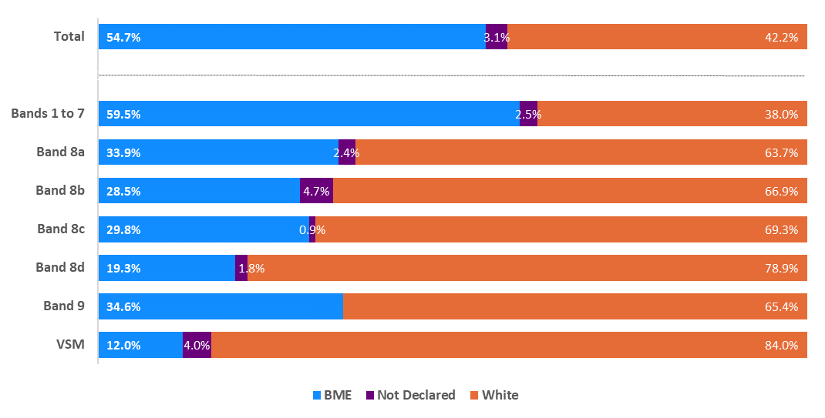
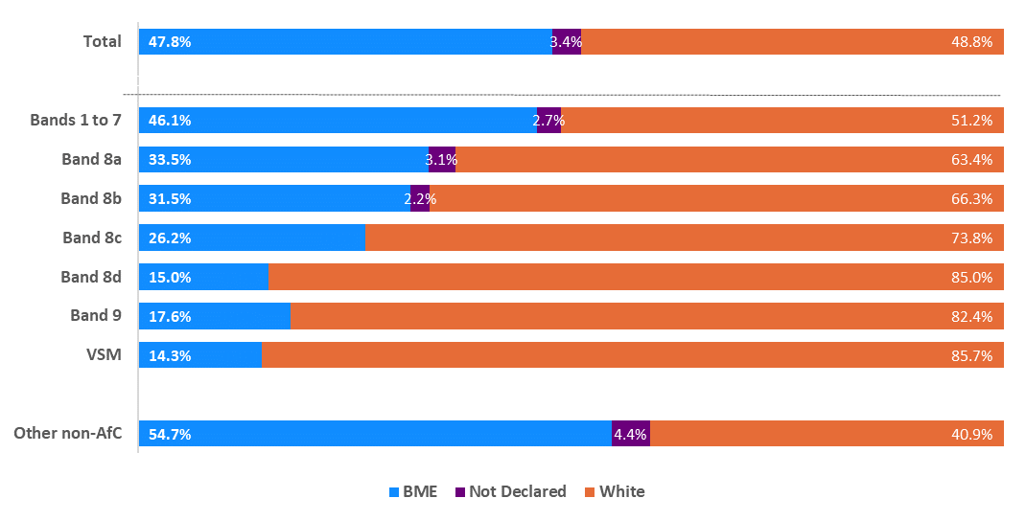
Ethnicity Pay Gap
Spotlight on AfC (and local contracts)
St George’s University Hospital (STG)
Epsom and St Helier Hospitals (ESTH)
BME staff represent 55% of the overall workforce. Representation is broadly aligned with this figure across bands 4 and 6, ranging between 52% and 58%. Over-representation is observed in bands 2, 3 and 5, with BME staff accounting for 59% or more. The highest proportions of BME staff are seen in band 5 (71.1%) and band 2 (67.9%). Overall, BME staff was represented by 59.5% of the workforce across bands 1 to 7.
Lower representation is evident in senior grades. VSM roles show the lowest proportion of BME staff at 12.0%, followed by band 8d at 19.3% and band 8b at 28.5%.
Rates of 'Not disclosed' were highest in band 4 at 4.8% and band 8b at 4.7%.
BME staff represent 48% of the overall workforce. Over-representation is observed in bands 2 and 5, as well as among staff on local contracts in facilities, where BME representation reaches 52% or higher. The highest proportions of BME staff were seen in band 5 (66.5%) and band 2 (56.7%). Overall, 46.1% of staff in bands 1 to 7 are from a BME background.
Lower representation is evident in senior grades. BME staff account for 14.3% of the workforce at VSM level, 15.0% in band 8d, and 17.6% in band 9.
Rates of ‘Not disclosed’ ethnicity were highest in band 4 and band 7, both at 3.5%.
Notes:
STG – chart and text updated

Slide 19
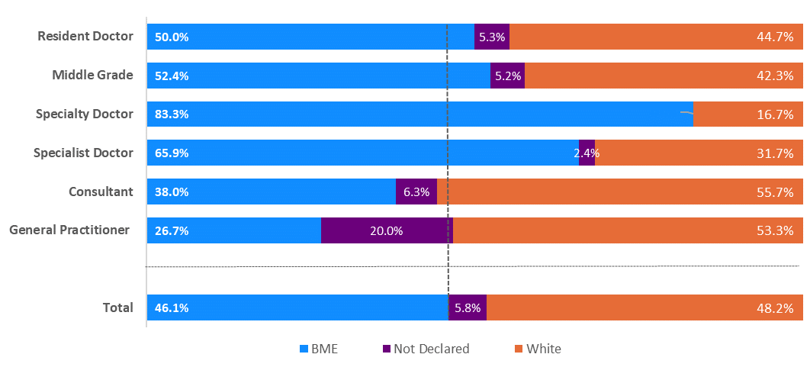
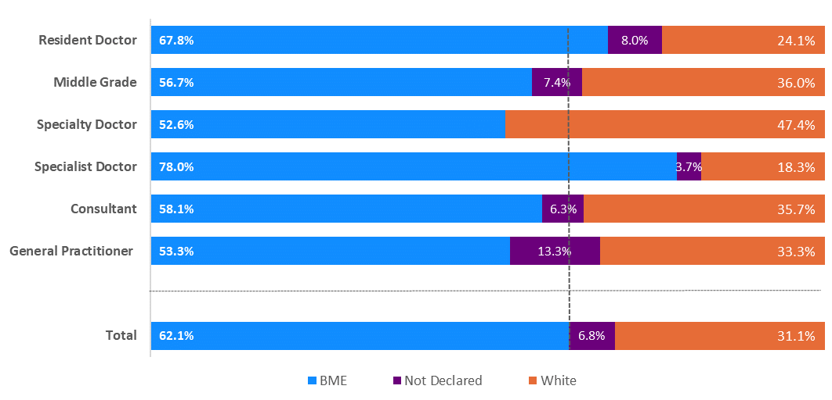
Ethnicity Pay Gap
Spotlight on Medical Staff
St George’s University Hospital (STG)
Epsom and St Helier Hospitals (ESTH)
The Medical Staff group includes all ‘Doctor in Training’ through to ‘Consultant’ roles.
Within this group, 46.1% of staff identified as Black and Minority Ethnic (BME), 48.2% as white, and 5.8% did not declare their ethnicity.
The mean hourly pay for BME staff was £4.91 lower than for white staff, resulting in a 9.9% pay gap, down from 10.5% last year. The median pay gap stood at £9.59 in favour of white staff (18.6%), also a reduction from 19.5% in 2024.
Focusing on consultants, BME staff earned £2.53 less per hour on average than their white counterparts - a 3.9% gap, down from 4.3% in the previous year.
The Medical Staff group includes all ‘Doctor in Training’ through to ‘Consultant’ roles.
Within this group, 62.1% of staff identified as Black and Minority Ethnic (BME), 31.1% as white, and 6.8% did not declare their ethnicity.
The mean hourly pay for BME staff was £4.58 lower than for white staff, resulting in a 9.2% pay gap, down from 12.5% last year. The median pay gap stood at £4.74 in favour of white staff (10.1%), also a reduction from 13.5% in 2024.
Focusing on consultants, BME staff earned £4.33 less per hour on average than their white counterparts - a 6.4% gap, up from 5.3% in the previous year.

Slide 20
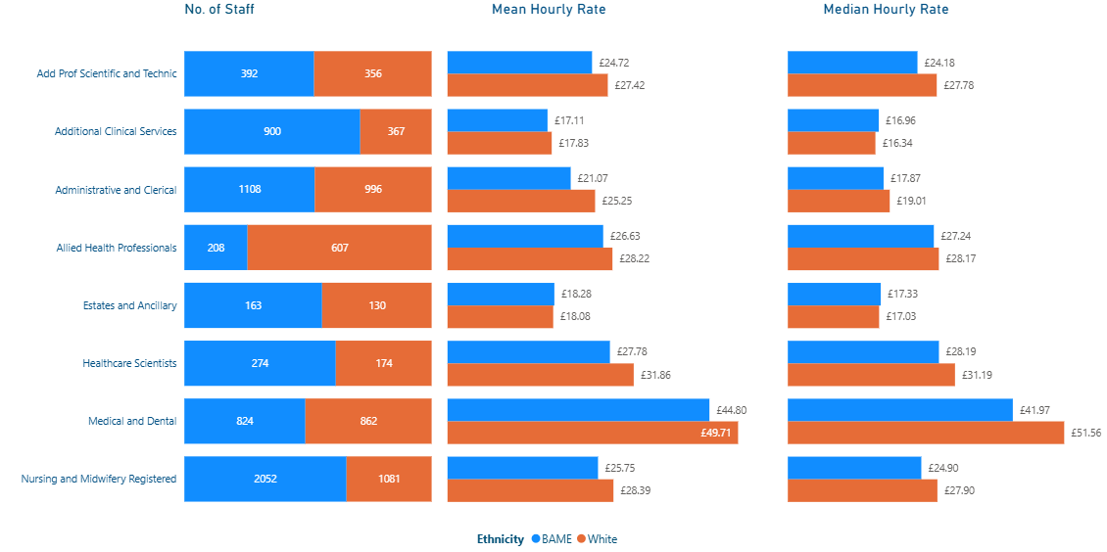
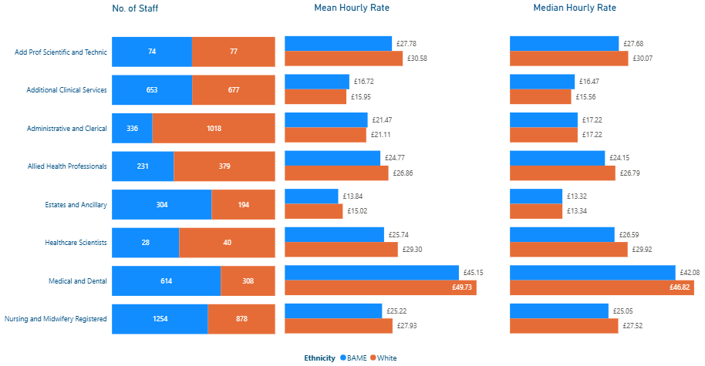
Ethnicity Pay Gap
Spotlight on Staff Group (excluding Medical and Dental)
St George’s University Hospital (STG)
Epsom and St Helier Hospitals (ESTH)
The largest pay gap in favour of white staff was seen within Admin and Clerical roles, with a mean gap of 16.5% (down from 17.4% in 2024) and a median gap of 6.0% (up from 2.9% in 2024). Healthcare Scientists followed, with a mean gap of 12.8%, then Add Prof Scientific and Technic (9.8%), Qualified Nursing staff (9.3%), Allied Health Professionals (5.6%) and Additional Clinical Services (4.0%).
In contrast, pay gaps in favour of BME staff was seen within Estates and Ancillary staff, with a mean gap of -1.1% and median gap of -1.8%.
The largest pay gap in favour of white staff was seen within Healthcare Scientists, with a mean gap of 12.2% (down from 13.6% in 2024) and a median gap of 11.1% (down from 11.4% in 2024). Qualified Nursing staff followed, with a mean gap of 9.7%, then Add Prof Scientific and Technic (9.2%), Estates and Ancillary (7.8%) and Allied Health Professionals (7.8%).
In contrast, pay gaps in favour of BME staff was seen within Additional Clinical Services staff, with a mean gap of -4.8% and median gap of -5.8%, followed by Admin and Clerical with a mean gap of -1.7% and a median gap of 0%.

Slide 21
Ethnicity Pay Gap
Site Trend 2024 - 2025
St George’s University Hospital (STG)
Epsom and St Helier Hospitals (ESTH)
The mean pay gap decreased by 0.3%
The median pay gap decreased by 0.3%
The mean bonus gap increased to 27.2%
The median bonus gap significantly increased to 10.7%
The % of white staff receiving a bonus decreased by 5.4%
The % of BME staff receiving bonus decreased by 3.4%
Unlike gender pay gap, we have two years of ethnicity pay gap data.
The mean pay gap widened by 2.4% and is in favour of BME staff
The median pay gap widened by 1.9% and is favour of BME staff
The mean bonus gap decreased to 17.9%
The median bonus gap significantly increased to 33.3%
The % of white staff receiving a bonus decreased by 2.1%
The % of BME staff receiving bonus decreased by 3.6%
Unlike gender pay gap, we have two years of ethnicity pay gap data.
In 2025, national changes to the consultant pay framework led to a significant reduction in the number of consultants eligible for bonus payments, including adjustments to the structure and criteria for clinical excellence awards. This has impacted the distribution of bonus pay across the workforce, and as such, direct comparisons with previous years should be approached with caution. In 2024 at STG, 618 consultants received a bonus, compared to 159 in 2025. At ESTH during 2024, 299 consultants received a bonus, compared to 92 in 2025.

Slide 22

Disability Pay Gap Report
Snapshot Date: 31 March 2025
Features: ESR data on 31/03/2025 (extracted on 30 April 2025)
Published: 31 March 2026
By: Workforce Systems and Intelligence / Equality, Diversity and Inclusion

Slide 23
Disability Pay Gap
Introduction
While public sector organisations are legally required to report and publish their gender pay gap annually under the Equality Act 2010 and Gender Pay Gap Information Regulations 2017, there is currently no mandatory requirement to report on the disability pay gap.
Despite this, St George’s, Epsom and St Helier University Hospitals and Health Group (gesh) has chosen to examine pay disparities between employees who have declared a disability and those who have not, using snapshot data from 31 March 2025. This voluntary analysis reflects our commitment to equity, transparency, and better understanding workforce experiences.
As of the snapshot date, the Group employed 18,147 staff, with 10,826 at St George’s University Hospitals (STG) and 7,321 at Epsom and St Helier Hospitals (ESTH).
At STG, all staff excluding Medical and Very Senior Management (VSM) roles are on Agenda for Change (AfC) pay scales. At ESTH, in addition to Medical, VSM and AfC staff, 570 Estates and Facilities staff are employed on locally agreed pay frameworks. Non-Executive Directors have been excluded from this analysis due to the nature of their roles and impact on comparative averages.
What is the disability pay gap?
The Disability Pay Gap reflects the difference in average hourly earnings between employees who have declared a disability and those who have not across the organisation.
For example, if staff with declared disabilities are underrepresented in higher-paid roles or work more frequently in part-time or lower-banded positions, the average hourly earnings of disabled staff may be lower than those of non-disabled staff.
It is important to note that the Disability Pay Gap is not the same as equal pay. Equal pay relates to ensuring that employees receive equal pay for the same or similar jobs, or for work of equal value, regardless of disability. It is unlawful to pay employees differently because of disability status.
What do we have to report on?
Unlike the statutory requirements for Gender Pay Gap reporting, there is currently no legal requirement to report on the Disability Pay Gap. However, gesh has chosen to undertake this analysis voluntarily as part of our commitment to workforce equity and transparency. In line with gender pay gap methodology, we have reported:
The mean basic disability pay gap
The median basic disability pay gap
The proportion of disabled and non-disabled staff within each pay quartile
The mean bonus disability pay gap
The median bonus disability pay gap
The proportion of disabled and non-disabled staff receiving a bonus payment
Who is included?
All staff who were employed across the gesh Group on full pay as of 31st March 2025, with the exception of Non-Executive Directors. Bank staff who worked a shift on the snapshot date are included, as are Consultant Additional Programmed Activities.
Excluded categories include:
Employees on half or nil pay due to absence or maternity leave
Hosted staff (e.g. GP Trainees)
Agency staff
General overtime pay and expenses
What pay is covered?
The report covers both basic pay only. To ensure strict anonymity within our Disability pay gap report, bonus pay information has been excluded due to the small number of employees with a disability.
For detailed information on how the pay gap is calculated please see Appendix A.

Slide 24




Disability Pay Gap
Site Overview
St George’s University Hospital (STG)
Epsom and St Helier Hospitals (ESTH)
Substantive Staff
Substantive Staff
Key:
Green +/- 0-3%
Amber +/-3-5%
Red +/- 5% & above
Pay Gap
Pay Gap
8.2%
Mean Pay Gap
3.8%
Median Pay Gap
7.9%
Mean Pay Gap
2.5%
Median Pay Gap
$↓$ (-2.0% from 2024)
$↓$ (-2.6% from 2024)
$↓$ (-0.7% from 2024)
$↑$ (+1.7% from 2024)

Slide 25
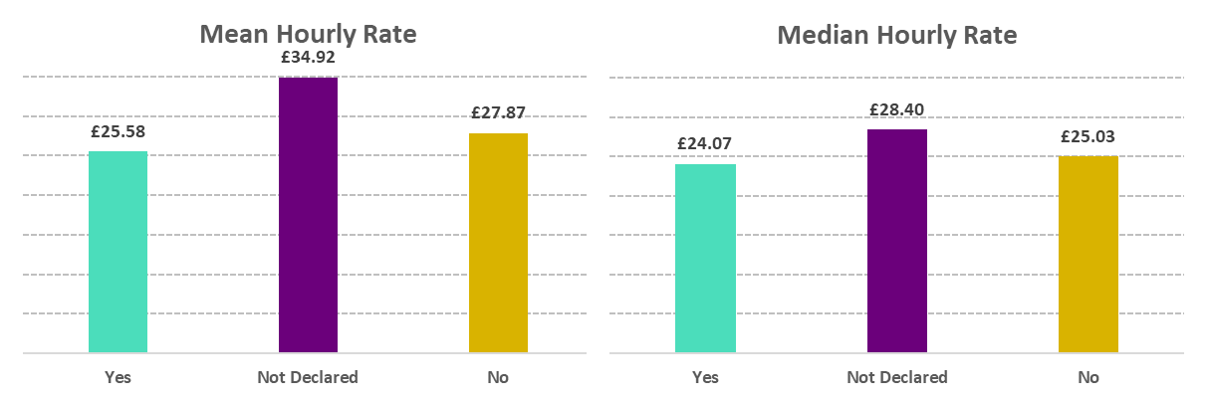
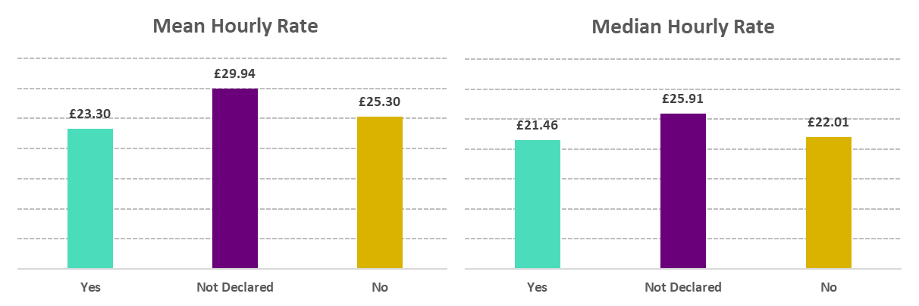
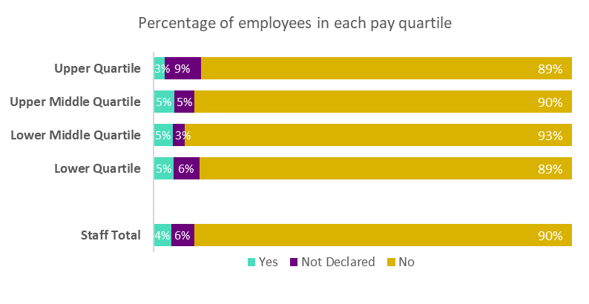
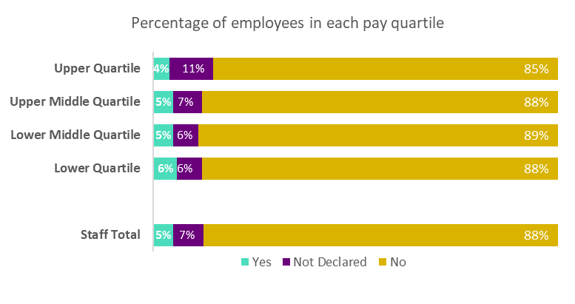
Disability Pay Gap
Definitions of Pay Gap
The mean pay gap is the difference between the average pay of all non-disabled employees and the average pay of all disabled employees.
The median pay gap is the difference between the pay of the middle non-disabled and middle disabled, when all non-disabled employees and then all disabled employees are listed from the highest to the lowest paid.
Basic Pay – Mean and Median Gap
St George’s University Hospital (STG)
Epsom and St Helier Hospitals (ESTH)
On 31st March 2025 STG employed 10,826 staff – 9,766 (90%) were non-disabled, 460 (4%) were disabled and 600 (6%) not declared. The mean hourly pay for disabled staff was £2.29 lower than non-disabled, which is a gap of 8.2% (a decrease from 10.2% in the previous year). Disabled median rate was £0.96 lower than non-disabled, which is a gap of 3.8% (a decrease from 6.4% in the previous year).
For AfC (including VSM) staff, average hourly rate of disabled staff was £0.18 lower than non-disabled (0.7% pay gap), down from 4.7% last year. The median hourly rate for disabled and non-disabled staff is £22.91. resulting in a pay gap of 0.0%, and an improvement from 1.0% last year.
On 31st March 2025 ESTH employed 7,321 staff – 6,408 (88%) were non-disabled, 367 (5%) were disabled and 546 (7%) not declared. The mean hourly pay for disabled staff was £2.00 lower than non-disabled, which is a gap of 7.9% (a decrease from 8.6% in the previous year). Disabled median rate was £0.55 lower than non-disabled, which is a gap of 2.5% (an increase from 0.8% in the previous year).
For AfC (including VSM) staff, the average hourly rate for disabled staff was £0.17 lower than for non-disabled staff (0.7% pay gap), a decrease from 1.3% in the previous year. The median hourly rate for disabled and non-disabled staff is £21.46, resulting in a pay gap of 0.0% (same as last year).

Slide 26
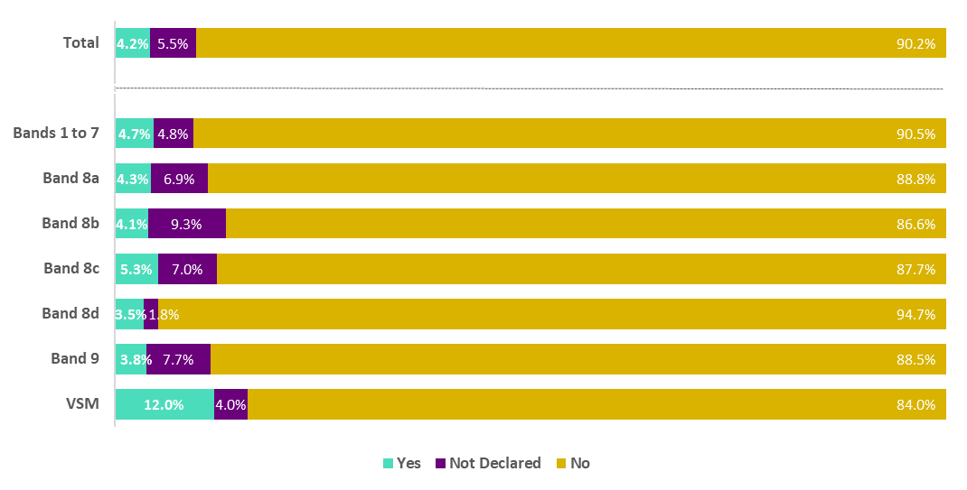
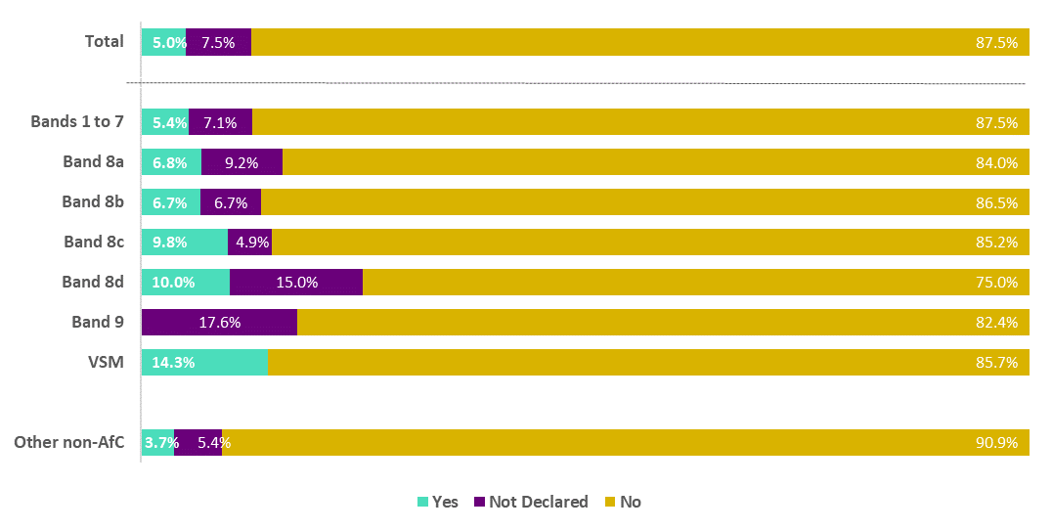
Disability Pay Gap
Spotlight on AfC (and local contracts)
St George’s University Hospital (STG)
Epsom and St Helier Hospitals (ESTH)
Disabled staff represent 4% of the overall workforce. Representation is broadly aligned with this figure across bands 2, 4, 5, 8a, 8b, 8d and 9 (ranging from 3.5% and 4.5%). Over-representation is seen at bands 7, 8c and VSM, with disabled staff accounting for 5% or more.
The highest disability declaration was found at VSM (12%) and band 8c (5.26%).
However, low overall declaration rates make robust pay gap analysis challenging, highlighting the need for ongoing awareness and engagement. Bands 8b saw the highest not declared rate at 9.3%.
Disabled staff represent 5% of the overall workforce. Representation is broadly consistent across bands 5 and 7 (ranging from 4.5% to 5.5%), with over-representation in bands 3, 4, 8a to 8d and VSM, where disabled staff account for 6% or more.
The highest disability declaration rates were at VSM (14.3%) and band 8d (10.0%).
However, low declaration volumes overall continue to challenge pay gap analysis, reinforcing the need for greater staff awareness and engagement. Notably, bands 8d (15.0%) and band 9 (17.6%) had the highest proportions of staff with undeclared disability status.
Notes:
STG – chart and text updated

Slide 27
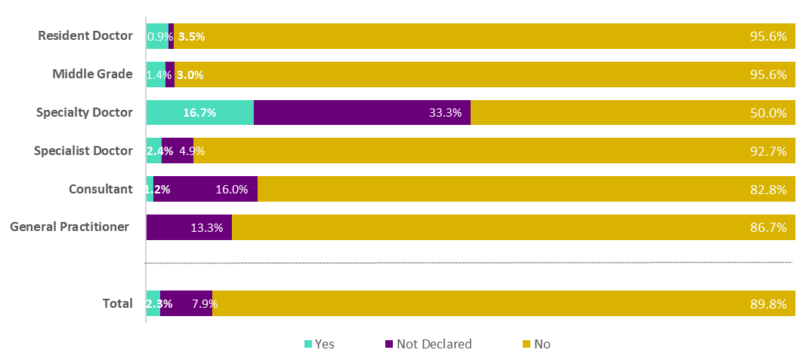
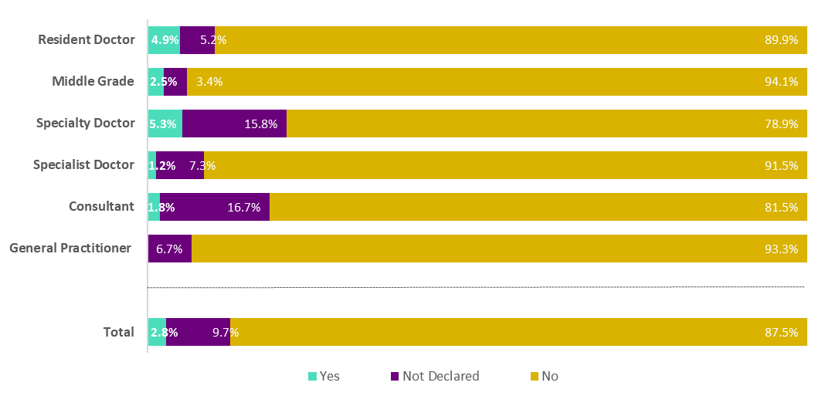
Disability Pay Gap
Spotlight on Medical Staff
St George’s University Hospital (STG)
Epsom and St Helier Hospitals (ESTH)
The Medical Staff group includes all ‘Doctor in Training’ through to ‘Consultant’ roles.
Within this group, 2.3% of staff declared a disability, 7.9% did not declare, and 89.8% were non-disabled.
The mean hourly pay gap between disabled and non-disabled staff is £6.03 in favour of non-disabled staff (a 13.2% gap) and is same as last year. The median gap is £3.81, or a pay gap of 9.0%, a decrease from 17.2% in 2024.
Among consultants, disabled staff earned £2.68 per hour less on average than non-disabled colleagues - a 4.3% gap, up from 0.9% last year.
The Medical Staff group includes all ‘Doctor in Training’ through to ‘Consultant’ roles.
Within this group, 2.8% of staff declared a disability, 9.7% did not declare, and 87.5% were non-disabled.
The mean hourly pay gap between disabled and non-disabled staff is £8.87 in favour of non-disabled staff (a 19.5% gap) and is a slight decrease from 19.8% from 2024. The median gap is £10.44, or a pay gap of 24.8%, also a decrease from 28.3% in 2024.
Among consultants, disabled staff earned £0.98 less per hour on average - a 1.5% gap, compared to a reversed gap of -1.6% in 2024.

Slide 28
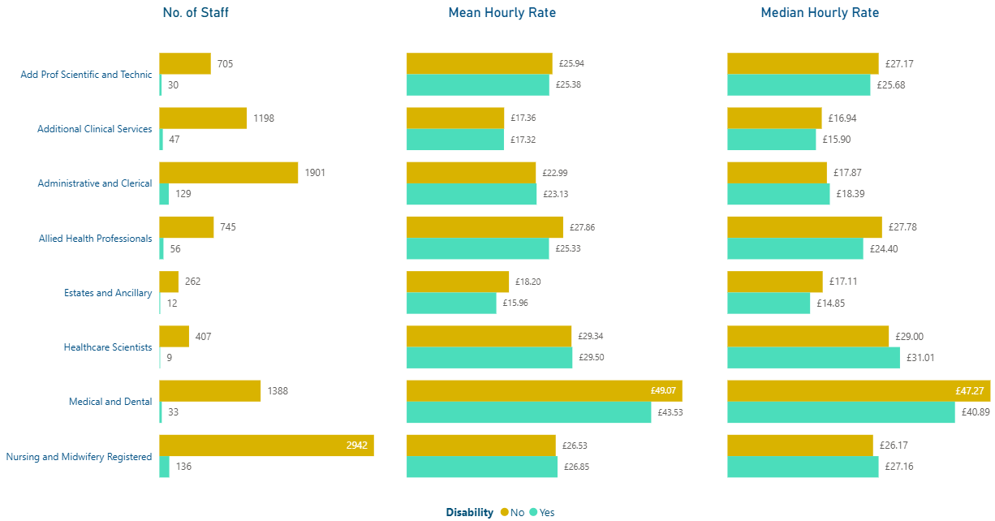
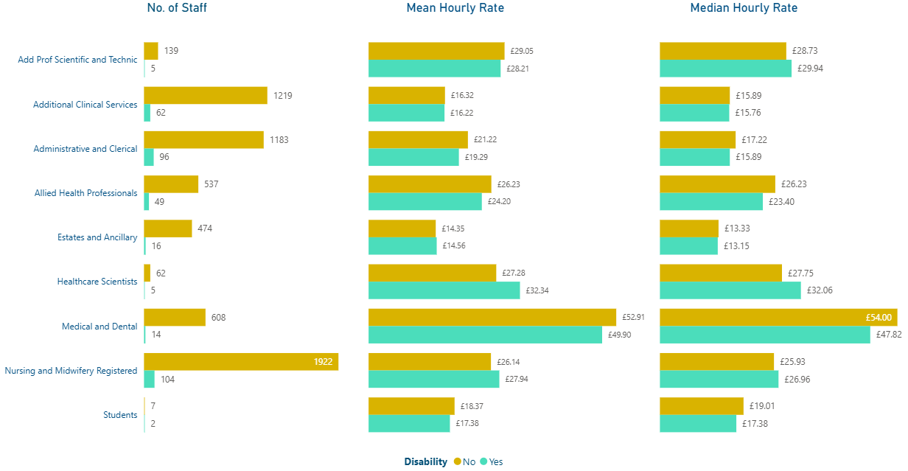
Disability Pay Gap
Spotlight on Staff Group (excluding Medical and Dental)
St George’s University Hospital (STG)
Epsom and St Helier Hospitals (ESTH)
The largest pay gap in favour of non-disabled staff was seen within Estates and Ancillary roles, with a mean gap of 12.3% (up from 11.9% in 2024) and a median gap of 13.2% (down from 13.3% in 2024). Allied Health Professionals followed, with a mean gap of 9.1%. Smaller mean pay gaps were reported in Add Prof Scientific and Technic (2.2%) and Additional Clinical Services (0.2%).
In contrast, pay gaps in favour of disabled staff were seen within Qualified Nursing staff, with a mean gap of -1.2% and median gap of -3.8%. Admin and Clerical also showed a small gap in favour of disabled staff (-0.6% mean gap) and Healthcare Scientists (-0.6% mean gap).
The largest pay gap in favour of non-disabled staff was seen within Admin and Clerical, with a mean gap of 9.1% (down from 9.4% in 2024) and a median gap of 7.7% (no change from 2024). Other mean pay gaps were reported in Allied Health Professions (7.8%) Add Prof Scientific and Technic (2.9%) and Additional Clinical Services (0.6%).
In contrast, pay gaps in favour of disabled staff were seen within Healthcare Scientists, with a mean gap of -18.6% and median gap of -15.5%. Qualified Nursing staff also saw a small gap in favour of disabled staff (-6.9% mean gap) and Estates and Ancillary (-1.5% mean gap).

Slide 29
Appendix: A
Calculating the Pay Gap
To calculate the pay gap, we first determine the average hourly pay for all valid employees within the month of March 2025. For each employee, the total pay - including basic salary, high cost allowance, any extra duties etc. – are totalled and then divided by the number of hours worked that month. This gives an average hourly rate. Note: The figures in this appendix are an example dataset and related to gender (but also applicable to ethnicity and disability calculations) to show the calculations. They are not the figures for a specific reporting period.
Calculating the ‘mean’ (i.e. average) hourly pay for all male employees and all female employees:
Total the average hourly pay for each gender and then divide this figure by the number of employees in each group
A sample of 14 employees is shown below to assist with understanding these calculations:
For each employee, their total monthly pay for March is calculated and then divided by the hours worked to determine an average hourly pay.
To get the mean hourly pay for the two genders, all the average hourly rates are added together and then divided by the number of employees (in this case, 7):
Female: (11.87 + 12.14 + 13.85 + 16.73 + 22.52 + 23.97 + 25.7) / 7 = £18.11
Male: (13.35 + 18.48 + 19.68 + 24.09 + 33.31 + 52.73 + 52.99) / 7 = £30.66
To calculate the Agenda for Change (AfC) staff only, medical staff must be removed before the calculation. In this example there are only male medical staff (indicated by an asterisk * in the table), and so for just AfC male staff the calculation is (13.35 + 18.48 + 19.68) / 3 = £17.17.
To get the mean pay gap, the calculation is the difference between the male and female hourly rates divided by the male hourly rate:
30.66 – 18.11 = 12.55
12.55 / 30.66 = 0.4093, which is 40.93%
For AfC only the calculation would be:
17.17 – 18.11 = -0.94
-0.94 / 17.17 = -0.055, which is -5.48%. A minus value indicates that the pay gap favours female.
Gender | Employee | Basic Pay | High Cost Allowance | Additional | Total | Hours worked | Average Hourly Pay
Female | Training Nurse Associate | £1,567.75 | £366.67 |  | £1,934.42 | 162.95 | £11.87
 | Administrator | £1,288.80 | £293.33 |  | £1,582.13 | 130.36 | £12.14
 | HCA - Acute Medicine | £676.66 | £168.67 | £193.11 | £1,038.44 | 74.96 | £13.85
 | Staff Nurse - Critical Care | £2,271.67 | £454.33 |  | £2,726.00 | 162.95 | £16.73
 | Research Nurse | £3,105.58 | £564.75 |  | £3,670.33 | 162.95 | £22.52
 | Receptionist | £3,341.00 | £564.75 |  | £3,905.75 | 162.95 | £23.97
 | Senior Staff Nurse - Critical Care | £3,105.58 | £564.75 | £518.03 | £4,188.36 | 162.95 | £25.70
Male | Theatre HCA | £1,585.00 | £366.67 | £224.34 | £2,176.01 | 162.95 | £13.35
 | Staff Nurse - Acute Medicine | £2,509.33 | £501.87 | £55.27 | £3,066.47 | 165.95 | £18.48
 | Anaesthetic Nurse | £2,509.33 | £501.87 | £235.53 | £3,246.73 | 164.95 | £19.68
 | Specialty Registrar – Dermatology* | £4,006.25 |  | £180.17 | £4,186.42 | 173.81 | £24.09
 | Specialty Registrar - A&E* | £4,006.83 |  | £1,782.90 | £5,789.73 | 173.81 | £33.31
 | Consultant – Radiology* | £8,477.92 |  | £685.84 | £9,163.76 | 173.8 | £52.73
 | Consultant – Anaesthetics* | £8,477.92 |  | £731.40 | £9,209.32 | 173.8 | £52.99

Slide 30
Appendix: A
Calculating the Pay Gap
To calculate the GPG we first determine the average hourly pay for all valid employees within the month of March 2025. For each employee, the total pay - including basic salary, high cost allowance, any extra duties etc. – are totalled and then divided by the number of hours worked that month. This gives an average hourly rate. Note: The figures in this appendix are an example dataset and related to gender (but also applicable to ethnicity and disability calculations)
to show the calculations. They are not the figures for a specific reporting period.
Gender | Employee | Basic Pay | High Cost Allowance | Additional | Total | Hours worked | Average Hourly Pay
Female | Training Nurse Associate | £1,567.75 | £366.67 |  | £1,934.42 | 162.95 | £11.87
 | Administrator | £1,288.80 | £293.33 |  | £1,582.13 | 130.36 | £12.14
 | HCA - Acute Medicine | £676.66 | £168.67 | £193.11 | £1,038.44 | 74.96 | £13.85
 | Staff Nurse - Critical Care | £2,271.67 | £454.33 |  | £2,726.00 | 162.95 | £16.73
 | Research Nurse | £3,105.58 | £564.75 |  | £3,670.33 | 162.95 | £22.52
 | Receptionist | £3,341.00 | £564.75 |  | £3,905.75 | 162.95 | £23.97
 | Senior Staff Nurse - Critical Care | £3,105.58 | £564.75 | £518.03 | £4,188.36 | 162.95 | £25.70
Male | Theatre HCA | £1,585.00 | £366.67 | £224.34 | £2,176.01 | 162.95 | £13.35
 | Staff Nurse - Acute Medicine | £2,509.33 | £501.87 | £55.27 | £3,066.47 | 165.95 | £18.48
 | Anaesthetic Nurse | £2,509.33 | £501.87 | £235.53 | £3,246.73 | 164.95 | £19.68
 | Specialty Registrar - Dermatology | £4,006.25 |  | £180.17 | £4,186.42 | 173.81 | £24.09
 | Specialty Registrar - A&E | £4,006.83 |  | £1,782.90 | £5,789.73 | 173.81 | £33.31
 | Consultant - Radiology | £8,477.92 |  | £685.84 | £9,163.76 | 173.8 | £52.73
 | Consultant - Anaesthetics | £8,477.92 |  | £731.40 | £9,209.32 | 173.8 | £52.99
Calculating the ‘median’ (i.e. middle point) hourly pay for all male employees and all female employees:
Rank the hourly pay rate of each employee, from smallest to largest, again separated by gender, and take the middle point hourly pay in the ranking. This is your ‘median’ value.
In the given example the median hourly rate for both female and male staff is highlighted below:
The calculation for the pay gap remains the same:
24.09 – 16.73 = 7.36
7.36 / 24.09 = 0.3055, which is 30.55%
Excluding medical staff there is again no change in the female median value, but the median hourly rate for male staff is £18.48:
18.48 – 16.73 = 1.75
1.75 / 18.48 = 0.094, which is 9.47%

