Slide 1
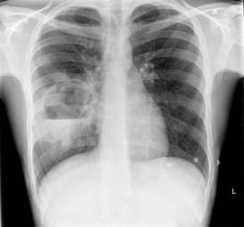
Clinical Respiratory Radiology Course
Target audience: Respiratory specialist registrars and early year consultants
What it covers: Basic radiological principles, best radiological tests in a given clinical scenario, what the expected radiological appearances are and how these relate to other respiratory investigations.
Delivered by: Radiology and respiratory consultants together to consolidate radiological knowledge in a clinical context
Day 1
Monday 8th June 2026
Basic CXR and CT anatomy
basic anatomy and principles
Collapses and consolidation
when further tests are needed and what
other conditions should be considered
Pleural & Diaphragmatic diseases
when is an effusion “worrying”
pneumothoraces - the pitfalls
diaphragmatic humps
~~~~~~~~ lunch ~~~~~~~~~~
Mysterious Mediastinum
What to do with mediastinal abnormalities
Pulmonary nodules
differential diagnoses and management
Lung cancer
latest lung cancer staging
how imaging affects management
Day 2
Tuesday 9th June 2026
HRCT
basic principles of CT
radiological anatomy (secondary pulm lobule)
radiological terms (cysts, ground glass,
reticulation, honeycombing)
Radiology of interstitial lung disease
CT patterns of common ILDs
case studies
Airways diseases
how radiological and clinical correlation helps
decision making
~~~~~~~~ lunch ~~~~~~~~~~
Complex infections
imaging appearances of TB
cavitating lesions, fungal infections
Pulmonary emboli and pulmonary vascular
diseases
acute or chronic
how to investigate pleuritic chest pain in
pregnancy.
Fees: £250 , early bird until February 27th 2026 - £200
Only in person attendance at St George’s Hospital, Blackshaw Road, London SW17 0QT
There is a limit of 30 participants for each course. Lunch is included.
https://www.stgeorges.nhs.uk/service/diagnostic-services/radiology/courses/
Applications to: Dr Yee Ean Ong Email: yee-ean.ong@stgeorges.nhs.uk

