Slide 1


Workforce Race Equality Standard (WRES)
2025 Report
Features: 2024 Staff Survey Data and workforce information on 31/03/2025
Published: 00/00/2024

Slide 2

Workforce Race Equality Standard 2025
Contents
Section | Item | Slide
1 | Purpose, Background and Definitions | 3
2 | Group Indicator Overview | 4
 | Our EDI Priorities and Next Steps | 5
3 | Site Report: St George’s University Hospitals NHS Foundation Trust | 6-18
4 | Site Report: Epsom and St Helier University Hospitals NHS Trust | 19-31
5 | Appendix A: Definitions of ethnicity: people covered by the WRES | 33
 | Appendix B: High impact action plan framework | 34

Slide 3
Workforce Race Equality Standard 2025
Purpose, background and definitions
Purpose
This paper provides an overview of the 2025 Workforce Race Equality Standard (WRES) findings.
This report will be published on the Trust website.
The Board is asked to receive this report and associated action plan for information and approve for publication.
Background
In April 2015, NHS England introduced the WRES in response to consistent findings that BME applicants and staff consistently fared worse in employment outcomes and satisfaction surveys. The WRES was designed to enable NHS organisations to demonstrate progress against a number of key indicators of workforce equality, including a specific indicator to address the low levels of BME Board representation.
Since April 2015, the WRES has been included in the full-length NHS Standard Contract and requires all providers of NHS services to address the issue of workforce race inequality by implementing and using the WRES.
There are nine WRES indicators. Four of the indicators focus on workforce data, four are based on data from national NHS Staff Survey questions, and one indicator focuses upon BME board representation. The WRES highlights differences between the experience and treatment of White staff and BME staff in the NHS with a view to organisations closing those gaps through the development and implementation of action plans focused upon continuous improvement over time.
The WRES is produced in line with Technical Guidance issued by NHS England.
Indicators 1-3 and 9 are produced via the Electronic Staff Record (ESR) from a snapshot of data taken on 31st March 2025. All other indicators are from the 2024 staff survey.
Definitions of ethnicity: people covered by the WRES
In line with Health Education England's WRES Guidance, the term ‘BME’ and ‘white’ are used to describe the two groups of staff referred to in this report.
‘White’ staff include white British, Irish, Eastern European and any other white. The ‘Black and Minority Ethnic’ staff category includes all others except ‘unknown’ and ‘not stated.’
Further information can be found in appendix A: Definitions of ethnicity: people covered by the WRES.
Overview of Workforce Numbers
STG | 2021 | 2022 | 2023 | 2024 | 2025
Total number of staff in organisation | 9,154 | 9,608 | 9,915 | 10,345 | 10,831
% of BME Staff | 47.7% | 50.1% | 51.9% | 53.6% | 54.7%
% of staff who self-reported ethnicity | 96% | 97% | 97% | 97% | 97%
ESTH | 2021 | 2022 | 20223 | 2024 | 2025
Total number of staff in organisation | 6,150 | 7,092 | 7,190 | 7,410 | 7,326
% of BME Staff | 38.1% | 38.2% | 42.0% | 44.2% | 47.8%
% of staff who self-reported ethnicity | 95% | 91% | 92% | 94% | 97%

Slide 4
Workforce Race Equality Standard 2025
Note: ‘Compared to White Staff’: A green cell indicates BME staff report a more positive experience (compared to white colleagues).
* Changes of +/- 0.5 or less are recorded as Static.
Indicator Overview
WRES Indicator |  | STG |  |  |  |  |  | ESTH
 |  | 2022 | 2023 | 2024 | 2025 | vs. LY | Compared to White Staff | 2022 | 2023 | 2024 | 2025 | vs. LY | Compared to White Staff
1 | % of BME staff in organisation | 50.1% | 51.9% | 53.6% | 54.7% | Increased |  | 38% | 41% | 44.2% | 47.8% | Increased
2 | Relative likelihood of White applicants being appointed from shortlisting compared BME applicants | 1.26 | 1.50 | 2.2 | 1.77 | Improved |  | 1.04 | 1.30 | 0.74 | 1.56 | Declined
3 | Relative likelihood of BME staff entering the formal disciplinary process, compared to that of White staff | 1.65 | 1.67 | 1.48 | 1.17 | Improved |  | 1.20 | 1.45 | 1.04 | 1.36 | Declined
4 | Relative likelihood of White staff accessing non-mandatory training and CPD compared to BME staff | 0.98 | 0.95 | 0.87 | 0.93 | Static* |  | 1.07 | 0.52 | 1.01 | 1.09 | Declined
5 | % of BME staff experiencing harassment, bullying or abuse from patients, relatives or the public in the last 12 months. | 23.3% | 27.0% | 25.7% | 25.2% | Static* |  | 27.5% | 28.3% | 25.5% | 24.8% | Improved
6 | % of BME staff experiencing harassment bullying or abuse from staff in the last 12 months | 25.9% | 27.3% | 26.9% | 28.0% | Declined |  | 26.2% | 25.5% | 23.2% | 21.6% | Improved
7 | % of BME staff believing that organisation provides equal opportunities for career progression or promotion | 42.1% | 43.8% | 44.0% | 45.2% | Improved |  | 44.7% | 45.9% | 51.6% | 51.0% | Declined
8 | % of BME staff personally experiencing discrimination at work from manager/leader/ or other colleagues. | 16.6% | 16.9% | 15.9% | 16.4% | Static* |  | 15.8% | 15.8% | 14.7% | 13.4% | Improved
9 | % difference between the board voting membership and its overall BME workforce | -32% | -43% | -35% | -25% | Improved |  | -10% | -16% | -26% | -26% | Static*
 | % difference between the board executive membership and its overall BME workforce | -36% | -41% | -41% | -42% | Static* |  | 0 | -10 | -33% | -35% | Declined

Slide 5
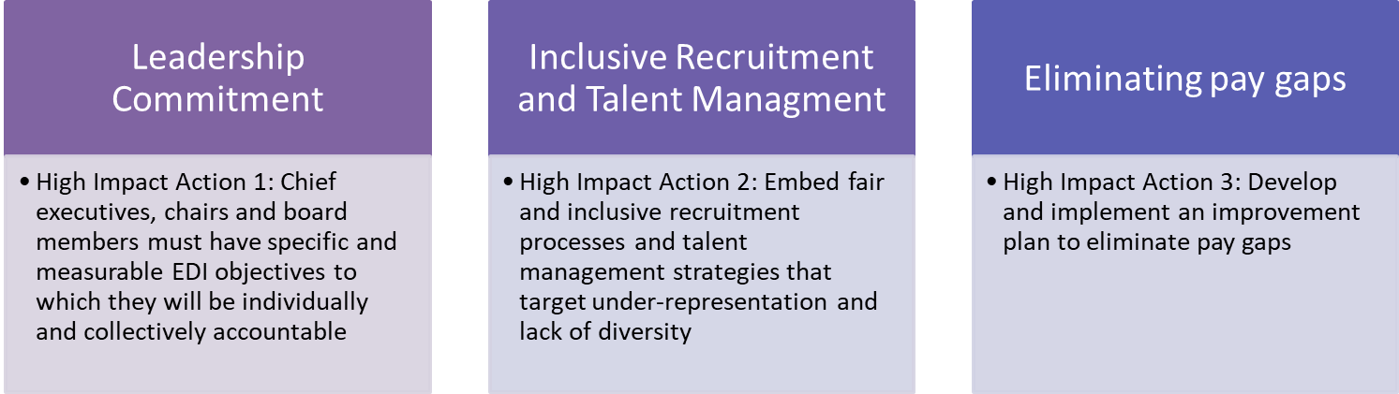
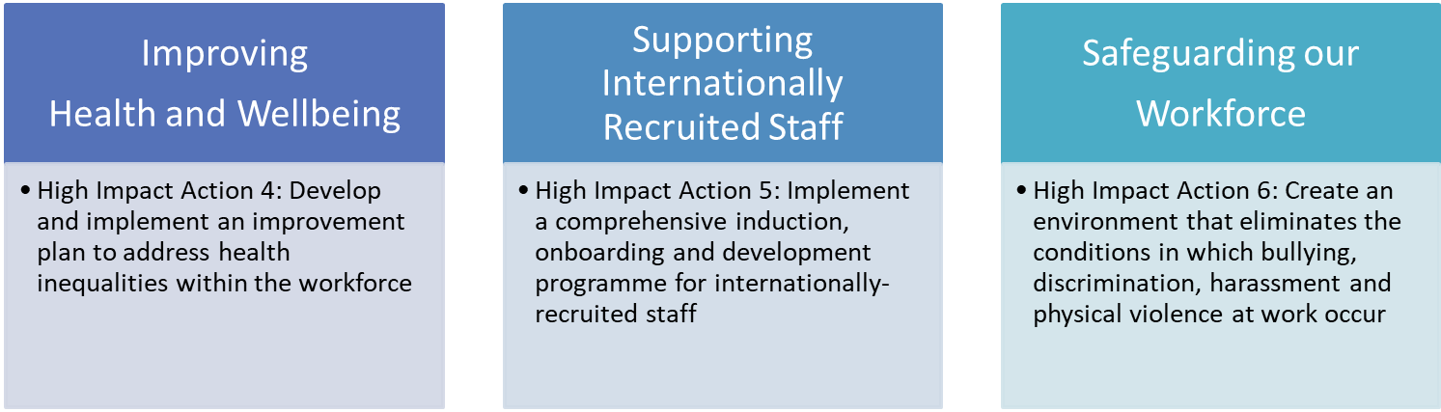

Workforce Race Equality Standard (WRES)
Next steps
Our existing Culture and Diversity and Inclusion Action Plans, which were introduced in late 2020, have driven a continued focus and commitment to improving the experience of those from marginalised groups, particularly those from Black, Asian and Minority Ethnic communities and those with disabilities or long term health conditions. Whilst many of the actions and projects set out in these action plans have now been successfully delivered, there are still a number to be implemented.
These open actions or live projects have been mapped across to NHSE’s EDI Improvement Plan (appendix b) and aligned to our People Strategy. This has identified six gesh EDI workstreams for 2025-27.
Following stakeholder engagement and internal governance, our EDI action plan was approved by our Board in February 2025. This plan has been launched across the group and progress will be monitored and reported quarterly.
Improve staff learning opportunities and wellbeing
Embrace integrated ways of working

Slide 6
Site Report: St George’s University Hospitals NHS Foundation Trust
Workforce Race Equality Standard 2025
Features: 2024 Staff Survey Data and workforce information on 31/03/2025
Published: 00/00/2024

Slide 7
Workforce Race Equality Standard 2025
Trust: STG
Executive summary
All NHS providers are required to complete an annual Workforce Race Equality Standard (WRES) report. The report is based on a snapshot of data from 31st March each year and aims to highlight progress against a number of key indicators of workforce equality, including a specific indicator to address the low numbers of Black, Asian and Minority Ethnic board members across NHS organisations. Data for WRES indicators 5 to 8 are drawn from questions in the NHS staff survey.
In line with national requirements, this report and any associated action plans should be reviewed internally and approved at Board before being published on the organisation’s website. The deadline for publication is 31st October 2025.
The key findings and metrics for this report submission are outlined below. Unless indicated, each point is compared to the previous reporting period:
Improved indicators
We have seen an improvement in 4 indicators, 4 have remained static and 1 has declined compared to the last year.
Overall, the BME staff population at St George’s continues to increase year on year (54.7%).
The relative likelihood of white applicants being appointed from shortlisting compared to BME applicants has improved, reducing from 2.2 to 1.7.
Relative likelihood of BME staff entering the formal disciplinary processes has reduced for the third consecutive year, from 1.67 in 2023 to 1.17 in 2025
Continued upward trend in the percentage of BME staff feeling the organisation provides equal opportunities for career progression or promotion. This has increased yearly since 2020 (+4 percentage points).
Though still significantly underrepresented at senior leadership level, we have seen small improvements in BME representation at bands 8C and above.
We have seen an improvement in voting board representation, from -35% in 2024 to -25% in 2025.
Reduced / static indicators
BME staff are over-represented in lower bands.
The number of white staff at VSM level has increased from 20 to 25, and BME staff from 3 to 2.
Of the 42 non-clinical Band 8d and above posts only 19% are held by a BME member of staff, compared to 81% being held by a white member of staff.
BME staff still make up just 16% of non-clinical VSM posts – compared to 84% white. This is the ratio of 10:1 (up from 8:1 last year).
Of the Band 8d, only 3 of 15 clinical Band 8d post are held by a BME member of staff. This is a ratio of 5:1.
Reported experiences of Harassment, Bullying and Abuse have remained static from patient-staff and worsened from staff-staff (for both white and BME staff).
Reports of experiences of discrimination from managers and colleagues have remained static– but is lower than the London average.

Slide 8
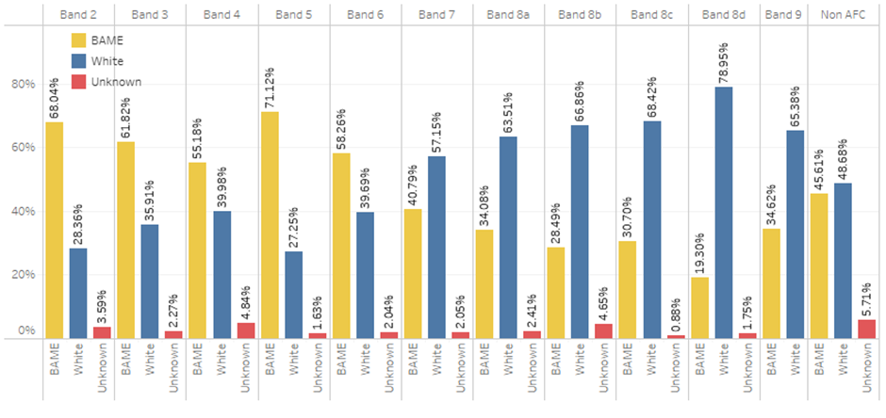
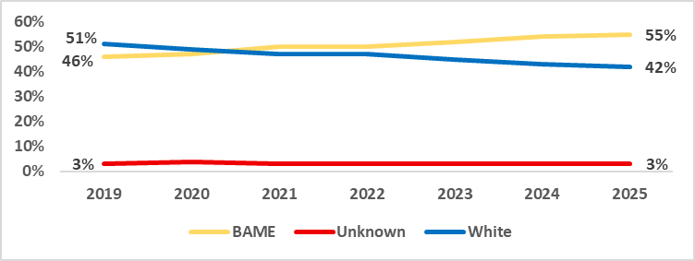
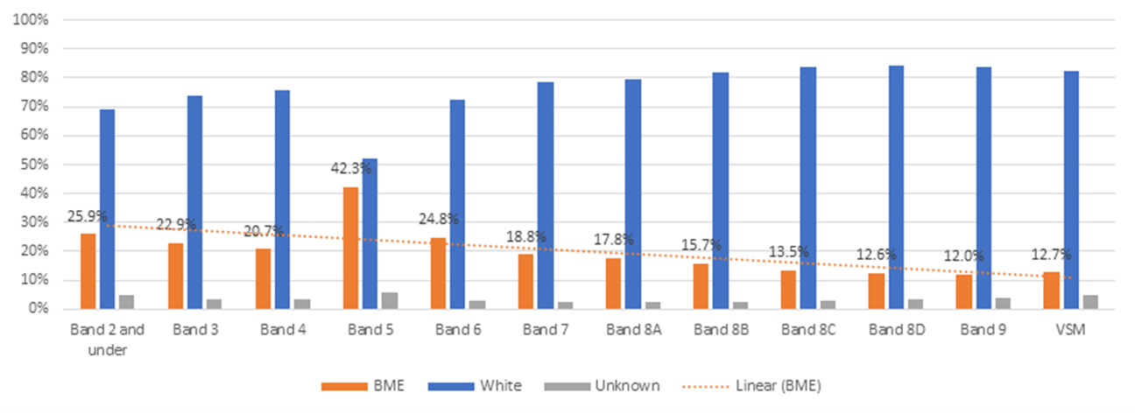
Workforce Race Equality Standard 2025
Trust: STG
Indicator 1 % of staff by AfC pay band and ethnicity
Table A: % of Staff in each AFC Band by Ethnicity at St Georges
Our Black, Asian and Minority Ethnic workforce has increased year on year since 2019 and continues to be representative of the local communities we serve.
For Indicator 1, we see an increase of over 1% which is approximately an increase of 486 Black, Asian and Minority Ethnic members of staff.
This is not unique to St George’s and mirrors what we see across NHS trusts nationally (see table A and B).
Note: The solid red line indicates the target for St George’s to be representative across all AFC pay bands.
Table B: % of Staff in each AFC Band by Ethnicity (National 2024)

Slide 9
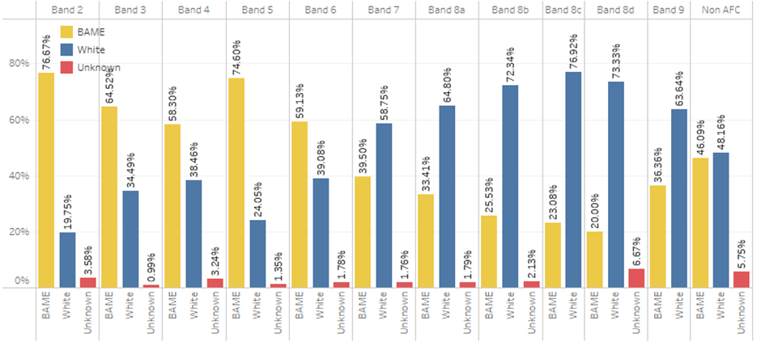
Workforce Race Equality Standard 2025
Trust: STG
Indicator 1
Clinical Staff - % of staff by AfC pay band and ethnicity
Table C: % of Clinical Staff in each AFC Band at St George’s:
For Clinical staff (table C), we see an increase in the percentage of Black, Asian and Minority Ethnic staff across 8 of the 11 AFC bands. Compared to last year we have seen an increase of white Staff (6), compared to an increased (+206) BME staff members. This is largely due to an increase at Bands 5 (+117) and 6 (+76).
We have seen a year-on-year increase in diversity with the consultant group, from 43% in 2023 to 46% in 2025. In terms of percentage our 2025 ratio for consultant staff was 48% white to 46% BME – this is one of the closest to representative we have seen within the consultant workforce (to the organisations overall).
The second lowest level of representation remains band 8a-c (31% BME) and 8d+. Our lowest level of representation is Band 8d and above posts. Of the 27 Band 8d+ posts, only 26% (7 posts) are held by a BME member of staff, compared to 70% (35 posts) being held by a white member of staff (table E). This is a ratio of 5:1.
Table E: % of staff by ethnic group (clustered):
Cluster | 2022 |  |  | 2023 |  |  | 2024 |  |  | 2025
 | White | BME | Unknown | White | BME | Unknown | White | BME | Unknown | White | BME | Unknown
Band 1 - 5 | 32.9% | 64.4% | 2.5% | 29.3% | 68.4% | 2.2% | 26.2% | 71.6% | 2.2% | 25.5% | 72.5% | 2.1%
Band 6 - 7 | 53.2% | 44.8% | 1.8% | 51.7% | 46.5% | 1.7% | 50.6% | 47.5% | 2.0% | 48.0% | 50.2% | 1.8%
Band 8a-8c | 69.6% | 28.5% | 1.8% | 69.4% | 29.3% | 1.3% | 67.1% | 31.1% | 1.8% | 67.3% | 31.1% | 1.7%
Band 8d + | 85.0% | 15.0% | 0.0% | 79.2% | 20.8% | 0.0% | 80.0% | 20.0% | 0.0% | 70.4% | 25.9% | 3.7%
Medical | 55.1% | 37.9% | 6.8% | 51.1% | 43.3% | 5.6% | 49.4% | 45.6% | 5.0% | 48.1% | 46.3% | 5.6%

Slide 10
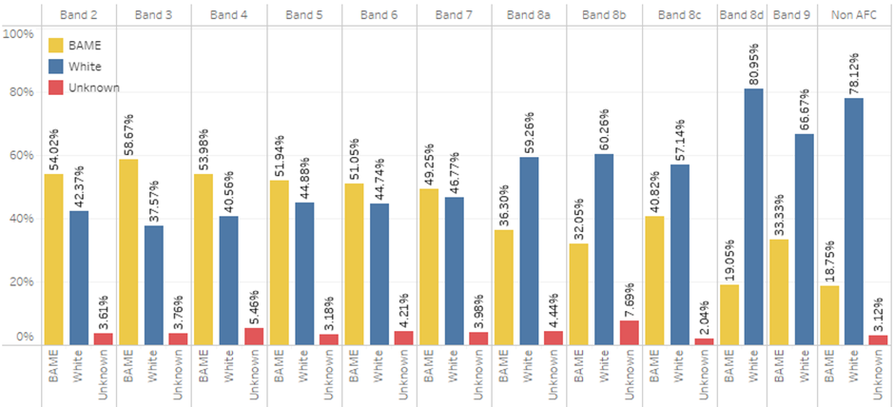
Workforce Race Equality Standard 2025
Trust: STG
Indicator 1
Non-Clinical Staff - % of staff by AfC pay band and ethnicity
Table C: % of Non-Clinical Staff in each AFC Band at St George’s:
For Non-Clinical staff we see an increase in the percentage of Black, Asian and Minority Ethnic staff across all 11 AFC bands. This compares to decrease in the number of white staff in all 11 AFC bands.
For the second year BME representation at Band 6 and Band 7 is greater than White representation and close to the organisation overall of 54% – with 51% at Band 6 and 49% at Band 7.
The number of white staff at VSM level has increased from 20 to 21, with the number of BME staff improving from 2 to 4. This means that BME staff make up just 16% of non-clinical VSM posts – compared to 84% White. This is the ratio of 5:1 white staff members to every 1 BME staff member appointed at VSM level. This ratio has remained static when compared to last year.
Of the 82 Band 8d and above posts only 20.7% are held by a BME member of staff, compared to 79.3% being held by a white member of staff (table E).
Table E: % of staff by ethnic group (clustered):
Cluster | 2022 |  |  | 2023 |  |  | 2024 |  |  | 2025
 | White | BME | Unknown | White | BME | Unknown | White | BME | Unknown | White | BME | Unknown
Band 1 - 5 | 46.0% | 50.0% | 3.8% | 45.1% | 50.7% | 4.1% | 42.7% | 53.2% | 4.1% | 41.2% | 54.6% | 4.2%
Band 6 - 7 | 46.3% | 51.7% | 1.9% | 43.6% | 54.6% | 1.8% | 46.5% | 49.6% | 3.9% | 45.8% | 50.1% | 4.1%
Band 8a-8c | 61.8% | 34.0% | 4.0% | 61.8% | 34.2% | 4.0% | 63.1% | 33.1% | 3.8% | 59.2% | 35.9% | 5.0%
Band 8d + | 81.4% | 17.1% | 1.4% | 82.7% | 16.0% | 1.2% | 83.3% | 15.4% | 1.3% | 79.3% | 20.7% | 0.0%

Slide 11
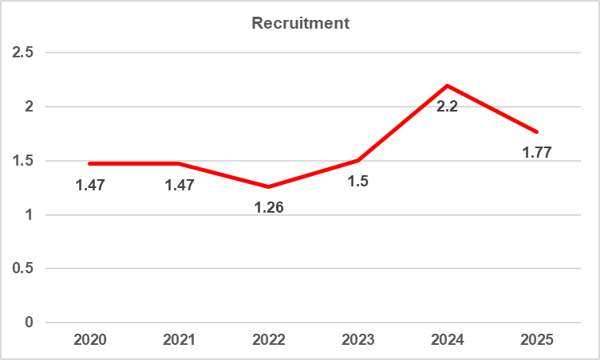
Workforce Race Equality Standard 2025
Trust: STG
Indicator 2
Relative likelihood of white applicants being appointed from shortlisting compared to BME applicants
Our 2025 figures show that white applicants at St George’s are 1.77 times more likely to be appointed from shortlisting compared Black, Asian and Minority Ethnic (BME) applicants. This is an improvement from 2.2 in 2024
In 2025 the likelihood of Black, Asian and Minority Ethnic applicants being appointed from shortlisting reduced from 27% to 18% - this means that of the 6498 (non-medical) shortlisted BME applicants, 658 were appointed. For medical and dental applicants, of the 207 shortlisted applicants, 147 were appointed. The total number of shortlisted BME applicants decreased from 9825 in 2024 to 7105 in 2025.
For non-medical white applicants, the likelihood of appointment has increased from 27% in 2024 to 41% in 2025.
Note: As part of the group formation and to maintain consistency with other SW London trusts serviced by the SWL Recruitment Hub, we have changed the way our data is sourced in 2024 and 2025 this have meant to shift in some of the previously reported figures for 2024.
Note: The solid green line indicates the target relative likelihood of 1.0
2020 | 2021 | 2022 | 2023 | 2024 | 2025
1.47 | 1.47 | 1.26 | 1.50 | 2.2 | 1.77

Slide 12
Workforce Race Equality Standard 2025
Trust: STG
Indicator 3
Relative likelihood of BME staff entering the formal disciplinary process compared to white staff
Our 2025 figures show that BME staff at St George’s are more likely to enter the disciplinary process compared to white staff.
Over the last five years we have seen a significant reduction in the relative likelihood of BME entering the disciplinary process, from 2.38 times more likely in 2020, to 1.17 in 2025. This is a 50% reduction in this time.
The number of BME staff entering the disciplinary process has decreased compared to last year - from 33 in 2024 to 26 BME staff members in 2025. This is a 22% reduction on the previous year.
The number of white staff entering the disciplinary process has also reduced, from 18 in 2024 to 17 in 2025.
Note: The solid green line indicates the target relative likelihood of 1.0
2020 | 2021 | 2022 | 2023 | 2024 | 2025
2.38 | 1.82 | 1.65 | 1.67 | 1.48 | 1.17

Slide 13
Workforce Race Equality Standard 2025
Trust: STG
Indicator 4
Relative likelihood of white staff accessing non–mandatory training and CPD compared to BME staff
For the fifth year we see an increase in the number of Black, Asian and Minority Ethnic staff accessing non-mandatory training and continuing professional development (CPD). The likelihood of BME staff accessing non-mandatory training and CPD has increased to 36%, from 29% in 2023.
In 2025 we saw a 5-percentage point increase in the number of white staff accessing non-mandatory training and continuing professional development, increasing the likelihood from 29% to 34%.
In 2024 we saw the greatest disparity, in terms of likelihood of each ethnic group accessing training, with a 5-percentage point difference – this has now reduced to 1-2 percentage points difference, inline with historic likelihoods.
 | 2022 |  |  | 2023 |  |  | 2024 |  |  | 2025
 | White | BME | Unknown | White | BME | Unknown | White | BME | Unknown | White | BME | Unknown
Number of staff in workforce | 4495 | 4817 | 296 | 4486 | 5141 | 288 | 4495 | 5542 | 308 | 4570 | 5929 | 322
Number of staff accessing non-mandatory training and CPD | 1324 | 1444 | 62 | 1222 | 1478 | 63 | 1300 | 1863 | 81 | 1577 | 2181 | 80
Likelihood of staff accessing non-mandatory training and CPD | 29% | 30% | 21% | 27% | 29% | 22% | 29% | 34% | 26% | 35% | 37% | 24%
Relative likelihood of white staff accessing compared to BME staff | 0.98 |  |  | 0.95 |  |  | 0.87 |  |  | 0.93

Slide 14
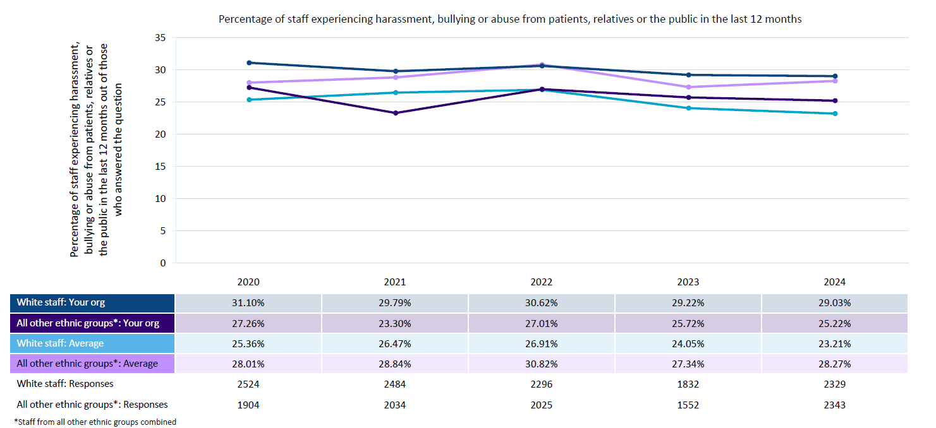
Workforce Race Equality Standard 2025
Trust: STG
Indicator 5
% of staff experiencing harassment, bullying or abuse from patients, relatives or the public in the last 12 months
% of staff experiencing harassment, bullying or abuse from patients/relatives or the public
For the third year, the percentage of staff who experienced harassment, bullying or abuse from patients, relatives or the public in the last 12 months was lower for BME staff (25%) than for white staff (29%).
When comparing 2024 to 2025, for white staff the figures have remained static at 29%. The gap between white and BME staff is around 3.8 percentage points, over 3 percentage points for the second year.
Note for internal use only: We are awaiting national WRES insight reports which will provide additional information for this report. This is expected to be received in September/October and will be updated prior to publication.
Notes:
White Nurses and Midwives and HCA (report the highest rates

Slide 15
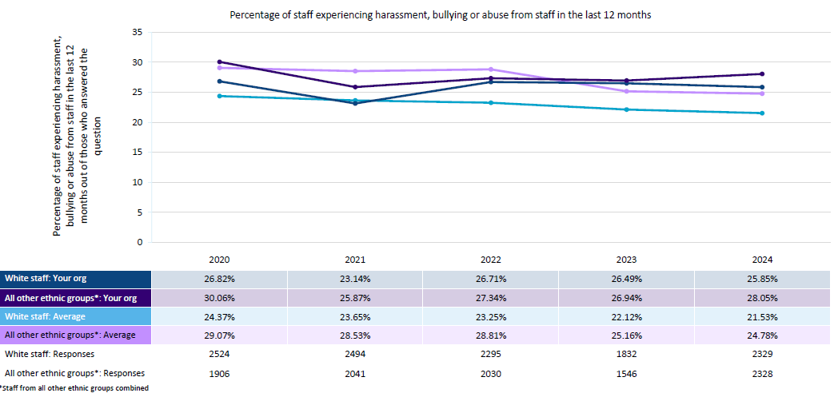
Workforce Race Equality Standard (WRES)
Trust: STG
Indicator 6
% of staff experiencing harassment, bullying or abuse from staff in the last 12 months
Reported rates of staff experiencing harassment, bullying or abuse from other staff have increased by 0.7 percentage points since last year’s staff survey. This is a change from the downward trend over the previous two years for this indicator.
Results show also show a change in trajectory for BME staff at St George’s who report higher rates of experiencing harassment, bullying or abuse. This has increased by 1.1 percentage points, from 26.9% in 2023 to 28% in 2024.
For white staff this has reduced by 0.6 percentage points.
Note for internal use only: We are awaiting national WRES insight reports which will provide additional information for this report. This is expected to be received in September/October and will be updated prior to publication.
% of staff experiencing harassment, bullying or abuse from staff

Slide 16
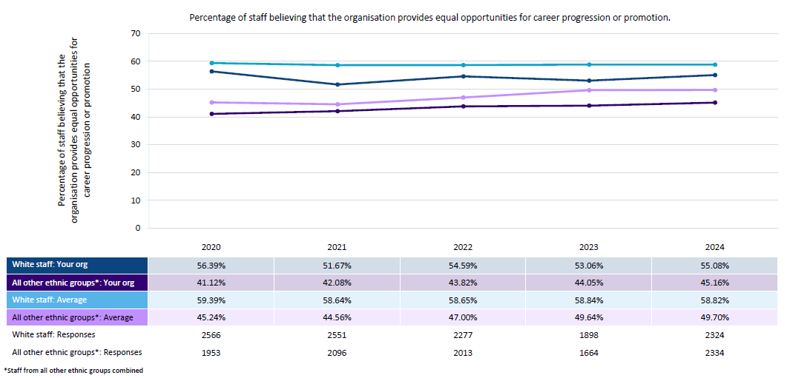
Workforce Race Equality Standard 2025
Trust: STG
Indicator 7
% of staff believing that trust provides equal opportunities for career progression or promotion
45% of BME staff felt the organisation provides equal opportunities for career progression or promotion. This follows a continued upwards trend since 2020 (+4 percentage points).
This compares to 55% of white staff, which has increased by 2.02 percentage points compared to last year.
The gap in perception between white and BME staff has increased from 8 percentage points in 2023 to 9 percentage points in 2024.
Both white and BME staff at St George’s still feel less confident compared to staff nationally.
Note for internal use only: We are awaiting national WRES insight reports which will provide additional information for this report. This is expected to be received in September/October and will be updated prior to publication
% of staff believing that trust provides equal opportunities for career progression or promotion

Slide 17
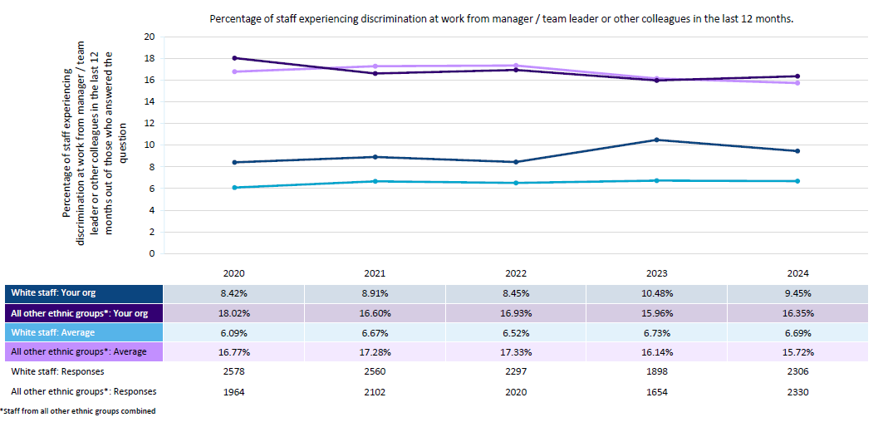
Workforce Race Equality Standard 2025
Trust: STG
Indicator 8
% of staff that personally experienced discrimination at work from a manager or colleagues
In 2024, 16.35% of BME staff completing the staff survey indicated that they had experienced discrimination at work from a manager or colleague. This has increased slightly, by 0.39 percentage points, since last year.
For white staff, this has reduced compared to last year, from 10.48% in 2023 to 9.45% in 2024.
Whilst BME staff continue to report experiencing higher rates of discrimination, compared to white colleagues, the gap in experience has widened from a gap of 5.48 percentage points in 2023 to 6.9 percentage points in 2024.
Note for internal use only: We are awaiting national WRES insight reports which will provide additional information for this report. This is expected to be received in September/October and will be updated prior to publication
% of staff that personally experienced discrimination at work from a manager or colleagues

Slide 18
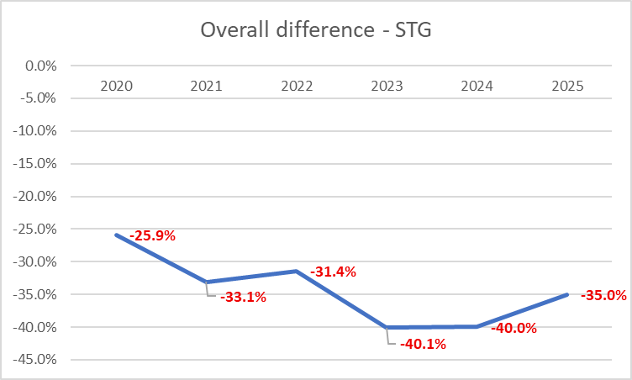
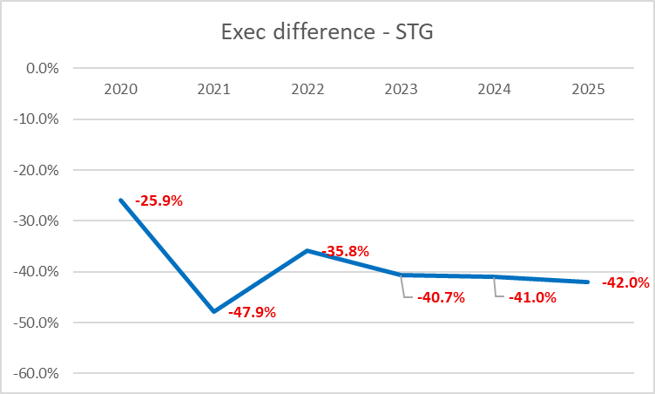
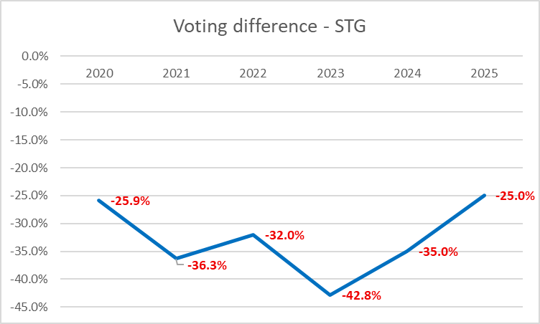
Workforce Race Equality Standard 2025
Trust: STG
Indicator 9
% of board members by ethnicity compared to BME workforce
As of 31 March 2025, the Trust Board of Directors comprised 15 members, three of whom identify as Black, Asian and Minority Ethnic (two non-executive directors, and one executive director). Of this, the Board comprised 10 voting members, seven of whom were non-executive directors and eight were executive directors. Of these 10 voting members of the Board, three voting Board members identify as BME. At St George’s this means BME staff are -35% under-represented at Board level overall, and -25% at Voting Board level. At ESTH this means BME staff are -34% underrepresented at Board level overall, and -26% at Voting Board level.

Slide 19
Site Report: Epsom and St Helier University Hospitals NHS Trust
Workforce Race Equality Standard 2025
Features: 2024 Staff Survey Data and workforce information on 31/03/2025
Published: 00/00/2024

Slide 20
Workforce Race Equality Standard 2025
Trust: ESTH
Executive summary
All NHS providers are required to complete an annual Workforce Race Equality Standard (WRES) report. The report is based on a snapshot of data from 31st March each year and aims to highlight progress against a number of key indicators of workforce equality, including a specific indicator to address the low numbers of Black, Asian and Minority Ethnic board members across NHS organisations. Data for WRES indicators 5 to 8 are drawn from questions in the NHS staff survey.
In line with national requirements, this report and any associated action plans should be reviewed internally and approved at Board before being published on the organisation’s website. The deadline for publication is 31st October 2025.
The key findings and metrics for this report submission are outlined below. Unless indicated, each point is compared to the previous reporting period:
Improved indicators
We have seen an improvement in 3 out of the 10 indicators, the remaining 2 have remained static.
Overall, the BME staff population at Epsom and St Helier continues to increase year on year (47.8%).
Reported experiences of Harassment, Bullying and Abuse have reduced, from patient-staff and staff-staff.
There is a reduction in reports experiences of discrimination from managers and colleagues – this however remains higher than the London average.
We have seen a year-on-year increase in diversity within the consultant group, from 45% in 2022 to 58% in 2024
Reduced / static indicators
There has been a decline in 5 out of 10 indicators, with 1 remaining static.
Relative likelihood of BME staff entering the formal disciplinary processes has declined.
The number of white staff at VSM level has reduced from 14 to 10, and BME staff remaining static at 1.
BME staff make up just 7.1% of non-clinical VSM posts – compared to 92% white.
Of the 37 non-clinical Band 8d and above posts only 13% are held by a BME member of staff, compared to 82% being held by a white member of staff.
The relative likelihood of white applicants being appointed from shortlisting compared to BME applicants has worsened from 0.74 to 1.56
BME staff are significantly under-represented at Executive at -35%
Slight downward trend in the percentage of BME staff feeling the organisation provides equal opportunities for career progression or promotion – from 51.6% to 51.0%
The % difference between the organisations’ board voting membership and its overall workforce has declined from -33% to -35%.

Slide 21
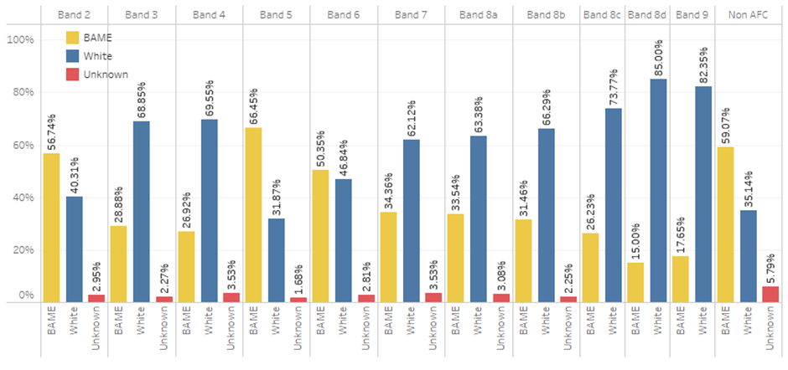
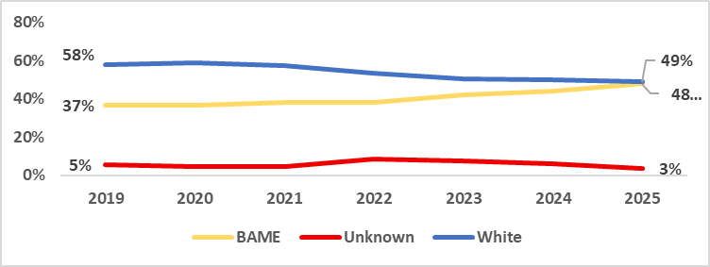
Workforce Race Equality Standard (WRES)
Trust: ESTH
Indicator 1 % of staff by AfC pay band and ethnicity
Table A: % of Staff in each AFC Band by Ethnicity
Our Black, Asian and Minority Ethnic workforce has increased year on year since 2020 and continues to be representative of the local communities we serve.
For this reporting year, we see an increase of +3.6% in indicator 1. This is approximately an increase of 225 Black, Asian and Minority Ethnic members of staff compared to the previous year.
For the second consecutive year, our Black, Asian and Minority Ethnic workforce remains 4.3% lower than the London average. Whilst we see a continued annual increase across the workforce, our workforce data still highlights that Black, Asian and Minority Ethnic staff are over-represented in lower bands and under-represented in higher bands
This is not unique to Epsom and St Helier and mirrors what we see across London NHS trusts (see table A and B).
Note: The solid red line indicates the target for St George’s to be representative across all AFC pay bands.
Table B: % of Staff in each AFC Band by Ethnicity (National 2024)

Slide 22
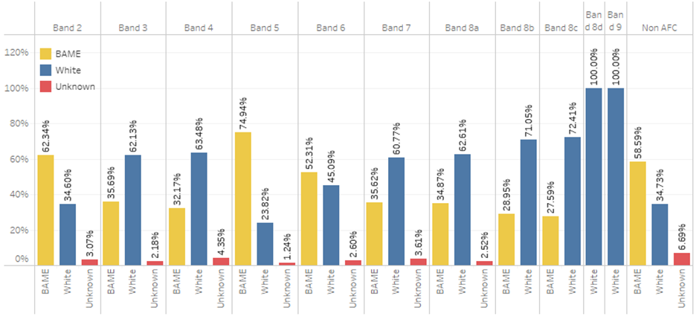
Workforce Race Equality Standard 2025
Trust: ESTH
Indicator 1 Clinical Staff - % of staff by AfC pay band and ethnicity
Table C: % of Clinical Staff in each AFC Band
For Clinical staff (table C), we see an increase in the percentage of Black, Asian and Minority Ethnic staff across 5 of the 11 AFC bands. Compared to last year we have seen a reduction of white Staff (-15), compared to an increased (+67) BME staff members. This is largely due to an increase at Bands 3, 5 and 6.
We have seen a year-on-year increase in diversity with the consultant group, from 45% in 2022 to 58% in 2024. In terms of percentage our 2024 ratio for consultant staff was 35% white to 58% BME.
The lowest level of representation remains band 8a-c (33% BME) and 8d+. Of the 13 Band 8d and above posts only 7% are held by a BME member of staff, compared to 92% being held by a white member of staff (table E).
Table E: % of staff by ethnic group (clustered):
Cluster | 2022 |  |  | 2023 |  |  | 2024 |  |  | 2025
 | White | BAME | Unknown | White | BAME | Unknown | White | BAME | Unknown | White | BAME | Unknown
Band 1 - 5 | 45.5% | 49.9% | 4.6% | 41.6% | 54.4% | 3.9% | 38.6% | 58.3% | 3.1% | 37.9% | 59.8% | 2.3%
Band 6 - 7 | 56.5% | 38.5% | 5.0% | 54.8% | 40.2% | 5.0% | 53.0% | 43.1% | 3.9% | 51.9% | 45.0% | 3.0%
Band 8a-8c | 65.7% | 29.3% | 5.1% | 67.0% | 29.0% | 4.0% | 64.7% | 32.8% | 2.5% | 64.6% | 33.4% | 2.0%
Band 8d + | 64.3% | 35.7% | 0.0% | 46.7% | 53.3% | 0.0% | 68.8% | 31.3% | 0.0% | 92.3% | 7.7% | 0.0%
Medical | 38.6% | 55.7% | 5.7% | 36.5% | 56.2% | 7.4% | 33.4% | 60.6% | 6.0% | 62.1% | 31.2% | 6.7%

Slide 23
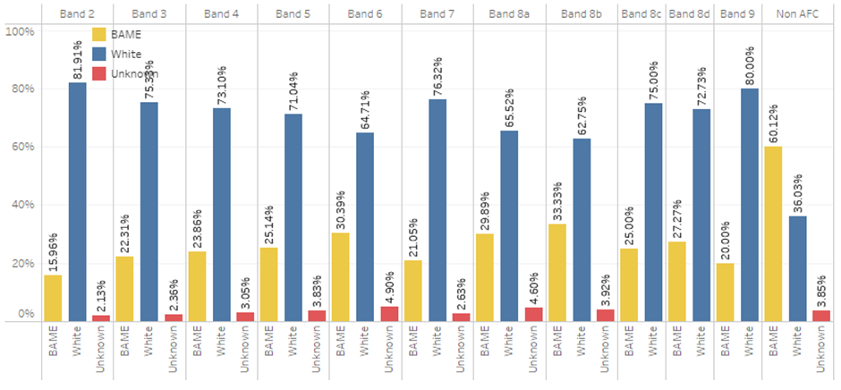
Workforce Race Equality Standard 2025
Trust: ESTH
Indicator 1
Non-Clinical Staff - % of staff by AfC pay band and ethnicity
Table C: % of Non-Clinical Staff in each AFC Band
For Non-Clinical staff we see an increase in the percentage of Black, Asian and Minority Ethnic staff across all of the 11 AFC bands. This conversely compares to decrease in the number of white staff in all of the 11 AFC bands.
For the second year BME representation at Band 6 and Band 7 (25.7%) is significantly lower than White representation (67.8%) and some distance away from the organisation overall of +47% – with 30% at Band 6 and 21% at Band 7.
The number of white staff at VSM level has reduced from 14 to 10, with the number of BME staff remaining static at 1. This means that BME staff make up just 7.1% of non-clinical VSM posts – compared to 92% White.
Of the 37 Band 8d and above posts only 13% are held by a BME member of staff, compared to 82% being held by a white member of staff (table H).
Table E: % of staff by ethnic group (clustered):
Cluster | 2022 |  |  | 2023 |  |  | 2024 |  |  | 2025
 | White | BAME | Unknown | White | BAME | Unknown | White | BAME | Unknown | White | BAME | Unknown
Band 1 - 5 | 76.5% | 19.1% | 4.4% | 75.3% | 21.1% | 3.6% | 75.5% | 21.5% | 3.0% | 74.8% | 23.0% | 2.2%
Band 6 - 7 | 72.6% | 21.5% | 5.9% | 69.8% | 25.1% | 5.0% | 70.3% | 24.5% | 5.2% | 67.8% | 25.7% | 6.6%
Band 8a-8c | 64.3% | 29.2% | 6.5% | 66.1% | 28.7% | 5.3% | 66.5% | 29.0% | 4.5% | 65.7% | 29.7% | 4.7%
Band 8d + | 83.6% | 12.7% | 3.6% | 78.3% | 19.6% | 2.2% | 80.0% | 17.5% | 2.5% | 81.1% | 18.9% | 0.0%
Cluster | 2022 |  |  | 2023 |  |  | 2024 |  |  | 2025
 | White | BME | Unknown | White | BME | Unknown | White | BME | Unknown | White | BME | Unknown
Band 1 - 5 | 46.0% | 50.0% | 3.8% | 45.1% | 50.7% | 4.1% | 42.7% | 53.2% | 4.1% | 41.2% | 54.6% | 4.2%
Band 6 - 7 | 46.3% | 51.7% | 1.9% | 43.6% | 54.6% | 1.8% | 46.5% | 49.6% | 3.9% | 45.8% | 50.1% | 4.1%
Band 8a-8c | 61.8% | 34.0% | 4.0% | 61.8% | 34.2% | 4.0% | 63.1% | 33.1% | 3.8% | 59.2% | 35.9% | 5.0%
Band 8D + | 81.4% | 17.1% | 1.4% | 82.7% | 16.0% | 1.2% | 83.3% | 15.4% | 1.3% | 79.3% | 20.7% | 0.0%

Slide 24
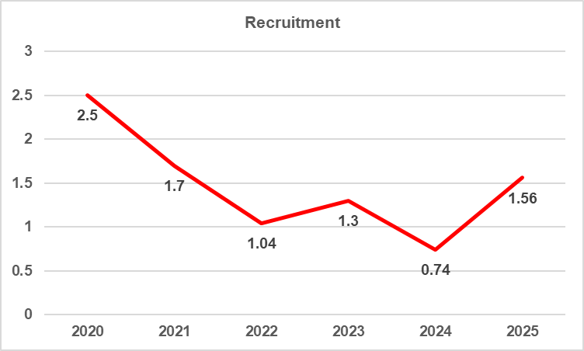
Workforce Race Equality Standard 2025
Trust: ESTH
Indicator 2
Relative likelihood of white applicants being appointed from shortlisting compared to BME applicants
Our 2025 figures show that white applicants at Epsom and St Helier are 1.56 times more likely to be appointed from shortlisting compared Black, Asian and Minority Ethnic (BME) applicants. This is a significant increase from 0.74 in 2024.
In 2025 the likelihood of Black, Asian and Minority Ethnic applicants being appointed from shortlisting reduced from 16% to 9% - this means that of the 3113 shortlisted BME applicants, 311 were appointed. The number of shortlisted BME applicants reduced from 556 in 2024 to 311 in 2025.
For white applicants, the likelihood of appointment has increased from 12% in 2024 to 16% in 2025.
For those that did not record an ethnicity the likelihood of appointment is 15% meaning of the 247 candidates who did not record an ethnicity, 38 of them were appointed.
Note: The solid green line indicates the target relative likelihood of 1.0
2020 | 2021 | 2022 | 2023 | 2024 | 2025
2.50 | 1.70 | 1.04 | 1.30 | 0.74 | 1.56

Slide 25
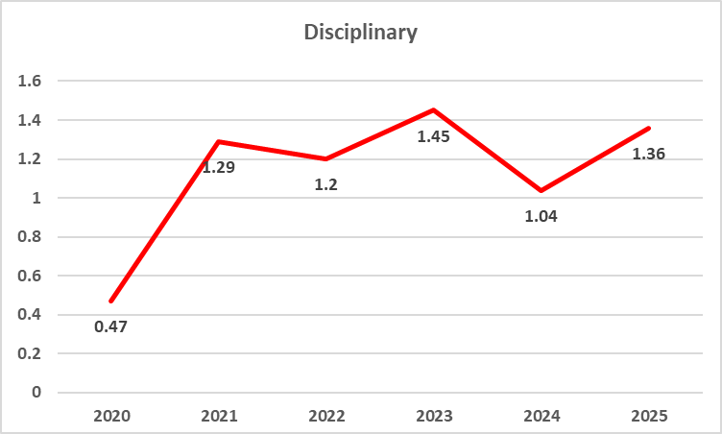
Workforce Race Equality Standard 2025
Trust: ESTH
Indicator 3
Relative likelihood of BME staff entering the formal disciplinary process compared to white staff
Our 2025 figures show that BME staff at Epsom and ST Helier are more likely to enter the disciplinary process compared to white staff.
There has been an increase from the previous year in the relative likelihood of BME entering the disciplinary process, from 1.04 times more likely in 2024, to 1.36 in 2025.
The number of BME staff entering the disciplinary process has increase compared to last year - from 13 in 2024 to 16 BME staff members in 2025. This is an increase of 23% on the previous year.
The number of white staff entering the disciplinary process has reduced, from 14 in 2024 to 12 in 2025. This is an increase of 16% on the previous year.
Note: The solid green line indicates the target relative likelihood of 1.0
2020 | 2021 | 2022 | 2023 | 2024 | 2025
0.47 | 1.29 | 1.20 | 1.45 | 1.04 | 1.36

Slide 26
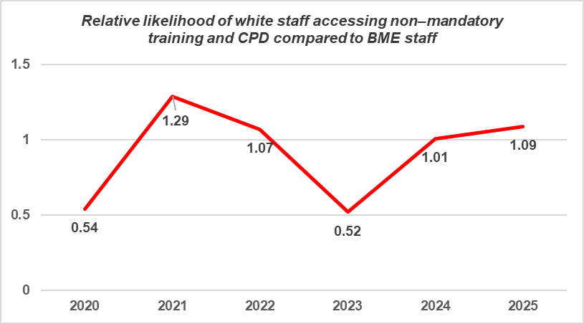
Workforce Race Equality Standard 2025
Trust: ESTH
Indicator 4
Relative likelihood of white staff accessing non–mandatory training and CPD compared to BME staff
For the second year we see an increase in the number of Black, Asian and Minority Ethnic staff accessing non-mandatory training and continuing professional development (CPD). The likelihood of BME staff accessing non-mandatory training and CPD has increased from 1.01 in 2024 to 1.09 in 2025.
In 2025 we saw a 3-percentage point increase in the number of white staff (224 white staff out of 3590) accessing non-mandatory training and continuing professional development compared to (113 white staff 3681) the previous year.
In 2025 the disparity, in terms of likelihood of each ethnic group accessing training is not statistically significant, with a 0.5 percentage point difference – in previous years this has been between 1-2 percentage points.
Note: The solid green line indicates the target relative likelihood of 1.0
2020 | 2021 | 2022 | 2023 | 2024 | 2025
0.54 | 1.29 | 1.07 | 0.52 | 1.01 | 1.09

Slide 27
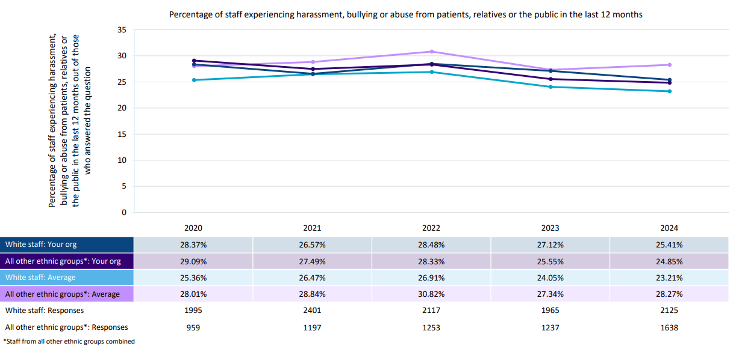
Workforce Race Equality Standard 2025
Trust: ESTH
Indicator 5
% of staff experiencing harassment, bullying or abuse from patients, relatives or the public in the last 12 months
% of staff experiencing harassment, bullying or abuse from patients/relatives or the public
For the first time in two yeas, the percentage of staff who experienced harassment, bullying or abuse from patients, relatives or the public in the last 12 months was lower for BME staff (24%) than for white staff (25%).
For white staff we see a decrease from 27% to 25%. The gap between white and BME staff has reduced by 1 percentage point from previous year.
In terms of the percentage of BME staff who experienced harassment, bullying or abuse from patients, relatives or the public in the last 12 months, the Trust performance is 3% lower than the national average.
Awaiting national benchmarking data for additional insight.
Notes:
White Nurses and Midwives and HCA (report the highest rates

Slide 28
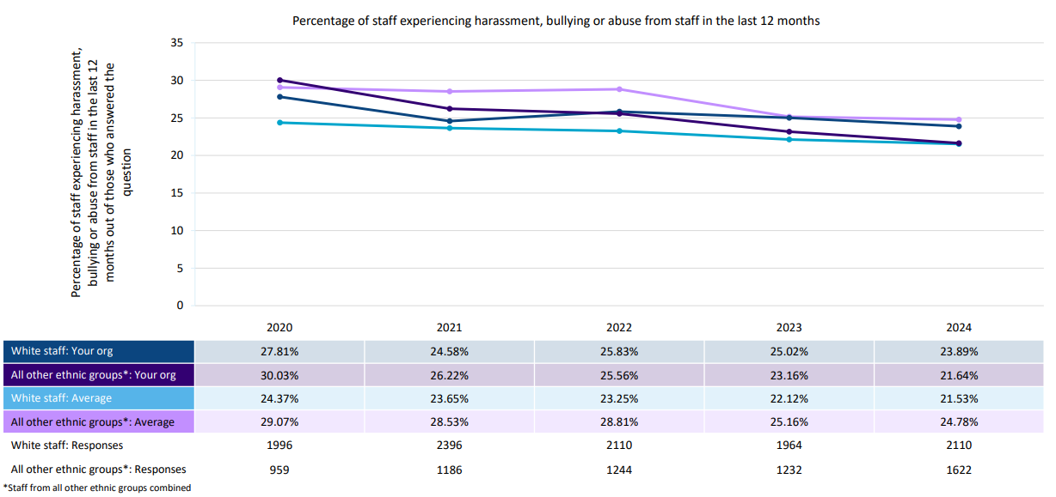
Workforce Race Equality Standard 2025
Trust: ESTH
Indicator 6
% of staff experiencing harassment, bullying or abuse from staff in the last 12 months
% of staff experiencing harassment, bullying or abuse from staff
Reported rates of staff experiencing harassment, bullying or abuse from other staff remains has improved since last year’s staff survey. There is a 1% reduction and though a slight reduction, the trend is moving in the right direction. This year’s result is also the lowest reported rate since 2020 for both white and BME staff.
For BME staff at St Epsom and St Helier, this has reduced by 1.52 percentage points, from 23.1% in 2023 to 21.6% in 2024.
For white staff this has reduced by 1.1 percentage points.
Awaiting national benchmarking data for additional insight.

Slide 29
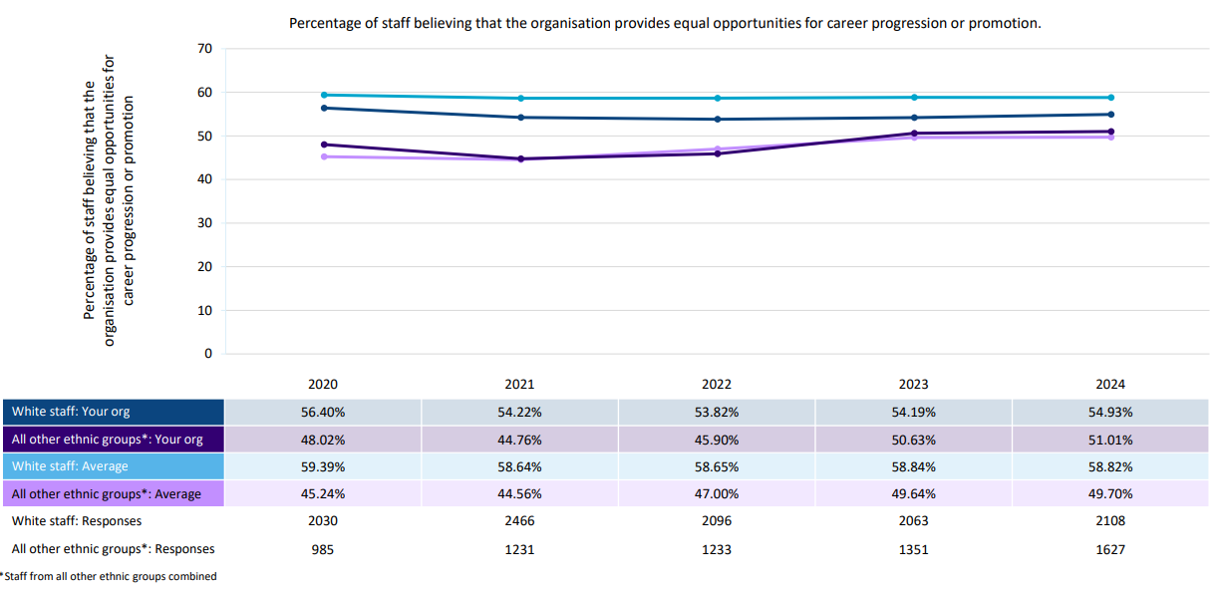
Workforce Race Equality Standard 2025
Trust: ESTH
Indicator 7
% of staff believing that trust provides equal opportunities for career progression or promotion
% of staff believing that trust provides equal opportunities for career progression or promotion
51% of BME staff felt the organisation provides equal opportunities for career progression or promotion. This follows a continued upwards trend since 2020 (+2.9 percentage points).
This compares to 54% of white staff, which has increased by 1.08 percentage points compared to last year.
The gap in perception between white and BME staff has reduced from 7.9 percentage points in 2022 to 3.9 percentage points in 2024.
While white staff at Epsom and St Helier still feel less confident compared to staff nationally, BME staff compares above the national average.
Awaiting national benchmarking data for additional insight.

Slide 30
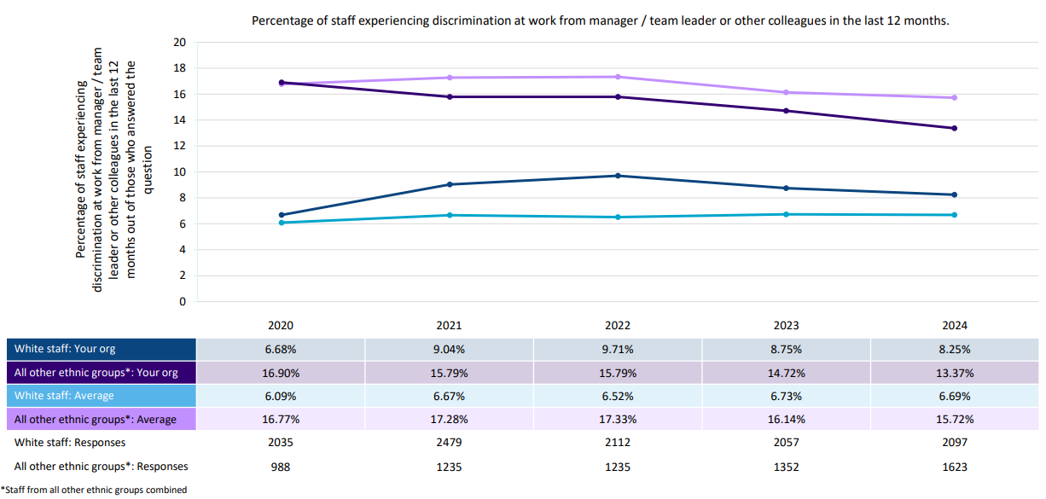
Workforce Race Equality Standard 2025
Trust: ESTH
Indicator 8
% of staff that personally experienced discrimination at work from a manager or colleagues
In 2024, 13.3% of BME staff completing the staff survey indicated that they had experienced discrimination at work from a manager or colleague. This has increased by 1.35 percentage points, since last year.
This is the lowest reported rate, for BME staff, since 2020.
For white staff, this has also reduced compared to last year, from 8.75% in 2023 to 8.25% in 2024.
Whilst BME staff continue to report experiencing higher rates of discrimination, compared to white colleagues, the gap in experience has remained relatively static over the past four years.
Awaiting national benchmarking data for additional insight.
% of staff that personally experienced discrimination at work from a manager or colleagues

Slide 31
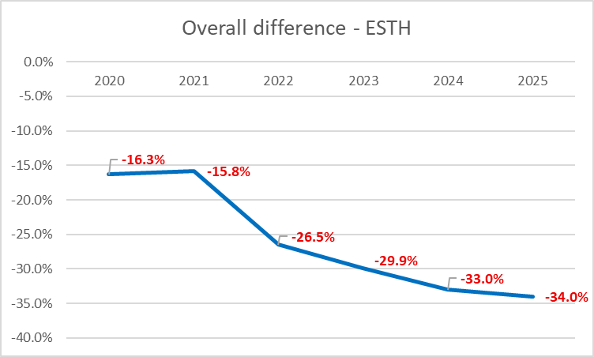
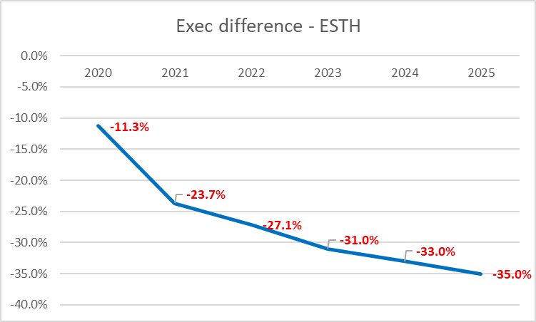
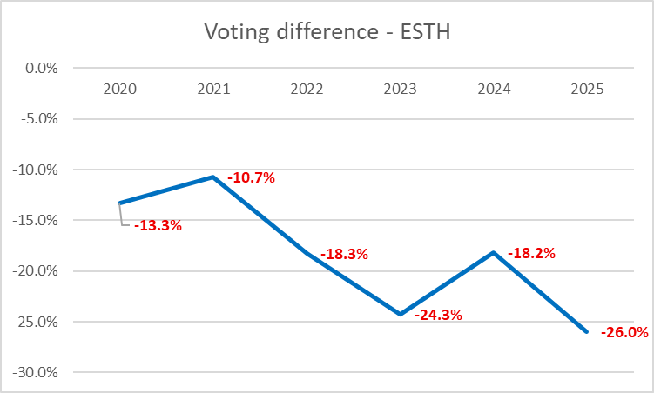
Workforce Race Equality Standard 2025
Trust: ESTH
Indicator 9
% of board members by ethnicity compared to BME workforce
As of 31 March 2025, the Trust Board of Directors comprised 15 members, three of whom identify as Black, Asian and Minority Ethnic (two non-executive directors, and one executive director). Of this, the Board comprised 10 voting members, seven of whom were non-executive directors and eight were executive directors. Of these 10 voting members of the Board, three voting Board members identify as BME. At St George’s this means BME staff are -35% under-represented at Board level overall, and -25% at Voting Board level. At ESTH this means BME staff are -34% underrepresented at Board level overall, and -26% at Voting Board level.

Slide 32
Workforce Race Equality Standard (WRES)
Appendix A: Definitions of ethnicity: people covered by the WRES
In line with Health Education England's WRES guidance and national WRES reporting metrics, the term ‘BME’ and ‘white’ are used to describe the two groups of staff referred to in this report.
The definitions of ‘black and minority ethnic’ and ‘white’ used in Health Education England's (HEE) WRES guidance 2024 have followed the national reporting requirements of ethnic category in the NHS data model and dictionary and are as used in NHS Digital data. At the time of publication these definitions were based upon the 2001 ONS Census categories for ethnicity. These are presented in Annex B.
‘White’ staff include white British, Irish, Eastern European and any other white i.e. categories 1–4 in the table in.
The ‘black and minority ethnic’ staff category includes all others except ‘unknown’ and ‘not stated.’
To aggregate data for BME staff, organisations should include categories 5-18 from current values and exclude ‘not stated’ and any ‘NULL’ values.
The treatment of staff from ethic categories [2 – white Irish] or [3 – Gypsy or Irish Traveler] or [4 – Any other white background] i.e. eastern European who may, in some organisations, be a significant minority group and experience considerable discrimination, is considered in the WRES FAQs document. Where this is the case, organisations should also explore such discrimination using workforce and staff survey data and take appropriate action.
Source: WRES Additional Information 2024 for NHS Trusts and Foundation Trusts (30/04/2024)
Ethnicity refers to: ONS definitions found here: Ethnic group, national identity and religion - Office for National Statistics (ons.gov.uk)
Ethnic Categories 2021
WHITE
1 – White –British / Welsh / Scottish / Northern Irish / British
2 – White –Irish
3 - Gypsy or Irish Traveller
4 – Any other white background please describe
MIXED / MULTIPLE ETHNIC GROUPS
5 – White and Black Caribbean
6 – White and Black African
7 – White and Asian
8 – Any other mixed / multiple ethnic background please describe
ASIAN / ASIAN BRITISH
9– Asian or Asian British –Indian
10 – Asian or Asian British –Pakistani
11 – Asian or Asian British – Bangladeshi
12 - Asian or Asian British – Chinese
13 – Any other Asian background please describe
BLACK / AFRICAN / CARIBBEAN / BLACK BRITISH
14 – Black or black British – African
15 – Black or black British – Caribbean
16 – Any other black background please describe
ANY OTHER ETHNIC GROUP
17 – Arab
18 – Any other ethnic group please describe

Slide 33
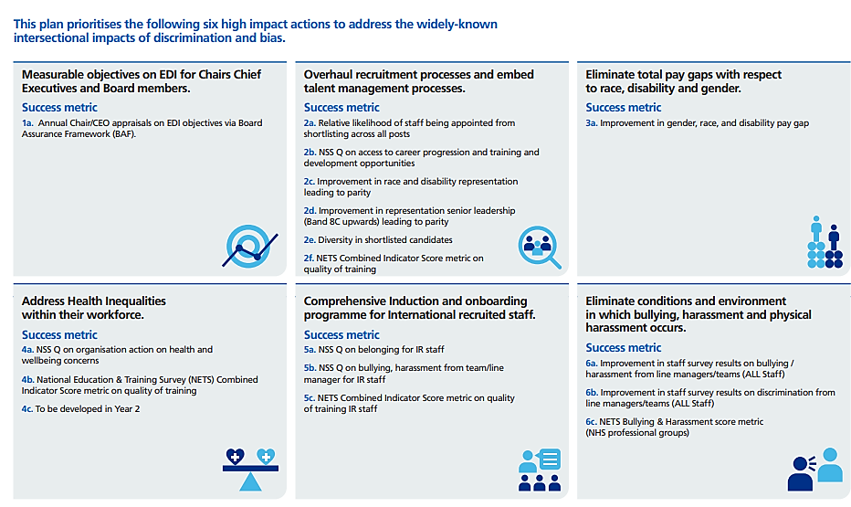
Workforce Race Equality Standard (WRES)
Appendix B: High impact action plan framework

