Slide 1
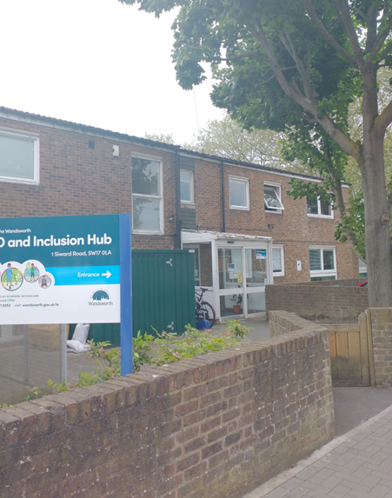
I have an appointment at this building on:
_________________
This information will help you know what to expect when you are here.

Slide 2
The building is called the SEND & Inclusion Hub, 1 Siward Road, Earlsfield.
I will arrive at: ____am.
I will be there for around 2 hours. It may be a little bit shorter than this, or a little bit longer.

Slide 3
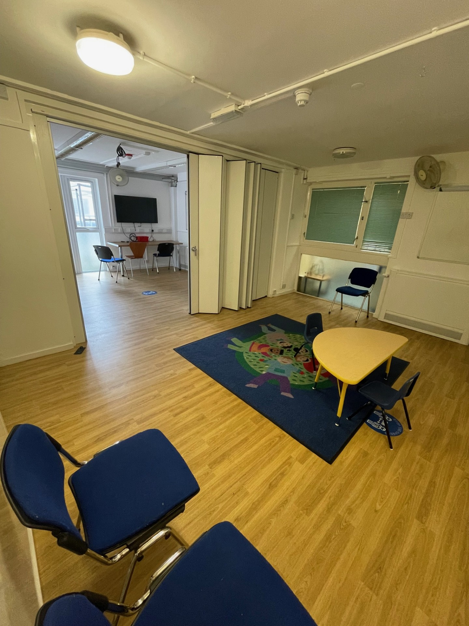
Me and my parent will be in this room.
We will meet with some new adults.

Slide 4
My parent will be on one side of the room talking to one of the adults.
I will sit on the other side of the room with one of the adults.
Sometimes the door will be closed, between where I sit and my parents sit. It is ok to ask to see my parents if I need to.

Slide 5

We will talk and play games. We want to learn more about you, to find out what you enjoy, what you are good at, and if there is anything you need help with.
We might talk about our interests, school, friendships and our feelings.

Slide 6
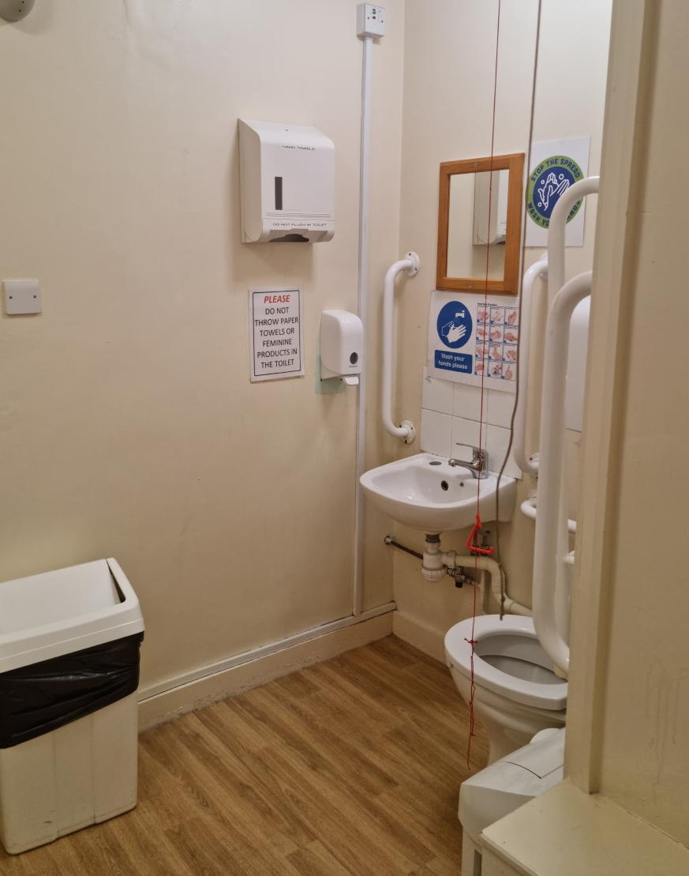
I can tell the adult if I need to use the toilet and they will show me where the bathroom is.

Slide 7

If I feel worried during the appointment, I can talk to the adult or to my parent.

Slide 8

When the appointment is finished, I will leave with my parent.

