Slide 1



Enhanced Induction for International Medical Graduates (IMGs)
Dr Elwina Timehin
Consultant Audiovestibular Physician
SAS-LED & IMG Tutor
14th February 2025

Slide 2
Who am I?
Consultant in Audiovestibular Medicine
SAS,LED & IMG Tutor
*SAS= Specialist, Associate Specialist & Specialty doctor
*LED = Locally Employed Doctors
*IMG = International Medical Graduate
My role
  Guidance and signposting to help further your career

Slide 3
Why
Contribution & diversity of experience overseas doctors bring to NHS & patients is invaluable
Adjusting to new workplace & healthcare system while accustoming to living in a new country can be challenging
Fundamental values of medicine may be universal but the way they are expressed will be different according to the social, cultural & organisational context in which care is delivered

Slide 4
Why?
Mistakes and misunderstandings
Difficulty getting on career pathway for progression
Sense of isolation, demotivation & loss of confidence
Enhanced IMG Induction
St George’s University Hospitals NHS Foundation Trust
Notes:
Mixed audience
Different stages in career
Some newly qualified & others already established in own country
Different country, cultures, practices

Slide 5
What & how?
Enhanced Induction has been put in place to help:
  facilitate professional and personal development
  reduce sense of isolation and promote well being

Slide 6
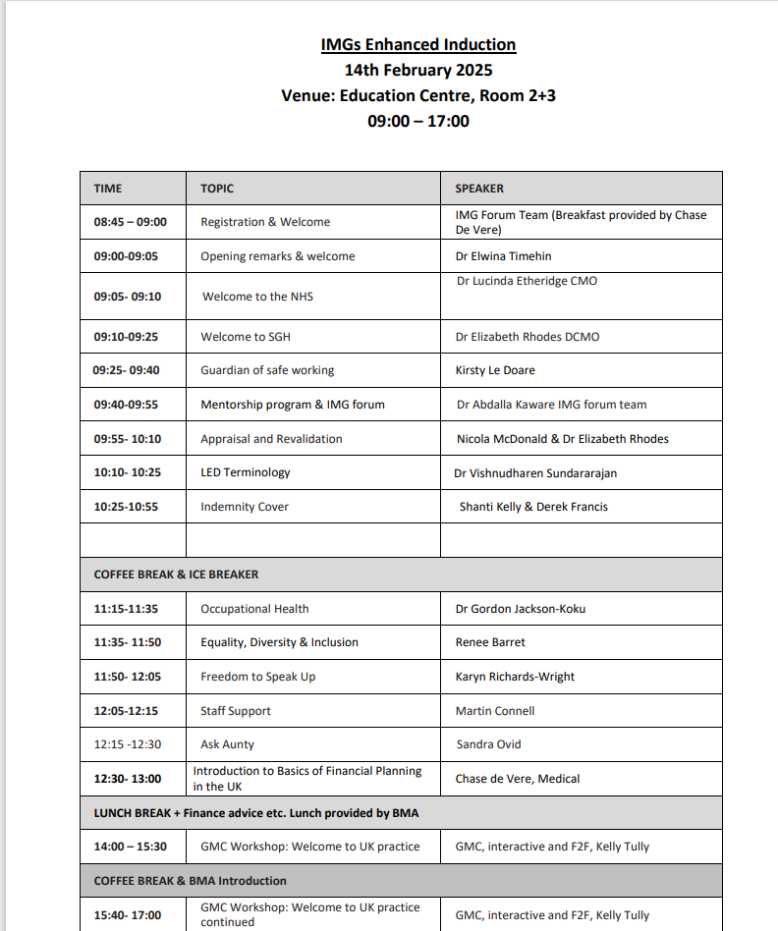

Slide 7
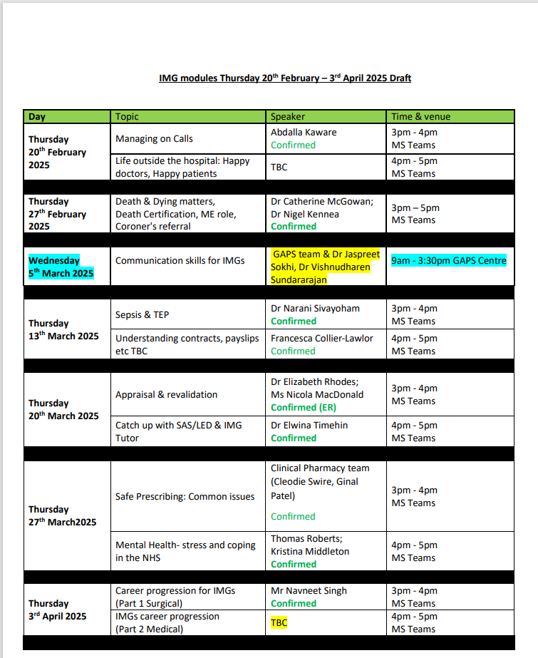
Thursday lunchtime teaching for 5 weeks

Slide 8
What & how?
Dedicated section on PGME webpage with links to IMG forum, Welcome kit, Mentoring scheme
LED-SAS-IMG Doctors - St George's University Hospitals NHS Foundation Trust (stgeorges.nhs.uk)
Encouraged to join the IMG & Trust’s junior doctor forum

Slide 9
What would we like from you....
Use information from today and during Thursday lunchtime teachings
Participate in Continuous Professional Development (CPD), research, audit & teaching
Make sure Mandatory and Statutory Training (MAST) is up to date
Enhanced IMG Induction
St George’s University Hospitals NHS Foundation Trust

Slide 10
What would we like from you cont…
Engage with appraisal & revalidation process to help career progression
Maintain wellbeing
Ask questions
Enjoy the journey & time at SGH
Presentation title to be placed here
St George’s University Hospitals NHS Foundation Trust

Slide 11
Useful Contacts
SASLEDIMGtutor@stgeorges.nhs.uk
PGME@stgeorges.nhs.uk
Queries about contracts:
CWTDmedstaffing@stgeorges.nhs.uk
MedCardmedstaffing@stgeorges.nhs.uk
SNCTmedstaffing@stgeorges.nhs.uk

Slide 12


For any other information, please contact PGME@stgeorges.nhs.uk

