Slide 1
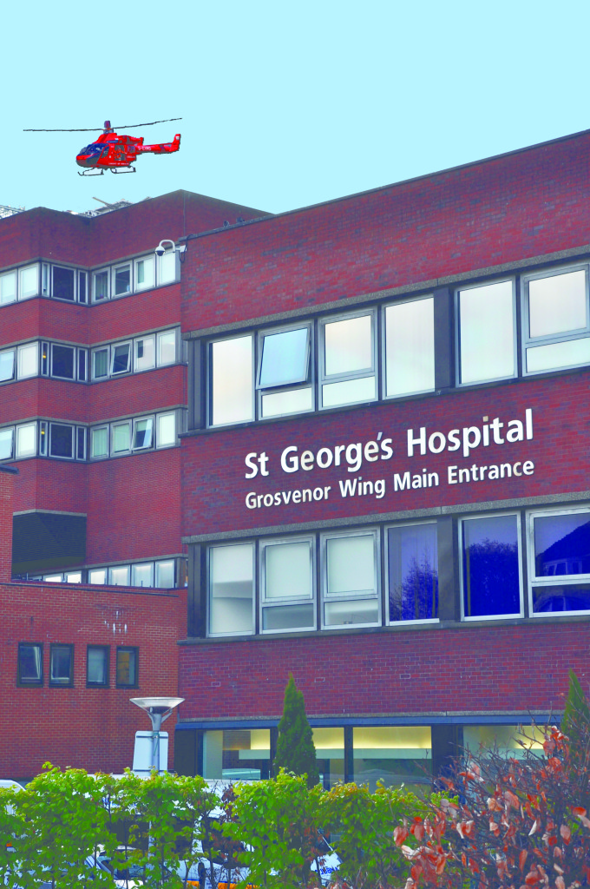
Welcome to St George’s
Dr Lizzie Rhodes
Consultant Haematologist &
Deputy CMO, Responsible Officer

Slide 2
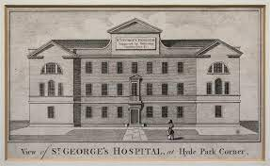
Who are we?
Large tertiary hospital for SW London – more than 9000 employees (>1200 doctors)
2 hospital sites – SGUH and QMUH Roehampton – 1.3million people across SWLondon
Specialty services across Surrey / Sussex for 3.4 million people
Group model with Epsom and St Helier hospitals 2021
Original Hospital opened 1773 at Hyde Park Corner

Slide 3
St George’s
a few examples of specialty care!
- medical school on site (health university)
- neurosciences
- surgery
- paediatric medicine , fetal medicine, maternal medicine
- HASU, Heart Attack Centre, Major Trauma (and paeds major trauma)
- infection and HIV
- Cancer services (inc children and BMT)
- GICU, NITU, CITCU, PICU, SCBU, NICU
Organisational Structure
- 4 Divisions (CWTD, SNCT, MedCard, SWLP)
- services called care groups – clinical lead is a Care Group Lead
- supported by management teams – service managers, general managers
Medical Staffing

Slide 4
Some people
Group Exec
CEO Jacqueline Totterdale,
Chair Gillian Norton,
Group CMO Dr Richard Jennings,
Group CNO Arlene Wellman
Site Leadership Team
Managing Director Kate Slemmeck,
COO Tara Agent
Site CMO Dr Luci Etheridge, Site CNO Nicola Shopland

Slide 5
Our values
Living our values is important to us
Expectation of all staff members at SGUH
Towards patients
Towards colleagues
We need to know if people are affected by those not acting in keeping with our values

Slide 6
Thank you!
We hope you enjoy working here
Let us know what you need

