Slide 1
Occupational Health
Gordon Jackson-Koku LLM, FFOM, PhD
Consultant Physician & Honorary Lecturer (SGUL)
Training Programme Director (Occupational Medicine, London & KSS Deanery)

Slide 2
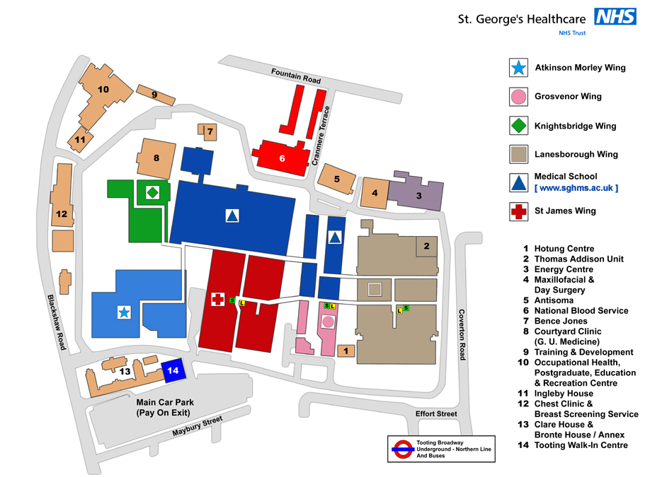
Occupational Health Department
Enter all or part of a department name:

Slide 3
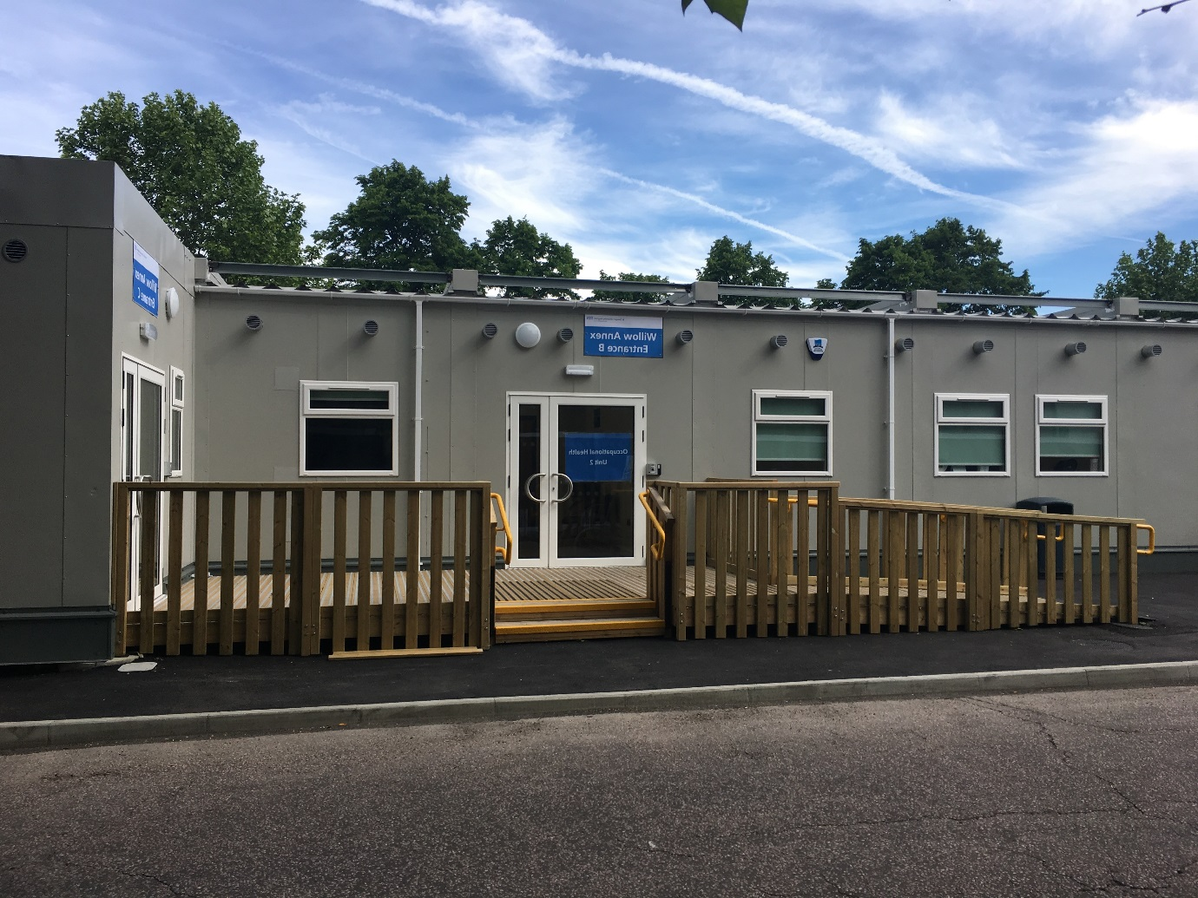
Occupational Health Department – Units 1 & 2
Opening hours: 8:30am to 4.30 pm, Monday - Friday
Telephone: 0208 725 1661
Email: ohadmin@stgeorges.nhs.uk

Slide 4
In this talk..
Role of occupational health & services we offer
Management referrals
Immunity screening and vaccination
Blood borne infections & exposure prone procedures
Sharps & splash injuries
Mental health, wellbeing & work
Neurodiversity & work
Notes:
In this session we will …

Slide 5
The Occupational Health Team
Consultant Leads - Dr Gordon Jackson-Koku FFOM, Dr Samuel Thayalan FFOM
Head of Nursing & Business Manager – Ms Toyin Oladotun
Administrative Manager – Ms Sreeja Pillai
Psychiatrist – Dr Annabelle Banks
Medical Residents – Dr O Talabi, Dr M Xue
Lead Infection Control Nurse – Ms Patricia A Beckford
7 Specialist Nurses
1 Physiotherapist
Staff counselling service

Slide 6
Occupational Health – Guiding principles
Impartiality
Confidentiality
Consent – to request and share information

Slide 7
Scope of our services
Management referrals (Fitness for work assessments / Health clearance assessments / other referrals)
Managing work-related/place infections (Liaise with I.D & Micro e.g., HIV, Hepatitis, Covid-19, etc)
Managing needle stick or splash injuries (Post expose prophylaxis)
Health Surveillance (e.g., ionizing radiation etc)
Vaccination and immunity testing (e.g., Measles, Varicella etc)
Work-related stress / burnout / mental health
Substance misuse (Drug & alcohol testing & monitoring)
General workplace risk assessments
Pregnancy related workplace risk assessments

Slide 8
Management referrals assessments
Source of referrals:
Clinical Lead / a manager/ Educational supervisor / another clinician.
What Happens:
We assess in clinic / by telephone / by MS Teams
We may obtain GP or specialist reports - your consent is required for this
We will give an opinion on your fitness to study
The report:
You can ask to see the report before it is sent to the referrer
You can request correction of factual inaccuracies
You can withdraw consent for the report to be sent to the referrer
You cannot request changes to professional opinion, unless based on inaccurate/wrong facts

Slide 9
Outcome of the mgt referral assessments
Fit for work – without workplace adjustments
Fit for work – with workplace adjustments
Fitness pending additional information
Unfit for work
Temporary or permanent adjustments may be offered (if there are health issues)

Slide 10
Workplace infections
Notes:
Other important aspects of your health in educational and clinical settings …

Slide 11
Immunity screening and vaccination
TB
Measles
Mumps
Rubella
Varicella
HIV, Hep B, Hep C (EPP Roles)
Those found susceptible to these infections - offered vaccination
Non-attendance (without notifying OH) is unprofessional behaviour and wastes appointments
Notes:
Other important aspects of your health in educational and clinical settings …

Slide 12
Flu vaccination
Protection for staff & vulnerable groups
Annual vaccinations
Flu vaccination programme from around end of September to end of March yearly
Free for staff and students
Available in Trust or GP
St George’s University Hospitals NHS Foundation Trust - Occupational health

Slide 13
Covid-19
Vaccination not mandatory
However, all healthcare staff should take up offer of vaccination & boosters when offered
Vaccination reduces adverse outcomes - with both ICU and non-ICU admissions and deaths.
Individual risk assessments for those with underlying health issues
Remember - Protection of vulnerable groups (is part of our professional responsibility)
St George’s University Hospitals NHS Foundation Trust - Occupational health

Slide 14
Blood borne infections (BBVs) screening
Hepatitis B Hepatitis C HIV (transmission blood & bodily fluids)
In clinical settings – transmitted via sharp, splash injuries, bites etc
Exposure Prone Procedures – EPP work
OH clearance is required e.g., surgery, midwifery, paramedics, medical students, renal, other specific specialist areas
Those who test positive for a BBV
Not an automatic ban for training in certain specialties e.g., surgery
But you will require support and regular monitoring via OH
St George’s University Hospitals NHS Foundation Trust - Occupational health

Slide 15
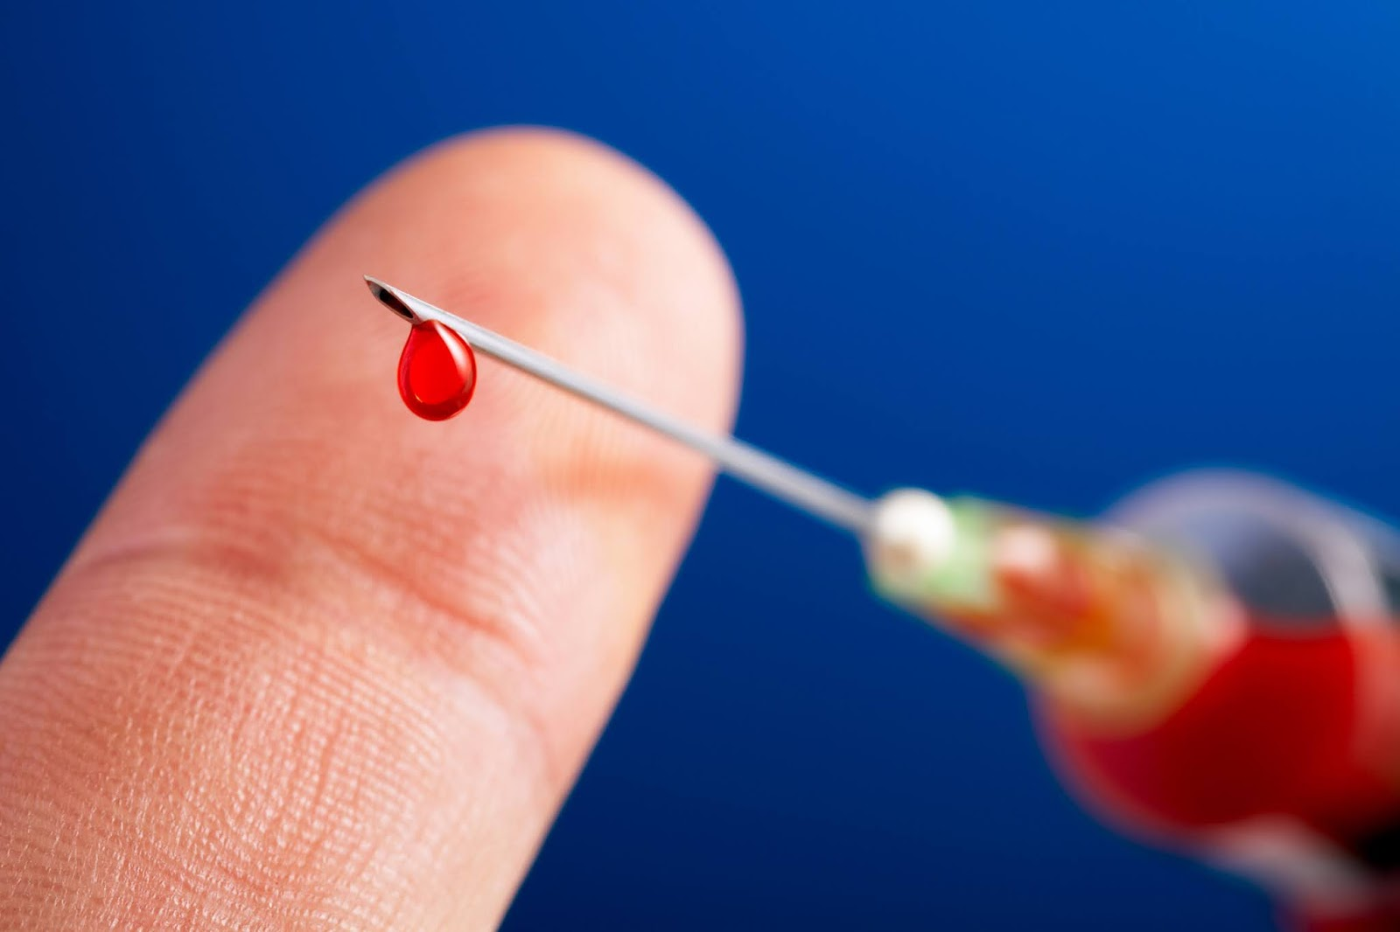
Exposure to blood, body fluids and Blood-Borne Viruses (needle stick, sharp, splash, bite, scratch injuries)
Contact Occupational Health Immediately
Bleep 8092
Call 020 8725 1661 / 2663 / 1662
Walk in 08.30 – 16.00 Mon-Fri
Out of hours – attend Emergency Dept or your local hospital ED. Follow-up next working day in OH.

Slide 16
Notes:
First aid is very important after accidental sharp injury or splash of blood or body fluids:
Splash –
Mouth – gargle with lot of fluid and spit it out (do not swallow)
Nose – rinse it
Eyes: wash it and irrigate with water or saline – the ward staff will help you or attend A&E
Sharp injury
Wash with soap and water
Do not suck
Do not squeeze and put strong chemicals as it invites ‘fighting cells’ in the body that can take the virus deep inside your body
Report to OH or A&E immediately as preventive medicine if required MUST BE TAKEN WITHIN 1 HOUR OR SOON AS POSSIBLE

Slide 17
Mental health & wellbeing (e.g. depression, anxiety, psychosis, stress, burnout, etc…)
Key areas of challenge in work
Impaired concentration and attention e.g., the condition itself or side effects of medication
Impaired motor skills e.g., EPSE (psychotropics)
Impaired communication & social skills e.g., confidence issues, selfcare issues
Risk to self & others e.g., risk of drug/alcohol use, suicide, patients, etc
Overall impact of the illness e.g., absenteeism, motivation issues, apathy, decreased productivity
Overall impact
Known negative linear relationship between severity of a mental health condition and work performance –

Slide 18
Mental health - Support at work
Tailored referrals/signposting for:
OH psychiatrist assessment
Primary care psychiatrist assessment
Psychologist assessment
Local talking therapies service interventions
Practitioner Health – https://www.practitionerhealth.nhs.uk
BMA Wellbeing Support Services
Health Education England Professional Support Unit
Outcomes
Monitor efficacy of interventions when back in work
OH may liaise with treating psychiatrist or mental health professional
Reasonable adjustments
Case-by-case-basis
Phased return to work

Slide 19
Neurodiversity in the workplace (e.g. ADHD, Autism, Dyslexia, Dyspraxia, Dysgraphia, etc..)
Key areas of challenge in work
Fitting in with colleagues & social awkwardness e.g. ASDs
Challenges with social discourse e.g. communicating issues with colleagues or patients e.g. ASDs
Challenges with Attention / focus / concentration e.g. ADHD
Challenges with hierarchy – this can lead to difficulties with management – e.g. in ASDs
Concentration / organization / physical coordination issues - e.g. dyslexia, dyspraxia
Challenges with working with numbers, performing calculations and remembering mathematical facts - e.g. dyscalculia
Overall impact
Many develop masking behaviours to fit in –
This can be exhausting and may lead to anxiety, burnout, work performance issues

Slide 20
Neurodiversity – support at work
The Environment
The Individual
The Task

Slide 21
Neurodiversity – Support at work
Tailored referrals for:
Specialist diagnostic assessments e.g. ASD, ADHD etc..
Specialist workplace needs assessments e.g. BDA – dyslexia
Specialist coaching e.g. ADHD
Communication and interpersonal relationships interventions e.g. ASD
Career guidance
Exam support
Workstation assessments
Assistive technologies
Outcomes
Monitor efficacy of interventions in work – liaise with treating physician / assessor
Reasonable adjustments
Case-by-case basis
Phased return to work

Slide 22
In summary Managing your health in the workplace
- Vital to seek help early – via OH / GP / hospital specialist
- Follow advise given by a GP / a specialist / or occupational health
- Do not treat yourself or check your own clinical records
- Do not rely on your own judgement about your fitness
- Reasonable adjustments as needed via OH
GMC: Good Medical Practice 2024
Domain 3: Managing risks posed by your health

Slide 23
Thank you
 Thank you Questions….

