Slide 1
IMGs, LEDs – WHO'S WHO
Dr Vishnu Sundararajan

Slide 2
TERMINOLOGIES
IMG
LED
NCHD
SAS
SHO

Slide 3
TERMINOLOGIES
IMG International Medical Graduates
LED Locally Employed Doctors
NCHD Non Contract Hospital Doctors
SAS Specialist, Associate specialist & Specialty doctors
SHO Senior House Officer
ST Specialty Trainee
SpR Specialty Registrar
BMA guidance
Toolkit for doctors new to the UK

Slide 4
WHY?
Keeping up with GMC Good Medical Practice
Avoid confusions with the patients & clinical teams
Knowing your contract & getting your pay right
Knowing your responsibilities & working within limits

Slide 5
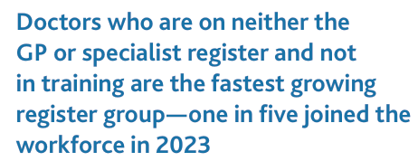
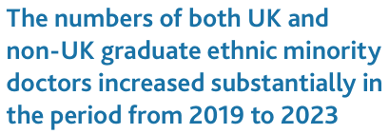
GMC WORKFORCE REPORT 2024

Slide 6
CAREER PROGRESSION?
UK graduates also have started enetering LE job roles following F2 years
As a result a large cohort of doctors in LE roles, that keeps growing each year
If training & career pathways adapt to this new reality & recognise skills & experience gained in LE roles, it will enhance career satisfaction & benefits healthcare by using existing doctors

Slide 7
MWRES

Slide 8
TOO OVERWHELMING?

Slide 9
CURIOUS?

