Slide 1


Workforce Race Equality Standard (WRES)
2023/2024 Report
St George’s University Hospitals NHS Foundation Trust
Published: 00/00/2024

Slide 2

Workforce Race Equality Standard (WRES)
Contents
Section | Item | Slide
1 | Executive Summary | 3
2 | Purpose, Background and Definitions | 4
3 | Indicator Overview | 5
4 | Indicator 1: ‘Percentage staff by AfC pay band and ethnicity’ | 6-8
4 | Indicator 2: ‘Relative likelihood of white applicants being appointed from shortlisting compared to BME applicants’ | 9
4 | Indicator 3: ‘Relative likelihood of BME staff entering the formal disciplinary process compared to white staff’ | 10
 | Indicator 4: ‘Relative likelihood of white staff accessing non–mandatory training and CPD compared to BME staff’ | 11
 | Indicator 5: ‘% of BME staff experiencing harassment, bullying or abuse from patients, relatives or the public in the last 12 months’ | 12
 | Indicator 6: ‘% of BME staff experiencing harassment, bullying or abuse from staff in the last 12 months’ | 13
 | Indicator 7: ‘% of staff believing that trust provides equal opportunities for career progression’ | 14
 | Indicator 8: ‘% of BME staff that personally experienced discrimination at work from a manager, team leader or colleagues’ | 15
 | Indicator 9: ‘Percentage of board members by ethnicity compared to BME workforce’ | 16
5 | Our EDI Priorities and Next Steps | 17-18
6 | Appendix A: Definitions of ethnicity: people covered by the WRES | 19
 | Appendix B: Appendix B: High Impact Action Plan Framework | 20

Slide 3
Workforce Race Equality Standard (WRES)
Executive summary
All NHS providers are required to complete an annual Workforce Race Equality Standard (WRES) report. The report is based on a snapshot of data from 31st March each year and aims to highlight progress against a number of key indicators of workforce equality, including a specific indicator to address the low numbers of Black, Asian and Minority Ethnic board members across NHS organisations. Data for WRES indicators 5 to 8 are drawn from questions in the NHS staff survey.
In line with national requirements, this report and any associated action plans should be reviewed internally and approved at Board before being published on the organisation’s website. The deadline for publication is 31st October 2024.
The key findings and metrics for this report submission are outlined below. Unless indicated, each point is compared to the previous reporting period:
Improved indicators
We have seen an improvement in 8 out of the 10 indicators, the remaining 2 have remained static.
Overall, the BME staff population at St George’s continues to increase year on year (53.6%).
Relative likelihood of BME staff entering the formal disciplinary processes has reduced.
For the second year we see an increase in the number of BME staff accessing non-mandatory training and continuing professional development.
Reported experiences of Harassment, Bullying and Abuse have reduced, from patient-staff and staff-staff.
There is a reduction in reports experiences of discrimination from managers and colleagues – this is now lower than the London average.
Continued upward trend in the percentage of BME staff feeling the organisation provides equal opportunities for career progression or promotion. This has increased yearly since 2018 (+6.1 percentage points).
The % difference between the organisations’ board voting membership and its overall workforce has improved from -43% to -35%.
Reduced / static indicators
BME staff are over-represented in lower bands.
The number of white staff at VSM level has reduced from 24 to 20, and BME staff from 3 to 2.
BME staff make up just 8.7% of non-clinical VSM posts – compared to 87% white. This is the ratio of 10:1 white staff members to every 1 BME staff member appointed at VSM level (compared to 8:1 last year).
Of the 87 non-clinical Band 8d and above posts only 15% are held by a BME member of staff, compared to 83% being held by a white member of staff.
The relative likelihood of white applicants being appointed from shortlisting compared to BME applicants has remained static at 1.5.
Of the Band 8d, only 3 of 18 clinical Band 8d post are held by a BME member of staff. This is a ratio of 5:1.
BME staff are significantly under-represented at Executive which remains about 41% for the second year.

Slide 4
Workforce Race Equality Standard (WRES)
Purpose, background and definitions
Purpose
This paper provides an overview of the 2024 Workforce Race Equality Standard (WRES) findings.
This report will be published on the Trust website.
The Board is asked to receive this report and associated action plan for information and approve for publication.
Background
In April 2015, NHS England introduced the WRES in response to consistent findings that BME applicants and staff consistently fared worse in employment outcomes and satisfaction surveys. The WRES was designed to enable NHS organisations to demonstrate progress against a number of key indicators of workforce equality, including a specific indicator to address the low levels of BME Board representation.
Since April 2015, the WRES has been included in the full-length NHS Standard Contract and requires all providers of NHS services to address the issue of workforce race inequality by implementing and using the WRES.
There are nine WRES indicators. Four of the indicators focus on workforce data, four are based on data from national NHS Staff Survey questions, and one indicator focuses upon BME board representation. The WRES highlights differences between the experience and treatment of White staff and BME staff in the NHS with a view to organisations closing those gaps through the development and implementation of action plans focused upon continuous improvement over time.
The WRES is produced in line with Technical Guidance issued by NHS England.
Indicators 1-3 and 9 are produced via the Electronic Staff Record (ESR) from a snapshot of data taken on 31st March 2024. All other indicators are from the 2023 staff survey.
Definitions of ethnicity: people covered by the WRES
In line with Health Education England's WRES Guidance, the term ‘BME’ and ‘white’ are used to describe the two groups of staff referred to in this report.
‘White’ staff include white British, Irish, Eastern European and any other white. The ‘Black and Minority Ethnic’ staff category includes all others except ‘unknown’ and ‘not stated.’
Further information can be found in appendix A: Definitions of ethnicity: people covered by the WRES.
Overview of workforce numbers
 | 2019 | 2020 | 2021 | 2022 | 2023 | 2024
Total number of staff in organisation | 8,884 | 8,873 | 9,154 | 9,608 | 9,915 | 10,345
% of BME Staff | 44.6% | 46.1% | 47.7% | 50.1% | 51.9% | 53.6%
% of staff who self-reported ethnicity | 97.2% | 96.7% | 96.1% | 97.0% | 97.1 | 97%

Slide 5
Workforce Race Equality Standard
Indicator Overview
Indicator |  | STG 2021 | STG 2022 | STG 2023 | STG 2024 | Performance vs. previous year | Exp. compared to White Staff |  | London Av. 2022 | London Av. 2023
1 | % of BME staff in organisation | 47.7% | 50.1% | 51.9% | 53.6% | Increased |  |  | 49.9% | 52.1%
2 | Relative likelihood of White applicants being appointed from shortlisting compared BME applicants | 1.47 | 1.26 | 1.50 | 1.52 | Static* |  |  | 1.44 | 1.47
3 | Relative likelihood of BME staff entering the formal disciplinary process, compared to that of White staff | 1.82 | 1.65 | 1.67 | 1.48 | Improved |  |  | 1.47 | 1.41
4 | Relative likelihood of White staff accessing non-mandatory training and CPD compared to BME staff | 1.03 | 0.98 | 0.95 | 0.86 | Improved |  |  | 0.97 | 0.92
5 | % of BME staff experiencing harassment, bullying or abuse from patients, relatives or the public in the last 12 months. | 27.3% | 23.3% | 27.0% | 25.7% | Improved |  |  | 30.2% | 32.1%
6 | % of BME staff experiencing harassment bullying or abuse from staff in the last 12 months | 30.1% | 25.9% | 27.3% | 26.9% | Improved |  |  | 28.1% | 28.3%
7 | % of BME staff believing that organisation provides equal opportunities for career progression or promotion | 41.1% | 42.1% | 43.8% | 44.0% | Static* |  |  | 43.6% | 46.2%
8 | % of BME staff personally experiencing discrimination at work from manager/leader/ or other colleagues. | 18.0% | 16.6% | 16.9% | 15.9% | Improved |  |  | 16.7% | 16.1%
9 | % difference between the organisations’ board voting membership and its overall workforce | -36% | -32% | -43% | -35% | Improved |  |  | -26% | -27%
 | % difference between the organisations’ board executive membership and its overall workforce’ | -47% | -36% | -41% | -41% | Static* |  |  | -33% | -33%
* Changes of +/- 0.5 or less are recorded as Static.

Slide 6
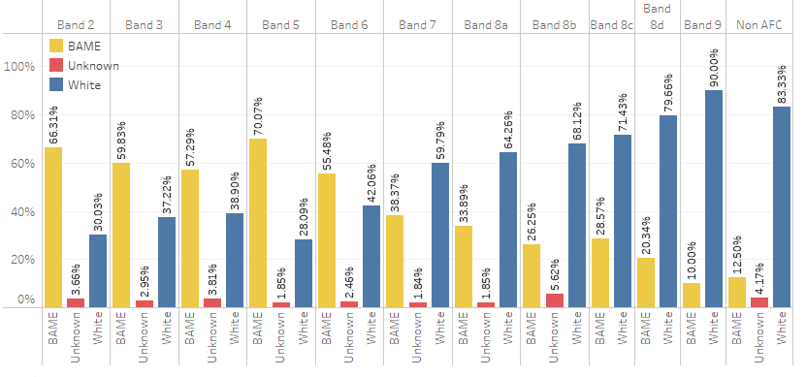
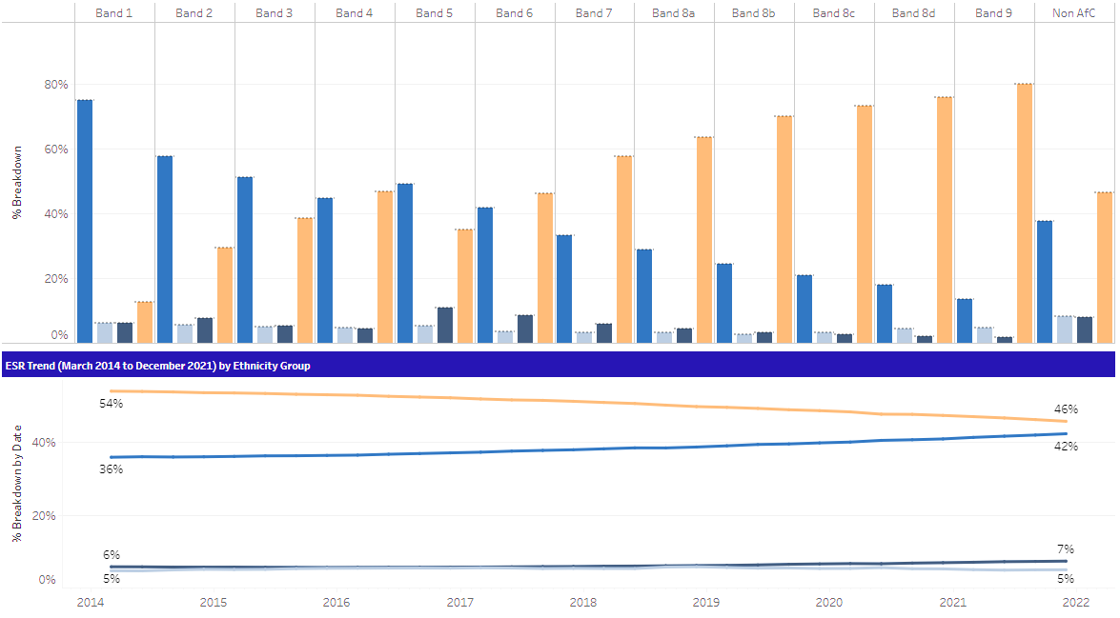

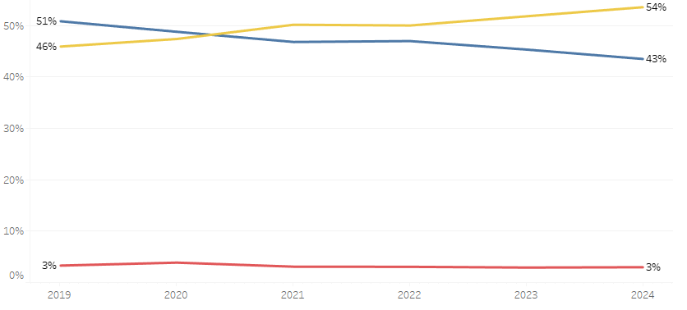
Workforce Race Equality Standard (WRES)
Indicator 1 % of staff by AfC pay band and ethnicity
Our Black, Asian and Minority Ethnic workforce has increased year on year since 2019 and continues to be representative of the local communities we serve.
For the second consecutive reporting year, we see an increase of +1.8% in indicator 1. This is approximately an increase of 400 Black, Asian and Minority Ethnic members of staff.
For the second consecutive year, our Black, Asian and Minority Ethnic workforce remains 2% higher than the London average. Whilst we see a continued annual increase across the workforce, our workforce data still highlights that Black, Asian and Minority Ethnic staff are over-represented in lower bands and under-represented in higher bands
This is not unique to St George’s and mirrors what we see across London NHS trusts (see table A and B).
Table A: % of Staff in each AFC Band by Ethnicity at St Georges
Table B: % of Staff in each AFC Band by Ethnicity (London 2023)
Note: The solid red line indicates the target for St George’s to be representative across all AFC pay bands.

Slide 7
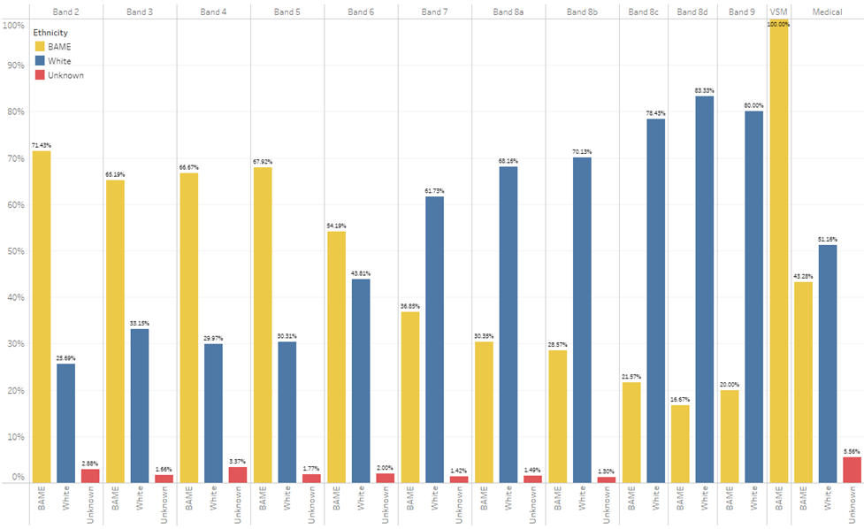
Workforce Race Equality Standard (WRES)
Indicator 1
Clinical Staff - % of staff by AfC pay band and ethnicity
Table E: % of staff by ethnic group (clustered):
For Clinical staff (table C), we see an increase in the percentage of Black, Asian and Minority Ethnic staff across 7 of the 11 AFC bands. Compared to last year we have seen a reduction of white Staff (-51), compared to an increased (+248) BME staff members. This is largely due to an increase at Bands 2, 5 and 6.
We have seen a year-on-year increase in diversity with the consultant group, from 38% in 2022 to 47% in 2024. In terms of percentage our 2024 ratio for consultant staff was 49% white to 47% BME – this is the closest to representative we have seen within the consultant workforce (to the organisations overall).
The lowest level of representation remains band 8a-c (31% BME) and 8d+. Of the 25 Band 8d and above posts only 20% are held by a BME member of staff, compared to 80% being held by a white member of staff (table E). We see similar low levels of representation at band 8d, of 18 posts only 3 (17%) are held by a BME member of staff. This is a ratio of 5:1.
Table C: % of Clinical Staff in each AFC Band at St George’s:
Table D: No. of Clinical Staff in each AFC Band:

Slide 8
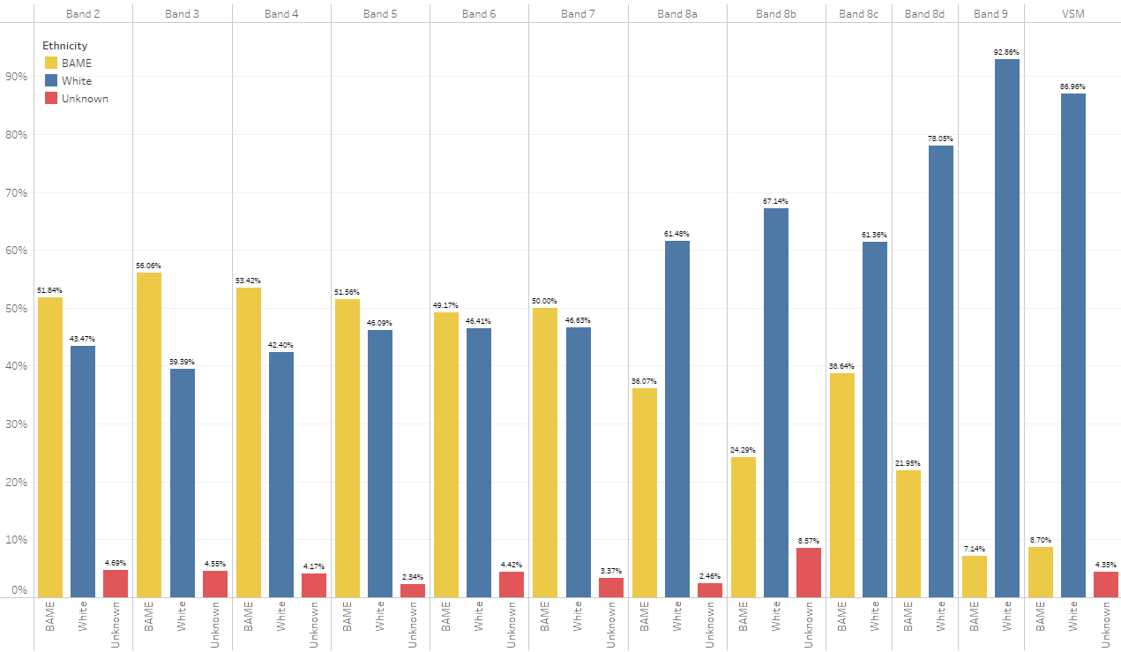
Workforce Race Equality Standard (WRES)
Indicator 1
Non-Clinical - % of staff by AfC pay band and ethnicity
Table H: % of staff by ethnic group (clustered):
For Non-Clinical staff we see an increase in the percentage of Black, Asian and Minority Ethnic staff across 8 of the 11 AFC bands. This compares to increase in the number of white staff in 7 of the 11 AFC bands.
For the second year BME representation at Band 6 and Band 7 is greater than White representation and close to the organisation overall of 54% – with 49% at Band 6 and 50% at Band 7.
The number of white staff at VSM level has reduced from 24 to 20, with the number of BME staff reducing from 3 to 2. This means that BME staff make up just 8.7% of non-clinical VSM posts – compared to 87% White. This is the ratio of 10:1 white staff members to every 1 BME staff member appointed at VSM level. This has increased from a ratio of 8:1 last year.
Of the 78 Band 8d and above posts only 15% are held by a BME member of staff, compared to 83% being held by a white member of staff (table H).
Table F: % of BME vs. White Non-Clinical Staff by Grade at St George’s:
Table G: No. of BME Non-Clinical Staff in each AFC Band at St George’s:

Slide 9
Workforce Race Equality Standard (WRES)
Indicator 2
Relative likelihood of white applicants being appointed from shortlisting compared to BME applicants
Our 2024 figures show that white applicants at St George’s are 1.52 times more likely to be appointed from shortlisting compared Black, Asian and Minority Ethnic (BME) applicants. This is a small increase of 0.02% from 1.50 in 2023.
In 2024 the likelihood of Black, Asian and Minority Ethnic applicants being appointed from shortlisting reduced from 27% to 18% - this means that of the 9825 shortlisted BME applicants, 1783 were appointed. The number of shortlisted BME applicants increased from 7751 in 2023 to 9825 in 2024.
For white applicants, the likelihood of appointment has decreased from 33.5% in 2023 to 27% in 2024.
For those that did not record an ethnicity we have seen a significant increase in the likelihood of appointment from 43% in 2023 to 72% in 2024. This is due to a notable increase in the number of shortlisted applicants and the number of appointed applicants (with an ethnicity recorded as ‘unknown’).
Note: The solid green line indicates the target relative likelihood of 1.0
2020 | 2021 | 2022 | 2023 | 2024
1.47 | 1.47 | 1.26 | 1.50 | 1.52

Slide 10
Workforce Race Equality Standard (WRES)
Indicator 3
Relative likelihood of BME staff entering the formal disciplinary process compared to white staff
Our 2024 figures show that BME staff at St George’s are more likely to enter the disciplinary process compared to white staff.
Over the last five years we have seen a significant reduction in the relative likelihood of BME entering the disciplinary process, from 2.38 times more likely in 2020, to 1.48 in 2024.
The number of BME staff entering the disciplinary process has increase compared to last year - from 21 in 2023 to 33 BME staff members in 2024. This is an increase of 57% on the previous year.
The number of white staff entering the disciplinary process has also increased, from 11 in 2023 to 18 in 2024. This is an increase of 64% on the previous year.
Note: The solid green line indicates the target relative likelihood of 1.0
2020 | 2021 | 2022 | 2023 | 2024
2.38 | 1.82 | 1.65 | 1.67 | 1.48

Slide 11
Workforce Race Equality Standard (WRES)
Indicator 4
Relative likelihood of white staff accessing non–mandatory training and CPD compared to BME staff
For the fourth year we see an increase in the number of Black, Asian and Minority Ethnic staff accessing non-mandatory training and continuing professional development (CPD). The likelihood of BME staff accessing non-mandatory training and CPD has increased to 34%, from 29% in 2023.
In 2023 we saw a 2-percentage point reduction in the number of white staff accessing non-mandatory training and continuing professional development, dropping to a likelihood of 27%. This has returned to a likelihood of 29% in 2024.
In 2024 we see the greatest disparity, in terms of likelihood of each ethnic group accessing training, with a 5 percentage point difference – in previous years this has been between 1-2 percentage points.
 | 2021 |  |  | 2022 |  |  | 2023 |  |  | 2024
 | White | BME | Unknown | White | BME | Unknown | White | BME | Unknown | White | BME | Unknown
Number of staff in workforce | 4464 | 4336 | 354 | 4495 | 4817 | 296 | 4486 | 5141 | 288 | 4495 | 5542 | 308
Number of staff accessing non-mandatory training and CPD | 1142 | 1076 | 60 | 1324 | 1444 | 62 | 1222 | 1478 | 63 | 1300 | 1863 | 81
Likelihood of staff accessing non-mandatory training and CPD | 26% | 25% | 17% | 29% | 30% | 21% | 27% | 29% | 22% | 29% | 34% | 26%
Relative likelihood of white staff accessing compared to BME staff | 1.03 |  |  | 0.98 |  |  | 0.95 |  |  | 0.86

Slide 12
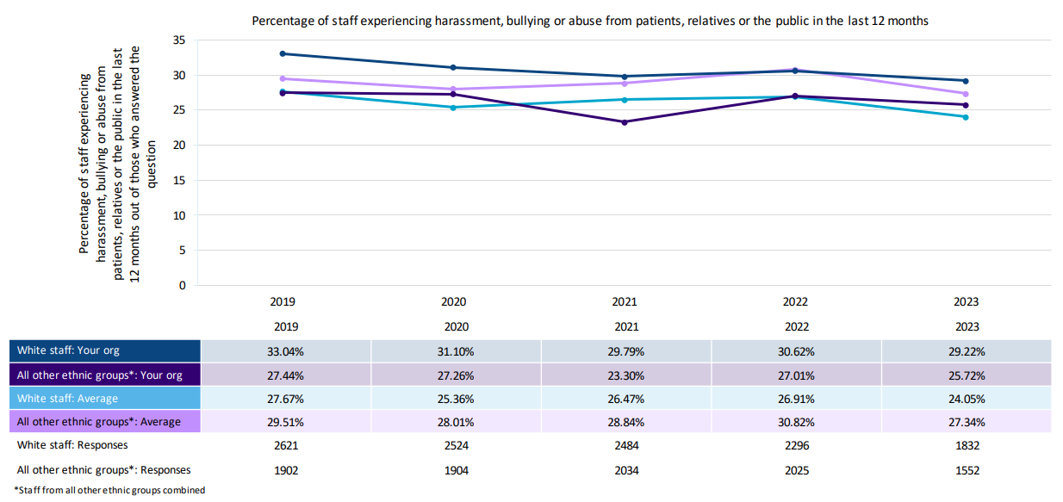
Workforce Race Equality Standard (WRES)
Indicator 5
% of staff experiencing harassment, bullying or abuse from patients, relatives or the public in the last 12 months
For the second year, the percentage of staff who experienced harassment, bullying or abuse from patients, relatives or the public in the last 12 months was lower for BME staff (26%) than for white staff (29%).
In terms of the percentage of BME staff who experienced harassment, bullying or abuse from patients, relatives or the public in the last 12 months, the Trust performed better than 65% of Trusts and worse than 35% of Trusts
For white staff we see a decrease from 31% to 29%. The gap between white and BME staff has remained at around 3.5 percentage points for the second year.
Both white and BME women (34% and 28% respectively) report experiencing higher rates of HBA compared to male colleagues, with white males reporting the lowest rates (21%). This has reduced for BME women and increased for white women
White nurses and midwives and Health Care Assistants (HCA) report the highest levels in this indicator.
% of staff experiencing harassment, bullying or abuse from patients/relatives or the public
Notes:
White Nurses and Midwives and HCA (report the highest rates

Slide 13
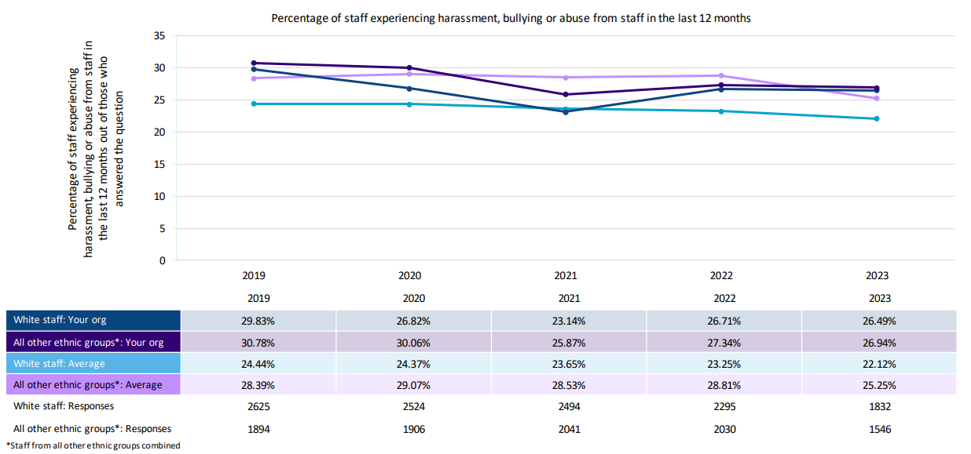
Workforce Race Equality Standard (WRES)
Indicator 6
% of staff experiencing harassment, bullying or abuse from staff in the last 12 months
Reported rates of staff experiencing harassment, bullying or abuse from other staff remains fairly static since last year’s staff survey. Whilst there is a slight reduction, moving in the right direction, it is very minor.
For BME staff at St George’s this has reduced by 0.4 percentage points, from 27.3% in 2022 to 26.9% in 2023.
For white staff this has reduced by 0.2 percentage points.
St George’s performed better than 29% and worse than 71% of Trusts in this indicator.
For the second year, BME women report the highest rates in this indicator at 30%, with BME men reporting the lowest rates at 22%.
White estate and ancillary staff report the highest rates at 40%, with white nurse and midwifery staff reporting the second highest at 35%
% of BME staff experiencing harassment, bullying or abuse from staff

Slide 14
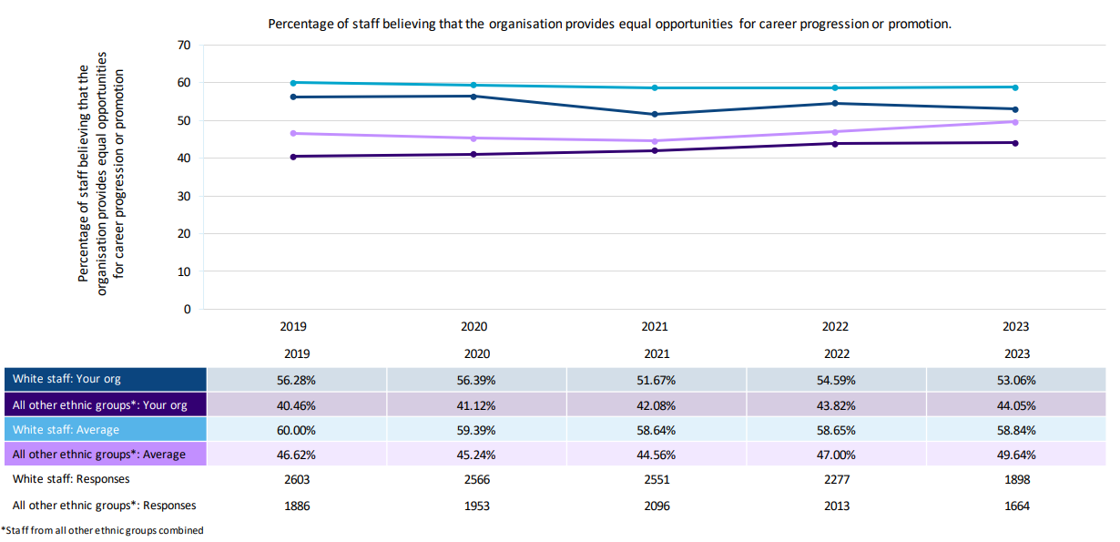
Workforce Race Equality Standard (WRES)
Indicator 7
% of staff believing that trust provides equal opportunities for career progression or promotion
% of staff believing that trust provides equal opportunities for career progression or promotion
44% of BME staff felt the organisation provides equal opportunities for career progression or promotion. This follows a continued upwards trend since 2018 (+6.1 percentage points).
This compares to 53% of white staff, which has reduced by 1.53 percentage points compared to last year.
The gap in perception between white and BME staff has reduced from 11 percentage points in 2022 to 9 percentage points in 2023.
Both white and BME staff at St George’s still feel less confident compared to staff nationally.
St George’s performed better than 26% of trusts and worse than 72% of trusts nationally.
White British and Asian staff report the highest in this indicator, 56% and 50% respectively.
Black staff reported than lowest satisfaction at 38%, this has improved compared to 34% last year and is the highest since reporting began in 2018.

Slide 15
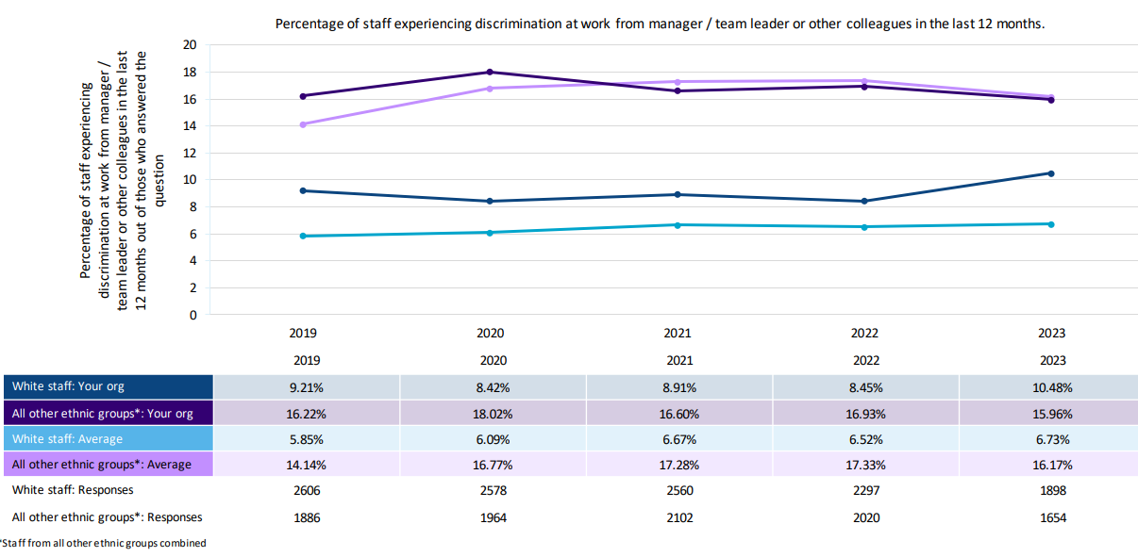
Workforce Race Equality Standard (WRES)
Indicator 8
% of staff that personally experienced discrimination at work from a manager or colleagues
% of staff that personally experienced discrimination at work from a manager or colleagues
In 2023, 15.9% of BME staff completing the staff survey indicated that they had experienced discrimination at work from a manager or colleague. This has reduced slightly, by 0.97 percentage points, since last year.
This is the lowest reported rate, for BME staff, since 2019.
For white staff, this has increased compared to last year, from 8.45% in 2022 to 10.48% in 2023.
Whilst BME staff continue to report experiencing higher rates of discrimination, compared to white colleagues, the gap in experience is at its lowest in five years. From a gap of 8.48 percentage points to 5.48 percentage points.
St George’s performed better than 40% of trusts and worse than 60% of trust nationally.

Slide 16
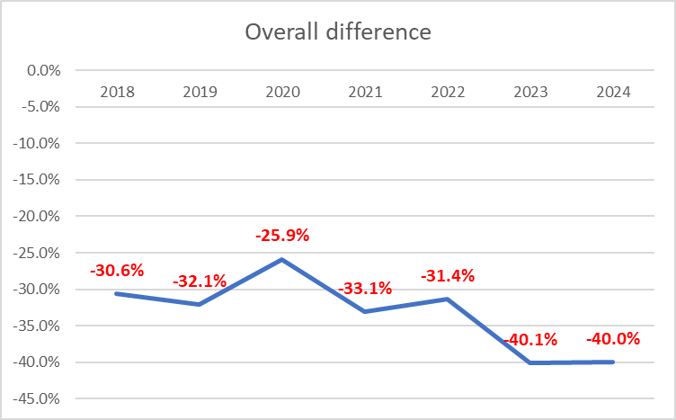
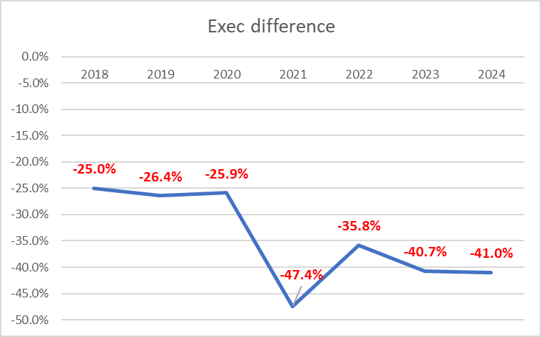
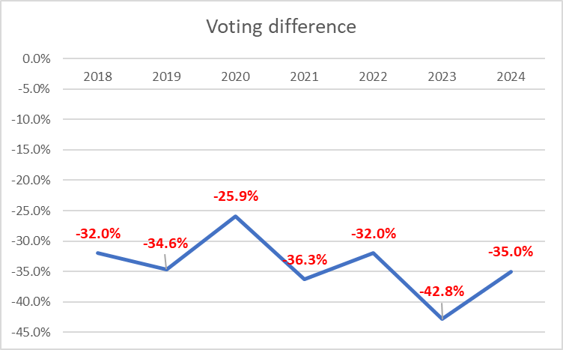
Workforce Race Equality Standard (WRES)
Indicator 9
% of board members by ethnicity compared to BME workforce
As of 31 March 2024, the Trust Board of Directors comprised 15 members, two of whom identify as Black, Asian and Minority Ethnic (one non-executive director, and one executive director). Of this, the Board comprised 11 voting members, seven of whom were non-executive directors and four were executive directors. Of these 11 voting members of the Board, two voting Board members identify as BME. This means BME staff are -35% under-represented at Board level.
On 12 October 2023, a longstanding Non-Executive Director at the Trust came to the end of their term of office, after seven years as a Non-Executive Director at the Trust. In the summer of 2023, the Trust ran an appointments process to identify a successor. Unfortunately, the panel were unable to make an appointment. A non-voting Associate Non-Executive Director who identified as BME was appointed to cover the voting NED role on an acting-up basis. Following a competitive external appointments process in the spring and summer, this individual was appointed substantively to the voting NED in October 2024.
Two further Board appointments will be made to the Board by December 2024, the Trust Chair and a Non-Executive Director, both voting positions on the Board. In discussion with the Council of Governors, it has been agreed that identifying a strong and diverse field of candidates is a key priority in these upcoming appointments processes. The roles are being advertised to ensure a diverse field and the search firms supporting the appointments have been asked by the Trust to actively seek applications from across the protected characteristics.
The Trust is committed to appointing to ensuring future appointments to all Board level roles (executive and non-executive) are appropriately targeted to ensure a diverse range of candidates.

Slide 17
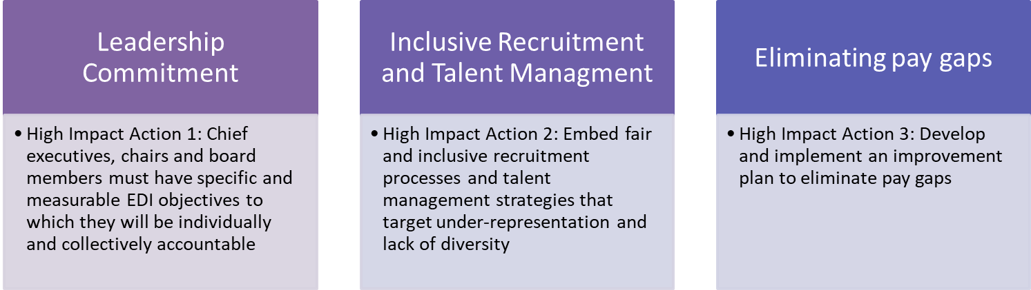
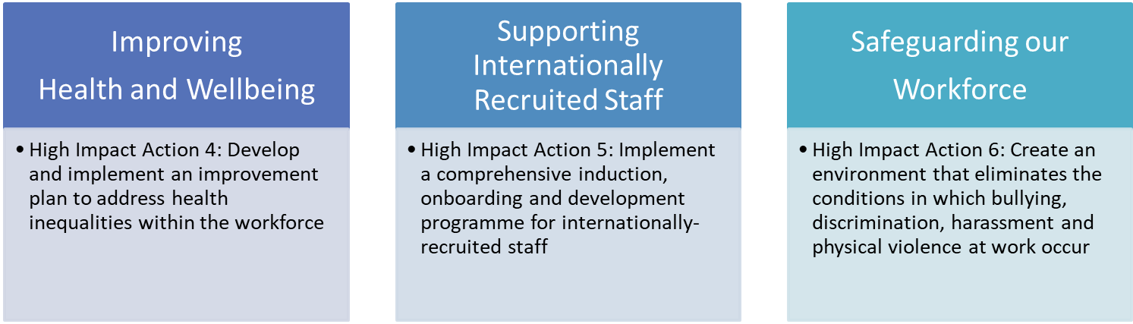

Workforce Race Equality Standard (WRES)
Next steps
Our existing Culture and Diversity and Inclusion Action Plans, which were introduced in late 2020, have driven a continued focus and commitment to improving the experience of those from marginalised groups, particularly those from Black, Asian and Minority Ethnic communities. Whilst many of the actions and projects set out in these action plans have now been successfully delivered, there are still a number to be implemented.
These open actions or live projects have been mapped across to NHSE’s EDI Improvement Plan (appendix b) and aligned to our People Strategy. This has identified six gesh EDI workstreams for 2024-26.
Following publication of our WRES and WDES Reports in late October 2024 we will commence a final review and Board approval of the specific actions which will enable us to deliver against our People Strategy and NHSE’s EDI Improvement Plan.
An overview of these action plans will be published shortly.
Improve staff learning opportunities and wellbeing
Embrace integrated ways of working

Slide 18
Workforce Race Equality Standard (WRES)
Appendix A: Definitions of ethnicity: people covered by the WRES
In line with Health Education England's WRES guidance and national WRES reporting metrics, the term ‘BME’ and ‘white’ are used to describe the two groups of staff referred to in this report.
The definitions of ‘black and minority ethnic’ and ‘white’ used in Health Education England's (HEE) WRES guidance 2024 have followed the national reporting requirements of ethnic category in the NHS data model and dictionary and are as used in NHS Digital data. At the time of publication these definitions were based upon the 2001 ONS Census categories for ethnicity. These are presented in Annex B.
‘White’ staff include white British, Irish, Eastern European and any other white i.e. categories 1–4 in the table in.
The ‘black and minority ethnic’ staff category includes all others except ‘unknown’ and ‘not stated.’
To aggregate data for BME staff, organisations should include categories 5-18 from current values and exclude ‘not stated’ and any ‘NULL’ values.
The treatment of staff from ethic categories [2 – white Irish] or [3 – Gypsy or Irish Traveler] or [4 – Any other white background] i.e. eastern European who may, in some organisations, be a significant minority group and experience considerable discrimination, is considered in the WRES FAQs document. Where this is the case, organisations should also explore such discrimination using workforce and staff survey data and take appropriate action.
Source: WRES Additional Information 2024 for NHS Trusts and Foundation Trusts (30/04/2024)
Ethnicity refers to: ONS definitions found here: Ethnic group, national identity and religion - Office for National Statistics (ons.gov.uk)
Ethnic Categories 2021
WHITE
1 – White –British / Welsh / Scottish / Northern Irish / British
2 – White –Irish
3 - Gypsy or Irish Traveller
4 – Any other white background please describe
MIXED / MULTIPLE ETHNIC GROUPS
5 – White and Black Caribbean
6 – White and Black African
7 – White and Asian
8 – Any other mixed / multiple ethnic background please describe
ASIAN / ASIAN BRITISH
9– Asian or Asian British –Indian
10 – Asian or Asian British –Pakistani
11 – Asian or Asian British – Bangladeshi
12 - Asian or Asian British – Chinese
13 – Any other Asian background please describe
BLACK / AFRICAN / CARIBBEAN / BLACK BRITISH
14 – Black or black British – African
15 – Black or black British – Caribbean
16 – Any other black background please describe
ANY OTHER ETHNIC GROUP
17 – Arab
18 – Any other ethnic group please describe

Slide 19
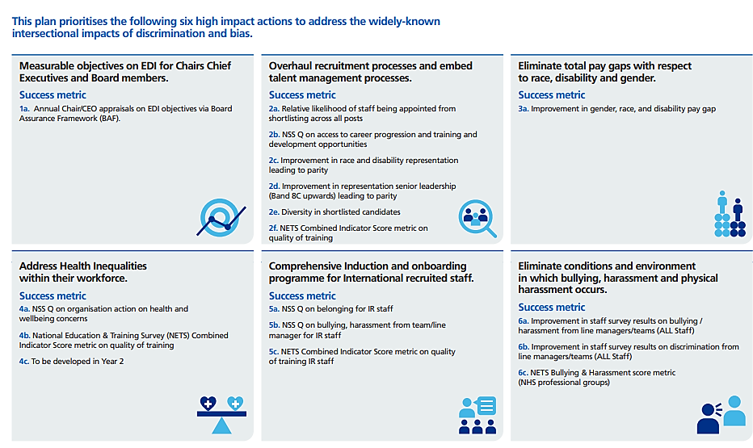
Workforce Race Equality Standard (WRES)
Appendix B: High impact action plan framework

