Slide 1



Workforce Disability Equality Standard (WDES)
2023/2024 Report
St George’s University Hospitals NHS Foundation Trust
Published: 28/10/2024

Slide 2

Workforce Disability Equality Standard (WDES)
Contents
Section | Item | Page
1 | Purpose and Terminology | 3
2 | Background and Metrics | 4
3 | Our Ambition | 5
4 | Executive Summary | 6
5 | Indicator Overview | 8
6 | Next Steps | 17
8 | Appendix A: Legal Obligations and Disability | 18

Slide 3
Workforce Disability Equality Standard (WDES)
Purpose and terminology
Purpose
This paper provides an overview of the 2024 Workforce Disability Equality Standard (WDES) findings.
This report will be published on the trust website.
The Board is asked to receive this report for information and approve for publication.
Terminology
For the purposes of this report and in line with national WDES metrics, the term ‘disabled staff’ and ‘non-disabled staff’ are used to describe the two groups of staff referred to in this report. St George’s and its staff encourages the use of ‘staff with a disability’ and ‘staff without a disability’ respectively as preferred terminology to foster better inclusion, reduce disability associated stigma and recognise the disability is not one’s identity but rather something people live with.
Overview of workforce numbers
 | 2021 | 2022 | 2023 | 2024
Total number of staff in organisation | 9,154 | 9,608 | 9,915 | 10,345
% of staff with a declared Disability on ESR | 2.3% | 2.9% | 3.5% | 3.7%
% of staff which indicated a disability via Staff Survey | 6.5% | 7.9% | 6.9% | 6.0%

Slide 4
Workforce Disability Equality Standard (WDES)
Background
Table A | Indicator Description
Metric 1 | % Disabled staff in AfC pay-bands (or medical and dental subgroups and VSMs) compared with the percentage of staff in the overall workforce (for both clinical and non-clinical groups)
Metric 2 | Relative likelihood of non-disabled staff compared to Disabled staff being appointed from shortlisting across all posts
Metric 3 | Relative likelihood of Disabled staff compared to non-disabled staff entering the formal capability process, as measured by entry into the formal capability procedure
Metric 4 | Staff Survey Q13: % Disabled staff compared to non-disabled staff: a) experiencing harassment, bullying or abuse from different groups b) saying that the last time they experienced harassment, bullying or abuse at work, they or a colleague reported it
Metric 5 | Staff Survey Q14: % Disabled staff compared to non-disabled staff believing that the Trust provides equal opportunities for career progression or promotion
Metric 6 | Staff Survey Q11: % Disabled staff compared to non-disabled staff saying that they have felt pressure from their manager to come to work, despite not feeling well enough to perform their duties
Metric 7 | Staff Survey Q5: % Disabled staff compared to non-disabled staff saying that they are satisfied with the extent to which their organisation values their work
Metric 8 | Staff Survey Q28b: % Disabled staff saying that their employer has made adequate adjustment(s) to enable them to carry out their work
Metric 9 | a) The staff engagement score for Disabled staff, compared to non-disabled staff b) Has your Trust taken action to facilitate the voices of Disabled staff in your organisation to be heard?
Metric 10 | % difference between the organisation’s Board voting membership and its organisation’s overall workforce
The WDES was introduced in 2019 and is designed to improve the experiences of people with a disability working in or seeking employment within the NHS. This mandated collection of evidence-based metrics helps an organisation understand more about the experiences of its staff. The 10 metrics on which we report against each year are included in the table opposite.
The WDES report compares data between staff that have a disability and staff that do not have a disability in order to identify disparities and barriers in the workplace. These findings inform the organisation’s D&I Action Plan, which aims to directly address inequalities faced by staff with protected characteristics.
We are pleased that the NHS, our parent organisation, is currently the only UK employer that mandates its member organisations to report annually on its representation and inclusion of staff with disabilities. However, our ambition is to go far beyond what is mandated, and to become a truly great employer of people with disabilities, and an exemplar for other NHS trusts.

Slide 5
Workforce Disability Equality Standard (WDES)
Our ambition
Serving a diverse population of 1.3 million and with over 10,000 employees, St George’s is the largest healthcare provider in south west London. It is crucial that the diversity of our workforce reflects the diversity of the communities we serve, and we are proud that in 2024 the number of Electronic Staff Record (ESR) declarations for people with a disability has increased. We will continue to reinforce the importance of declaring one’s disability on ESR to ensure adequate representation, resource allocation and support and importantly, reduce stigma by building inclusion.
St George’s is committed to building a workforce in which each employee can enjoy a strong sense of belonging and where diversity, difference and uniqueness are truly valued. As well as being well-represented across all levels, we must ensure that people from marginalised groups, including people with a disability, are actively and always included, and that this inclusion is felt authentically at a personal level. Lip-service will not suffice.
Achieving strong diversity and inclusion of people with a disability at St George’s will offer significant benefits for our organisation:
Delivery of better patient care, because:
  Staff who feel included, engaged, and supported have greater personal resources and resilience to offer thorough and compassionate care
  Staff who are differently abled may offer enhanced empathy and support to patients due to their lived-experience of disability
  Patients with disabilities may be more able to identify with and relate to our staff with a disability
Stronger team performance by maximising our blend of skills, talents, knowledge, and professional experience
Stronger individual performance by enabling staff with a disability to use their disability at work as advantage instead of a disadvantage
Improved retention of our staff, especially our staff with a disability (including staff who may later become affected by a disability)
A reduction in bullying, harassment, discrimination and other forms of exclusion by building greater understanding, appreciation and respect for people with disabilities
Supporting our organisational journey towards adopting a more compassionate and inclusive culture.
”Our ambition is to create an organisation - and a reinforcing culture - that not only offers equality and a positive experience for all our colleagues with a disability, but one that actively nurtures and celebrates our physical and mental differences in ability. We strive for this in the certainty that our rich diversity and a universal sense of belonging will be integral to our success as a healthcare organisation”

Slide 6
Workforce Disability Equality Standard (WDES)
Executive summary
All NHS providers are required to complete an annual Workforce Disability Equality Standard (WDES) report. The report is based on a snapshot of data from 31st March each year and aims to highlight progress against a number of key indicators of workforce equality. Data for WDES indicators 4 to 9a are drawn from questions in the most recent NHS staff survey. In line with national requirements this report and associated action plan should be reviewed internally and approved at Board before being published on the organisation’s website. The deadline for publication is 31st October 2024. The key findings are outlined below, the full findings are available in appendix B (awaiting document from NHSE). Unless indicated, each point is compared to the previous reporting period:
Workforce numbers and declaration
At St George’s 3.7% of the workforce have shared they have a disability on ESR, the Staff Survey indicates figure is closer to 6% of the workforce.
Of the national working population, 10% have a disability, for Wandsworth, our local community, this is 11%.
There is an 0.2 percentage point increase in the number of staff that have declared a disability. Overall, this group makes up 3.7% of the workforce – this is 4.8% for non-clinical staff groups and 3.7% for clinical staff groups.
There is a higher number of staff with a disability in lower bands (non-clinical).
There is a reduction in the number of staff with a disability status recorded as ‘unknown’, from 754 in 2022 to 650 in 2023 and 626 in 2024.
Staff with a declared disability within the medical workforce remains very low, particularly the consultant grade (currently 0.94% reduced from 1.63% in 2023).
Whilst staff with a disability are under-represented at Executive and Board level within non-voting, they are positively represented in voting and Non-Executive Director groups.
Recruitment
Applicants without a disability are 1.26 times more likely to be appointed compared to applicants with a disability, this has increased from 1.15 in 2023.
This is likelihood of appointment from shortlisting of 0.16 for those with a disability, compared to 0.21 for those that did not indicate they had a disability.

Slide 7
Workforce Disability Equality Standard (WDES)
Executive Summary cont.
Harassment, Bullying and Abuse
There has been a reduction in the percentage of staff experiencing harassment, bullying and abuse from patients/service users and from colleagues but that trend does not follow for managers.
21.1% of staff with a disability reported HBA from managers. This is 5.8% above the national average(15.3%).
Beliefs about equal opportunities, career progression and promotion
Fewer staff with a disability believe the trust provides equal opportunities with regards to career progression and promotion – with percentage reducing from 44.7% in 2023 to 41.5% in 2024.
The gap in perceptions between the groups has widened – from 6% in 2023 to 8.5% in 2024.
Capability
Staff with a disability are 4.08 times more likely to enter the capability process compared to staff that do not have a disability. This high likelihood is due to the relatively low numbers of staff with a declared disability.
As a percentage of each group 0.26% of the workforce with a disability have entered the process, reducing from 0.57% last year, compared to 0.06% of the workforce that do not have a declared disability.
Feeling pressure to go to work when unwell (presenteeism)
There has been a reduction in the number of staff with a disability who reported feeling pressure to come into work despite not feeling able to carry out their duties – from 32% in 2023 to 29% in 2024.
Whilst this was also reported in previous years, this year the gap between staff with a disability and staff without a disability is at its lowest at 5.3% - a 4.3% drop from 2023 where it was 9.6%.
Staff without a disability report feeling slightly more pressured compared to previous years.
Feeling that work is undervalued
Whilst both groups report an improvement in rates of feeling valued by the organisation, staff with a disability are still much less likely to feel that their work is valued.
31.3% of staff with a disability who responded to the Staff Survey said they felt the organisations valued their work - compared to 43.6% of staff without a disability. The gap between the two groups has worsened in the past year – currently at 12.3% (increased from 10.6% in 2023).
Adjustments in the workplace
Only 68.9% of staff with a disability felt that reasonable adjustments had been made to enable them to carry out their work. This improved by 7.2% points compared to last year.
Last year, St George’s was 10.7% behind the national average figure in this indicator. Progress in this area has reduced the gap to just 4.4% in the last 12 months.

Slide 8
Workforce Disability Equality Standard (WDES)
Indicator overview – St George’s
Metric | Description | Staff with a disability |  |  |  |  | Staff without a disability
 |  | 2021 | 2022 | 2023 | 2024 | 23 vs. 24 | 2021 | 2022 | 2023 | 2024 | 23 vs. 24
1 | % Disabled staff in AfC pay-bands (or medical and dental subgroups and VSMs) compared with the percentage of staff in the overall workforce (for both clinical and non-clinical groups) | 2.3% | 2.9% | 3.5% | 3.7% | Improved | 90% | 89% | 90% | 90% | N/A
2 | Relative likelihood of non-disabled staff compared to Disabled staff being appointed from shortlisting across all posts | 1.08 | 1.21 | 1.15 | 1.26 | Declined
3 | Relative likelihood of Disabled staff compared to non-disabled staff entering the formal capability process, as measured by entry into the formal capability procedure | 0 | 4.78 | 4.26 | 4.08 | Improved
4a. | Staff Survey Q14: % of staff experiencing harassment, bullying or abuse from patients/ service users | 35.8% | 34.8% | 37.1% | 35.1% | Improved | 28.4% | 25.3% | 27.5% | 25.8% | Improved
4b. | Staff Survey Q14: % of staff experiencing harassment, bullying or abuse from managers | 23.5% | 21.1% | 20.1% | 21.1% | Declined | 13.1% | 10.0% | 11.7% | 12.6% | Declined
4c. | Staff Survey Q14: % of staff experiencing harassment, bullying or abuse from other colleagues | 34.4% | 31.6% | 32.1% | 29.3% | Improved | 20.9% | 17.8% | 19.9% | 19.5% | Static
4.d | Staff Survey Q14: % of staff saying that the last time they experienced harassment, bullying or abuse at work, they or a colleague reported it | 49.2% | 47.9% | 44.3% | 50.7% | Improved | 47.7% | 46.2% | 45.7% | 51.1% | Improved
5 | Staff Survey Q15: % of staff believing that the Trust provides equal opportunities for career progression or promotion | 42.7% | 40.1% | 44.1% | 41.5% | Declined | 50.1% | 48.4% | 50.4% | 50.0% | Static
6 | Staff Survey Q11: % of staff saying that they have felt pressure from their manager to come to work, despite not feeling well enough to perform their duties | 35.1% | 35.2% | 32.0% | 29.0% | Improved | 25.8% | 23.8% | 22.4% | 23.7% | Declined
7 | Staff Survey Q4: % of staff saying that they are satisfied with the extent to which their organisation values their work | 34.9% | 31.0% | 29.9% | 31.3% | Improved | 49.1% | 42.2% | 40.5% | 43.6% | Improved
8 | Staff Survey Q28b: % of staff saying that their employer has made reasonable adjustment(s) to enable them to carry out their work | 71.5% | 63.0% | 61.7% | 68.9% | Improved
9 | The staff engagement score for Disabled staff, compared to non-disabled staff | 6.6 | 6.2 | 6.3 | 6.3 | Static | 7.1 | 6.9 | 6.9 | 6.9 | Static
10 | % difference between the organisation’s Board voting membership and its organisation’s overall workforce with a declared disability | -2.0% | -3.0% | 5.6% | 14.0% | Improved

Slide 9
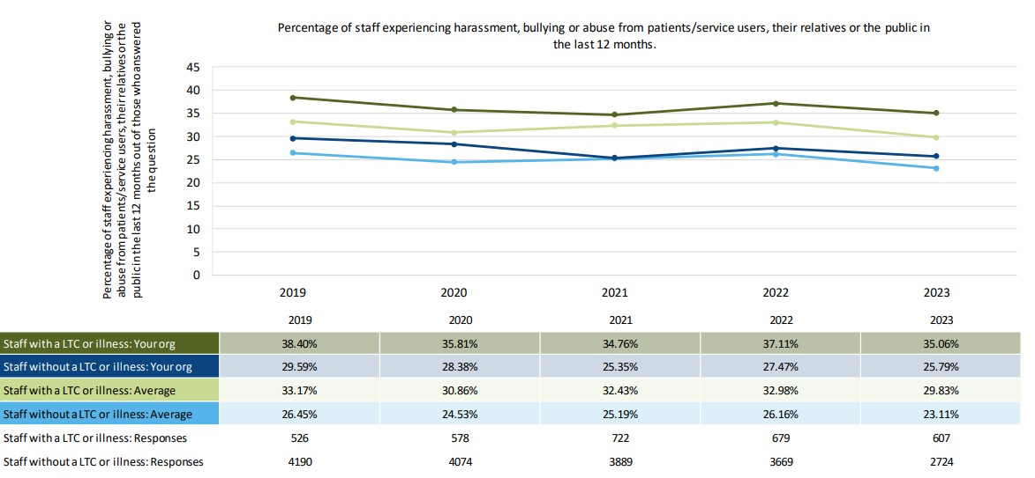
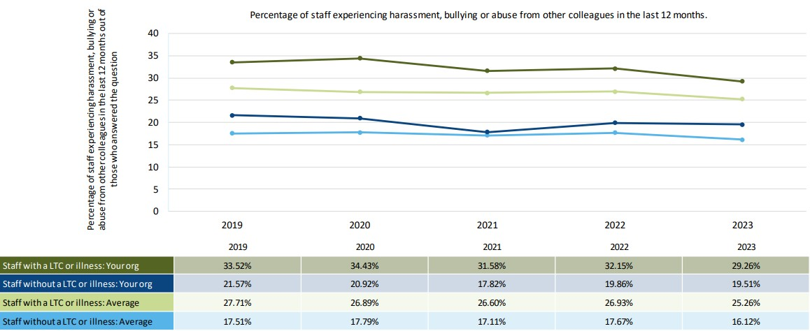
Workforce Disability Equality Standard (WDES)
Indicator 4a and 4b
HBA from patients/service users (4a) is down 2.05 % points on the previous year and significantly higher than colleagues without a disability (+9.27%). Both reported rates at STG are higher than the national average.
HBA from colleagues (4c) is down 2.8% points at 29.26% however this is still significantly higher than reported rates from staff without a disability (19.51%). Both reported rates at STG are higher than the national average.
Notes:
White Nurses and Midwives and HCA (report the highest rates

Slide 10
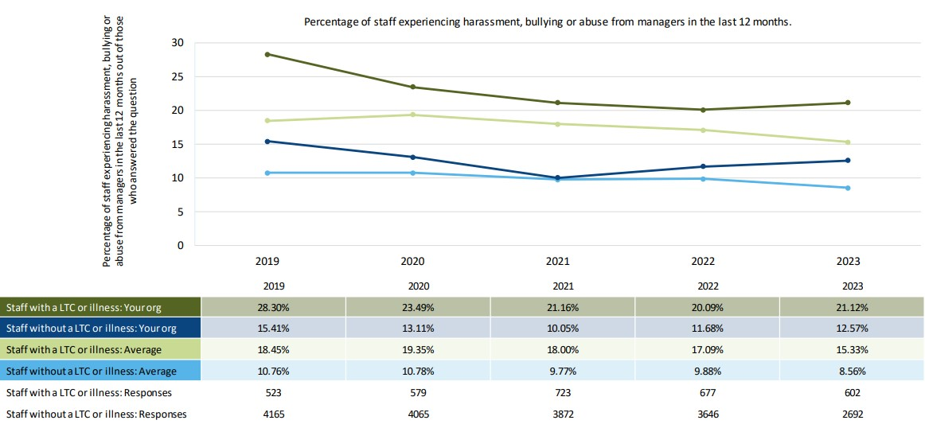
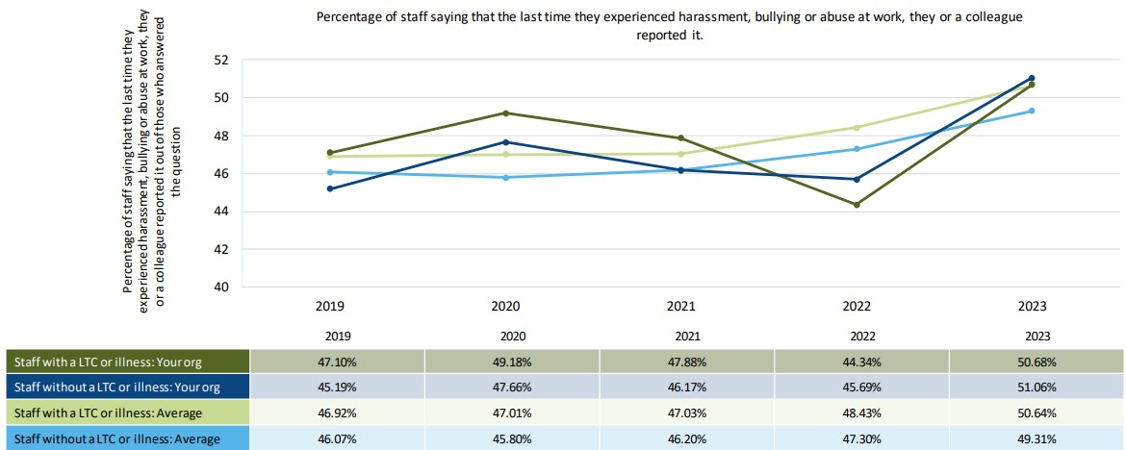
Workforce Disability Equality Standard (WDES)
Indicator 4c and 4d
HBA from managers (4b) is up 1.3% points, and remains significantly higher than colleagues without a disability. Both reported rates at STG are higher than the national average.
Reporting HBA has increased by 6.4% points compared to 2023. Both staff with a disability and those without reports similar rates (50.7% and 51.1% respectively).
Notes:
White Nurses and Midwives and HCA (report the highest rates

Slide 11
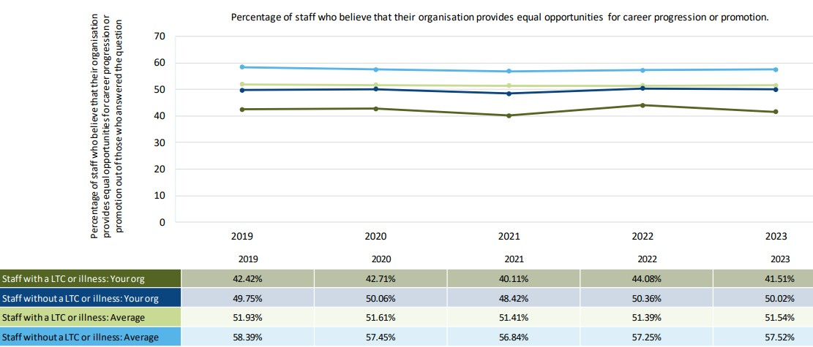
Workforce Disability Equality Standard (WDES)
Indicator 5
Staff Survey Q15: % of staff believing that the Trust provides equal opportunities for career progression or promotion
Staff Survey Q15: % of staff believing that the Trust provides equal opportunities for career progression or promotion
Beliefs about equal opportunities, career progression and promotion
Fewer staff with a disability believe the trust provides equal opportunities with regards to career progression and promotion – with percentage reducing from 44.7% in 2023 to 41.5% in 2024.
The gap in perceptions between the groups has widened – from 6% in 2023 to 8.5% in 2024.
Notes:
White Nurses and Midwives and HCA (report the highest rates

Slide 12
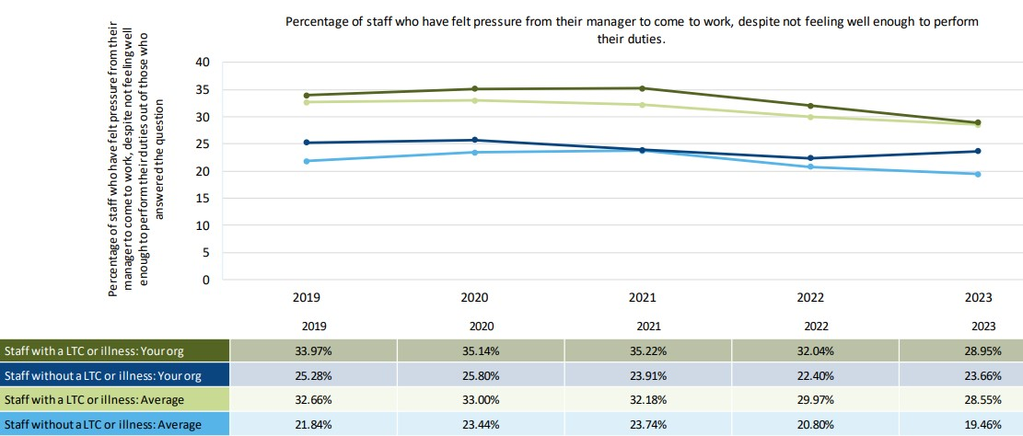
Workforce Disability Equality Standard (WDES)
Indicator 6
Staff Survey Q11: % of staff saying that they have felt pressure from their manager to come to work, despite not feeling well enough to perform their duties
Feeling pressure to go to work when unwell (presenteeism)
There has been a reduction in the number of staff with a disability who reported feeling pressure to come into work despite not feeling able to carry out their duties -3% compared to last year.
Whilst this was also reported in previous years, this year the gap between staff with a disability and staff without a disability is at its lowest at 5.3% - a 4.3% drop from 2023 where it was 9.6%.
Staff without a disability report feeling slightly more pressured compared to previous years
Staff Survey Q11: % of staff saying that they have felt pressure from their manager to come to work, despite not feeling well enough to perform their duties
Notes:
White Nurses and Midwives and HCA (report the highest rates

Slide 13
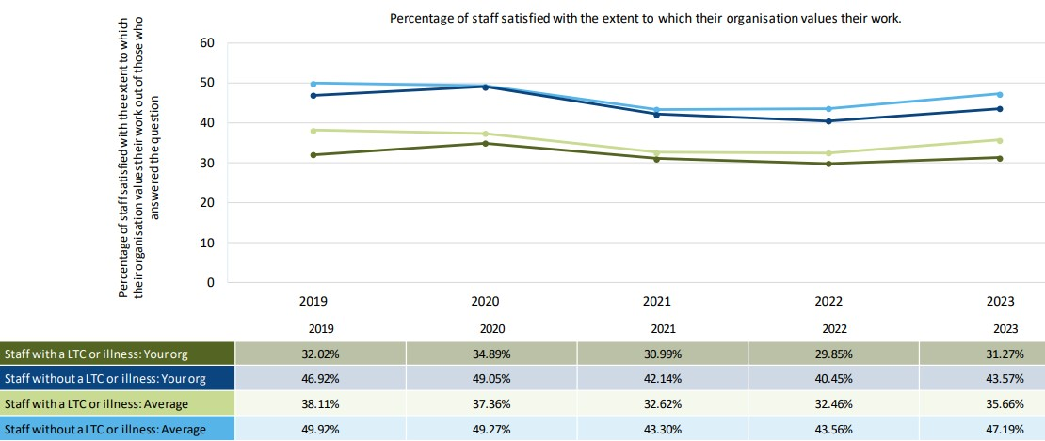
Workforce Disability Equality Standard (WDES)
Indicator 7
Staff Survey Q4: % of staff saying that they are satisfied with the extent to which their organisation values their work
Feeling that work is undervalued
Whilst both groups report an improvement in rates of feeling valued by the organisation, staff with a disability are still much less likely to feel that their work is valued.
31.3% of staff with a disability who responded to the Staff Survey said they felt the organisations valued their work - compared to 43.6% of staff without a disability. The gap between the two groups has worsened in the past year – currently at 12.3% (increased from 10.6% in 2023).
Staff Survey Q4: % of staff saying that they are satisfied with the extent to which their organisation values their work
Notes:
White Nurses and Midwives and HCA (report the highest rates

Slide 14
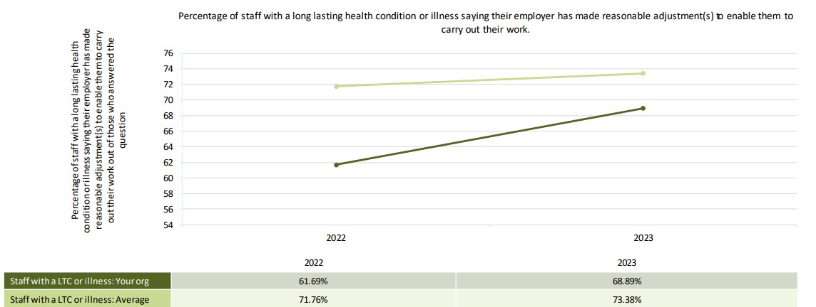
Workforce Disability Equality Standard (WDES)
Indicator 8
Staff Survey Q28b: % of staff saying that their employer has made reasonable adjustment(s) to enable them to carry out their work
Staff Survey Q28b: % of staff saying that their employer has made reasonable adjustment(s) to enable them to carry out their work
Adjustments in the workplace
Only 68.9% of staff with a disability felt that reasonable adjustments had been made to enable them to carry out their work. This improved by 7.2 percentage points compared to last year.
This is lower than the national average of 73%.
Last year, St George’s was 10.7% behind the national average figure in this indicator. Progress in this area has reduced the gap to just 4.4% in the last 12 months.
Notes:
White Nurses and Midwives and HCA (report the highest rates

Slide 15
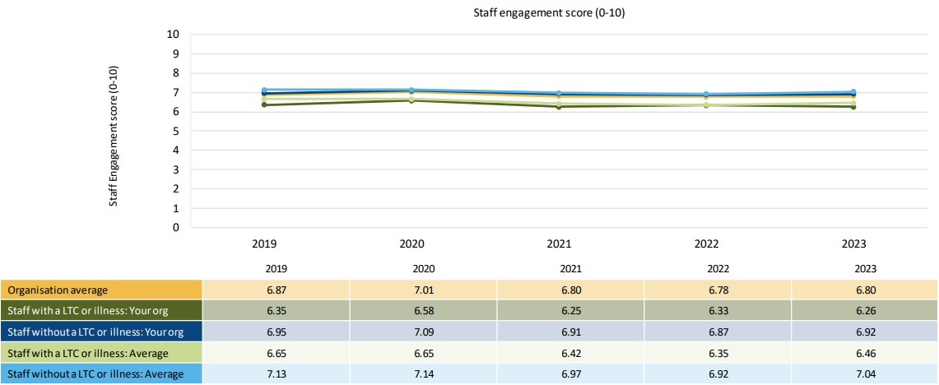
Workforce Disability Equality Standard (WDES)
Indicator 9
Staff Survey: The staff engagement score for Disabled staff, compared to non-disabled staff
Engagement
The overall indicator trend for engagement is stable. The overall is 6.80, compared to 6.26 for those with a disability and 6.92 for those without a disability.
The national average is slightly higher for those with a disability at 6.46, compared to 6.26 at St George’s.
The staff engagement score is made up of three broad measures, outlined in more detail below:
  motivation (related to individual job)
  involvement (at ward and wider level)
  advocacy (willingness to recommend the organisation as a place to work and to be treated).
Staff Survey: The staff engagement score for Disabled staff, compared to non-disabled staff
Notes:
White Nurses and Midwives and HCA (report the highest rates

Slide 16
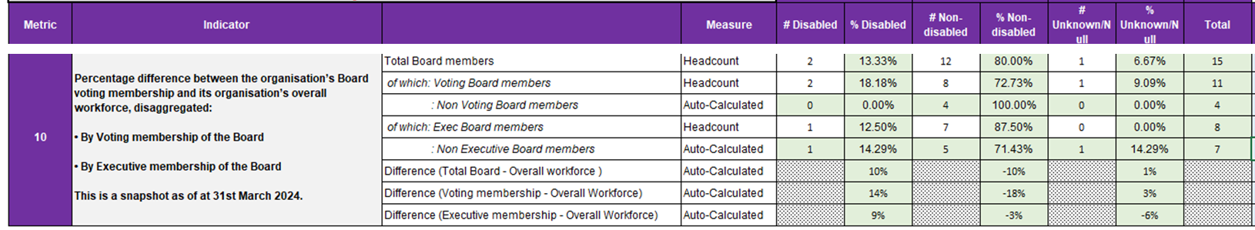
Workforce Disability Equality Standard (WDES)
Indicator 10
% difference between the organisation’s Board voting membership and its organisation’s overall workforce
As of 31 March 2024, the Trust Board of Directors comprised 15 members, two of whom have declared a Disability (one executive director and one non-executive director).
Of this, the Board comprised 11 voting members, seven of whom were non-executive directors and 4 were executive directors. Of these 11 voting members of the Board, two voting Board members have a declared disability. This means staff with are positively represented at all level, including Board overall (+13.33%) and Board voting (+18.8%).
Two further Board appointments will be made to the Board by December 2024, the Trust Chair and a Non-Executive Director, both voting positions on the Board. In discussion with the Council of Governors, it has been agreed that identifying a strong and diverse field of candidates is a key priority in these upcoming appointments processes. The roles are being advertised to ensure a diverse field and the search firms supporting the appointments have been asked by the Trust to actively seek applications from across the protected characteristics.
The trust is committed to appointing to ensuring future appointments to all Board level roles (executive and non-executive) are appropriately targeted to ensure a diverse range of candidates.

Slide 17
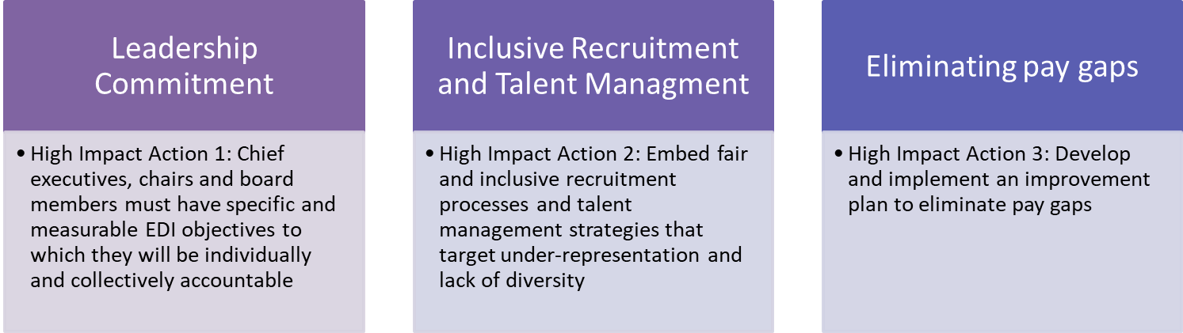
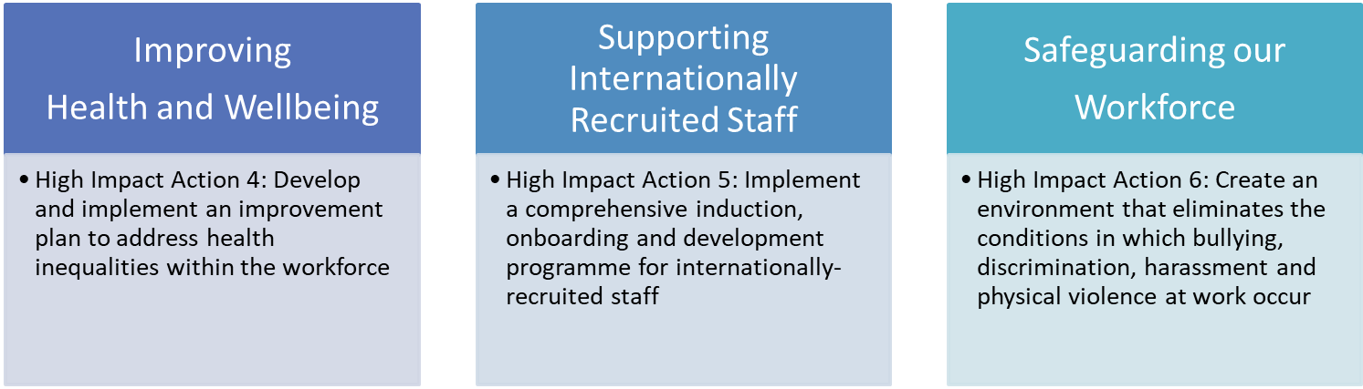
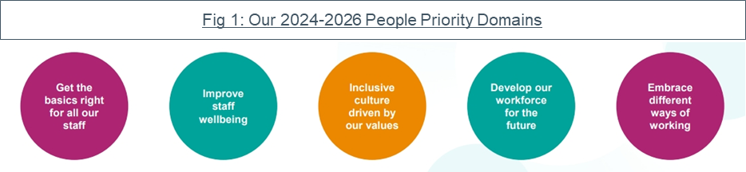
Workforce Disability Equality Standard (WDES)
Next Steps
Our existing Culture and D&I Action Plans, which were introduced in late 2020, have driven a continued focus and commitment to improving the experience of those from marginalised groups, particularly those from Black, Asian and Minority Ethnic communities. Whilst many of the actions and projects set out in these action plans have now been successfully delivered, there are still a number to be implemented.
These open actions or live projects have been mapped across to NHSE’s EDI Improvement Plan (appendix b) and aligned to our People Strategy. This has identified six gesh EDI workstreams for 2024-26.
Following publication of our WRES and WDES Reports in late October 2024 we will commence a final review and Board approval of the specific actions which will enable us to deliver against our People Strategy and NHSE’s EDI Improvement Plan.
An overview of these action plans will be published shortly.
Improve staff learning opportunities and wellbeing
Embrace integrated ways of working

Slide 18
Workforce Disability Equality Standard (WDES)
Appendix A: Legal Obligations and Disability
Legal Obligations of Employers and Workplace Adjustments (formerly Reasonable Adjustments)
Protection against disability-based discrimination is enshrined in the Equality Act 2010. Due to the additional barriers faced by people with a disability, it is permitted to treat applicants with a disability more favourably than their colleagues without a disability. Understanding this, and the reasons for it, is crucial to removing the barriers that continue to deny people with a disability equality of outcome in work and more broadly.
The Equality Act 2010 protects employees, and covers areas including recruitment, assessment and selection, terms of employment, promotion and training opportunities, dismissal or redundancy, and discipline and grievances. The Equality Act 2010 also requires that reasonable adjustments (now ‘workplace adjustments’ are made to working conditions, policies and practices that put a staff member with a disability at a disadvantage. A workplace adjustment could include any of the following:
making adjustments to premises or acquiring/modifying equipment
providing a reader or interpreter, or employing a support worker
reallocating an employee with a disability’s duties to another person
providing supervision, training, mentoring or other support
transferring a person to fill an existing suitable vacancy without competitive interview
altering working hours or the place of work
allowing someone to be absent during working hours for rehabilitation, assessment or treatment
modifying procedures for testing or assessment
Useful checklists and further detail on the legal obligations can be found in the Guidance relating to disability for the NHS document, published by NHS Employers. This guidance document also sets out examples of good practice (when not legally obligated), particularly around the supporting carers and disability related absence from work.
What is ‘disability’?
Defining ‘disability’ is not always straightforward. The Equality Act 2010 defines a person with a disability as:
“someone who has a mental or physical impairment that has a substantial and long-term adverse effect on the person’s ability to carry out normal day-to-day activities.”
Some of the terms in this definition are open to interpretation, and further guidance is found in Appendix C. However, instead of trying to judge whether a person falls within the statutory definition of disability, we should focus on meeting the needs of the worker (or job applicant). In supporting a staff with a disability, it is almost always more important to understand and support the effects of a disability rather than the cause.
It is important to note that the definition of disability regards the person as they are without aids, support or medication (the exception being visual impairment where it can be addressed by use of wearing prescription spectacles). This is particularly relevant for those with mental health conditions who are able to control their condition with medication, and also for those with conditions such as epilepsy and diabetes that are otherwise controlled by medication.
Additional information on the definition of disability is attached in Appendix C, taken directly from guidance produced and published by NHS Employers. This guidance was published in 2014. We will continue to closely monitor best practice and guidance and communicates updates as necessary.

