Slide 1
If you’ve never been a member and join today, you’ll get your first year of membership free
Visit our stand and join today!

Slide 2
The BMA: Supporting you at work
We are the trade union and professional association for doctors in the UK

Slide 3
Supporting IMGs
The BMA can help you as an IMG | Join the BMA

Slide 4
Career development

Slide 5
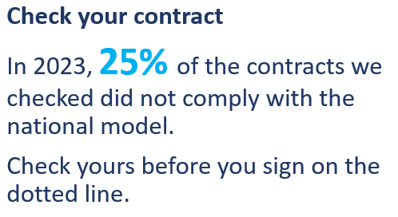
Get the support you need
UK residency and your visa
Ethics guidance
Contract checking
Workplace difficulties
BMA.org.uk/contactus
0300 123 1233
support@bma.org.uk

Slide 6
Develop your learning potential
BMA webinars
Live and recorded sessions, delivered by experts:
– How to achieve better work life balance
– Dealing with conflict
– Interview skills for ST1
High quality, evidence-based modules:
– Managing difficult conversations and difficult people
– Leadership – Time management
+ free copy of The BMJ
bma.org.uk/learning

Slide 7
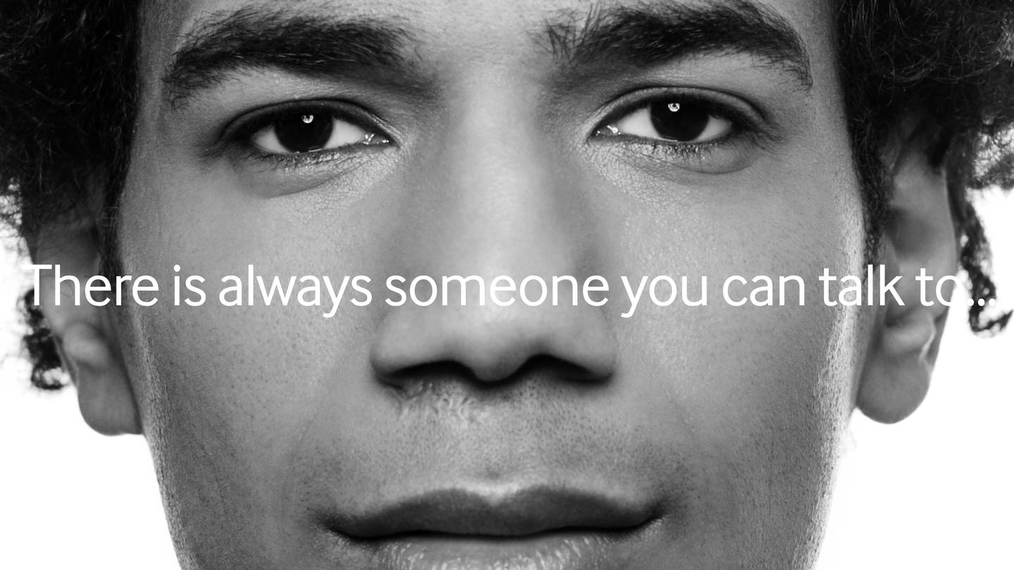
Protect your wellbeing
There is always someone to talk to
Our confidential counselling and peer support services are open 24/7 and free of charge to all doctors and medical students.
0330 123 1245
bma.org.uk/yourwellbeing

Slide 8
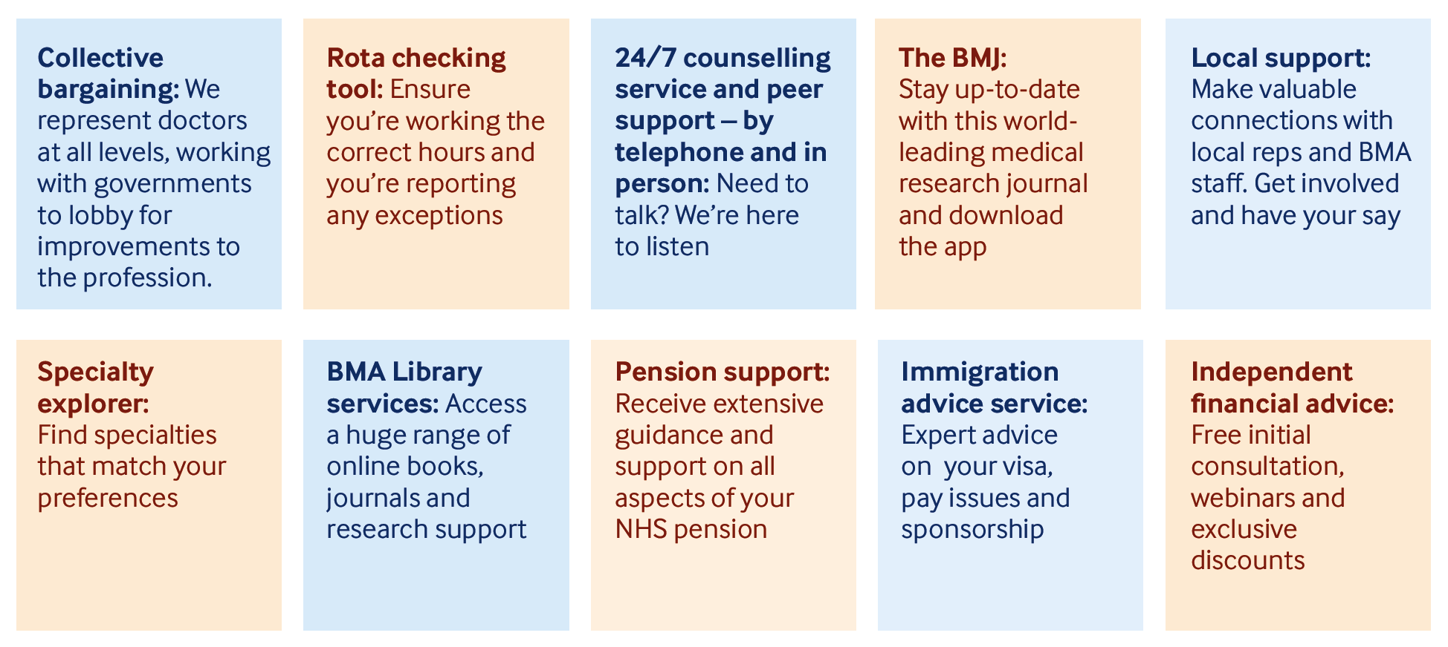
Other key member benefits

Slide 9
Campaign for pay restoration
Striking as an IMG - BMA guidance

Slide 10
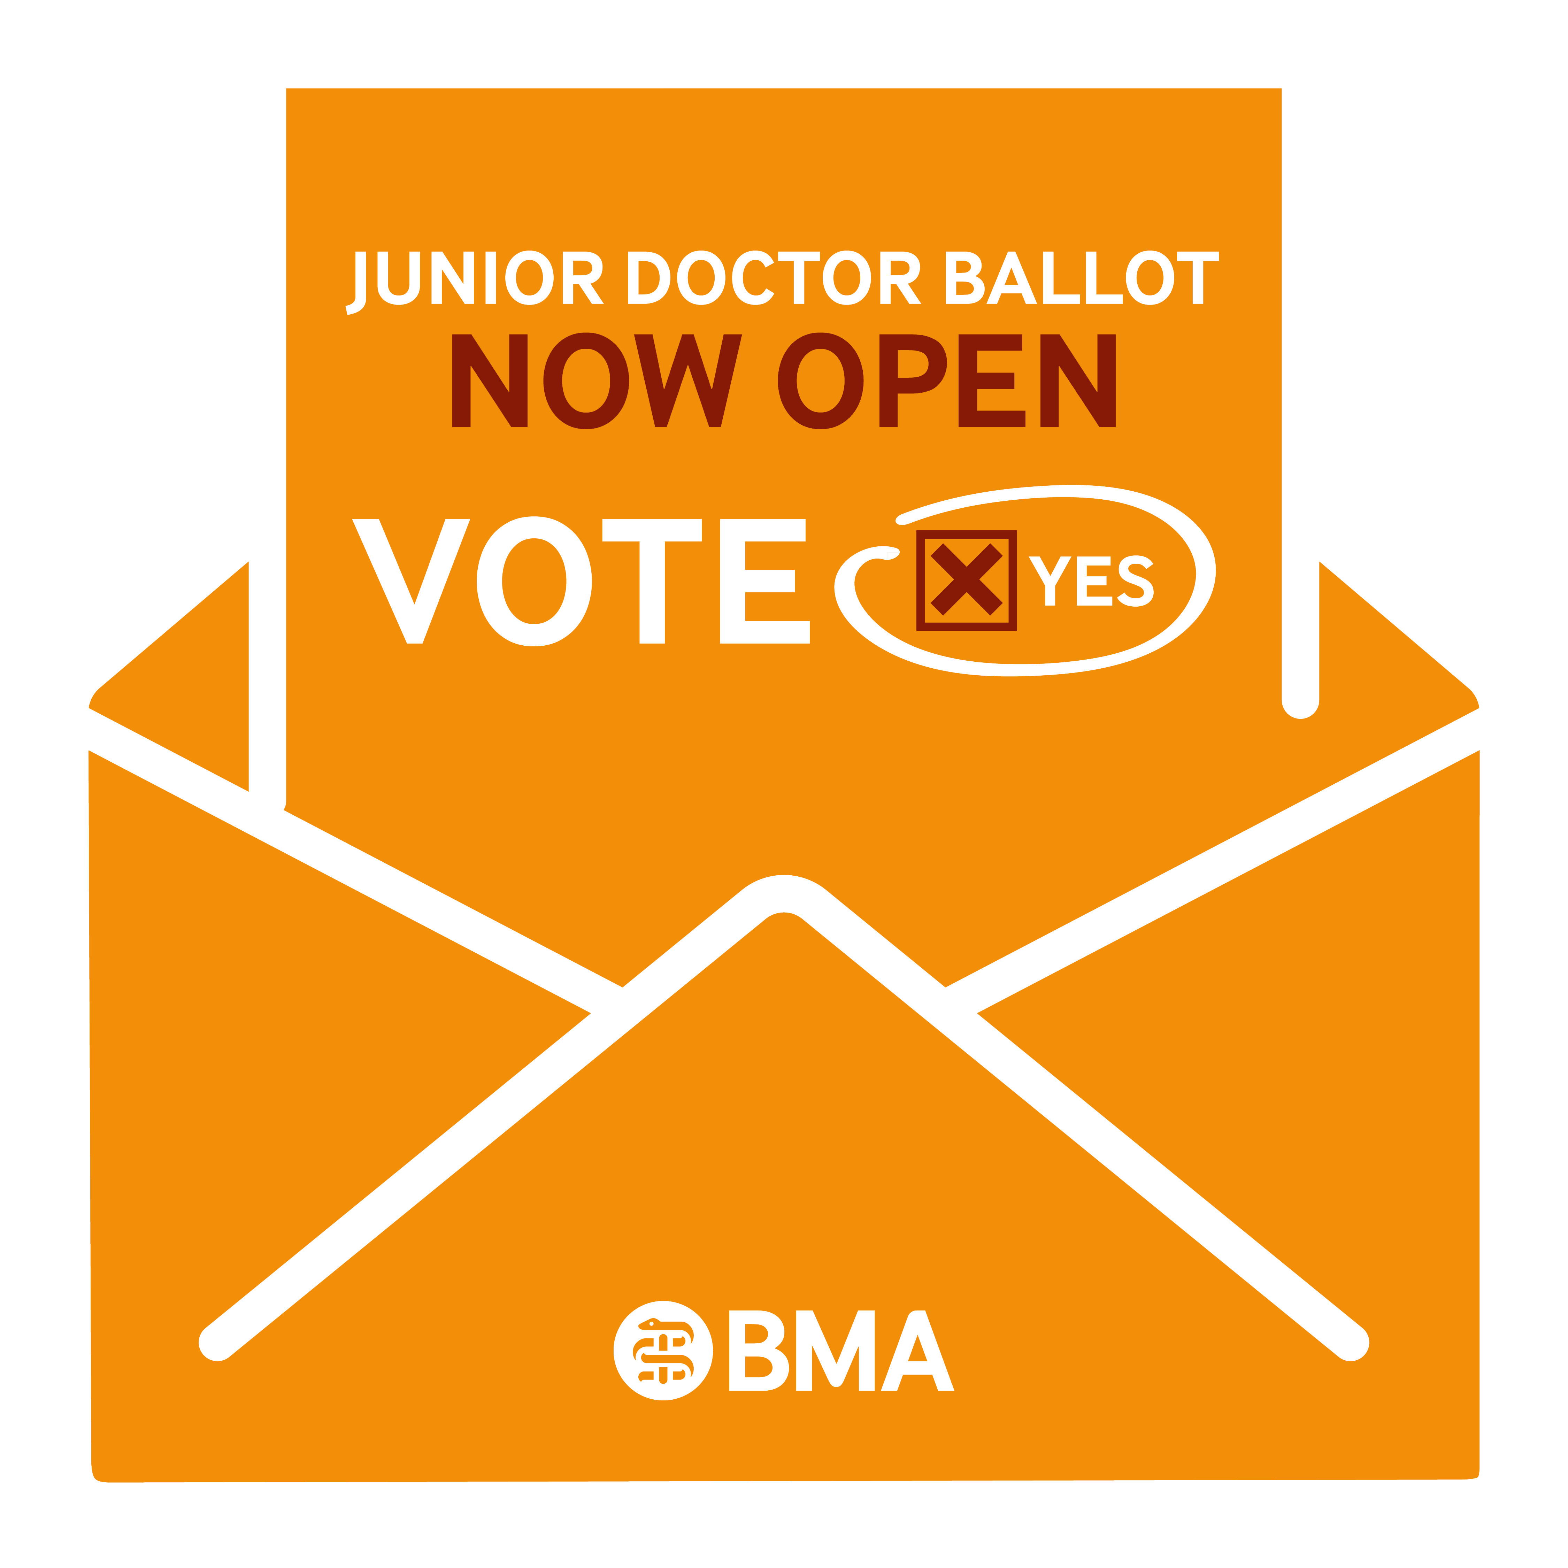
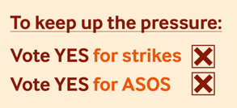
#PayRestoration for junior doctors in England
Join NOW
Ballot closes 20 March
Return your postal ballot by 15 March

Slide 11
If you’ve never been a member and join today, you’ll get your first year of membership free

