Slide 1


MANAGING ON CALLS, REFERRALS, ESCALATION AND HOSPITAL AT NIGHT
Dr Trisha Sengupta
Junior Clinical Fellow

Slide 2
Timings and Nomenclature
Depending on which department timings may be different
  Medicine On calls usually 13 hour shifts-
NIGHT 9pm to 10 am
DAY 8.30am to 9 pm
ED: variable(12 to 8 or 1 to 9 or 2 to10)
  On Team: Consultant , SpR (Registrar- ST3/ Senior Clinical Fellow), SHO(Senior House Officer/Clinical Fellow/ Trust Grade/IMT1/2/FY2/FY3) and F1( foundation year 1)

Slide 3




Tips for a successful On Call
Objective 02
Objective 01
Team Work and making sure your team is okay
Delegating and asking for help
Objective 03
Empathy and Responsibility

Slide 4
Before On Calls
  Have a good day/night of rest
  Try to arrive 5-10 mins before your shift starts so you have time to change and get acquainted
  print out the handover
  carry food and water--M&S Foods, Pret etc all close at 6.30pm
  Identify roles , priorities and names of your team--usually Whatsapp group to join--or at least make a note of the bleeps and contact numbers

Slide 5
HANDOVER
  Collect your bleep from your previous colleague who will be handing over to you--red bleeps are cardiac arrest bleeps--and the cardiac arrest team has a huddle after the handover at 9.30pm/9.15 am morning
  Handover usually SpR to SpR ; and for ward cover in Medicine will be ward cover to ward cover SHO
  Consists of outstanding jobs from the list, reviewing sick patients, following up on urgent bloods/imaging
  If you are carrying a arrest bleep-to attend a cardiac arrest call promptly

Slide 6
Structured Handover Model /Approach-SBAR
SBAR can be used very effectively to escalate a clinical problem that requires immediate attention, or to facilitate efficient handover of patients between clinicians or clinical teams.
SBAR stands for:
Situation
Background
Assessment
Recommendation
These are the key building blocks for communicating critical information that requires attention and action – thus contributing to effective escalation and increased patient safety

Slide 7
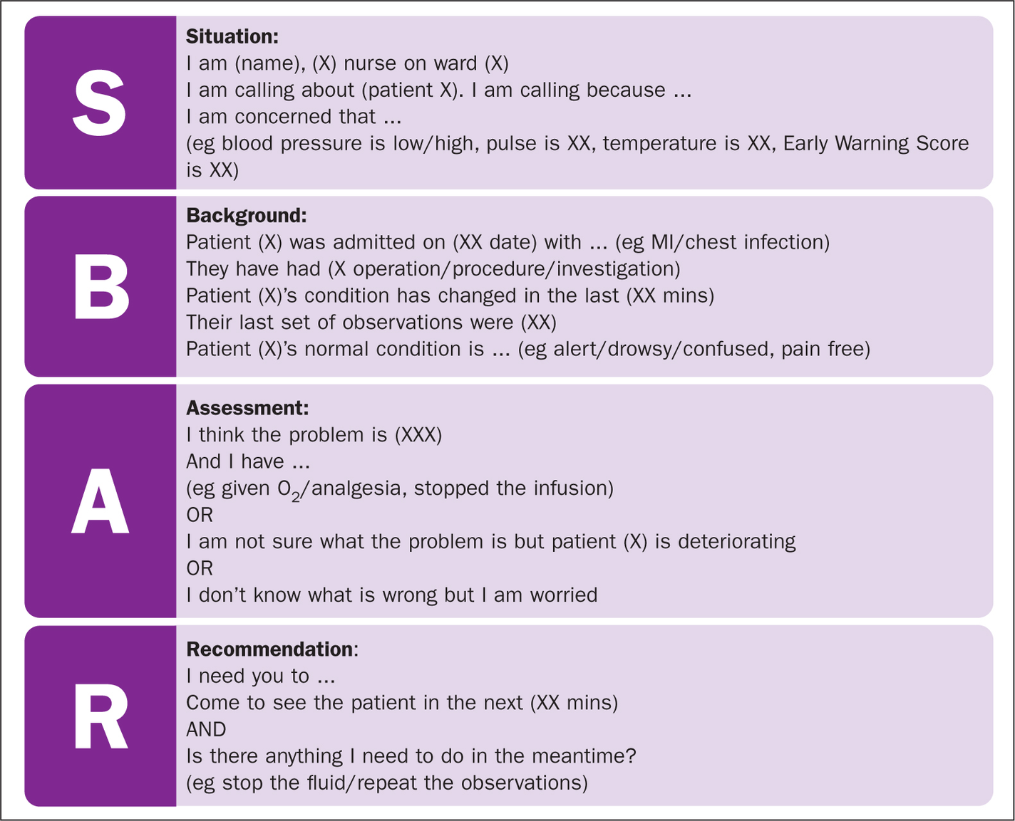
Handover Model /Approach-SBAR

Slide 8
The Bleep
  Good to clip it on your scrubs/lanyard/pocket
  have your own system of making a jobs list-I usually have a manual paper-which has 2 columns-Bleeps and sick patients to review
  to bleep: 88--->the number you want to bleep--->the extension that you want to be called back on
  Try bleeping back as soon as you can--you never know if the bleep is just for a prescription or for a really sick patient

Slide 9
MEDICAL SHOs
  St James SHO(bl 6406)-Covers St James Wing
  seperate AMU SHO for AMU
  Lanesborough SHO (bl 6030) covers the wing and
also clerks in any Haem/Oncology patient

Slide 10
During On calls
  When you return a bleep/arrive to a ward
-introduce yourself to the nursing staff and patient
- review the patient/ the job
- let the NS know when you are done and what action if any they have to take
- let them know how to contact you
  If you are ward cover-can get bleeped for the wards you are covering in your wing
  If you are clerking--you are seeing new patients coming to the A&E
APPS that are your best friends:
  Microguide
  BNF for medication indications contraindications renal dosing and doses
  INDUCTION for all the numbers/bleeps
  UpTpDate or NICE for recent guidelines
  Our own St George's Intranet has all guidelines on the Grey Book
( if you search for intranet on the internet bar or simply click the home icon)
  GEEKY MEDICS
  MIND THE BLEEP

Slide 11
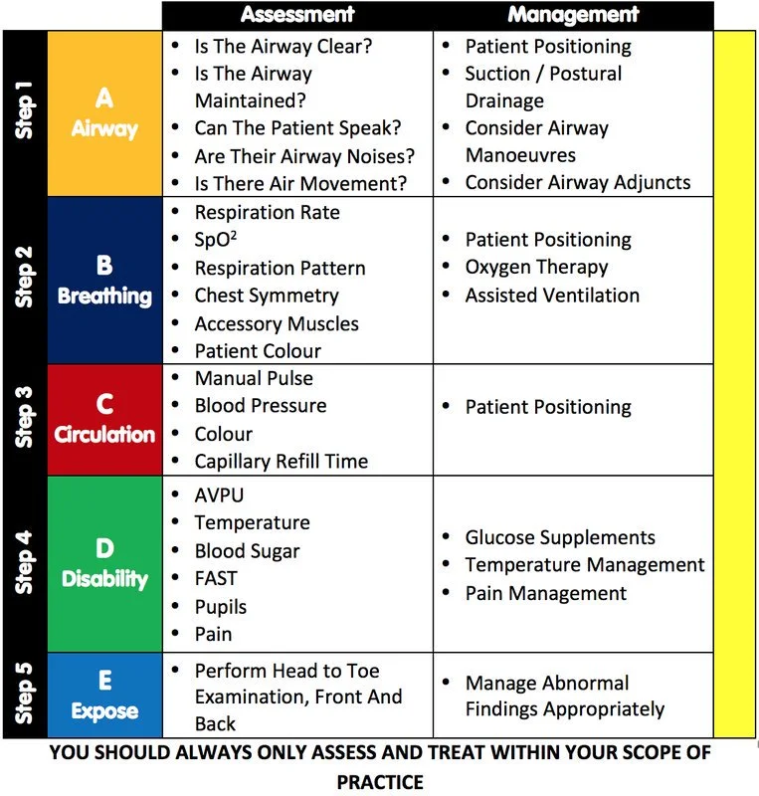
Basic Structure for Review:
  Ward Review:
-A-E approach
-after A-E, check patient investigations
bloods
relevant imaging
previous documentation
-order whatever relevant tests
-check medications he is on
-check observations

Slide 12
Basic Structure for Review:
    Clerking:
  Check details and ambulance/LAS summary first
  take history from patient in usual format with
-presenting complain
-HPC
-Past medical History
-Medications and Allergies--very important to record exactly what allergic recation the patient has--rash/anaphylaxis
-Family history
-recent GP/ hospital appointments
-Examination : systemically
-relevant investigations so far
-your clinical impression
-your management plan
-Once you have a plan and discussed with Senior-order tests/ make prescriptions and ensure you have informed the nursing staff to get those done--remember the patient is now your responsibility

Slide 13
ESCALATION AND REFERRALS
  If you are concerned a patient is very unwell/ rapidly deteriorating
or needs a higher/specialist lever of care-- DO NOT HESITATE TO ESCALATE!!
  PATIENT SAFETY IS ALWAYS KEY--IT IS GOOD PRACTICE TO ASK FOR HELP AND SUPPORT
  Registrars and Consultants are very approachable
  Escalation must be TIMELY, FOCUSED, ACCURATE
  Remember we are junior doctors and not expected to handle everything alone
--- it is better to be safe than in doubt
  If you are feeling any uneasiness or doubt--that is a sign to escalate!

Slide 14
ESCALATION AND REFERRALS
  Escalation ladder/support:
-first speak to your registrar
-Med Reg bleep 6613
-Advanced nurse practioners- bl 7740
-surgical reg bl 7370
-if it is a cardiac arrest --put out a call 2222 ( can be put out even in peri arrest)
-CCOT CRITICAL CARE OUTREACH TEAM: Bleep 8772
-Anesthetist bleep: 6111

Slide 15
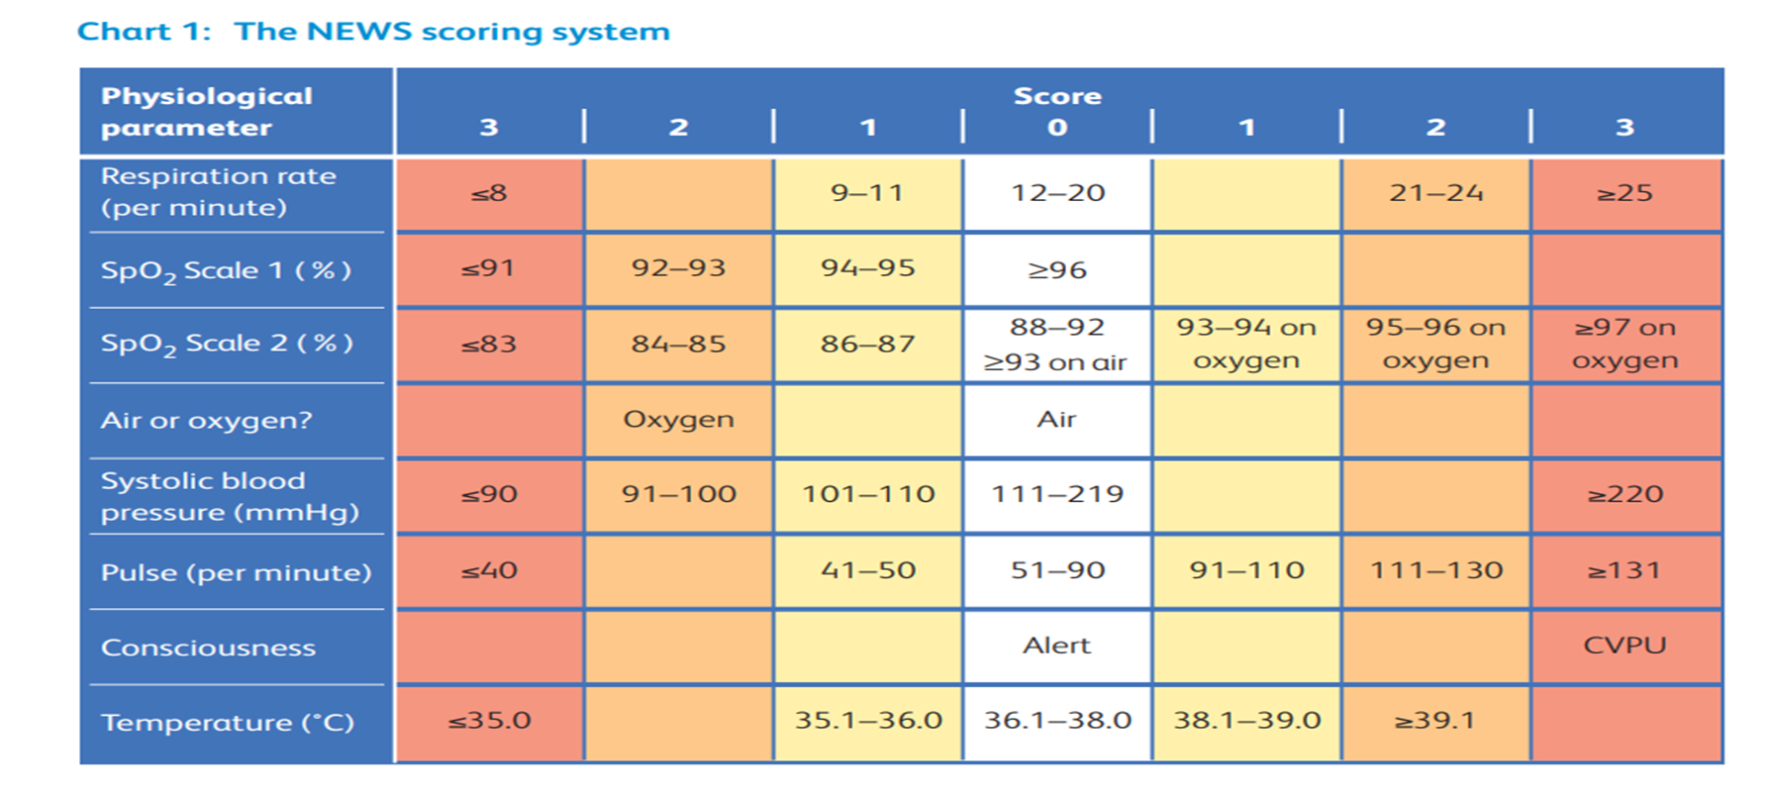
When to refer: when patient has high NEWS score or in a peri arrest situation

Slide 16
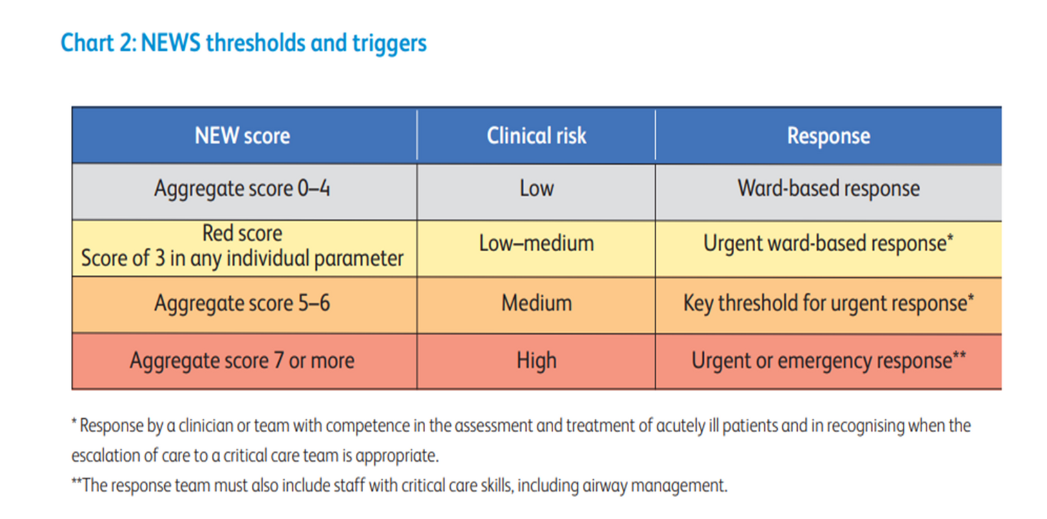
When to refer: when patient has high NEWS score or in a peri arrest situation

Slide 17
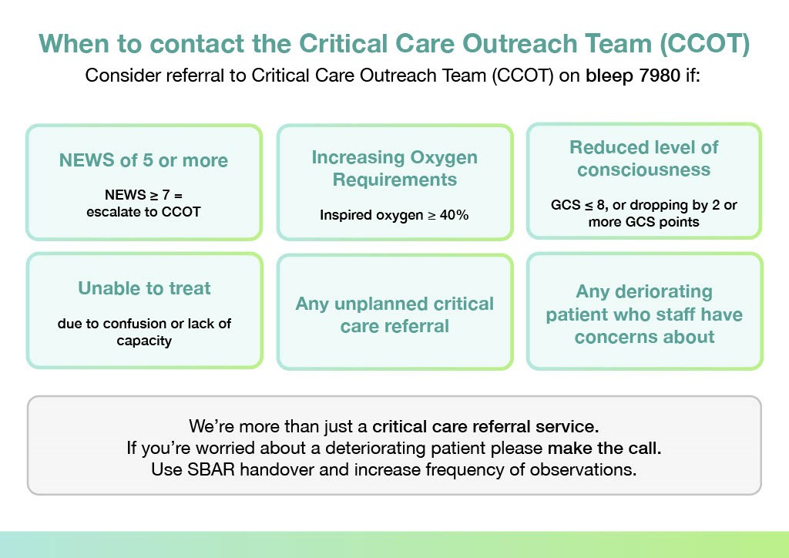
Consider referral to Critical Care Outreach Team on bleep 7980/8772 if:

Slide 18
Consider referral to Critical Care Outreach Team on bleep 7980/8772 if:
►All ward referrals for Unplanned Admissions to ICU will now go through the Critical Care Outreach Nurse – Bleep 7980
►Resus Huddle: 09.15am outside Monckton Well
►SBAR handover over the phone.
►Patient assessed by parent team and relevant treatment/investigations started: ABG, CXRay ordered. If peri-arrest please call us straight.
►DISCUSS and DOCUMENT TEP EARLY.
►Specific reason to refer patient: deterioration requiring review/advice, not ‘to be aware of’.
►Any member of staff can refer to CCOT, including nursing staff.
►If increasing O2 requirement and performing ABG, please do not leave patient on room air.

Slide 19
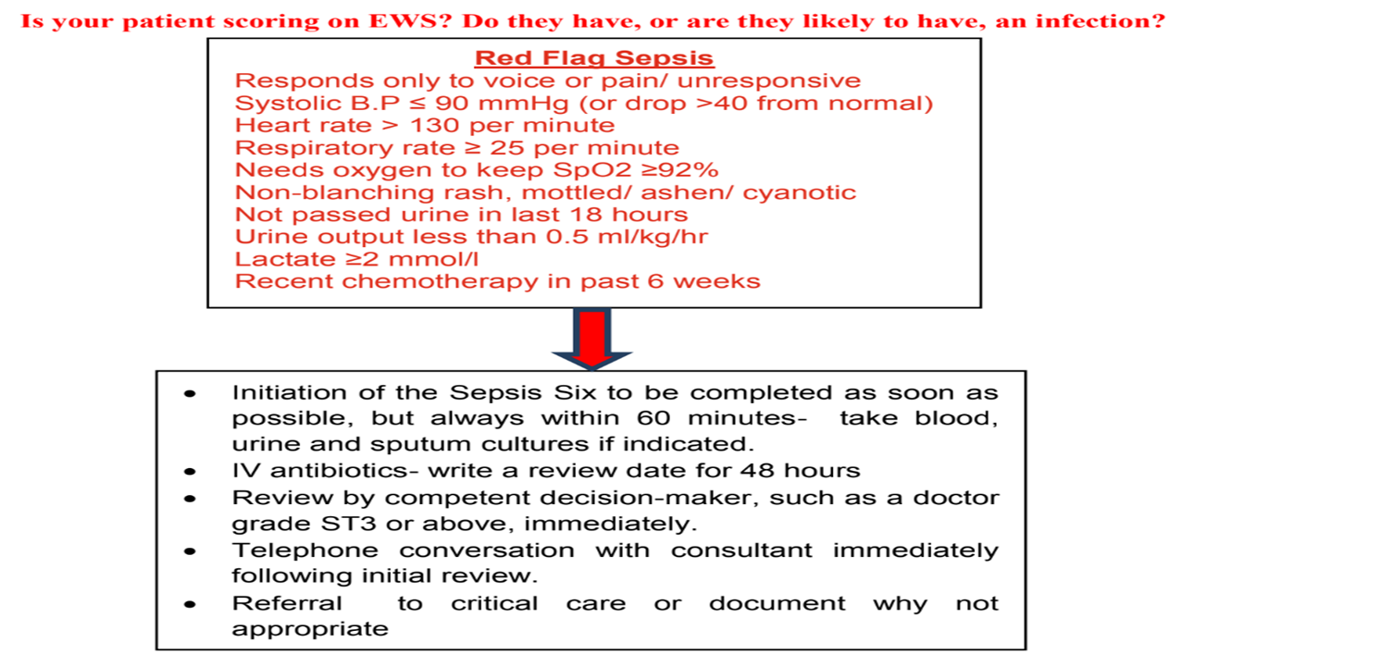

Slide 20
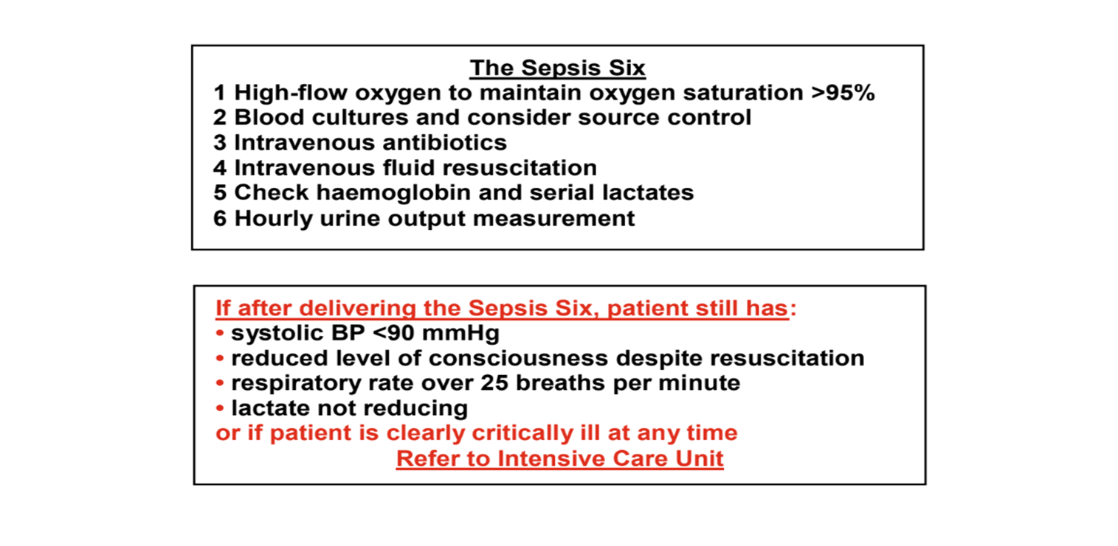
SEPSIS

Slide 21
Radiology and Imaging:
  All scans need to be ordered
  Xrays do not need vetting; however CT , US scans and MRI needs vetting--to discuss with Radiology on call- why this patient needs that particular scan ( ext 0168/4290)
  Make sure you have mentioned all the pertinent information
bloods, clinical history while ordering the scan
  NG Tube- once a NG Tube is in and we cannot get accurate aspirate pH(less than 5)- Chest XR needs to be ordered, reviewed , reported and feed started within 2 hours--so ensure you are on top of that!!
  all images can be reviewed on PACS--which should be on your toolbar--if PACS not working can contact them on 2665

Slide 22
TEAMWORK
  Ensure you are respectful and kind towards all the staff-including nurses, porters, colleagues, other departments
  Ensure you have taken breaks and checked in with your colleagues as well
  Nursing staff are your best friends and allies:
Very valuable asset
Be kind and respectful
Treat as equals not subordinates
Involve in care and decision making: esp NIC!
Offer to help if you can
Consider how would your actions affect them

Slide 23
End Of Life Care:
      Might see patients with treatment escalation plan on wards for who
further invasive interventions considered inappropriate/not in best interest
Focus of medical and nursing care is on patient’s comfort and dignity
Family and loved ones to be called
Close coordination with palliative care team: look for specific note from the team

Slide 24
Capacity and Consent:
•Out of our scope today:
•Patients should be asked for consent prior to any medical intervention including physical examination
•Patients with capacity have the right to refuse even if it sounds irrational
•Try to explain the intervention in detail including the benefits and risks
•Explore the reasons for refusal:
•Document every discussion:

Slide 25
VTE(venous thromboembolism) prophylaxis and form
  always ensure all patients have their VTE assessment forms filled- if they are not filled you will usually get a pop up
  you can find the form on Ad Hoc on the taskbar--> assessments---> VTE --->Record
  Usually hospital policy is dalteparin 5000 units SC daily every evening
  Unless patient has renal dysfunction--in which case calculate creatinine clearance and prescribe unfractionated heparin 5000 sc BD
  When in doubt--always ask the Pharmacist on call
  Complete policy found on Intranet
  if anticoagulation not an option--at least ensure TED stockings

Slide 26
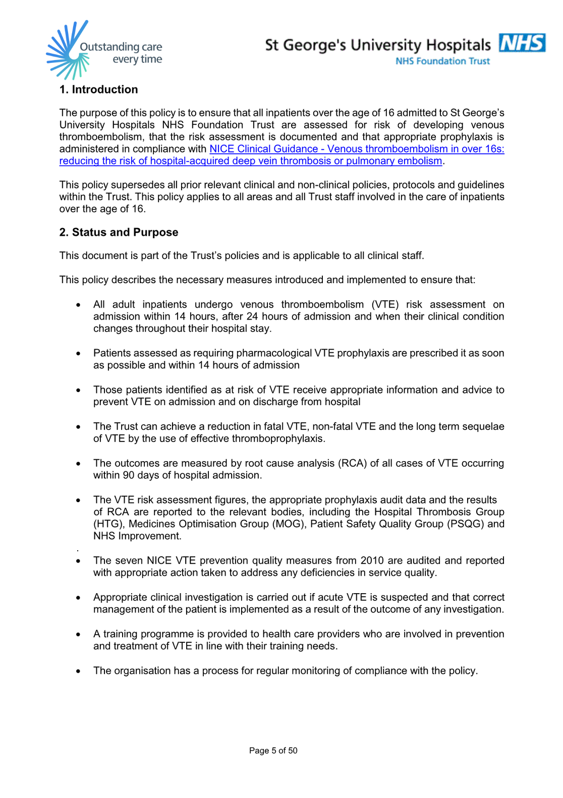

Slide 27
Resuscitation and DNAR TEP conversation:
  all patients who are admitted- check in form browser or GP /community records or ask pt /NOK if they have TEP form--it is policy that each patient should have one filled out
  if they do not have one--the conversation can be hard but it must be had
  can record it on i clip--Order--add order--resuscitation staus
  My colleague will speak in detail about this...........

Slide 28
THANK YOU!!
Any questions/comments? The floor is up for discussion now

