Slide 1
=
IMG Programme Creating a supportive
& inclusive environment
Dr Kassiani Iliadou MRCP(UK), MSc
Clinical Teaching Fellow in AMU
IMG Programme Lead

Slide 2
Dr Kassiani Iliadou IMG Programme and Mentorship Programme
Dr Silvana Alcala Welcome Kit
Dr Abdala Kaware IMG Induction
Dr Trisha Sengupta IMG Induction
Dr Jaspreet Sokhi IMG Induction
Dr Tinsy George IMF Mentorship Programme
Dr Maria Devesa IMG Forum
Dr Elwina Timehin Cons. Audiovestibular Physician, SAS-LED Tutor
Professor Indranil Chakravorty Cons. AMU, Director of Medical Education

Slide 3
International Medical Graduates (IMGs) and the NHS
Data show that IMGs play a crucial role in the medical workforce.
Marked increase in IMGs joining the workforce since 2017.
52% of new joiners in 2022 were IMGs.
32% of all doctors is predicted to be IMGs in 2036.
The state of medical education and practice in the UK Workforce report 2023

Slide 4
The challenges that can hinder performance
New healthcare system
New required skillset
New medicolegal frameworks
Communication-language barrier
Negotiation of working relationships with other professionals.
Adaptation to the UK culture
Cultural differences
Racial discrimination
Emotional distress
New guidelines
These additional challenges can hinder career progression

Slide 5
IMG Programme
The aim of the programme
Create a welcoming and supportive environment
Help you increase your productivity
Empower you
Support your wellbeing
Facilitate your transition to the NHS
Help you provide safe patient care
Support you reach your full potential
IMG Programme
IMG Induction
IMG Forum
IMG Mentorship Programme
Welcome Kit

Slide 6
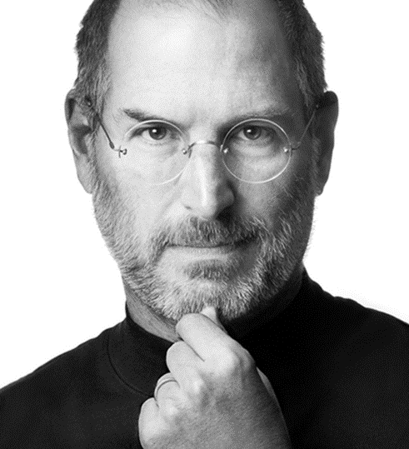

Slide 7
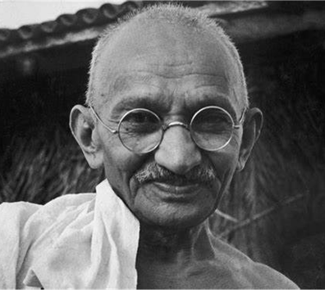
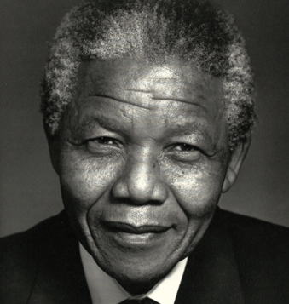

Slide 8
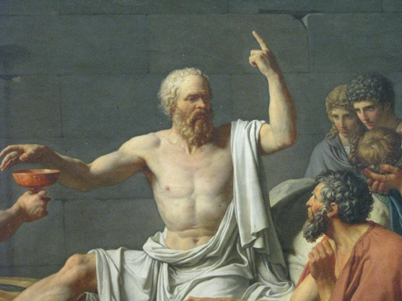
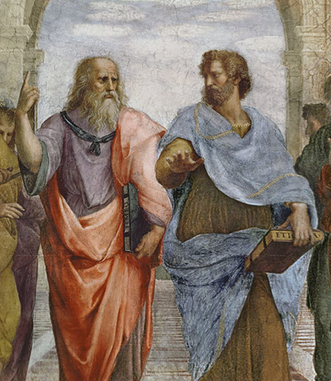

Slide 9
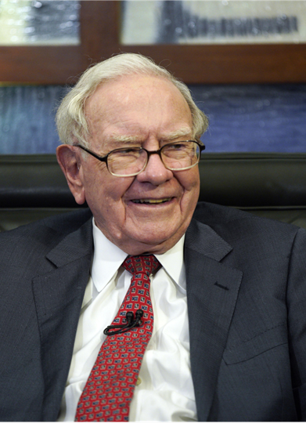
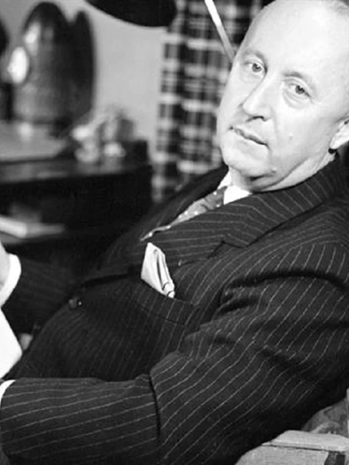

Slide 11
The mentor & the mentee
Mentor
A person who is perceived to have greater relevant knowledge, wisdom, or experience
Mentee
A person who is perceived to have less relevant knowledge, wisdom, or experience
This relationship is additional to a manager or boss and benefits from a more personal and confidential structure

Slide 12
Mentoring: What is it?
The act or process of helping and guiding another person to support their personal development.
Mentoring is about people and beyond a day job.
Informal transmission of knowledge
Social capital (network and relationships)
Psychosocial support

Slide 13
Mentoring: Why is it important?
Mentoring is associated with:
Improved job performance (job satisfaction)
Reduction of stress and workplace burnout
Creating an inclusive work environment
Mentoring has the power to:
Accelerate self-development
Accelerate career progression
Improve overall confidence
Mentoring programmes have the best track record at making diversity a reality helping with building cultural competencies.

Slide 14
Mentoring vs Supervising
Performance
10%
Supervising
Image – impression about ability to succeed (30%)
Mentoring
Success in the workplace
Exposure - access to opportunities (60%)
Mentoring

Slide 15
What a mentor isn’t
❌ A mentor is not a therapist. ‍
❌ A mentor is not the same as a coach.
❌ Mentoring is not a magic cure.

Slide 16
Our Mentorship Programme
Open to everyone interested at any stage of career
Invitation and application
9–12-month
Engagement with regular meetings
Resources :
What is mentoring
What are the responsibilities
and expectations
Suggested topics for discussion
How to provide feedback
What is reflective practice
Matching based on compatibility (specialty, training pathway, background)
1:1 or in a group
Formal form
Established goals
Strategic pairing

Slide 17
IMG Forum
IMG forum every 2 months (online, MS Team)
IMG What’s App Group
A mean to:
Contact others
Raise questions or concerns, seek advice and help, share information of interest
Organise social events
Inform about sessions, events or activities

Slide 18
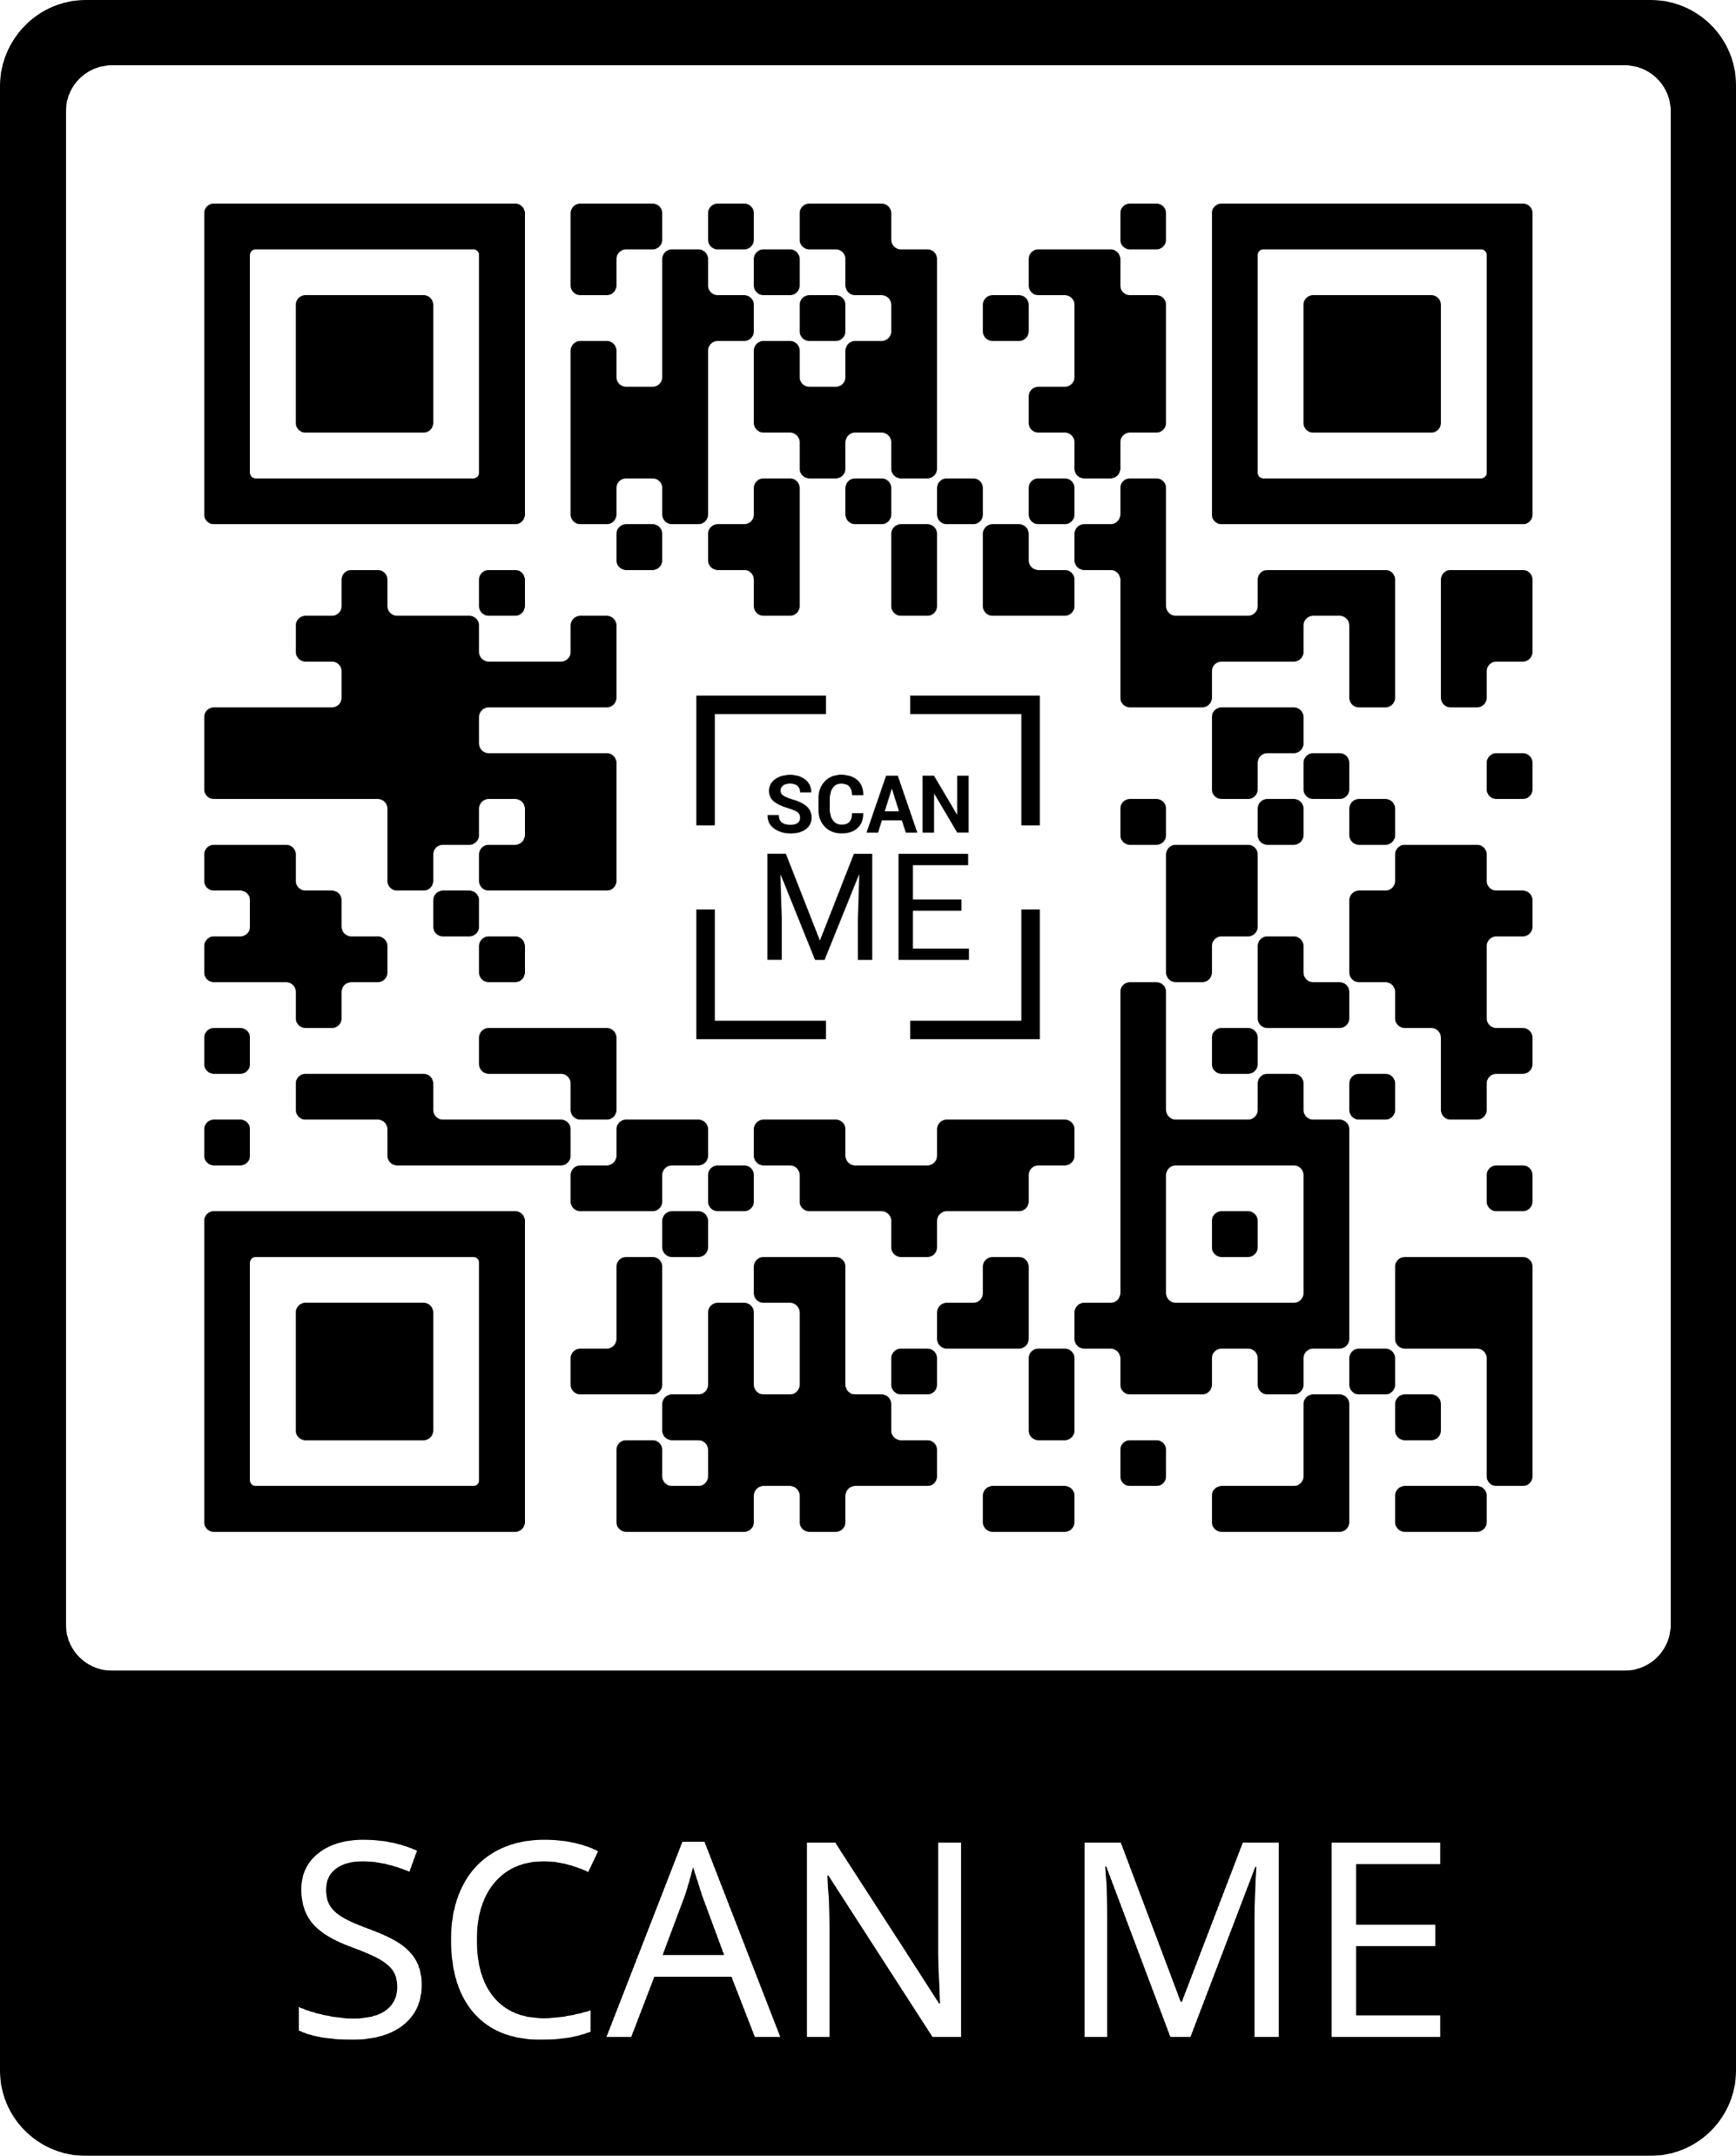

Slide 19
Online ms

