Slide 1
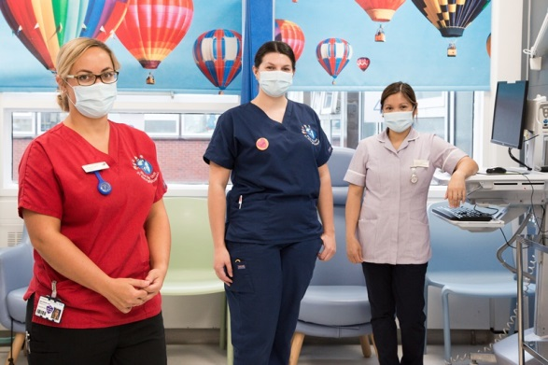
Staff Health and Wellbeing induction presentation for new starters
Staff Health & Wellbeing induction
Kristina Middleton
Health and Wellbeing Lead
September 2023

Slide 2
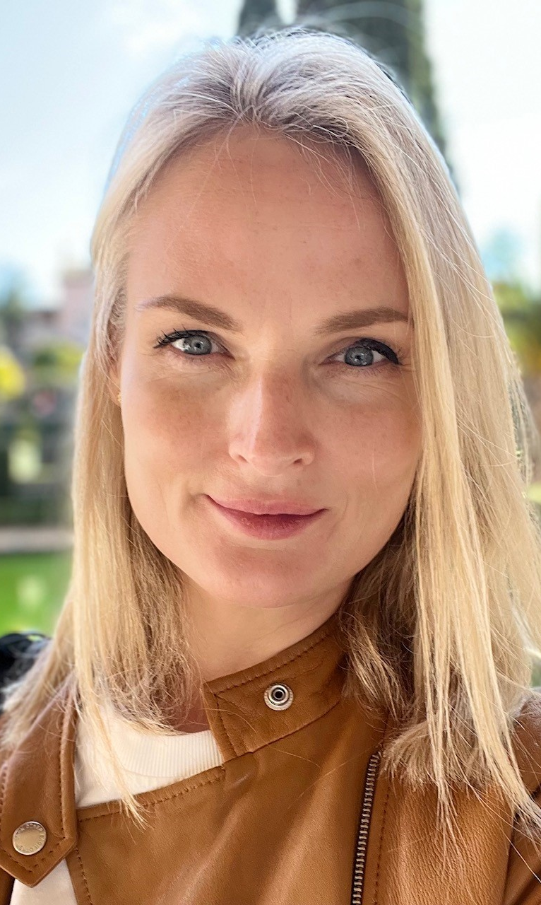
Meet the team
Kristina Middleton
Health and Wellbeing Lead
Organisational Psychologist
PhD student researching utilisation of flexible working arrangements
Thomas Roberts
Health and Wellbeing Coordinator
Expertise in Mental Health and Physical Activity
MSc in Exercise Physiology

Slide 3
How we support your wellbeing at work
Mental
Mental Health training options
Physical
Exercise
Menopause education and cafes
Social
Team challenges and initiatives
Health and Wellbeing Champion Network
Financial
Work
Staff Arts Club
Cycling
Staff discounts
Wellness Action Plan
Manager’s Toolkits
Training
Policies
Car Leasing Scheme
Mental Health Awareness for Managers
Suicide Prevention
Mental Health First Aid
Free apps (Headspace, Unmind)
£2 meal options in the canteen
Wagestream – flexible access to earned wages, benefits checker, savings
Outdoor gym at St Georges
Free gym & classes at QMH
Gym discounts
Cycle to Work options,
Bicycle User Group,
Bike sheds and showers
Dr Bike visits
Actio platform

Slide 4
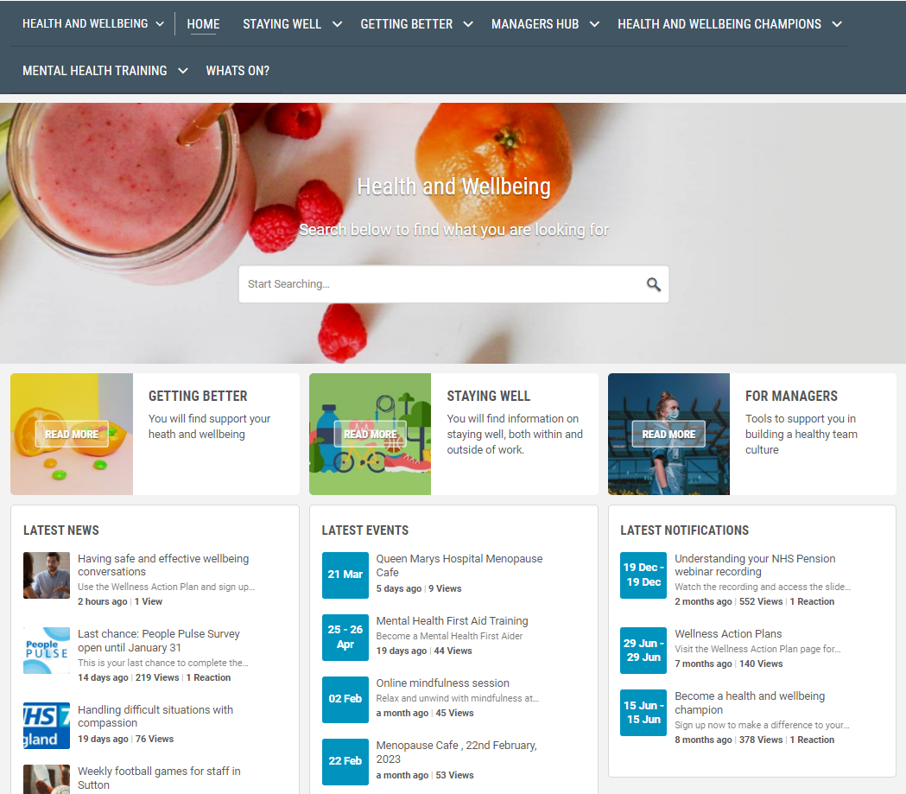
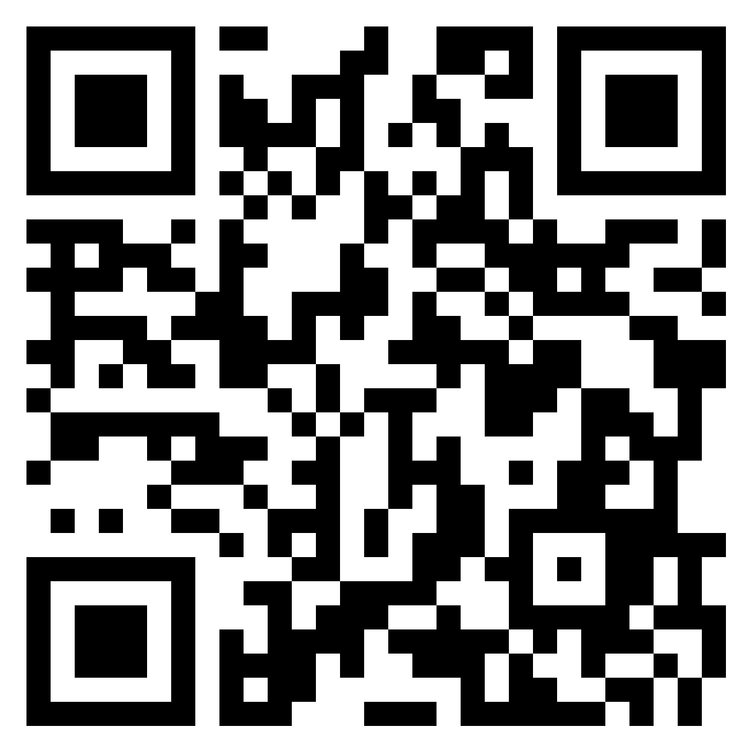
Health and Wellbeing intranet pages
Our intranet pages contain a range of resources on how to stay well or get better, resources for managers and available courses and events.
Kindness Wall
Health and Wellbeing induction

Slide 5
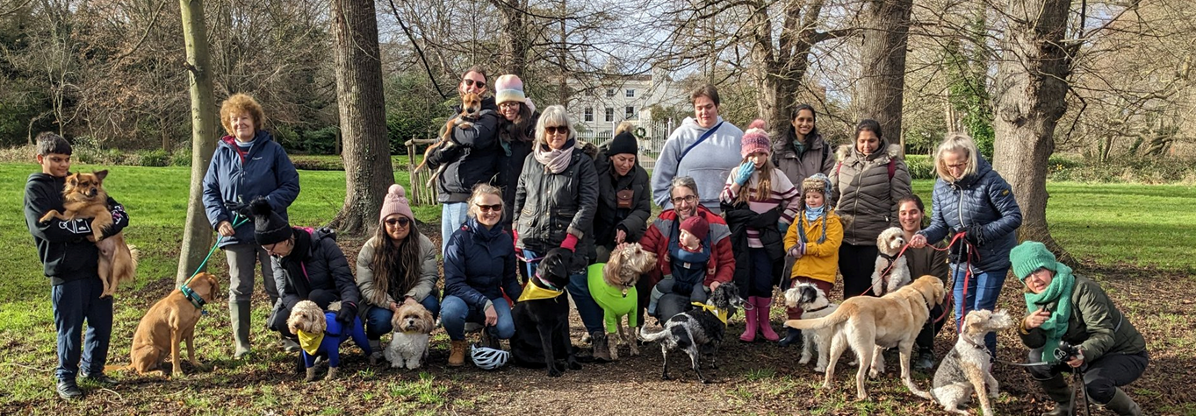
Keep in touch
Health and Wellbeing
Health.Wellbeing@stgeorges.nhs.uk
Bicycle User Group
cyclist@stgeorges.nhs.uk
Health and Wellbeing induction

