Slide 1



Enhanced Induction for International Medical Graduates (IMGs)
Dr Elwina Timehin
Consultant Audiovestibular Physician
SAS-LED & IMG Tutor
21st February 2024

Slide 2
Who am I?
Consultant in Audiovestibular Medicine
SAS,LED & IMG Tutor
*SAS= Specialist, Associate Specialist & Specialty doctor
*LED = Locally Employed Doctors
*IMG = International Medical Graduate
My role
  Guidance and signposting to help further your career

Slide 3
Why
Contribution & diversity of experience overseas doctors bring to NHS & patients is invaluable
Adjusting to new workplace & healthcare system while accustoming to living in a new country can be challenging
Fundamental values of medicine may be universal but the way they are expressed will be different according to the social, cultural & organisational context in which care is delivered

Slide 4
Why?
Mistakes and misunderstandings
Difficulty getting on career pathway for progression
Sense of isolation, demotivation & loss of confidence
Enhanced IMG Induction
St George’s University Hospitals NHS Foundation Trust
Notes:
Mixed audience
Different stages in career
Some newly qualified & others already established in own country
Different country, cultures, practices

Slide 5
What & how?
Enhanced Induction has been put in place to help facilitate integration professionally and personally
Thursday lunchtime teaching for 8 weeks
IMG forum, Welcome kit, Mentoring scheme
  Medical Induction - St George's University Hospitals NHS Foundation Trust (stgeorges.nhs.uk)
Encouraged to join the Trust’s junior doctor forum
Enhanced IMG Induction
St George’s University Hospitals NHS Foundation Trust

Slide 6
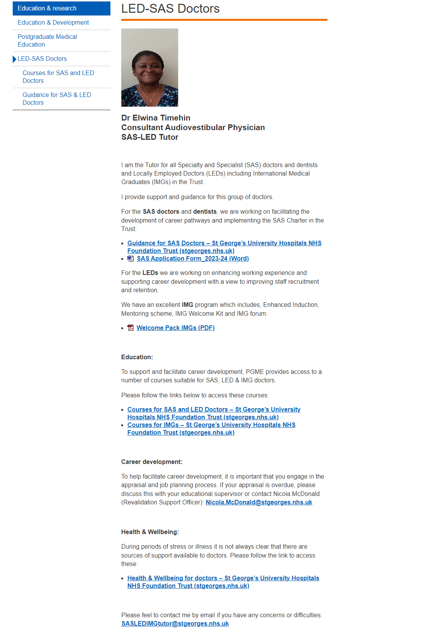
PGME external website
LED-SAS Doctors - St George's University Hospitals NHS Foundation Trust (stgeorges.nhs.uk)

Slide 7
What we would like from you....
Use information from today and during Thursday lunchtime teachings
Participate in Continuous Professional Development (CPD), research, audit & teaching
Make sure Mandatory and Statutory Training (MAST) is up to date
Enhanced IMG Induction
St George’s University Hospitals NHS Foundation Trust

Slide 8
What we would like from you cont…
Engage with appraisal & revalidation process to help career progression
Maintain wellbeing
Enjoy the journey & time at SGH
Presentation title to be placed here
St George’s University Hospitals NHS Foundation Trust

Slide 9
Useful Contacts
SASLEDIMGtutor@stgeorges.nhs.uk
PGME@stgeorges.nhs.uk
Queries about contracts:
CWTDmedstaffing@stgeorges.nhs.uk
MedCardmedstaffing@stgeorges.nhs.uk
SNCTmedstaffing@stgeorges.nhs.uk

Slide 10


For any other information, please contact PGME@stgeorges.nhs.uk

