Slide 1
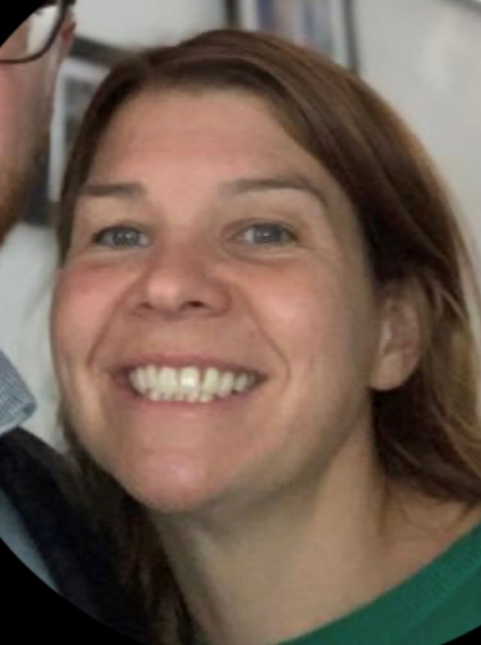
Guardian of Safe Working
IMG Induction
Dr Rosy Wells
Paediatric Allergy Consultant
Guardian of Safe Working
Supported return to training (SuppoRTT) and LTFT training Champion

Slide 2
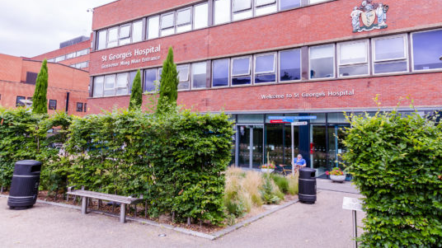
Welcome to St George’s Hospital!

Slide 3
Exception reporting
What’s the point?
Allows me (and the trust) to see areas where juniors are consistently working extra hours
Can lead to changes in rotas/staffing where areas are consistently reporting or safety concerns
Patient safety
Payment and/or TOIL

Slide 4
Exception reporting
What to report:
Immediate safety concerns
Working extra time, different work patterns
Missed educational/training opportunities

Slide 5
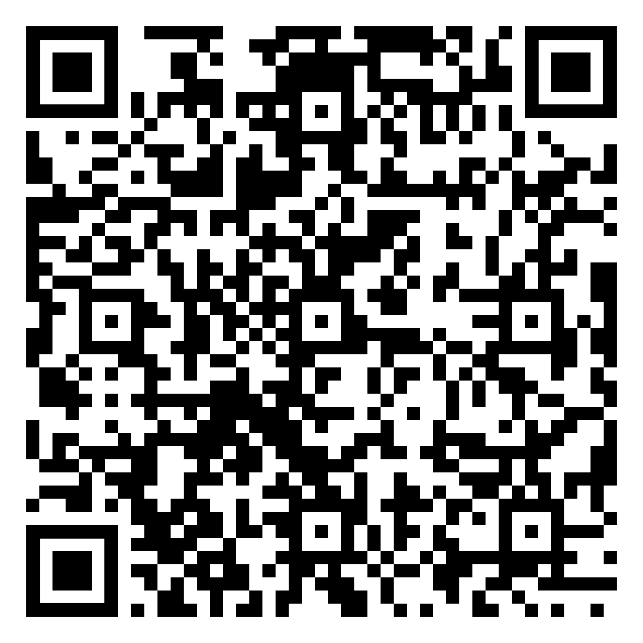
How to report
Everyone should have received a log in for exception reporting (trainees and LED)
E mail GuardianofSafeWorking@stgeorges.nhs.uk
if need log in or help
Instructions on reporting and using the Allocate software: Guardian of Safe Working - St George's University Hospitals NHS Foundation Trust (stgeorges.nhs.uk)

Slide 6
Junior Doctors Forum
An opportunity to speak up and share concerns/ideas
Make positive changes in the trust to improve working conditions for juniors doctors
Occurs once monthly in the doctors mess
Representatives from HR, PGME, trust
Free food!

Slide 7
GuardianofSafeWorking@stgeorges.nhs.uk
rosy.wells@stgeorges.nhs.uk

