Slide 1
iClip for IMG Induction
Presentation: Champion Users

Slide 2
Introduction
What is iClip (Cerner Millenium)?
View of Cerner Metaframe
Why Do We Use iClip (Cerner Millenium)?
Who To Ask for Help with iClip Issues/Queries?

Slide 3
Introduction – iClip (Cerner Millenium)
Integrated Clinical Information Program is the internal branding for Electronic Patient Record (EPR) at SGUH.
Our main EPR but we also use other software within the Trust e.g. Soliton (Radiology), Euroking & Viewpoint (Maternity), Badgernet (NNU) ….

Slide 4
Introduction
iClip (Cerner Millenium) Meta frame

Slide 5
Introduction – Why Do We Use iClip?
Helps provide data that enables users to make informed decisions for better management of operations.
Arms the clinicians with the information needed to provide smarter care.
Empowers users to know, manage and engage with patients.

Slide 6
Introduction-Who To Ask for Help with iClip Issues/Queries?
Colleagues with iClip experience e.g: local Super Users
Ward Pharmacists (in hours)
Urgent OOH prescribing enquiries (5:30pm – 9am): On Call Pharmacist (bleep 6267)
IT Helpdesk – ext. 3456
Contact the Champion Users:
SGH - Bleep 9911 (Mon- Sun 7:30-19:30)
QMH - Bleep 128 (Mon-Fri 8:00- 18:00)
Hotline 07775020254 (Mon-Fri 8:00-18:00)

Slide 7
Topic Outline
What Do You Need to be able to Access iClip?
How to Obtain a Smartcard?
Personal Smartcard
Temporary Access Card (TAC)
Tips on How to Care for your Smartcard
How to Unblock your Smartcard?
iClip Tips and Tricks

Slide 8
What Do You Need to be able to Access iClip?
Complete your iClip Training
Face to Face – booked via e- Learning or by emailing IT.Trainers@stgeorges.nhs.uk
Online Training - via e-Learning
You will need to be set up with your e-Learning account usually done during induction.
Have a working Smartcard
Personal Smartcard
Temporary Access Card (TAC)

Slide 9
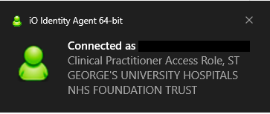
What is a Working Smartcard?
Personal Smartcard with correct SGUH access and role set up
Temporary Access Card (TAC) with the correct role - should only to be used in exceptional circumstances ie: you left your card at home that day and not to be used as a permanent access card.

Slide 10
How to Obtain a Smartcard?
Personal Smartcard
after completing your iClip Training, present the required documentation to Registration Authority.
NB: for the list of acceptable forms of ID please refer to the Handbook to be distributed by the Champion Users after the presentation.
Temporary Access Card (TAC)
obtained from NIC, Site Team, Department Service Manager.
NB: You will be asked to complete a TAC Borrower’s Form before the card is given to you and you must complete the return part of the form when you hand in the TAC after your shift otherwise this will mean you did not return the card which can have serious IG implications.

Slide 11
Do’s and Don’ts on How to Care for your Smartcard
Do check your card access prior to working especially if you were off or did not use your card for more than 6 months. - NB: also worth calling IT Helpdesk x3456 to reinstate your VDI access if you were off for 4 weeks.
Do Log Off / Disconnect do not just pull out your card from the card reader when you finish.
Do renew smartcard certificate weeks before it expires. - pop up reminders usually appear when your certificate is about to expire, please visit RA (Registration Authority) Office the earliest time possible to renew your certificate when you see the reminders. - RA Office is open 8-4 Mon -Fri
Do not leave your card unattended at anytime.
Do not share your card or PIN with others.

Slide 12
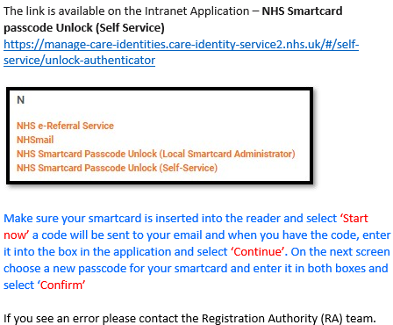
How to Unblock your Smartcard?

Slide 13
How to Unblock your Smartcard?

Slide 14
iClip Tips and Tricks
List of patients – it is good practice to create your patient list rather than searching for your patient by MRN as this is a clinical risk.

Slide 15
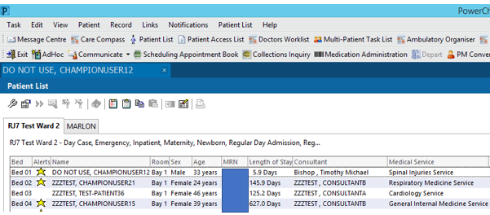
iClip Tips and Tricks
1. List of patients

Slide 16
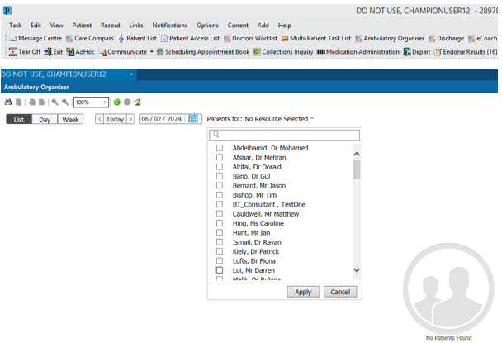
iClip Tips and Tricks
1. List of patients

Slide 17
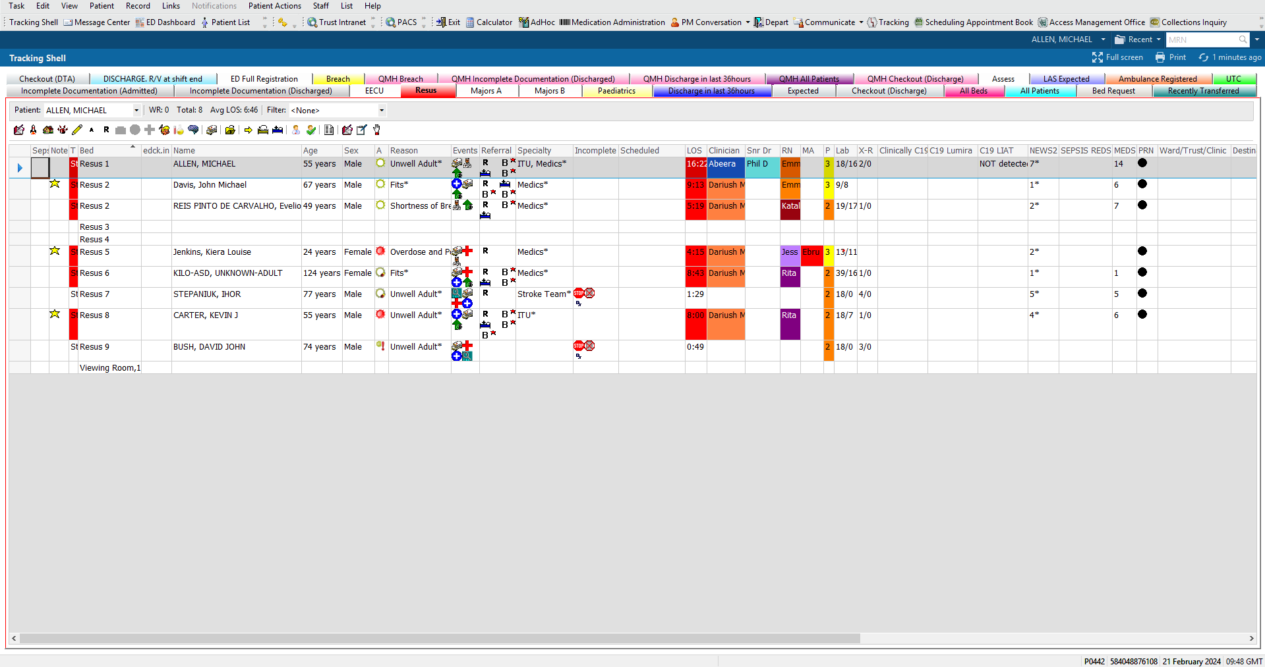
iClip Tips and Tricks
1. List of patients – ED Tracking Shell

Slide 18
iClip Tips and Tricks
2. Documentation
Use Department’s Speciality Templates and Clinical Notes – set this up as Favourites.
Save Pre-Configure Templates or catalogue in you Favourites.
Mark resolved problems for ease when completing the Discharge Summary.

Slide 19
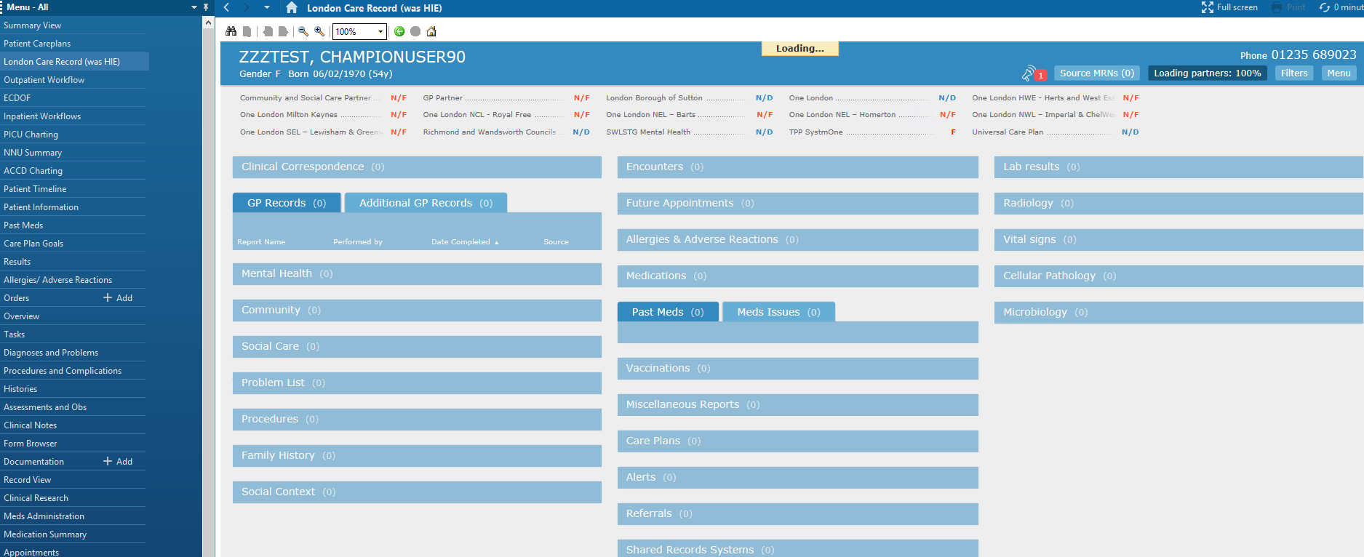
iClip Tips and Tricks
2. Documentation
Use London Care Record (formerly HIE) to review information from GP records and other Hospital linked through Oracle Cerner.

Slide 20
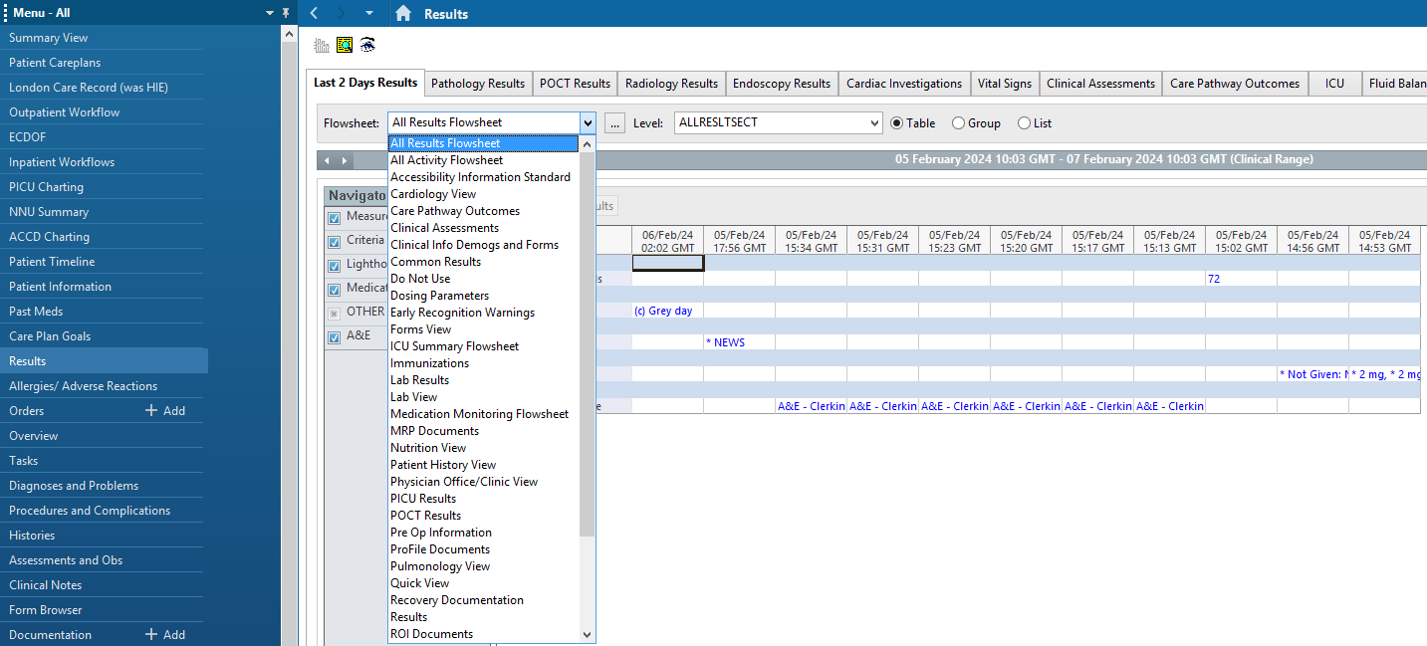
iClip Tips and Tricks
2. Documentation
Results – filtering

Slide 21
iClip Tips and Tricks
2. Documentation
Results – filtering

Slide 22
iClip Tips and Tricks
2. Documentation
Results – which type of results can be found in Message Centre?
Message from colleagues
Histology Results
Radiology Results

Slide 23
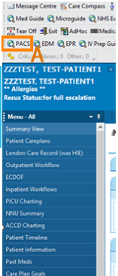
iClip Tips and Tricks
2. Documentation
Results – Open the link to Radiology Images

Slide 24
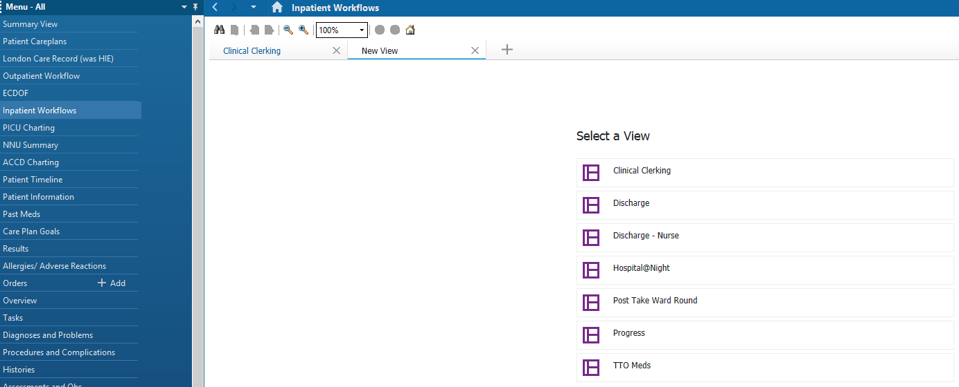
iClip Tips and Tricks
2. Documentation
Discharge Summary- IP Workflow

Slide 25
iClip Tips and Tricks
2. Documentation
Discharge Summary- IP Workflow

Slide 26
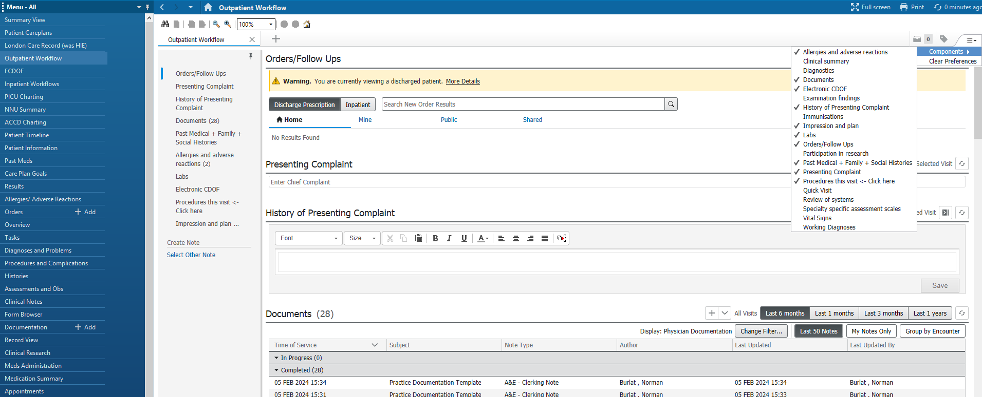
iClip Tips and Tricks
2. Documentation
Discharge Summary – OP Workflow

Slide 27
iClip Tips and Tricks
2. Documentation
Discharge Summary – OP Workflow

Slide 28
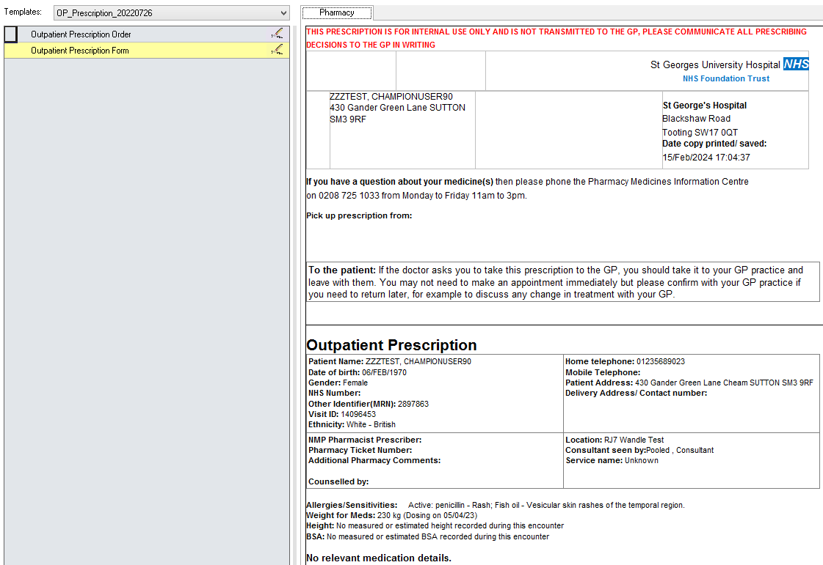
iClip Tips and Tricks
2. Documentation
Discharge Summary – OP Workflow

Slide 29
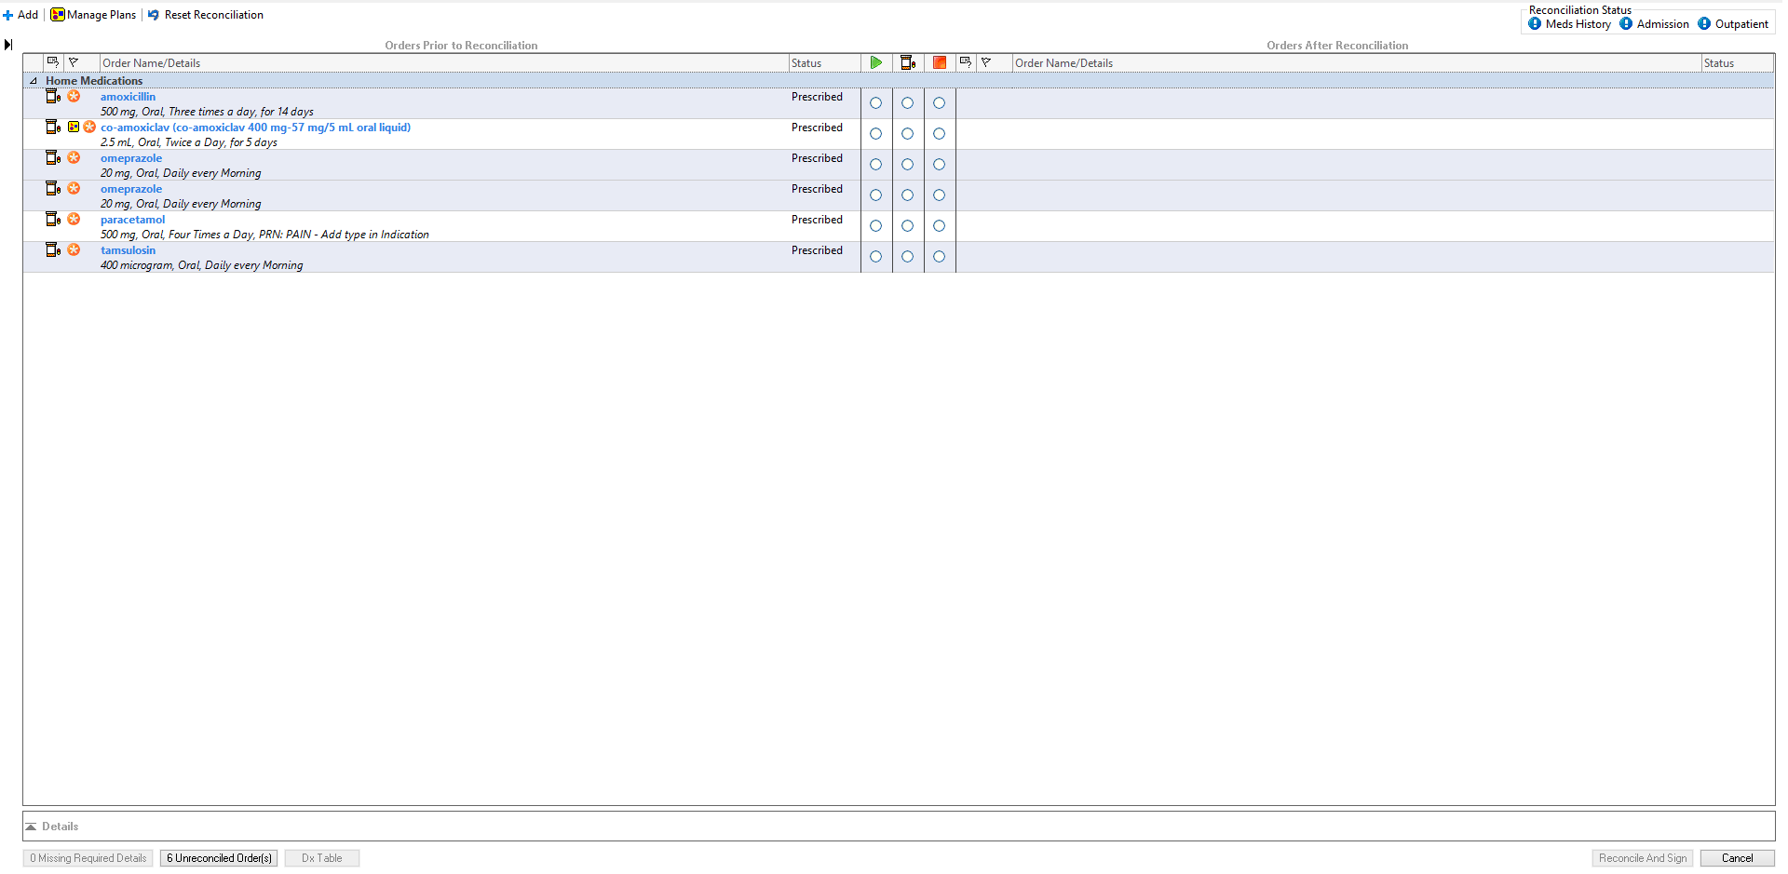
iClip Tips and Tricks
2. Documentation
Discharge Summary – OP Workflow

Slide 30
iClip Tips and Tricks
2. Documentation
ECDOF

Slide 31
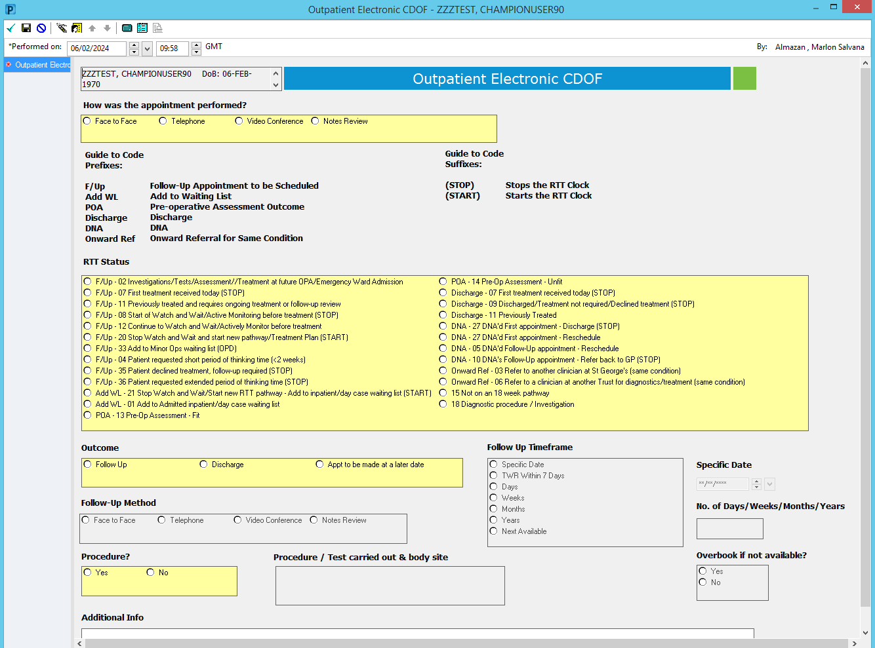
iClip Tips and Tricks
2. Documentation
ECDOF

Slide 32
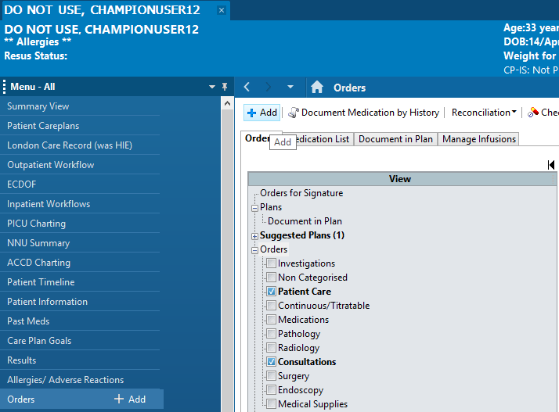
iClip Tips and Tricks
3. Ordering
Ordering Emergency Procedures

Slide 33
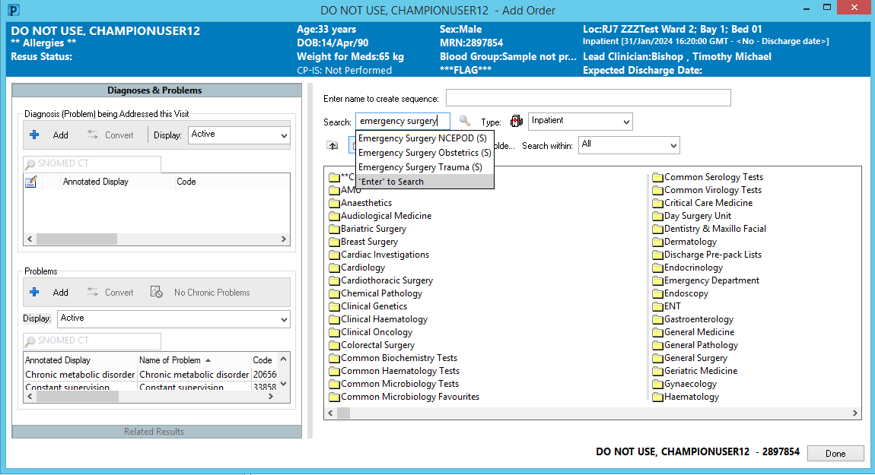
iClip Tips and Tricks
3. Ordering
Ordering Emergency Procedures

Slide 34
iClip Tips and Tricks
3. Ordering
Ordering Emergency Procedures

Slide 35
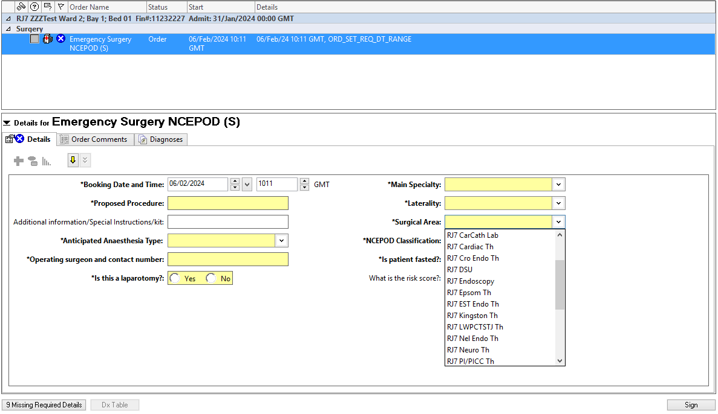
iClip Tips and Tricks
2. Ordering
Ordering Emergency Procedures – ensure to select the correct Surgical Area so the order will show in the Theatre Coordinator Emergency Appointment List and can book the case into a theatre.

Slide 36
Any questions?

