Slide 1
Induction
Diversity and Inclusion

Slide 3
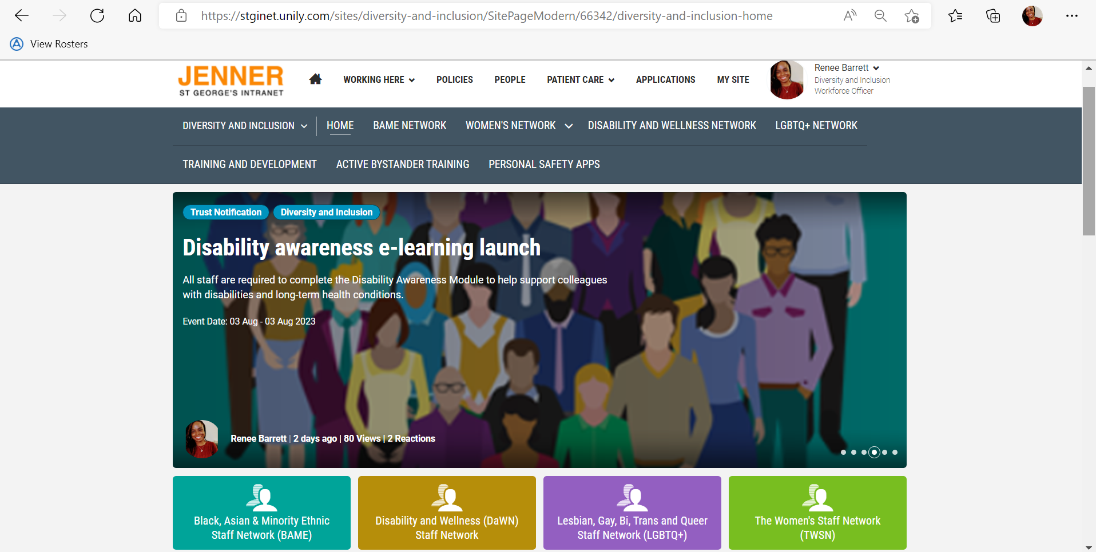
Notes:
Website intro – note to attendees that the D&I page can be found by clicking on working here then diversity and inclusion page is under shared services. Alternative you can type Diversity and Inclusion into the search bar on the intranet

Slide 4
Notes:
Presenter notes: introduce the staff networks – covered as protected characteristics under the Equalities Act 2010. The networks and the Diversity and Inclusion Team help to provide confidential support and advice in the Trust for anything related to inclusion. Staff can reach out to the networks directly if thinking of joining/hearing more about events or get in touch with the diversity and inclusion team by emailing the D&I inbox or reaching out to the team members directly.

Slide 5
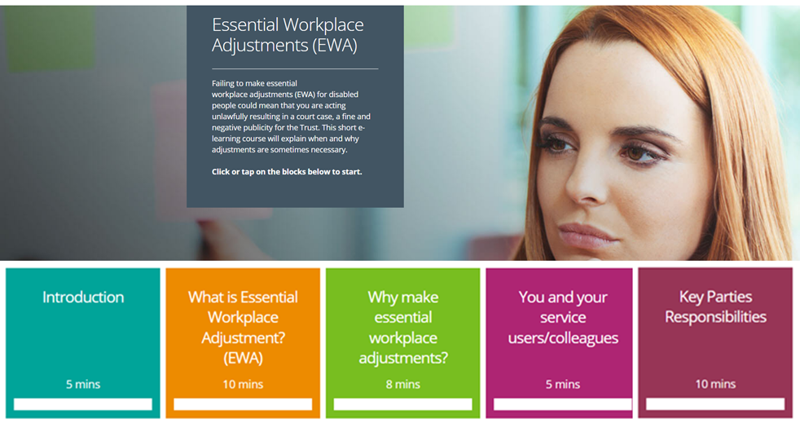
Some ways we help
Disability Awareness Module and Essential Workplace Adjustments Module
As part of our commitment to improving the experience of staff with a disability or long-term health condition we have now launched a new e-learning package.
This bespoke package was developed in house and underwent extensive review with stakeholders, including DaWN members, Calibre delegates and specialist departments like OH and ER.
Accompanying guidance documents for staff and managers has also been developed and are now available on the intranet.
Speak with your line manager regarding any adjustments you may need to support you in work with a disability or long-term health condition. Complete Wellness Action Plan or Occupational Health referral
We can support with adjustments such changes to start/end times, equipment, training etc
Notes:
Presenter notes: working with staff networks like Disability and Wellness Network, D&I set up a working group to hear about staff’s experience of having conversations about their disability or requesting adjustments at work. This lead to the creation of mandatory e-learning around Disability Awareness and practical information on providing Essential Workplace Adjustments such as specialist equipment, changes in working patterns or training for staff with disabilities.
This alongside developing inclusion related training, workshops and providing advice and support to staff and specialist teams like Employee Relations and Occupational Health – Diversity and Inclusion aim to facilitate and support inclusion and promote diversity for all areas of employee life at the Trust

Slide 6
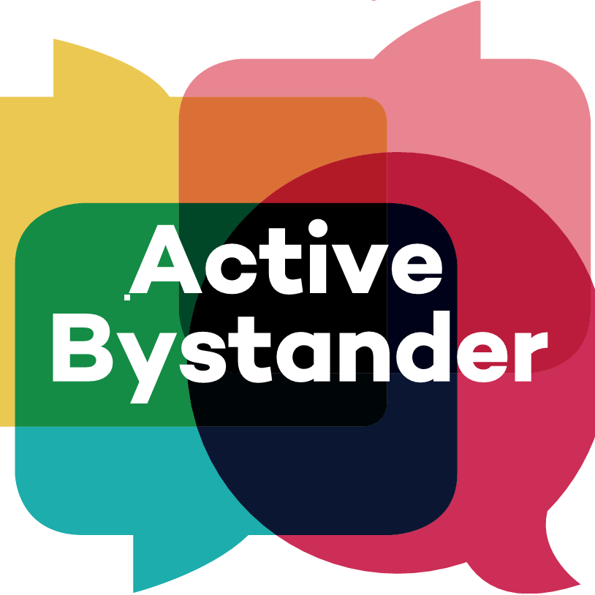
Building Inclusion
LGBTQ+ Awareness Module
Executive Sponsorship
Active Bystander – Bitesize e-Learning
This is delivered as part of the Management Fundamentals Toolkit in September 2022 and follows on from the delivery of Sussex NHS Trust Lead Dr Jamie Willo’s LGBTQ+ Gender Identity Basic and Intermediate Training and will deliver long term sustainable LGBTQ+ awareness for our Trust
We’ve developed a Staff Network Exec Sponsor Role Profile which has now been endorsed by both the networks and the trust executive. New Executive Sponsors have now been assigned to all our network, each network will have two sponsors – one site sponsor and one group sponsor. These sponsors will work in collaboration to support the network objective as well as strengthening the relationship between networks across the group.
To support the external ABT workshops that have been delivered to over 300 staff, the D&I team have developed a bitesize online training which encompasses the 4 staff networks to support the reduction of bias and discrimination brought about by poor behaviours. This will be delivered as part of the Management Fundamentals Toolkit from September 2022

Slide 7
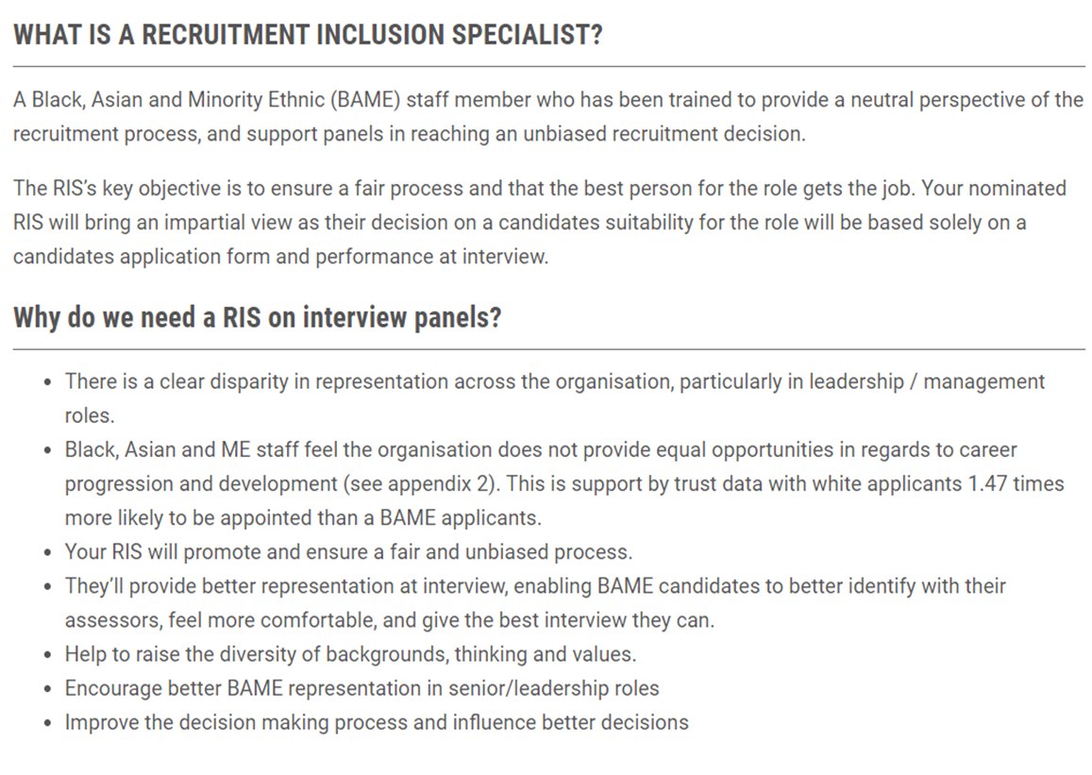
Building Inclusion
RIS Training
1:1 Staff Support
Ally Movie Nights
We speak to staff who reach out to us about issues they face in their teams/departments and provide bespoke support and information.
We can liaise confidentially with individuals or teams on your behalf, suggest ways of moving forward or making teams/initiative more inclusive and use information to ensure trust-wide practices are supporting staff
Our Ally Movie Nights continue to grow in success, we have run three movie nights to date, with more dates scheduled for Sept, Oct and Nov.
Over 40 members of staff have attended these social educational evenings with complimentary pizza and refreshments.

Slide 8
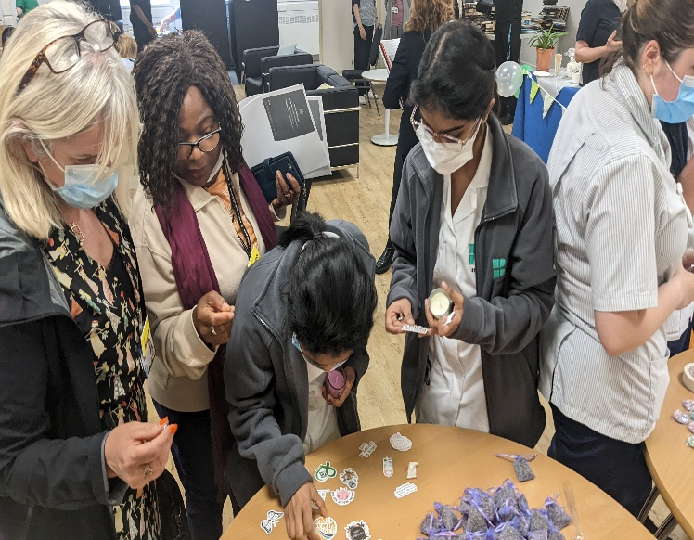
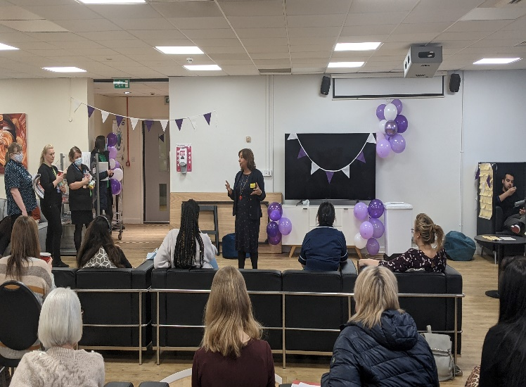
Staff Networks Events
We support the LGBTQ+ Pride Mental Health Awareness Week and International Women’s Day Events across the Trust
The LGBTQ+ network held an all staff event in July to celebrate Pride, The DaWN group held Mental Health Awareness Week staff event and The Women’s Network arranged International Women’s Day celebrations.
Activities included a weekly all staff communication pieces , sharing Pride Pledge videos of staff, Executive Support from Trust leaders and engaging talks from staff at all levels at the organisation
Notes:
Presenter notes

Slide 9
Staff Network Activity
Breastfeeding Room - TWSN
See Me First – BAME
BSL Workshops - DaWN
The Women’s Staff Network are pleased to announce the opening of the Breastfeeding Room for those returning from maternity leave or staff that are nursing/expressing.
The BAME Staff Network have launched the See Me First Initiative pioneered by Whittington NHS Trust to improve and promote equality, diversity and inclusion and reduce discrimination for BAME staff.
Disability and Wellness Staff Network delivered British Sign Language Workshop facilitated by Royal National Institute For Deaf People for 10 staff which was highlighted as a need during Sign Language Awareness Week
Notes:
Presenter notes: Can read slide content or mention headings for the network initiatives to save time

Slide 10
Being Respectful and Kind - Active Bystander and the 4 D’s
To live the Trust values of being Respectful and Kind in our daily lives and while at work, at times we might witness or be bystanders to situations that happen around us. These situations at times make us uncomfortable as it might involve harassment, bullying or discrimination.
If we stand by without intervening, we give the impression that unacceptable behaviour is alright – reinforcing these behaviours.
Being an active bystander means you notice poor behaviour, understand that it is a problem, feel empowered to do something about it and that you have the necessary tools to act.
When intervening, its important to keep in mind the 4 D’s:
Direct action
Call out negative behaviour, tell the person to stop or ask the victim if they are OK or need support.
Distract
Interrupt the person, start a conversation with them to allow their potential target to move away or redirect the situation
Delegate
If you feel too embarrassed or shy to speak out, or you don’t feel safe to do so, get someone else to step in who may be better able to deal with the situation such as a line manager or specialist team/department.
Delay
If the situation is too dangerous to challenge then and there report it when its safe to do so.
St George’s University Hospitals NHS Foundation Trust
Notes:
Presenter Notes: Read slide content
Summary is that we aim to promote an inclusive and diversity workforce where everyone feels welcome however at times people we interact with may fall short of this standard. By using the Active Bystander approach and the 4 D’s, you can intervene if you notice poor behaviour and challenge it in a way that works best for you.

Slide 11
Active Bystander and the 4 D’s - Common Reasons People Don’t Act
“Its not my issue”
Even if you’ve never been the target of poor behaviour, a friend or loved on probably has been. Poor behaviour hurts everyone
“I’m worried it will turn on me”
Trust your gut and chose a less direct action
“I can’t make a difference”
Our actions can discourage the person displaying poor behaviour, support the person who was the target of this behaviour and help prevent it in the future
“It’s harmless, right?
Poor behaviour, verbal abuse or harassment makes people feel uncomfortable, threatened and like they don’t belong
“I don’t fully understand what’s going the situation”
Try asking, ‘what’s going on here?’
St George’s University Hospitals NHS Foundation Trust
Notes:
Presenter notes: Read slide content or allow a few moments for attendees to review these

Slide 12
St Georges Trust Resource Links:
Diversity & Inclusion Team – Email diversity.inclusion@stgeorges.nhs.uk
Career Training and Development:
https://stginet.unily.com/sites/education-and-development/SitePageModern/54055/take-control-of-your-career
Freedom to Speak Up:
https://stginet.unily.com/sites/freedom-to-speak-up
Health and Wellbeing:
https://stginet.unily.com/sites/health-and-wellbeing/SitePageModern/30392/health-and-wellbeing-home
Occupational Health:
https://stginet.unily.com/sites/health-and-wellbeing/SitePageModern/39375/occupational-health-home
Staff Support:
https://stginet.unily.com/sites/health-and-wellbeing/SitePageModern/37132/staff-support-service
St George’s University Hospitals NHS Foundation Trust
Notes:
Presenter notes: signpost the D&I email address and other areas of information/support within the trust

