Slide 1
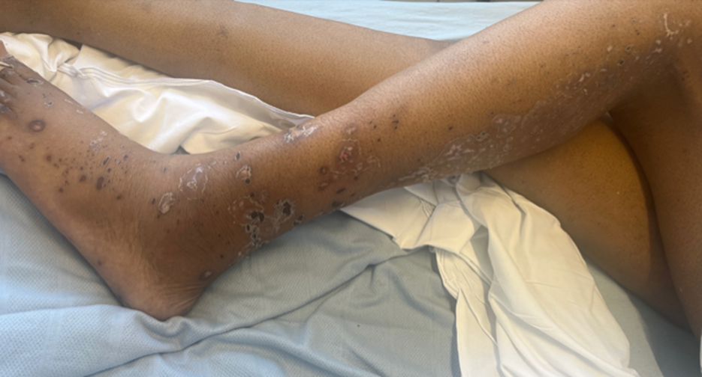
“Aciclovir induced electrolyte dysfunction following a delayed diagnosis of an acute herpes zoster lumbosacral radiculopathy”
Figure demonstrating crusted lesions distributed along the L5/S1 dermatomal distribution. Taken with consent from the patient.
Incidence of shingles among 70 to 79 years UK: 790 to 880 cases/100,000 (van Hoek et al., 2009)
Incidence of shingles is greater in the immunocompromised e.g. solid organ transplant recipients.
Shingles vaccine will be offered to Immunosuppressed patients (BTS/UKKA, 2023)
Joshua Asto, Final Year Medical Student
(Supervisors: Dr Harsha Sanathkumar, Dr Joyce Popoola)

Slide 2
62-year-old Male, Kidney Transplant Recipient in 2014. End stage renal disease due to Lupus Nephritis, Hypertension DH: Tacrolimus , Mycophenolate Mofetil, Prednisolone Omeprazole, Alfacalcidol, Atorvastatin, Aspirin, Doxazosin
A&E VISIT 1 (DAY 0)
2/52 Hx Rash and burning pain in left leg
5/7 Hx Left hip pain
Walking with a limp
Reduced straight leg raise on left leg
Differentials: Sciatica, Molluscum Contagiosum
MANAGEMENT
Co-dydramol
Discharged, GP follow up
A&E VISIT 2 (DAY 11)
3/7 Hx Left foot to knee numbness
Painful papular and bullous lesions from dorsum of left foot to buttock
Dermatology: Consistent with Shingles
Viral Swabs: +ve VZV DNA, -ve HSV 1/2 DNA
MANAGEMENT
Aciclovir 800mg five times a day
eGFR 29
Prednisolone doubled
Discharged & advised to drink 3L of Fluids daily
A&E VISIT 3 (DAY 23)
Day 11 on Aciclovir
1/7 Hx Reduced urine output & nausea
Dry mucous membranes.
200mL on bladder scan pre-void
Na 114
Impression: Acute hyponatraemia
MANAGEMENT
Co-dydramol, Morphine, Ondansetron
Aciclovir stopped & Pregabalin started
Fluid rehydration
Renal admission

Slide 3
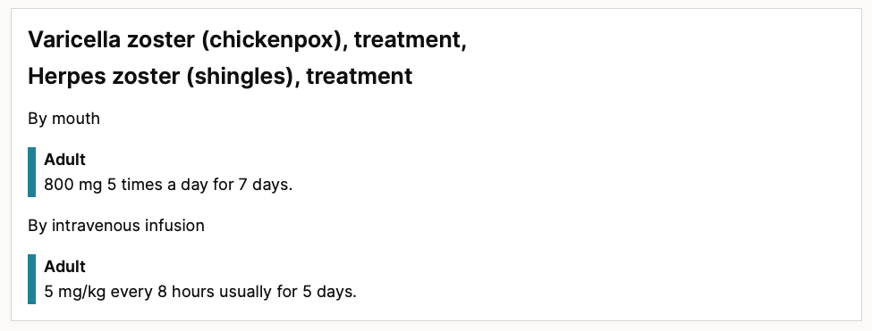
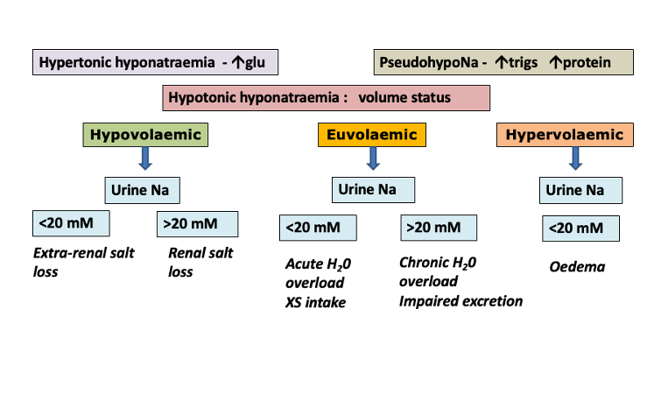
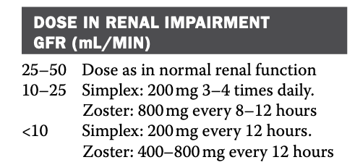
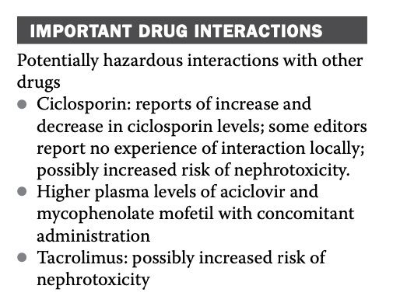
Assessment of Hyponatraemia
Serum Osmolality: 240.3 (< 280mOsm/Kg)
Fluid Status: Hypovolaemic
Urine Na+: 25 (>20mmol/L)
Magnesium 0.54 (0.7-1)
Joint Formulary Committee (2023) ‘Aciclovir', in British National Formulary. Available at: https://bnf.nice.org.uk/drugs/aciclovir/ Accessed: 14 December 2023
Diagram adapted from SGUL (2021): Fluids & Electrolytes
Lupus Serology & Immunology Screen:
ANA Ab -ve, Complement C3 & C4 normal, ANCA -ve
Serum protein electrophoresis: no evidence of paraprotein.
Viral serology:
VZV IgG Antibody detected >4000 mU/mL
Varicella Zoster IgM antibody – Not detected
Ashley, C. and Dunleavey, A. (2019) The Renal Drug Handbook: The ultimate prescribing guide for renal practitioners.

Slide 4
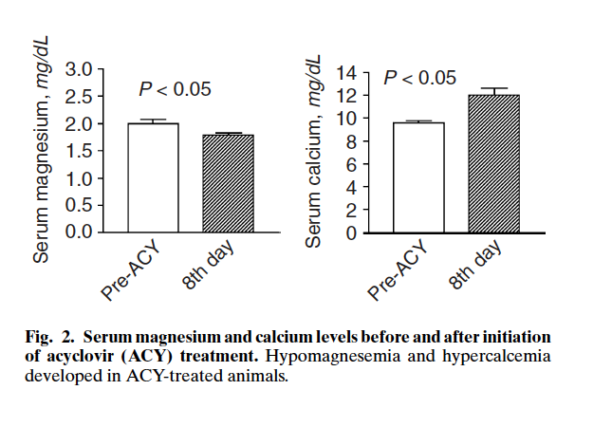
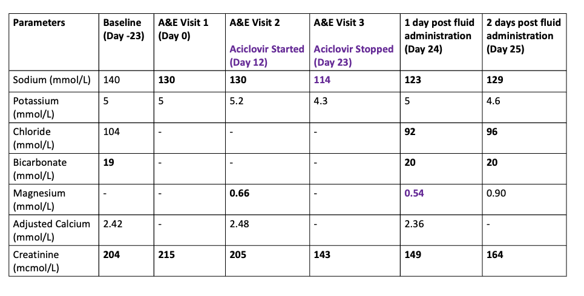
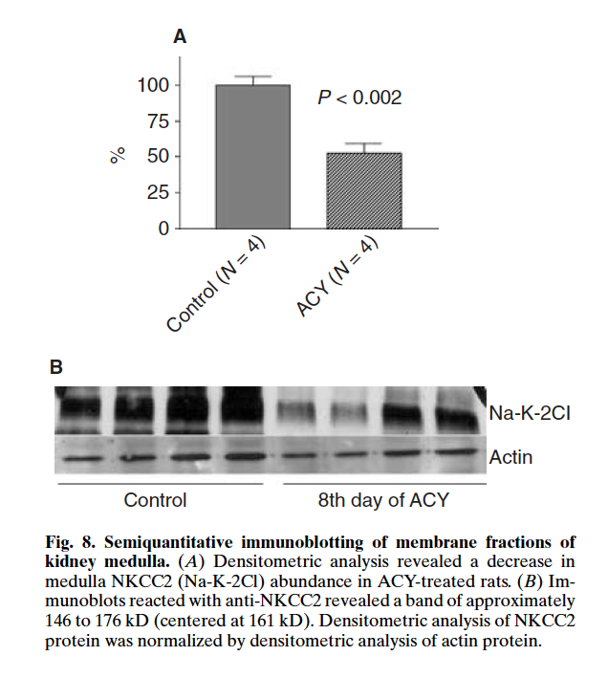
Hypothesis
ACY treated rats: measurements made on Day 8 of ACY treatment.
Increased urinary Na+ excretion.
Decreased NKCC2 mRNA and protein expression.
Reported Hypomagnesemia associated with Hypomagnesuria.
Downregulation of AQP2 expression
Andrade, L., Rebouças, N.A. and Seguro, A.C. (2004) ‘Kidney International’, 65(1), pp. 175–183. doi:10.1111/j.1523-1755.2004.00359.x.

Slide 5
Learning Points
DIAGNOSIS:
Recognition of shingles in immunocompromised populations
Shingles may present atypically awareness avoids delayed diagnosis
MANAGEMENT
Appropriate hydration and dose modification when treating Aciclovir is important in renal impairment, older patients
Awareness of drug interactions and side effects
Acyclovir may contribute to renal tubular dysfunction resulting in hyponatremia and hypomagnesemia

