Slide 1



Green Plan
Healthy planet, healthy people
Our strategy for 2025-2028

Slide 2
Contents
Executive Summary
Where are we now?
What do we want to achieve?
How do we get there?
Glossary of terms
Appendices
Green Plan

Slide 3

Foreword
We’re all part of this big wonderful life system we call the planet. It’s our home, we belong here. We know that our planetary ecosystem provides the basis for human health. You could say the ecosystem is our life support system. We simply cannot have healthy people without a healthy ecosystem. And we know that climate change and biodiversity loss will have profound impacts on the health of the population we serve, as well as our ability to deliver those services. We also recognise that we are part of the problem, burning fossil fuels and using scarce resources in the day-to-day delivery of healthcare. So, we must change.
This plan sets out how we will change. We are committed to achieving environmental sustainability and in the process improving our performance on the three key areas of Care, Cost and Carbon. Our vision is that by 2028 we will have integrated sustainability into everything we do. I encourage you to be part of this change and support the Green Plan.
We will be guided towards our vision by the following principles:
The ecological principle – ecosystems are the basis of our health and wealth; ecosystems are our life support systems and the foundation of our economics too.
The prevention of pollution principle – we have a responsibility to prevent pollution of and damage to our ecosystems as that damages the health of the people we aim to care for.
The polluter pays principle – if we cause the pollution, we should be responsible for the costs of cleaning it up
The hierarchy approach – we will seek to prioritise prevention, then reduction, reuse and recycling of waste, materials, energy and water
The principles of a circular economy – mirroring the natural cyclical processes of ecosystems and maximising reuse and recycling of materials
Supporting regenerative processes – seeking to support ecological regeneration and the natural ability of life to heal
The principle of nonmaleficence – the obligation of a physician, as the ancient Greek physician Hippocrates said, “to do good or to do no harm“. We recognise that damaging the environment damages the health of our staff, patients and wider population, we have a responsibility to prevent harm and support health. That is the essence of our role and this Green Plan.
Jacqueline Totterdell
Group Chief Executive Officer
Green Plan
Notes:
New slide Forword to draw out the link with healthcare and a healthy planet/ecosystem.
Included the Principals from separate slide.
Added JT sign off to give weight to the doc.

Slide 4
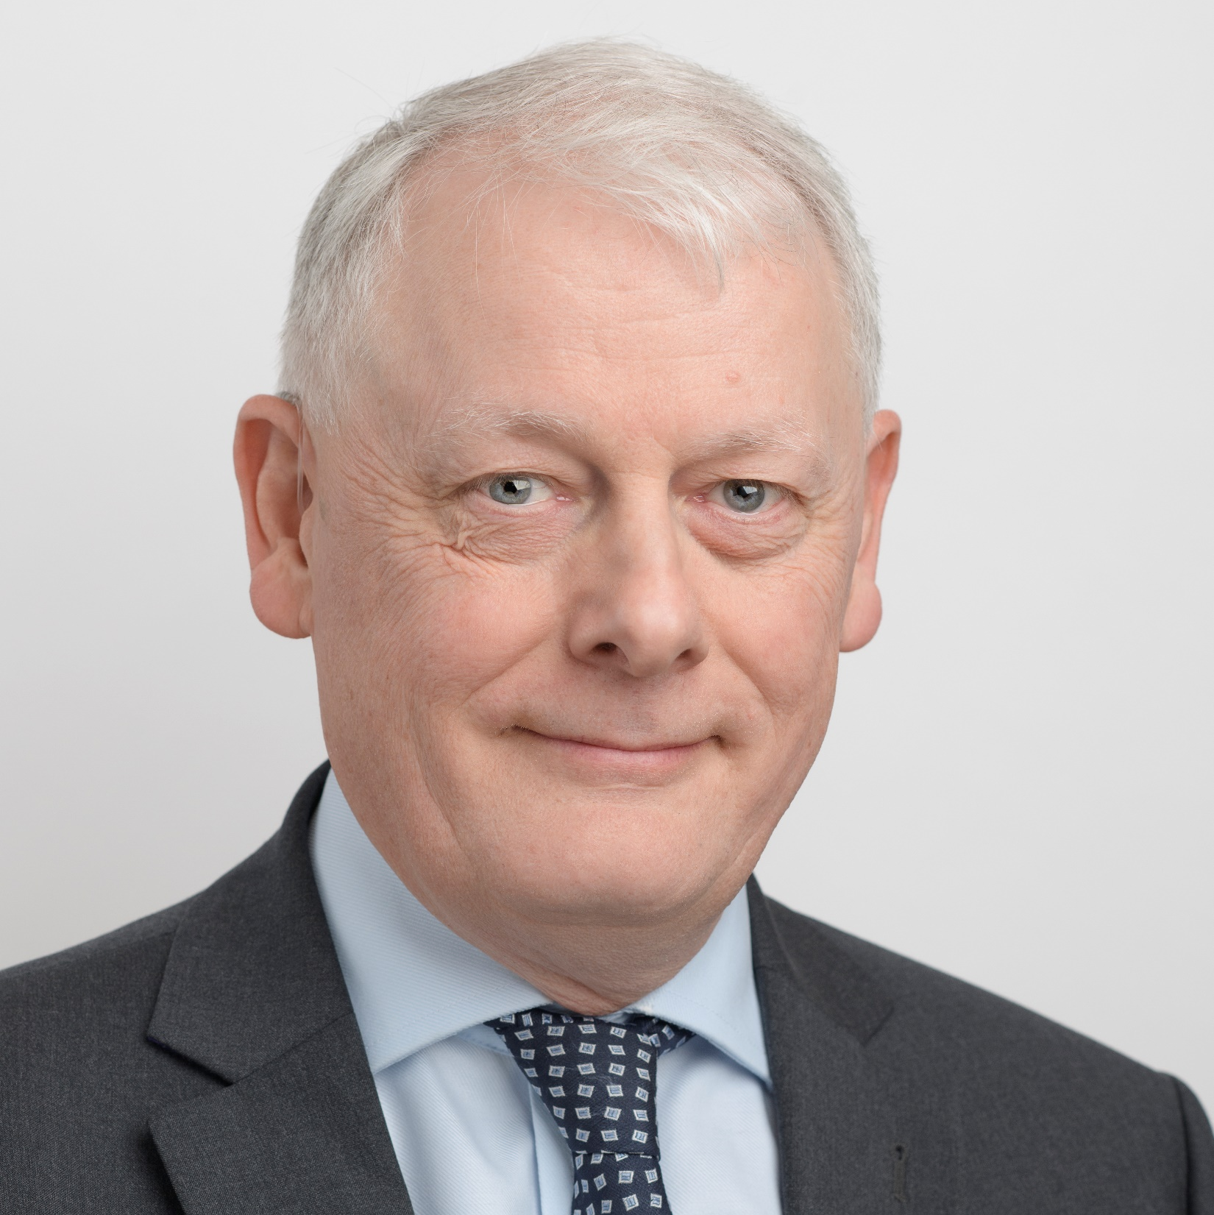
Executive Summary
This strategy is an enabling strategy for our overarching CARE Strategy and vision of ‘Delivering outstanding care, together’ it sets out:
How we intend to meet the legal and policy requirements around sustainability including Net Zero Carbon
Our own strategic objectives and targets
Our governance arrangements for how we will manage, monitor and continually improve our performance
Our vision is that we will integrate Net Zero Carbon into everything we do.
Environmental sustainability and Net Zero Carbon present significant challenges and we have set out objectives for our four domains:
For Clinical Transformation we will enable our clinical staff to make sustainable improvements to their workplaces bring in best practice and innovation.
For Leadership and Workforce, we will ensure the Group leadership teams are actively engaged in the Green Plan, supporting its delivery and championing its vision and aims. Our staff across the Group will be supported and enabled to make change through a program of training and communications.
For Estates and Facilities, our buildings and operations will move away from fossil fuel to electricity from renewable sources. We will promote low emissions and active travel to staff, offer healthy sustainable food, maintain flourishing grounds, minimize our waste, construct energy efficient new buildings, move to an electric fleet, and ensure we’re adapting to climate change.
For Procurement, we will support and promote sustainability, social value as well as circular economy principles within our procurement activity. We will seek environmentally friendly suppliers who can demonstrate a commitment to achieving Net Zero Carbon and we will apply best practice i.e. buying products from sustainable sources that can be reused, repaired and recycled, and avoiding single use products.
Mark Bagnall
Group Chief Facilities, Infrastructure &
Environmental Officer.
Board Lead for the
Green Plan
Green Plan
Notes:
Reworded the exec summary to summarise the strategy.

Slide 5


Where are we now?
Green Plan
Notes:
Added the vision to this section. I’ve simplified the vision. But make reference to vision in the exec summary of ‘environmental sustainability’

Slide 6

The Green Plan is a key part of Our Care Strategy
CARE Strategy
Quality Strategy
Green Plan Strategy
Digital Strategy
Estates Strategy
People Strategy
Research & Innovation Strategy
The Green Plan is one of six enabling strategies that run throughout the organisation enabling ‘Outstanding Care, Together’ to be achieved.
The CARE strategy states:
“We will have reduced our carbon footprint, and be on our way to net zero by 2040”
“Becoming an increasingly sustainable group of hospitals is a growing priority due to the climate emergency and the link between environment and health.”
Green Plan
Notes:
Slide added – to draw out the links with wider strategy

Slide 7
The wider context
Net Zero Carbon by 2050
In June 2019 the UK government adopted the legally binding target of achieving Net Zero Carbon by 2050. Enacted through the Climate Change Act of 2008, this enables the UK to achieve its nationally determined contributions and help the international community to achieve the Paris Agreement 2015 target of limiting global warming to 2°C by the year 2100, with an aspiration of 1.5°C.
Net Zero Carbon by 2040
The NHS Vision: To deliver the world’s first net zero health service and respond to climate change, improving health now and for future generations.
In October 2020, the NHS became the world’s first health service to commit to reaching Net Zero Carbon recognising that climate change has direct consequences for patients, the public, and the NHS as a whole. In July 2022, the NHS embedded the net zero requirement into legislation, through the Health and Care Act 2022. This places a duty on NHS England, and all trusts, foundation trusts, and integrated care boards to contribute towards emissions reduction and environmental targets.
The Act requires commissioners and providers of NHS services specifically to address the net zero emissions targets. Trusts and integrated care boards (ICBs) will meet this new duty through the delivery of their localised Green Plans, and every Trust and ICB in the country is also required to have a board-level lead.
National
Ambition
The NHS
Vision
Green Plan
Notes:
Added Mark as Board Lead for the Green Plan

Slide 8
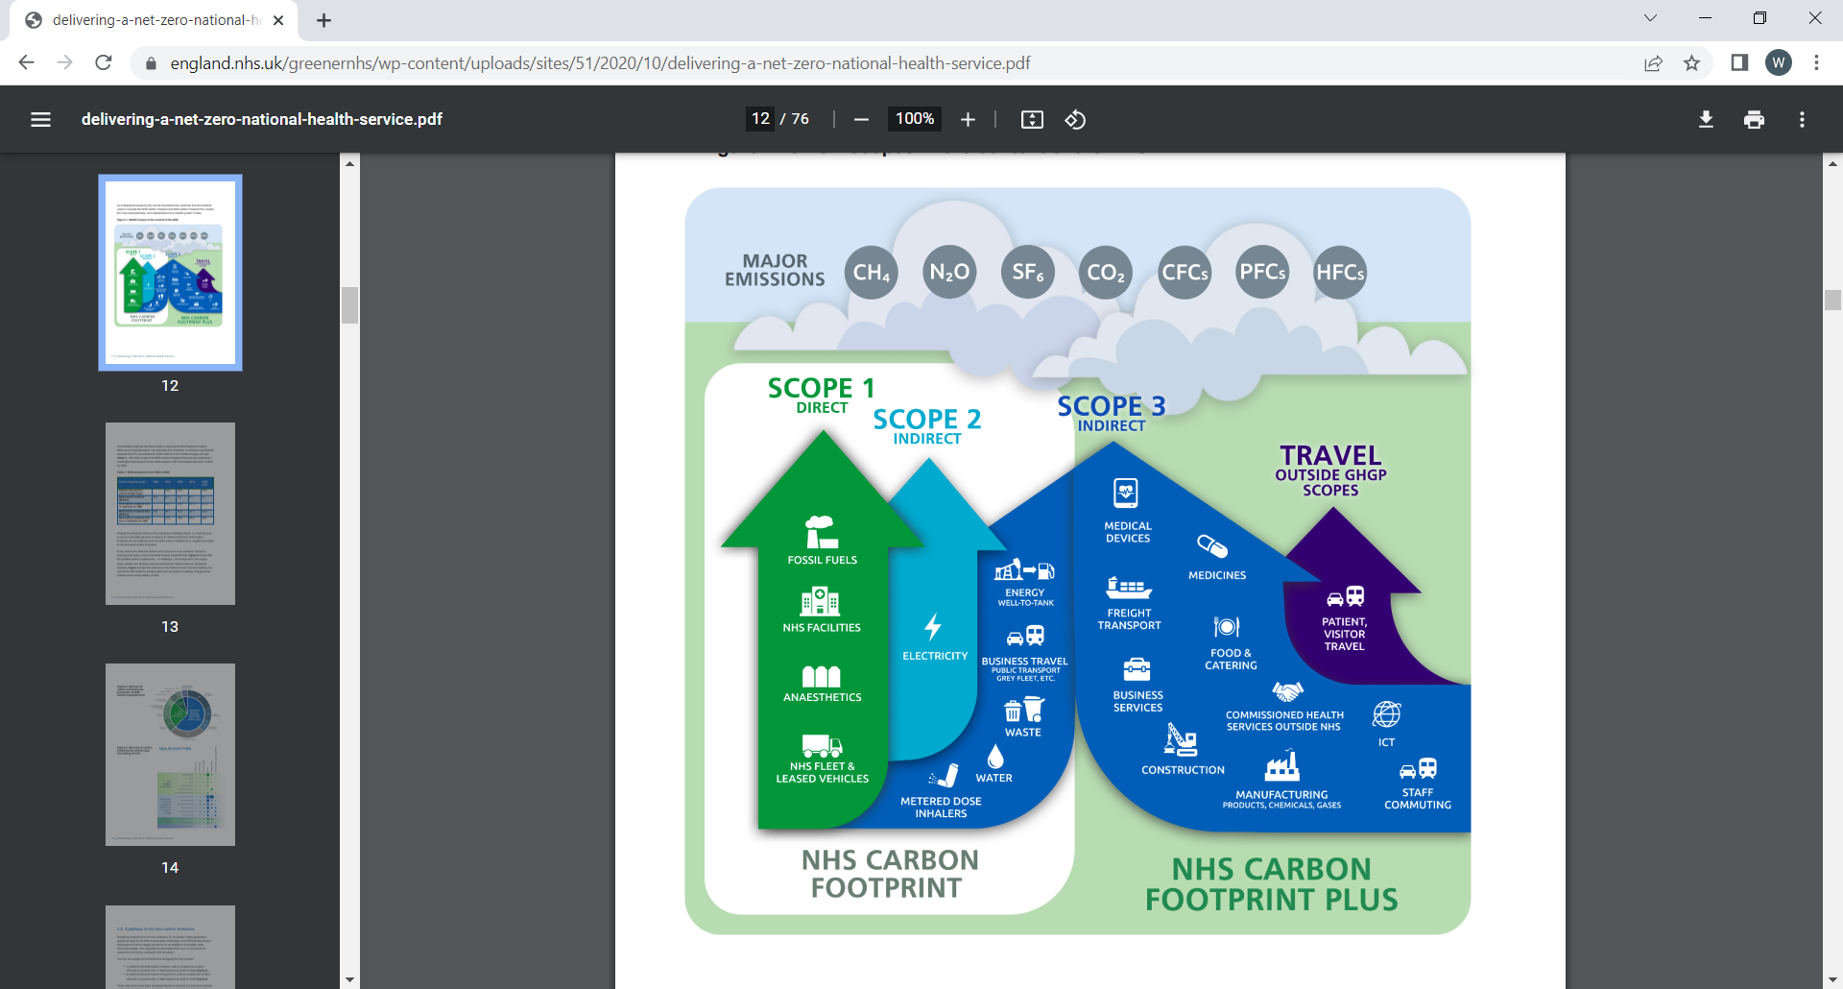
The NHS Net Zero targets
For the emissions we control directly we will reach net zero by 2040, with an ambition to reach an 80% reduction by 2028 to 2032 (the NHS Carbon Footprint).
For the emissions we can influence we will reach net zero by 2045, with an ambition to reach an 80% reduction by 2036 to 2039 (the NHS Carbon Footprint Plus).
Against the 2019/20 emissions footprint baseline:
  Carbon Footprint, reducing emissions by at least 47% by 2028-2032;
  Carbon Footprint Plus, reducing emissions by at least 73% by 2036-2038.
Green Plan
Notes:
Added the targets in a separate slide here to highlight their importance.

Slide 9
Where are we now?
Work to improve sustainability has been underway for some time through the St George’s Green Plan agreed by Board in July 2021, and the Epsom & St Helier Green Plan agreed at Board in June 2023. Some excellent progress has also already been made at both St George’s and Epsom & St Helier, including most recently:
A successful bid application for over £3.14m from Greener NHS to install LED lighting across the group potentially saving over £1m per year and over 1000 tonnes of carbon.
A successful bid applications for £468k from Great British Energy to install solar photovoltaic panels at St George’s Hospital. We should be able to generate over £60k of electricity and save 60 tonnes of carbon each year.
gesh
St George’s (SGUH) An Estates Decarbonisation Strategy document has been produced, giving a pathway to Net Zero We have developed the UK’s first SMART theatres, reducing energy use and improving patient flow and outcomes We have ended the use of highly polluting anaesthetic gases, moved to low carbon methods of administering anaesthetics, decommissioned our Nitrous Oxide manifold and installed Nitrous Oxide cracking technology A programme of work has been implemented encouraging active travel e.g. Cycle to work events held, Dr Bike (free bike repair workshops for staff), Cycle to Work Scheme, and offering only ULEZ compliant and electric lease cars | Epsom & St Helier (ESTH) A Heat Decarbonisation Plan document has been produced by an external contractor through the Low Carbon Skills Fund, giving a pathway to Net Zero for our estates. A programme of work implemented encouraging active travel e.g. Staff travel survey, Travel Plan, Cycle to work events held, Dr Bike (free bike repair workshops for staff), Cycle to Work Scheme, and offering only ULEZ compliant & EV lease cars Low carbon patient menus have been implemented Tree planting scheme in place Grant received for walking aid return scheme
Green Plan
Notes:
Updated with high level funding we have won recently. Removed ref to CARE strategy text as added prior slide

Slide 10
Financial sustainability
Delivery of this Green Plan will also support financial sustainability longer term for gesh by:
Reducing costs due to improved efficiency and lower energy demand
Future proofing the Trust against energy price shocks and by minimising the risk of emergency expenditure from climate issues such as flooding and heat waves
Reducing the risk associated with supply chain partners by choosing those tackling their own carbon emissions and environmental impacts
Delivering benefits of the circular economy by building sustainability into new contracts e.g. reusable, remanufactured, recyclable and low impact equipment and supplies that can save costs in the long run
Improving the performance of clinical service delivery through efficiency savings, better use of staff time, and through reduced use of materials, transportation, and energy
Acting as an anchor organisation communicating the co-benefits of environmental sustainability (e.g. active travel) thus improving health of patients and reducing the strain on services
To ensure delivery of commitments and funding to support this Green Plan we will investigate and explore external funding opportunities, alternative finance options, and innovative mechanisms designed to keep costs of change low. An indicative outline of the financial benefits of delivering this Green Plan is in development.
Financial sustainability
Green Plan
Notes:
Updated highlighted text

Slide 11
Key challenges
Finance
In a financially challenging environment, internal and external funding needs to be accessed for longer term sustainability initiatives e.g. electric vehicle pool cars and charging points, and for developing and delivering investment grade proposals for estates heat decarbonisation. Improving levels of front-end investment to deliver longer term financial efficiencies and carbon reduction will be needed
Building capacity and capability around “green” issues. Understanding needs to be developed across gesh that achieving sustainability is a requirement for the whole organisation not just estates and facilities
Given that sustainability has many factors, setting up robust Group oversight whilst also having site-based action plans, and real ownership of actions within all sustainability workstreams is a challenge. We will develop robust reporting assurance across the group.
Capacity and capability
Accountability
Green Plan
Notes:
Added section highlighted

Slide 12
Opportunities
Scale and spread
  The benefits of Group level collaboration provide a real opportunity to scale and spread what is working well at each site and to share sustainability resources e.g. training, education and awareness raising materials
Building a reputation for sustainability
  Delivering the gesh Green Plan will improve the reputation and standing of the organisation as a centre of sustainability excellence. gesh has already led the way with nationally significant projects such as SMART theatres and the maternity departments Central Destruction Unit.
Improved outcomes and efficiency
  Using a continuous improvement approach to deliver the Group Green Plan will lead to efficiency savings, better clinical services and improved outcomes for patients
Working Collaboratively
Learning from and sharing best practice with our PFI partners, local community partners the South-West London ICB, the local authorities Wandsworth, Merton and Sutton, the Greener NHS team and the NHS Estates team.
Green Plan
Notes:
Added highlighted text,
Added Working Collaboratively

Slide 13
What do we want to achieve?
Green Plan
Notes:
Added the vision to this section. I’ve simplified the vision. But make reference to vision in the exec summary of ‘environmental sustainability’

Slide 14
Our vision: we will integrate Net Zero Carbon into everything we do
Outstanding care will be provided across the Group in an environmentally sustainable manner
We will have integrated environmental sustainability into our clinical quality improvement processes
Where care can be provided more sustainably using digital technology we will default to this
We will produce minimal waste and be meeting national waste targets
Our current and new infrastructure will be sustainable, and resilient to the impacts of a changing climate
Patients, staff and the public will benefit from flourishing grounds and healthy sustainable food
We will transition to an electric fleet, generating minimal harmful air pollution
We will enable and encourage all staff, patients and visitors to use low emission travel
We will support and promote sustainability, social value as well as circular economy principles within our procurement activity.
We will seek environmentally friendly suppliers who can demonstrate a commitment to achieving Net Zero Carbon and we will apply best practice i.e. buying products from sustainable sources that can be reused, repaired and recycled, and avoiding single use products.
The Group leadership teams will be actively engaged in the Green Plan, supporting its delivery and championing its vision and aims.
Our staff across the Group will be supported and enabled to make positive changes to their workplaces, operations and systems to promote sustainability
Clinical
Transformation
Clinical
Transformation
Leadership & Workforce
Estates & Facilities
Procurement
Green Plan
Notes:
Added the targets in a separate slide here to highlight their importance.

Slide 15
Domains
Clinical Transformation
Leadership & Workforce
Estates and Facilities
Procurement
Green Plan
Notes:
Removed Travel & Transport, added Leadership & workforce

Slide 16
Clinical Transformation
Where are we now?
Clinical transformation is key to achieving sustainability, and this area covers optimising prescribing, substituting high carbon products for low-carbon alternatives, and making improvements in service delivery and waste processes. Additionally, development of more sustainable clinical models of care will also help to prevent unnecessary journeys through improved preventative medicine and enhanced digital care. So far, the following progress has been made:
  We have decommissioned use of desflurane across gesh, moved to TIVA pumps and oral anaesthetics, significantly reducing the clinical carbon footprint
  St George’s have closed 3 of the 4 nitrous manifolds in 2024, and ESTH are planning to close the nitrous oxide manifolds in 2025
  Clinicians have been involved in the SMART theatres project and in implementing the Intercollegiate Green Theatre Checklist
  We have started the roll out of the clinical engagement workshops aimed at implementing a sustainable quality improvement process for all clinical departments
Green Plan
Notes:
Updated and added highlighted text.

Slide 17
Clinical transformation
What do we want to achieve? | How will we get there?
Sustainable models of care - we will deliver improvements in the three key areas of Care, Cost and Carbon. We will take a whole systems approach to the way care is delivered. Our approach will embed consideration of sustainability into any existing or new clinical model/ service change. | We will support our clinical and operational teams to consider sustainability in their delivery of care through a Quality Improvement process by: Developing Sustainable Quality Improvement process and a programme of communication/ engagement for all clinical departments We will help them to learn from our own successes, the professional bodies and national best practice. Ensuring sustainability is embedded as a requirement for consideration in any future service change Supporting programmes of work to avoid clinically unnecessary interventions and the procurement of sustainable products and equipment Maximising digital delivery of care e.g. outpatient follow up activity Seeking to deliver patient care in community-based settings closer to people’s homes Promoting preventative healthcare and lifestyle changes that support sustainability e.g. active travel, healthy diets.
Medicines - our clinical teams will be supported to optimise prescribing for example, by reducing the use of inhalers, nitrous oxide, and anaesthetic gases. We will have low levels of drug waste and will have minimised our emissions from medicines. | We will implement plans to optimise sustainability in pharmacy. This will include: Manifold closures to reduce wastage (leaks) Introduction of N₂O cracking for patient-controlled delivery Promotion of Sevoflurane as the preferred anaesthetic gas Moving to TIVA for anaesthetics Increase of dry powder inhaler prescriptions and reducing/ recycling Metered Dose Inhalers Developing a programme of awareness raising for staff Minimising drug waste and over prescription
Green Plan
Notes:
Updated highlights

Slide 18
Leadership & Workforce
Where are we now?
This domain covers the essential role leadership and the workforce in general plays in delivering the aims of the Green Plan. Good progress has been made to date with the following success:
  We hold Trust level steering group meetings with the managing directors for both sites.
  We have a governance structure agreed at the group level.
  We have active working groups for each of the workstreams and key projects
  We have active staff led groups for Theatres, ED and ICU
  We have an active group Green Champions Group with representatives from throughout the organisation
  We have specialist groups like the Bicycle User Group
Green Plan

Slide 19
Leadership & Workforce
What do we want to achieve? | How will we get there?
Leadership The Group leadership teams will be actively engaged in the Green Plan, supporting its delivery and championing its vision and aims. | We will implement the governance structures and performance reporting for the group including: Integrating the Green Plan Steering Group into existing leadership meetings Ensuring the workstream areas have a nominated lead and support group Developing a performance report including a dashboard of indicators Fully integrate sustainability and Net Zero Carbon into financial decision making at all levels Ensure capital investment is allocated to deliver longer term efficiencies and Net Zero Carbon
Workforce Our staff across the Group will be supported and enabled to make positive changes to their workplaces, operations and systems to promote sustainability | We will develop and deliver a staff training, awareness and communications program ensuring that All staff have the opportunity to access a Group programme of sustainability training and education from Board level down, this will be role specific and key to increase education and raise awareness in clinical and corporate teams Staff are enabled and empowered to take personal responsibility for integrating sustainability into everything they do and will support this with SusQi. The Green Plan Team is in place to enable ongoing delivery of the Green Plan Working with the Group Communications team to share sustainability messaging Working with HR to include the Green Plan objectives into job descriptions Working with the Wellbeing and Health and Safety teams to align sustainability messages and promote the importance for workforce wellbeing
Green Plan
Notes:
Slide added

Slide 20
Where are we now?
This domain covers all functions which are responsibilities of Estates and Facilities including: waste, energy, capital projects, landscape & biodiversity, adaptation, food & nutrition, and travel & transport. The Green Plan Team is embedded in Estates & Facilities. Estates & Facilities is therefore at the heart of Group action on sustainability and has made some great Progress already:
  St George’s have developed the SMART Theatres project saving £393,900 in energy costs and 254,484 kgC02e reduction every year
  We are replacing the fleet cars with Electric Vehicles (EVs)
  Both St George’s and Epsom & St Helier have diverted all of their waste from landfill
  Our capital projects, the new Intensive Care Unit is targeting a Building Research Establishment Environmental Assessment Method (BREEAM) rating of “Excellent”. The Renal and the Specialist Emergency Care Hospital in Sutton are now on pause but have both targeted “Outstanding”.
  Our estates strategy is being informed by the Green Plan and Decarbonisation Strategies for St George’s and Epsom & St Helier
  We have an abundant and varied set of gardens that provide a healing resource for staff, visitors and patients across gesh
  We have low carbon patient and canteen menus in place, digital ordering for the patient menu, and have moved to reusable cutlery and crockery and waste food recycling in the canteens across gesh
  We have ensured all Trust Vehicles (owned and leased) are ULEZ compliant across gesh
  Also across gesh only Low Emissions Vehicles (LEV) and Zero Emissions Vehicles (ZEV) vehicles available to staff through Trust lease scheme
  A Travel survey is being completed across the group and will inform a Travel Strategy.
  A digital parking system was introduced in April 2024 at ESTH saving the equivalent of 350 trees per year compared with the scratch card system
  Cycle to work schemes are in place for staff with active cycling groups at both Trusts and the Cycle2Work scheme is available for staff across the group (includes electric bikes) and DASH cycle hire scheme is also available for staff at St George’s
  “Dr Bike” free bike repair is available across both Trusts
Estates and Facilities
Green Plan
Notes:
Highlighted text confirmed

Slide 21
Estates and Facilities
What do we want to achieve? | How will we get there?
Energy - we will be delivering key elements of our roadmap to 80% carbon reduction by 2028-32 and net zero carbon by 2040 and have moved a significant portion of the estate from gas to electric heating. Significant upgrades will have been made to more efficient fabric, low energy lighting, and smart metering. We will have minimised our local air pollution emissions and delivered energy efficiency work. | To do this we will deliver our Estates Decarbonisation Strategies for each site. This will include: Mapping the pathway to move from gas to all electric heating and cooling Improving the efficiency of our building fabric, lighting, and HVAC systems Applying for funding for further decarbonisation support to replace equipment coming to the end of its life through upcoming phases of the Public Sector Decarbonisation Scheme (PSDS) and Low Carbon Skills Fund (LCSF) A review the requirements for connection to the local electrical Distribution Network Operator, Developing the on-site renewables capacity, electrical capacity and battery storage Promoting energy efficient behaviours and efficient use of our buildings
Capital projects - our new buildings and refurbishments (Intensive care unit, Renal, SECH) will all meet the NHS Net Zero Building Standard (NZBS) requirements and target the BREEAM ratings of “Outstanding” and “Excellent”, demonstrating sustainable construction and minimising embodied carbon, as well as reducing their operational energy demand. | We will achieve key standards in the delivery of all new capital projects (e.g. BREAAM and NZBS). We will: Ensure ongoing delivery in line with the requirements of the Net Zero Building Standard Integrate the requirements of BREEAM/ NZBS into business as usual and achieve them where appropriate
Green Plan

Slide 22
Estates and Facilities
What do we want to achieve? | How will we get there?
Waste - our waste volumes going to incineration will be low, and we will have improved segregation and recycling rates. In particular we will be achieving the targets for reducing the carbon footprint of our waste to Net Zero and implementing the requirements of the Clinical Waste Strategy 20/20/60. | To do this we will deliver national Clinical Waste targets, ensure that the waste targets are embedded in relevant contracts, minimise waste production, improve segregation and recycling, aiming for net zero carbon from waste.
Adaptation - our approach to adapting to climate change will be well defined, with clear protocols and risk assessments across the Group to respond to heat waves, cold weather, floods and other aspects of climate change and their impact on clinical services. | We will develop and implement a group Climate Adaptation Plan for responding to the changing climate. This will assess the vulnerability of the existing group estate against a list of key climate scenarios. We will develop a group wide climate risk assessment with consideration of longer-term potential issues and the impact on clinical services e.g. flooding and overheating.
Landscape and biodiversity - we will be recognised as a leader in this area, with a robust landscape & biodiversity management plan in place across all current and future group sites. We will work in partnership with our patients, staff and communities to enhance our biodiversity and connection to it. | We will develop and implement a group Landscape & Biodiversity Management Plan. This will include a review of open spaces across all current and future sites to prioritise the maintenance and development of landscape and biodiversity. We will identify opportunities to engage with staff, public and local communities to support ongoing promotion and development of biodiversity and wellbeing.
Green Plan

Slide 23
Estates and Facilities
What do we want to achieve? | How will we get there?
Food and nutrition - our delivery of food and nutrition across gesh will ensure minimal food waste, organic certification of products, delivery of low carbon menus, local sourcing and reduced food miles, and enhanced nutritional content. | We will integrate sustainability into the delivery of food and nutrition by identifying further opportunities for improvement in food waste reduction, improved purchasing and provision of ‘sustainable’ food e.g. organic certification, low carbon, locally sourced, and minimal waste
Transport The Group will be well along its roadmap of transition to an electric fleet with pooled community cars and couriers, shuttle buses, and an electric Patient Transport fleet generating minimal harmful air pollution | We will transition to low carbon transport and an electric fleet. This will entail: Reviewing requirements and opportunities for infrastructure/ investment and funding for electric vehicle charge points Develop new vehicles leases for pooled/ community/ courier vehicles The Non-Emergency Patient Transport Service vehicle provider to offer a proposal for charging infrastructure and transition to an all-electric fleet
Travel Our staff across the Group will be able to work flexibly as appropriate and supported to choose sustainable methods of transport for their commute, with high levels of staff using active travel | A key focus will be to promote active travel for staff, patients and the public: We will prioritise promoting the health and cost benefits to staff of active travel as well as the reduction in air pollution A travel survey will be carried out annually and actions determined from staff feedback Criteria for staff parking across the Group will be reviewed and aligned An investment programme to be determined for staff cycling facilities A programme of awareness raising will be developed for staff to include information on public transport/ active travel and air quality awareness We will continue to work to develop air quality monitoring and communication
Green Plan
Notes:
Updated highlighted text

Slide 24
Where are we now?
The NHS supply chain accounts for approximately 62% of total carbon emissions and is a clear priority area for our Green Plan. We can use our purchasing power and decision-making processes to reduce carbon embedded in our supply chains. For example, reducing the use of clinical and non-clinical single-use plastic items, reusing or reprocessing equipment (such as walking aids) and considering lower carbon alternative supplies, such as reusable equipment. Progress to date includes:
    All relevant procurements include at least 10% of the evaluation weighting on criteria assessing social value and sustainability, with these themes embedded across the contract lifecycle within supplier KPIs as part of the ongoing contract management process.
    From April 2024, a full Carbon Reduction Plan is required for procurements of over £5m p.a. and a Net Zero Commitment is required for procurements of under £5m p.a. that are above the PA23 threshold.
    Developing a sustainable procurement working group and updating procurement processes across the Group.
    Encouraging suppliers to go beyond minimum requirements and engage with the Evergreen Sustainable Supplier Assessment.
Procurement
Green Plan
Notes:
Reworded text using the NHS guidance doc

Slide 25
Supply chain and procurement
What do we want to achieve? | How will we get there?
Supply chain and procurement - we will be an ethical and sustainable procurer of goods and services, with clear requirements for all our suppliers to outline their own sustainability plans and pathway to net zero. We will implement the principles of a circular economy prioritising products that can be reused and recycled. Greatly reducing single use plastics, substituting high carbon products with low-carbon alternatives and procuring products from sustainable sources. | We will build sustainability requirements into procurement processes and contracts using evaluation weightings, KPIs and ongoing contract management and: Review procurement spend to identify high carbon products and contracts and develop a plan to tackle these as a priority Ensure social value/ sustainability has 10% weighting for all relevant tender contract scoring Make sure KPIs for sustainability are built into all new relevant contracts The procurement team will engage with all suppliers on net zero requirements We will review goods and services purchased against relevant sustainability criteria develop and promote a programme to ensure we procure products that are reusable, repairable, recyclable, have a low embodied carbon footprint and are from sustainable sources. We will remove any unnecessary single use plastics from supply chain by 2028.
Green Plan
Notes:
Deleted “Ensure plastic packaging purchase contains at least 30% recycled plastic”

Slide 26
Enablers
This Green Plan will support delivery of the Quality Strategy, specifically the priority domain of “sustainably resourced”
We will implement the principles of ISO14001 to ensure the consistency and rigour in developing appropriate management systems
The Digital Strategy will align with the Green Plan in terms of leveraging the benefits of digital innovation e.g. use of patient apps to encourage patient access and communications
We will work closely with other stakeholders who utilise our estate or where we lease estate, particularly with City St George’s University to ensure we are delivering against our sustainability vision in a collaborative manner
We will also work closely with colleagues at SWL ICB, the NHS Estates Sustainability team and national Greener NHS team to deliver our plan
Quality and Digital Strategies
Partnership approach
Green Plan

Slide 27
How do we get there?
Green Plan
Notes:
Added the vision to this section. I’ve simplified the vision. But make reference to vision in the exec summary of ‘environmental sustainability’

Slide 28
Implementation approach
The Green Plan Team will manage implementation of the Green Plan and coordinate an annual review of the plan and update it as required.
We will develop a road map of the high-level milestones for achieving the strategy phased over the four years of delivery and review progress annually
We will develop annual action plans for each year of the strategy which will contain the detailed actions required to step gesh towards delivering key strategic objectives in each of the four domains
  Work to define the financial cost/ benefit analysis of actions will be a key part of implementation planning to ensure financial benefits are derived through implementation
Implementation
Evaluating impact
  A scorecard/ dashboard will be developed with key metrics to track progress and report on progress including:
    Carbon emissions & energy use
    Waste management
    Travel and transport emissions
    Sustainable procurement
    Clinical transformation
    Cost savings
    Improvements in care
Green Plan
Notes:
Highlighted text added

Slide 29
Green Plan Governance
Board
The Board receives papers from each committee
Infrastructure Committee
FIC / SWLPP Committee
The Infrastructure Committee receives the Green Plan Progress Report from GEM considers and approves recommendations.
Quality Committee
Group Executive Meeting
The GEM acts as the gesh Green Plan Steering Group, receives the Green Plan Progress Report from SLT considers and approves recommendations at the group level.
Gesh Green Plan steering group
SGH & ESTH Site SLT
The Site SLT acts as the site Green Plan Steering Group considers and approves the Green Plan Progress Report. Recommendations for improving performance and management are agreed.
SWL ICB Green Plan Group
Site Green Plan steering group
Greener NHS / DHSC
The Green Plan Team facilitate the development, implementation and achievement of the Green Plan and create the Green Plan Progress Report. Reporting to wider NHS groups & SWL ICB as required.
Green Plan Team
Workforce & Leadership
Estates & Facilities
Energy
Waste
Food & Nutrition
Adaptation
Capital Projects
Travel & transport
Clinical provision
Sustainable Models of Care
Digital
Medicines
Procurement
The Domain/Workstream leads report progress to the Green Plan Team. Existing governance meetings used where possible e.g. Site E&F division meetings, clinical division meetings, SWL Procurement Partnership governance meetings.
Green Plan
Notes:
New slide added

Slide 30
Glossary of terms
Green Plan

Slide 31
Glossary
BREEAM | Building Research Establishment Environmental Assessment Method
DHSC | Department of Health and Social Care
EV | Electric Vehicle
ICB (SWL) | Integrated Care Board (South-West London)
KPI | Key Performance Indicator
LCSF | Low Carbon Skills Fund
LEV | Low Emissions Vehicle
NOx | Nitrous Oxide
NZBS | Net Zero Building Standards
NZC | Net Zero Carbon
PA23 | Procurement Act 2023
PSDS | Public Sector Decarbonisation Scheme
SECH | Specialist Emergency Care Hospital
SMART | Intelligent design
SWLPP | South-West London Procurement Partnership
TIVA | Total intravenous anaesthesia
ULEZ | Ultra Low Emission Zone
ZEV | Zero Emissions Vehicle
Green Plan

Slide 32
Appendices
Green Plan

Slide 33
Appendix 1: Consultation
We’ve consulted with our stakeholders on the key themes and detail of this gesh Group Green Plan - here’s what they said.
All staff | Staff responded to the Executive Question Time survey question “To what extent to you agree with this statement: I feel able to make green changes in my area” 1= not at all, 10 = completely with an Average of 4.725 (out of 161 respondents). We have developed all staff training and a program of Sustainable Quality Improvement as a result of this to engage staff where they work and to empower them to make positive changes.
Executive Team | Executive training on the Green Plan was held on 5 December 2024. We had positive feedback from the training with the Chairman and CEO convening a leadership action meeting in support of the Green Plan.
Green Champions | We have consulted with our Green Champions groups and integrated feedback into this plan.
Travel Survey | We have noted the views of staff, patients and visitors in developing our objectives and plans in this area.
Clinical Divisions & Departments | We have run a series of engagement presentations for clinical directorates and departments as well as consulted with existing clinical action groups. The feedback is that there is good support for the Green Plan aims but more could be done to engage clinical teams via quality improvement initiatives. We’ve made this the priority supported using a Sustainable Quality Improvement model.
Consultation
Green Plan
Notes:
Added this slide as a requirement from Greener NHS.

Slide 34

Appendix 2: Equalities & health inequalities
The solutions to the problem of sustainability needs to include the principles of equality and justice. Only global economic and social systems that prioritises the health of the planets ecosystems and a fair distribution of wealth will ultimately prove to be sustainable. We will strive to promote equality and reduce health inequalities as part of the Green Plan in line with the Public Sector Equality Duty. We will reach out to groups with protected characteristics to engage them in areas where they may be underrepresented.
Action | Impact | Groups impacted | How is the Green Plan helping?
Increasing active travel and use of public transport | Reduces air pollution, improves population fitness, reduces obesity, improves mental health | Those with disabilities or mobility impairments Staff working nights Local community Staff, Patients, Visitors | Working with TfL to extend bus routes where possible Carrying out regular travel surveys to understand needs of our stakeholders to develop a Sustainable Travel Plan. Supporting active travel with facilities, advice and support (e.g. Dr Bike, DASH cycle hire and cycle to work scheme).
Access to green spaces | Helps to cool urban areas, improves air pollution, reduces stress, improves physical and mental health | Patients Visitors Staff Local community | Maintaining the grounds and gardens as a resource for all. Applying for charitable funds to develop new green spaces
Improved energy efficiency | Improves air quality, saves money, reduces carbon emissions and climate change | Patient Visitors Staff Local community | Installing solar panels, LED lighting and developing feasibility studies for future funding applications reduces the impacts of air pollution and climate change for everyone.
Increase in plant-based diets | Helps to tackle obesity, improves physical and mental health, improves food security | Patients Visitors Staff | Increasing plant-based options in our restaurants and on patient menus promotes a healthy diet for all.
Health inequalities
Green Plan
Notes:
New slide addressing the Greener NHS requirement to include consideration of this topic.

