Slide 1
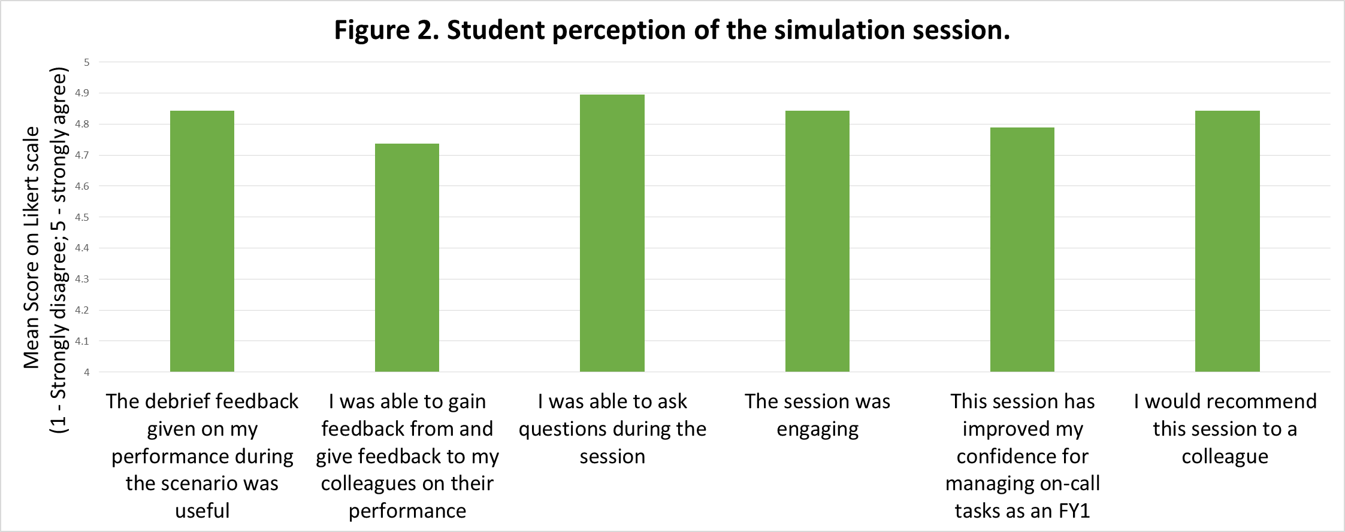
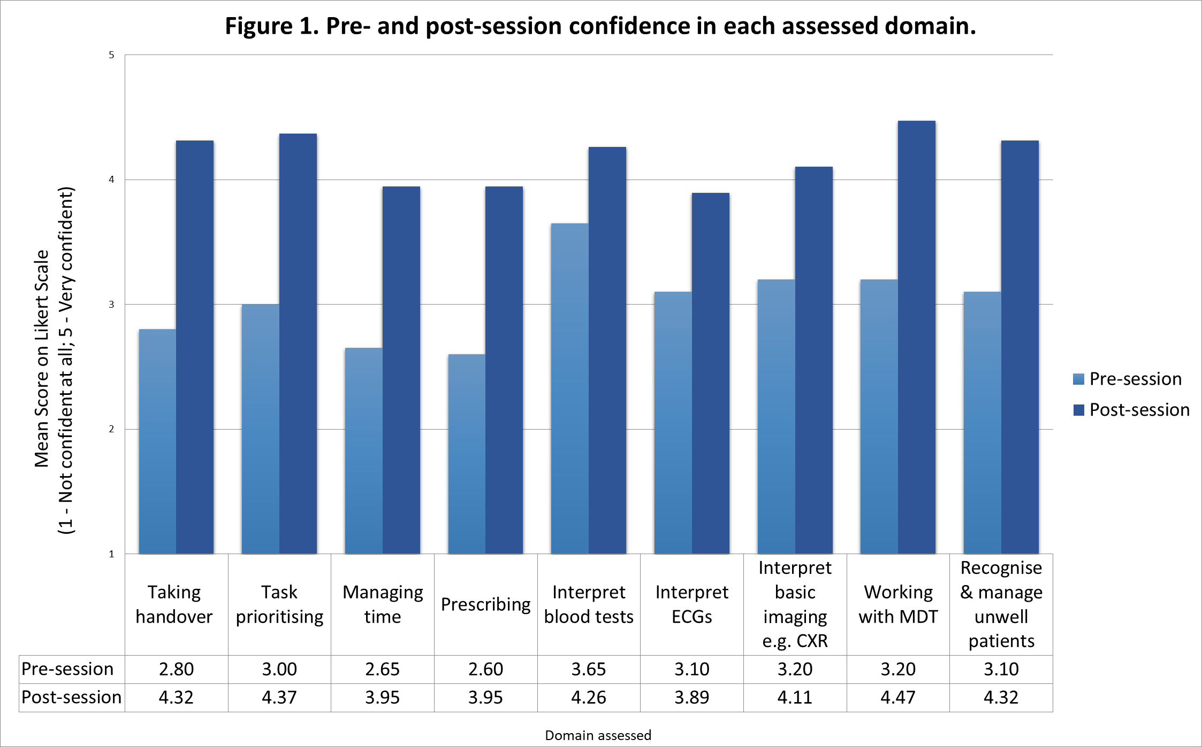
Improving student preparedness for foundation training, confidence in task prioritisation and multi-disciplinary team communication using on-call simulation training for final year medical students
Dr Emily Morrison, Dr Gareth Davies, Dr Charlie Anderson, Dr Etienne Chew
Undergraduate Department, Epsom & St Helier University Hospitals NHS Trust
1. Introduction
The transition from medical student to junior doctor is a well-recognised challenge. Leadership, decision-making in acute settings, complex communication and prioritisation are areas of practice where medical graduates feel less prepared.¹ An on-call simulation session for final year medical students at St Helier Hospital was delivered to improve student preparedness in these areas.
We aimed to extend the representation of real life by creating multi-task simulation scenarios to aid in the learning and assessment of prioritisation, decision making and a variety of clinical skills.
2. Methods
Final year medical students from St George’s, University of London participated in the session. The scenario began with a handover of clinical tasks, including prescribing, interpreting investigations, and reviewing an acutely unwell patient. Scenarios were designed to assess skills in task prioritisation, time-management, multidisciplinary communication, and clinical management. The students received ‘bleeps’, throughout the session, with extra tasks of varying urgency. A pre- and post-session survey explored student preparedness for foundation on-calls in the aforementioned areas. Students rated aspects on a Likert scale,² from 1 (very low/very unprepared/strongly disagree) to 5 (very high/very prepared/strongly agree). These surveys provided qualitative and quantitative data. The quantitative data was analysed via IBM® SPSS® Statistics 29.³ The qualitative data was analysed using thematic analysis.
3. Results:
20 students participated in the on-call sessions. Prior to delivery of the session, students rated their level of preparedness for managing on-call shifts as 2.6/5. Student confidence increased in all aspects evaluated; the greatest increase was demonstrated in ‘taking a medical handover’, from a mean of 2.8 to 4.3. Following the session, over 90% of students felt the session was engaging and improved their confidence in managing on-call tasks.
Quantitative Findings:
​Qualitative Findings​:
Thematic analysis of 19 responses to 'I liked the following about the session…' revealed four main themes. These were 'variety of tasks', and 'real life representation', both mentioned 8 times, and 'debrief/feedback' and 'facilitator input', mentioned 3 times. ​
Analysis of the 19 responses to 'the session could be improved by...' revealed multiple themes. The most common theme, 'tasks', had 5 responses and was subdivided into 'result interpretation', 'prescribing', 'procedures' and 'crash calls'. These comments either involved asking for more of existing tasks or suggesting new tasks. 'Equipment', such as improved manikins, was mentioned 3 times.
4. Discussion:
Our data shows that student's perceived confidence in preparedness for foundation training was improved by our multi-task and prioritisation simulation session. This suggests that expanding simulation from a single acute assessment to involve further tasks increases student confidence before starting foundation training.
The variety of tasks and improved representation of an on-call shift are potential contributing factors to improved student confidence, and a wider range of tasks may improve this further. Confidence is vital for student progression, and for effective decision making as a doctor.⁴ However, confidence alone may not be predictive of clinical performance.⁵
5. Conclusion:
The on-call simulation and prioritisation session improved student preparedness and confidence in key tasks and skills necessary for foundation training.
Where possible, multi-task and prioritisation simulation should be integrated across medical schools to improve student preparedness for foundation training. The combination of an objective assessment of student performance and student perceived confidence should be considered to further assess this simulation model
P<0.001 p<0.001 p<0.001 p<0.001 p=0.017 p=0.015 p=0.004 p<0.001 p<0.001
References
Gale T, Brennan N, Langdon N, Read J, Keates N, Burns L, et al. PREPAREDNESS OF RECENT MEDICAL GRADUATES TO MEET ANTICIPATED HEALTHCARE NEEDS GMC1203 Final Report. 2022.
Nemoto T, Beglar D. Likert-scale questionnaires. In: JALT 2013 conference proceedings. 2014. p. 1–8.
IBM. SPSS Statistics for Mac Version 29. 2023.
Copeland LG. DEVELOPING STUDENT CONFIDENCE: THE POST CLINICAL CONFERENCE. Nurse Educ [Internet]. 1990;15(1). Available from: https://journals.lww.com/nurseeducatoronline/Fulltext/1990/01000/DEVELOPING_STUDENT_CONFIDENCE__THE_POST_CLINICAL.1.aspx
Morgan PJ, Cleave-Hogg D. Comparison between medical students’ experience, confidence and competence. Med Educ [Internet]. 2002 Jun 1;36(6):534–9. Available from: https://doi.org/10.1046/j.1365-2923.2002.01228.x

