Slide 1
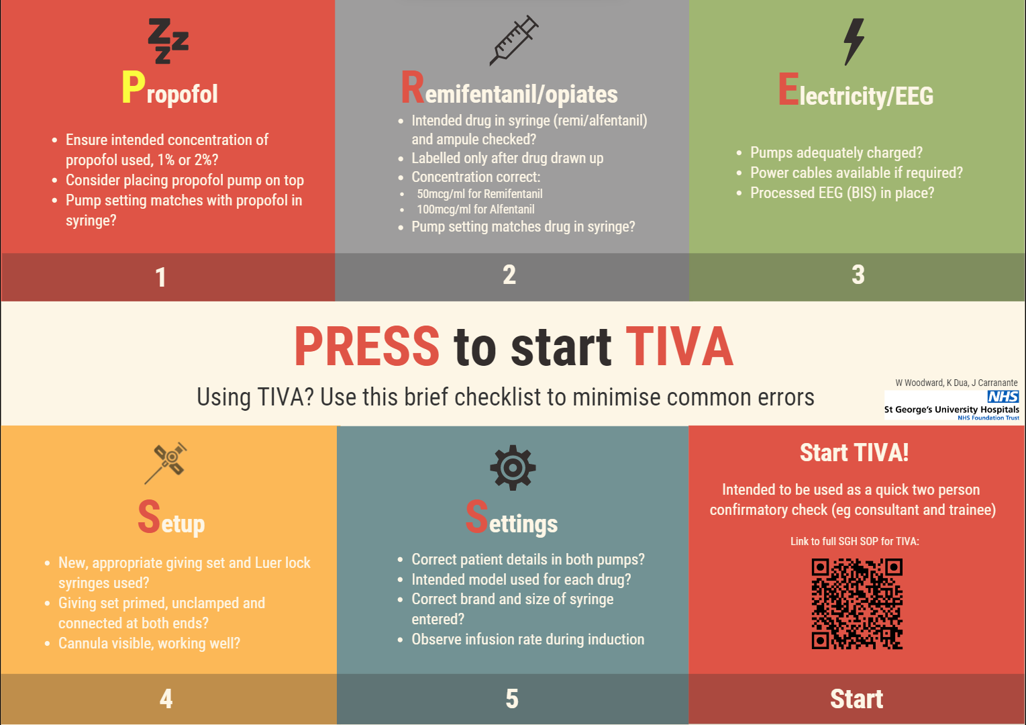
‘PRESS to Start’ - Introducing a TIVA checklist at a large teaching hospital
W Woodward, K Dua, J Carrannante
Introduction
Total intravenous anaesthesia (TIVA) is becoming more widely used, and as yet there are few safety checks for the use of TIVA when compared to inhaled anaesthesia. TIVA use more than trebled from 2013, used for 8% of total anaesthetics recorded, compared to 26% in 2021. [1] According to the 5th National Audit Project (NAP5) there is a higher incidence of awareness during TIVA than with inhaled anaesthesia. [2] Checklists have been introduced successfully at other centres. [3] In this study we aim to assess the feasibility and utility of introducing a TIVA checklist at our hospital.
Method
A survey was sent out to all consultant and trainee anaesthetists regarding their use of TIVA and errors they have seen in practice. A checklist was then created based on common errors reported in the survey, in NAP5 and using our hospital’s standard operating procedure.
The checklist was introduced by placing posters in all adult anaesthetic rooms, putting the poster up virtually on the hospital online forum, and the poster was also sent by email to all anaesthetists. We sent another survey a month after the checklist was introduced to assess the compliance, utility and to gain feedback.
Method used to check for errors?
Results
In the first survey, 64% (N=39) had seen an error with the use of TIVA. Of those using TIVA 70% of the time or more, 31% had seen an error in the last three months. 12% of those who had seen errors found that it led to patient harm. Only 33% of those surveyed used a method to double check for errors .
80% of those who used the checklist found it useful, 30% had corrected an error whilst using the checklist. 87% felt the checklist would prevent errors from being made. 86% of total respondents would use some method of checking for errors in future.
References
A. D. Kane, J. Soar, Patient characteristics, anaesthetic workload and techniques in the UK: an analysis from the 7th National Audit Project (NAP7) activity survey. https://doi.org/10.1111/anae.15989 2023
J. J. Pandit, T. M. Cook et al. NAP5 Full Report: Accidental Awareness during General Anaesthesia in the United Kingdom and Ireland. Chapter 18. The Royal College of Anaesthetists, 2014.
R. J. Fleming PERUSE before you infuse. Anaesthesia News. Issue 396, page 19. July 2020

