Slide 1
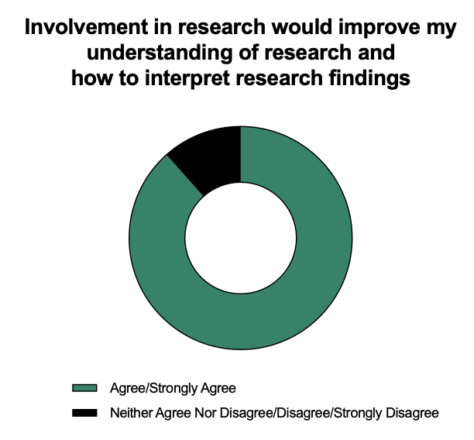
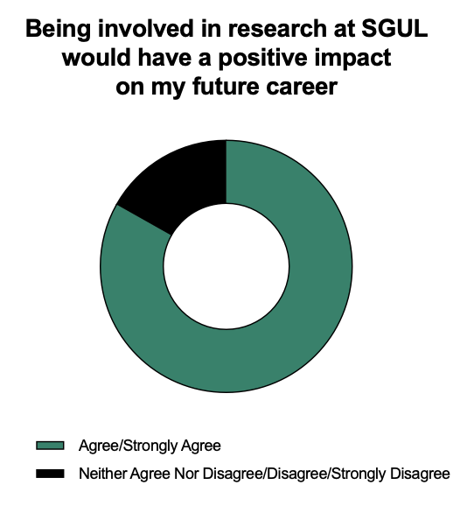
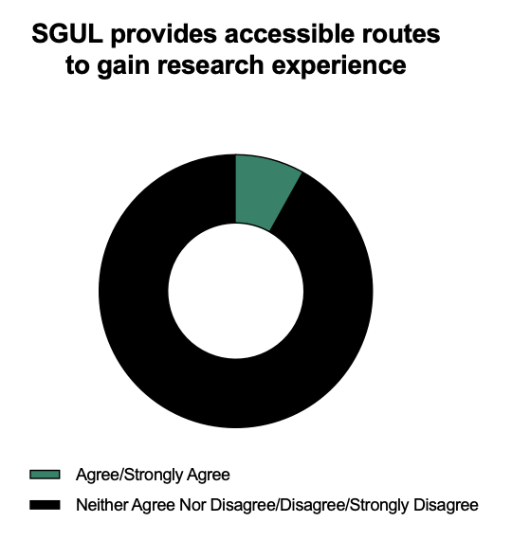
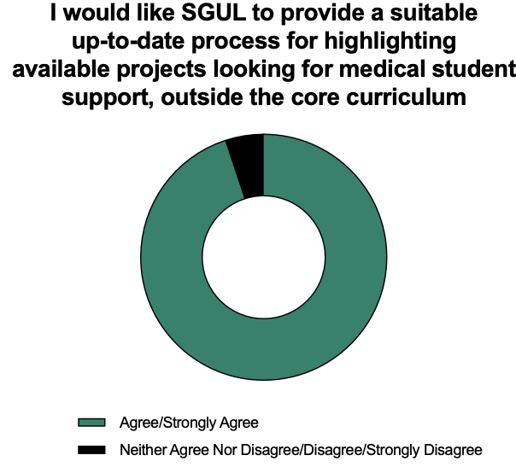
The Power of Staff-Student, University-Trust Collaboration: Improving Student Access To Research Opportunities At St George’s, University of London (SGUL)
De Oliveira, J.¹ Chatterjee, N.¹, Chaudhry, U.², Crego, R.³, Xing, E.⁴, Iatropoulou, D.⁴, Ibison, J.^{.4}, Rafi, I.⁴
1. Student, SGUL 2.Population Health Research Institute, SGUL 3. Translational and Clinical Research Institute, St George’s University Hospitals NHS Trust 4. Institute for Medical and Biomedical Education, SGUL
Aims
To carry out a survey to assess how far students value research opportunities, and whether they felt there was a need for more support with these at SGUL
To design and pilot an online student-supervisor matching platform at St George’s, University of London (SGUL), to make it easier for students to get involved with research
Background
Involvement in research can help clinicians to achieve essential skills required by the General Medical Council, such as the ability to interpret, appraise and communicate research information in a meaningful way for patients^{[1]}
Engaging medical students in research during their undergraduate studies can increase the likelihood of research involvement post-graduation^{[2,3]}
Anecdotally, we had heard that some students struggle to find opportunities to become involved in research at SGUL.
The SGUL Academic Stretch Working Group, comprising a varied team of students and staff from SGUL and the Translational and Clinical Research Institute (TACRI) at St George’s University Hospitals NHS Trust, was put together to address this issue.
Methods and Results
We designed and disseminated a survey (REC Reference Number: 2022.0110) to MBBS students. An overall response rate of 16% was obtained from P- and F-year students
Most students felt research involvement would:
Improve their understanding of research (88.4%)
Benefit their future career (83.2%)
This was despite future career intentions, however, those with research-focused career goals agreed more strongly that it would benefit their future career.
63% of students believed SGUL does not provide accessible routes to gain research experience
95% of students agreed that they would welcome a suitable process to highlight available research projects looking for medical student support. This was despite future career goals.
Discussion
Regardless of career intentions, students wanted a research matching platform suggesting this project has utility for all students
Time constraints, number of extracurricular commitments and financial difficulties were identified as barriers to being involved in research
Data is only from P- and F-years and does not ascertain wishes of lower year students
Ongoing Work
TACRI is matching students who expressed an interest, via our survey, in becoming involved in research projects, with TACRI staff keen to involve students
Current projects offered are audits, but we are keen ultimately to expand the range of opportunities
We are looking to link the project with already-existing initiatives to teach students research skills
Our vision is for TACRI to host a webpage containing a regularly updated list of projects looking for student involvement, including a section to provide their interests for TACRI to locate an appropriate supervisor.
Timeline
Implementation Challenges
Timing – our pilot has coincided with a particularly busy time of year for students and staff, reducing the number of people able to participate
Continuing momentum – TACRI has recently changed leadership, and we need to form strong links with the new leadership to ensure continued essential TACRI commitment to the project
Conclusions
Our project demonstrates an inspiring and highly successful example of student-staff and University-Trust collaboration
Our survey showed a strong demand for a student-supervisor matching service to improve research opportunities at SGUL
We are at a crucial point where links with TACRI must be reaffirmed, and momentum retained to ensure a successful pilot and future rollout
References
[1] General Medical Council: Outcomes for graduates 2018. https://www.gmc-uk.org/-/media/documents/dc11326-outcomes-for-graduates-2018_pdf-75040796.pdf. Accessed 6 May 2023.
[2] Reinders JJ, Kropmans TJB, Cohen-Schotanus J. Extracurricular research experience of medical students and their scientific output after graduation. Med Educ. 2005 Feb;39(2):237
[3] ​Solomon SS, Tom SC, Pichert J, Wasserman D, Powers AC. Impact of medical student research in the development of physician-scientists. J Investig Med. 2003 May;51(3):149–56.
St George’s University Academic Stretch Working Group

Slide 2
Aug 2022
March 2023
Academic Year 2023-2024
Dec 2022
Nov 2022
Initial survey to MBBS students opened
Initial survey close date
Initial results presented at Research Day
Pilot matching scheme rollout
Upscaling

