Slide 1
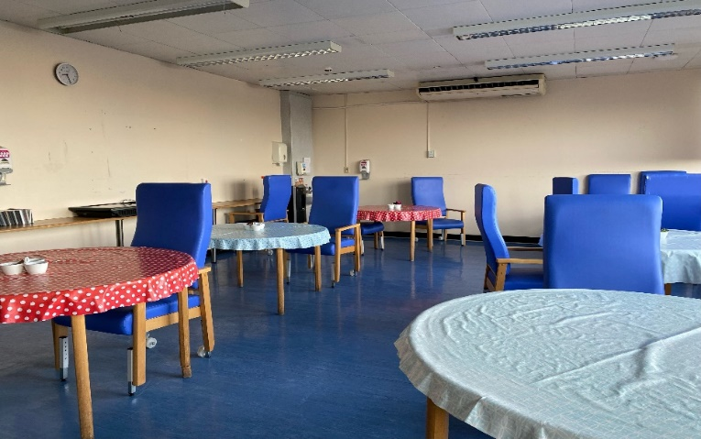
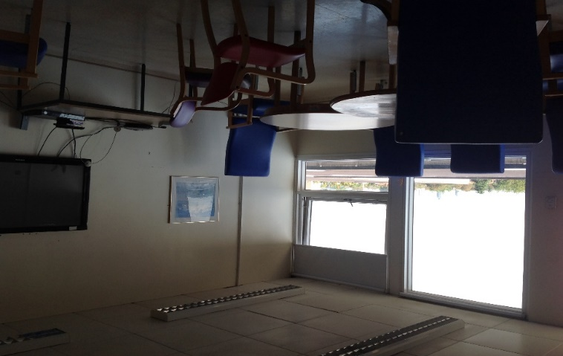
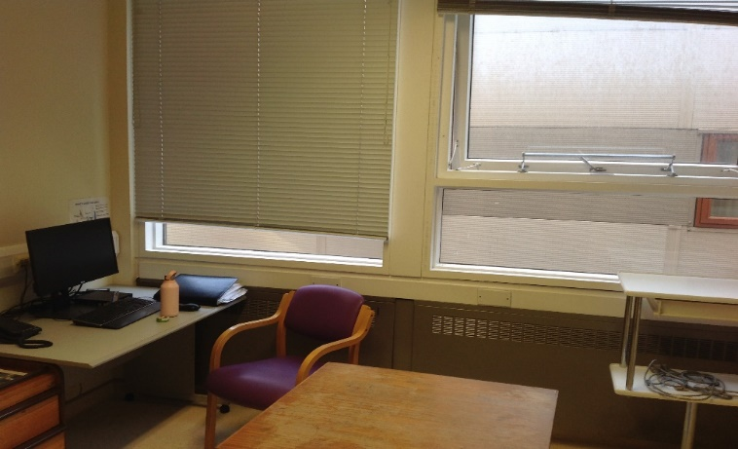
A collaborative project aimed at improving the acute rehabilitation unit environment in order to increase patient’s social interaction and better support their sense of well being – PHASE 1
Lorraine Kenneally Highly Specialist Speech and Language Therapist
Background
Following a stroke, survivors can spend many weeks or months as an in-patient
Observational studies show stroke patients can be inactive and alone for more than 60% of waking hours with few opportunities for social interaction
During the pandemic spaces available for patients to relax and socialize were repurposed for clinical use
Methods
CREATE, a research project was used, aimed at increasing patient activity on stroke units, as our model
Questionnaires were adapted to collect views of the current state and use of space on the ward, including suggestions for change
Estates and Charitable Funds at St George’s were contacted for advice around provision of resources, funding and redecoration
An MDT working party was set up to drive the project forward
Results
Both patients and staff felt there was a lack of alternative, social spaces for patients and families to relax in and enjoy activities outside of therapy time
There is a need for some quiet spaces, away from the patient bays, where patients and families can enjoy some privacy, as well as having more organized social and group activities
The dining room area is currently under-used. Communal spaces are seen as ‘drab and bare’, ‘neglected, like an afterthought’, ‘not warm or inviting’
Two main strands were selected as a starting point. Redecorating and updating of the dining room and TV room and providing more opportunities for organized and independent activities on the ward
Progress so far
Therapists and volunteers have organized Friday Coffee Club, Movie and takeaway nights, Pets as therapy
Spaces have been decluttered, plants donated and wish lists created
Top Tips for implementation
Allowing protected and allocated time
Commitment from all staff is needed
Contact local voluntary groups and charities for funding, volunteers and resources
Next steps
Submit a case for a permanent activities coordinator post
Reorganise dining room area to create a more flexible and welcoming space including café style area
Re-vamped TV room
Establish and advertise an expanded schedule of regular weekly activities
Barriers to implementation
Pandemic and staff changes lead to lack of momentum
Patient safety (e.g supervision) and infection control concerns
Lack of funding and time
Literature cited
Jones F, Gombert-Waldron K, Honey S, Cloud G, Harris R, Mackdonald A, etal. Using co-production to increase activity in acute stroke units: the CREATE mixed-methods study, Health Services and Delivery Research 2020; Vol.8: No. 35
BernhardtJ, Dewey H, Thrift A, Donnan G. Inactive and alone. Stroke 2004;35:1005-9
Rosbergen IC, Grimley RS, Hayward KS, Walker KC, Rowley D, Capbell AM, et al. Embedding an enriched environment in an acute stroke unit increases activity in people with stroke: a controlled before-after pilot study. Clin Rhabil 2017;31:1516-28
Acknowledgments
The Multi-disciplinary therapy and nursing teams, patients and families on Thomas Young Ward, Acute Stroke and Wolfson Rehabilitation Units at St George’s Hospital, London
Please contact me lorraine.kenneally@stgeorges.nhs.uk if you have a question or comment

