Slide 1
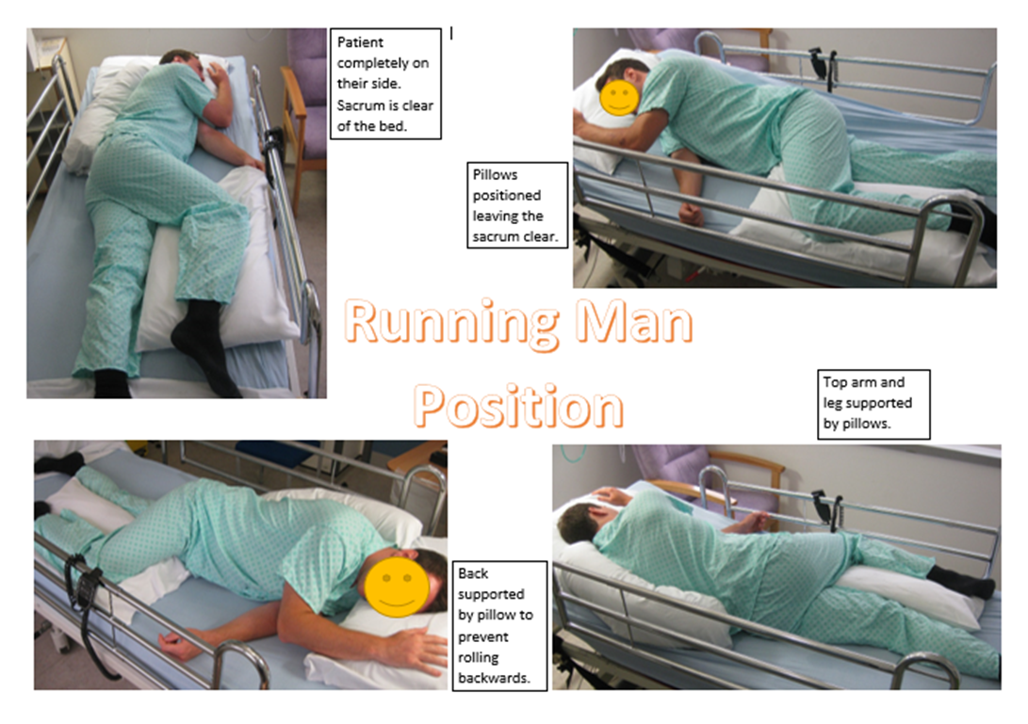
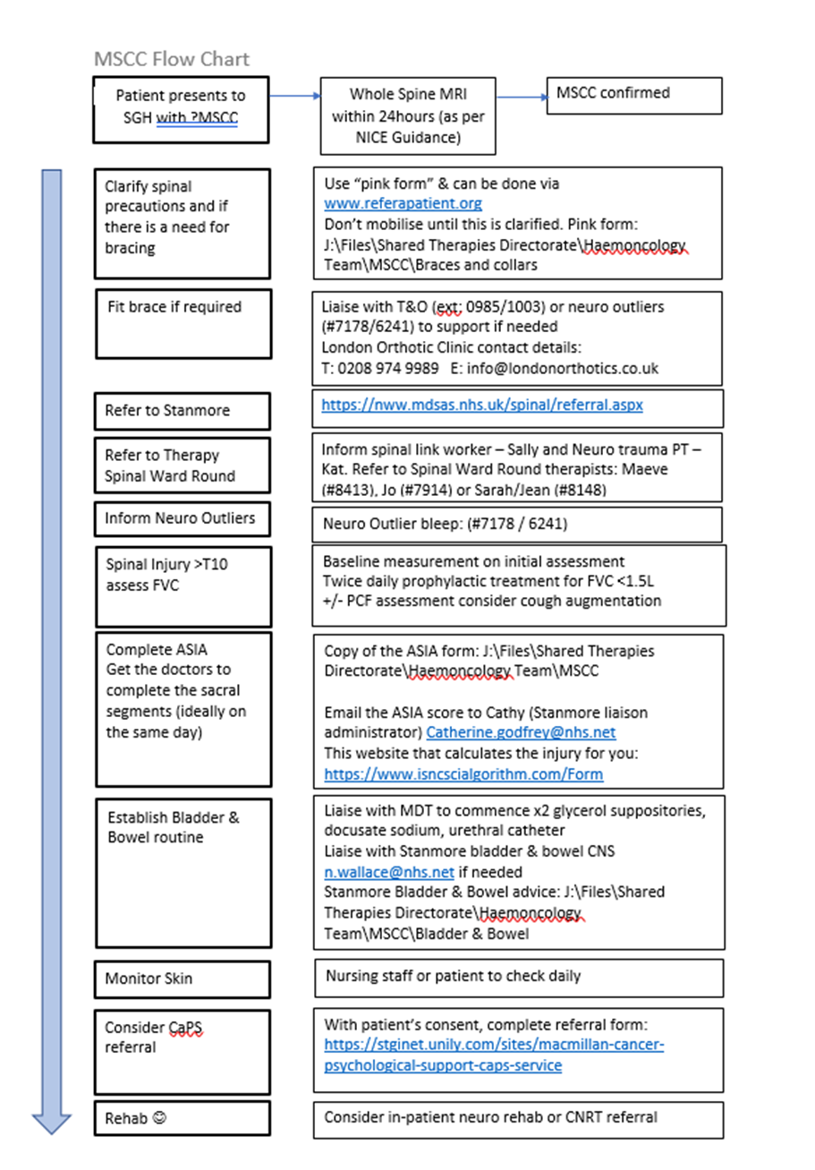
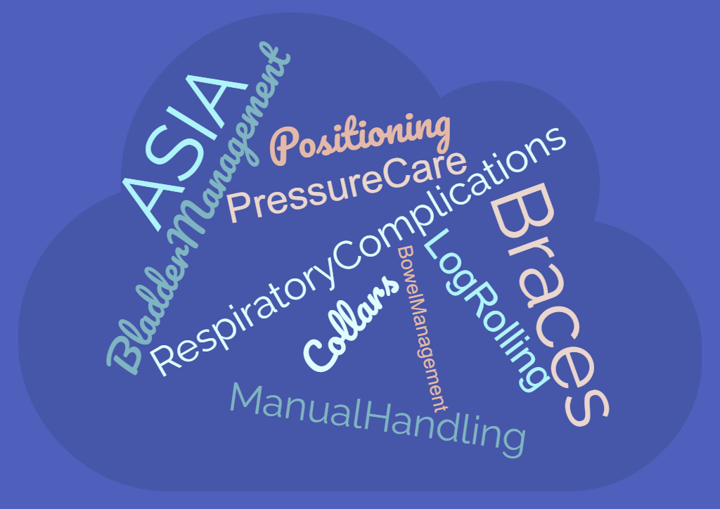
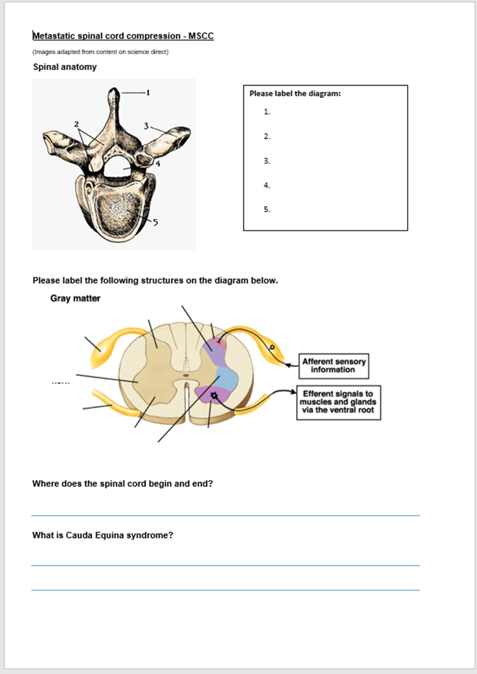
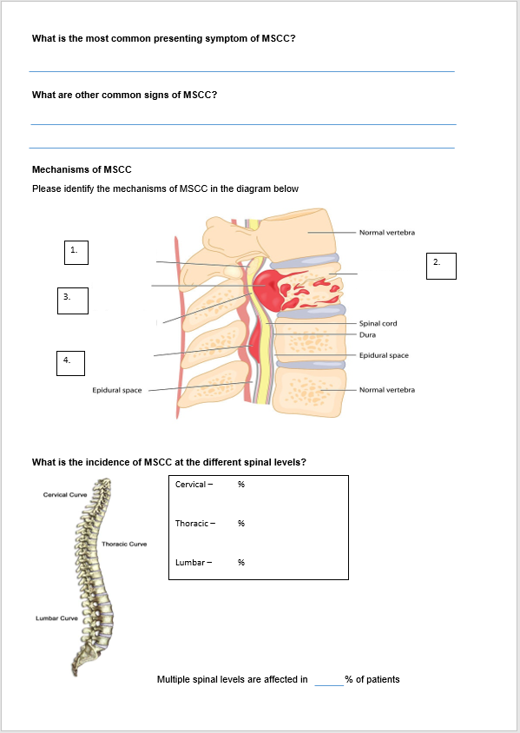
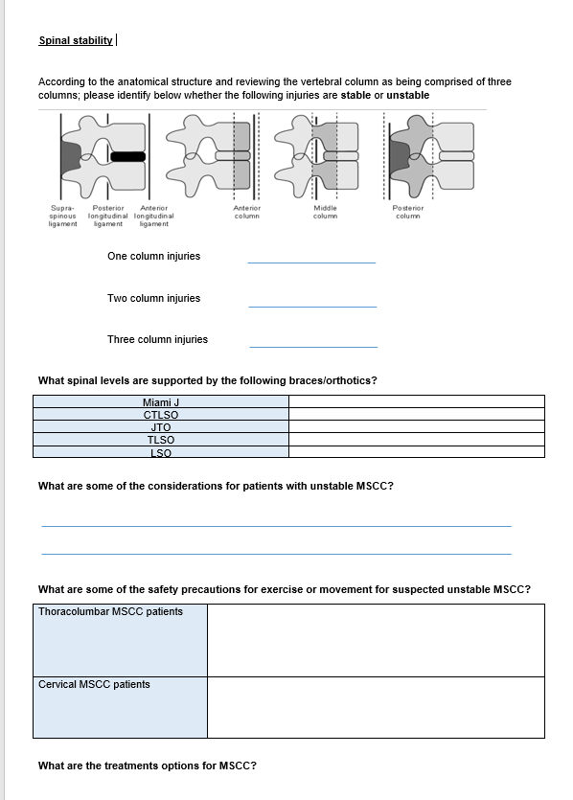
Education Programme to Enhance Management of Oncology and Haematology Inpatients with Metastatic Spinal Cord Compression (MSCC)
Lucy Pidgeon and Helen Ricketts
Helen.ricketts@stgeorges.nhs.uk
Background
Training design 1. Training resources
Learning points
Metastatic spinal cord compression (MSCC) is a rare condition, thought to affect 15% of people living with advanced cancer. The consequences of developing MSCC and sustained compression includes vascular injury, cord necrosis and permanent neurological damage ^{[1]} .
This project arose due to:
Increased incidence of patients presenting with MSCC
Increased complexity of patients
Rehabilitation complexity, challenging bladder and bowel management, pressure areas
Increased frequency of unstable spinal patients
Non-compliance with guidelines (GAIN & NICE)
Delays to therapy input due to determining spinal restrictions
Staff training needs
Reviewed guidelines and up to date evidence base
Developed posters and quick reference guides
Sourced training videos
Sourced equipment to enable practical sessions
Liaised with spinal specialists at Stanmore and SGH regarding content
Learning from the established traumatic spinal injury pathway
Need for flexibility with ward training
Regular review of training needed
Lots of internal expertise to link in with
Benefit of a SGH specific pathway to guide processes
Feedback
“Topics were relevant”
“Topics were helpful”
“Training on the ward beneficial”
“Further sessions needed”
Overall training rated “excellent”
Training design 2. Education Week
Training Needs Analysis (TNA)
Pathway development
Flexibility with approach to work around availability of nursing staff.
Base set up in ward day room for drop in sessions
1:1 sessions on the ward
Group sessions
Joined ward nursing huddles
Therapy pathway developed to guide assessment and rehabilitation processes according to guidelines and local processes
Included as part of team induction
Survey completed across oncology and haematology wards
All nurses and HCA’s included
Separate therapy TNA
Interest and appetite for training
from all staff surveyed
Preference for face to face
training
Education content determined from analysis of TNA
Exploration of how best to deliver training
Acknowledgement of shift patterns and challenges for nursing staff to be released mid-shift for training
Training design 3. Therapy team training
The Next Steps
Developed therapy team training resources
Self-directed learning workbook
Team teaching sessions
Presented at clinical governance to raise awareness
amongst medical colleagues
Resources displayed on the ward as a reference guide
Availability for further training sessions
Non-traumatic spinal injuries included in therapy
spinal ward round
Therapy team documentation template on iClip
Reference: [1] Metastatic Spinal cord compression: a rare but important complication of cancer. Robson (2014) Clin Med (Lond) 14(5): 542-545

