Slide 1
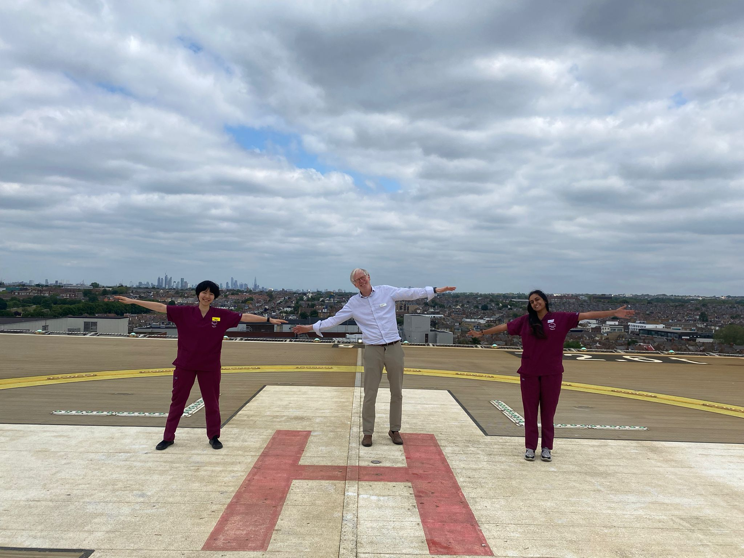
An Elective in Simulation: Bridging the Gap Between Learner and Teacher
Aims:
Exploring educational theories underlying simulation
Observing how a simulation is run from prebrief to debrief
Understanding the technology of high-fidelity simulators
Developing skills in facilitating prebrief and debrief
My Experiences in Simulation:
Over the course of 5 weeks, the GAPS team supported me in playing several roles within simulation courses detailed below:
A participant – the impact of prebriefing on confidence
An observer – different styles of facilitating and sim delivery
A technical supporter – operating high-fidelity simulators
An actor – understanding patient perspectives in illness
A facilitator – teaching approaches to facilitate learning
The most compelling part of simulation for me was the facilitation, which followed a constructivist approach where the learner actively constructs knowledge rather than simply receiving a transmission of knowledge (3), drawing parallels with the cognitive skills required in clinical reasoning (4). Having observed this learning philosophy being applied to simulation, I was given the opportunity to use this style of learner-centred pedagogy to run a simulation scenario independently.
Conclusions:
As a final year medical student, I have been pushed to shift my perspective as a learner to one of a facilitator. This has revealed my personal reliance on teacher-centred learning approaches, which has the potential to blunt natural curiosity and capability for learning. This elective in simulation has allowed me to develop my competency in facilitation and teaching. This has direct relevance to my immediate future as I prepare for foundation training, where I will undoubtedly be faced with situations requiring facilitated learning amongst colleagues, across different levels of seniority and healthcare professions.
Introduction:
The introduction of simulation in medical school curricula has allowed students to safely apply theoretical knowledge into practice (1). The final year medical school simulation course run by GAPS simulation follows the S.O.F.T framework, which allows participants to anticipate possible issues and mentally rehearse adaptive solutions prior to the simulation (2). I found that adopting such a framework optimised my performance in simulation and subsequent patient encounters, an instrumental learning experience in preparing for practice.
Based on this, I wanted to undertake an elective in simulation to explore the practical steps involved in simulation from design to delivery, whilst improving my own development as an educator.
Reflections:
My previous experiences of educating undergraduate medical students involved teaching a set curriculum and an arbitrary transmission of information. Upon reflection, I noticed how difficult it was for me to shift this understanding of learning from a teacher-centred approach to one that focussed on ‘how’ I was facilitating learning, rather than ‘what’ was being taught. Additionally, whilst debriefing, I tended to simply point out erroneous actions, instead of using advocacy and inquiry feedback techniques to explore reasons for these decisions (5).
Whilst a challenging experience, facilitating a simulation independently has revealed potential pitfalls in my own repertoire of teaching events. Adopting this newer style of learning has been vital in developing my experience with medical education. It has also revealed the multi-dimensional learning opportunities that can arise from simulation-based education.
Acknowledgements:
I would like to thank everyone in the GAPS Simulation Team for their unwavering encouragement and support on my elective.
References:
Al-Elq A. Simulation-based medical teaching and learning. Journal of Family and Community Medicine [Internet]. 2010;17(1):35.
Snelgrove H, Fernando A. Practising forethought: the role of mental simulation. BMJ Simulation and Technology Enhanced Learning. 2018 Jan 29;4(2):45–6.
Bada and Steve Olusegun. Constructivism Learning Theory: A Paradigm for Teaching and Learning. 2015.
Dennick R. Constructivism: reflections on twenty-five years teaching the constructivist approach in medical education. International Journal of Medical Education [Internet]. 2016 Jun 25;7(1):200–5.
Rudolph JW, Simon R, Dufresne RL, Raemer DB. There’s No Such Thing as “Non-judgmental” Debriefing: A Theory and Method for Debriefing with Good Judgment. Simulation in Healthcare [Internet]. 2006;1(1):49.

