Slide 1
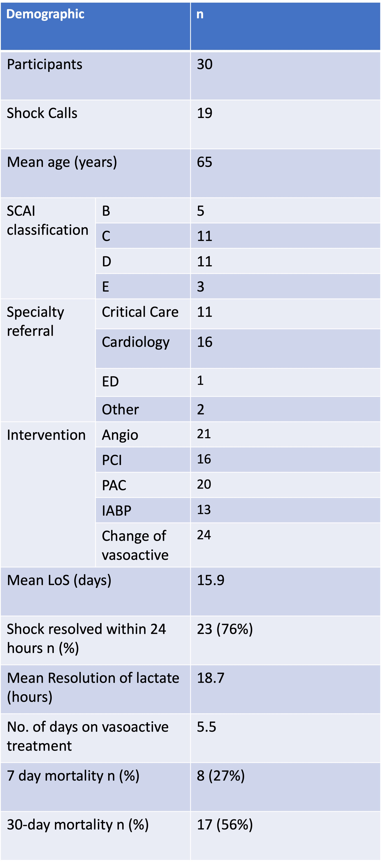
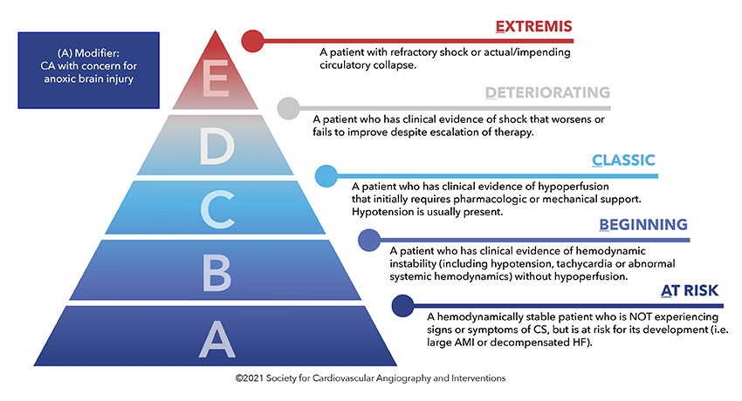
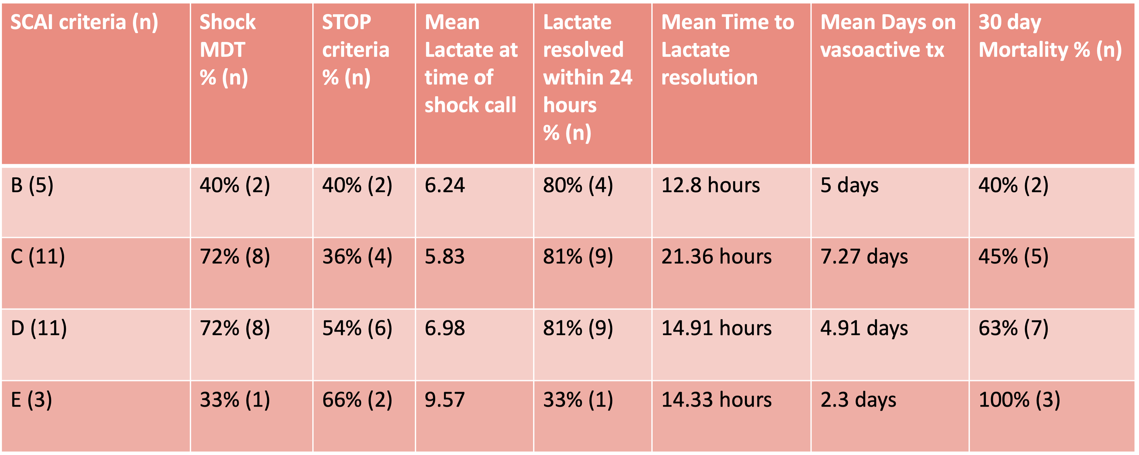
Introducing a Cardiogenic Shock Call Service – A new concept
November ‘22 – April ‘23
Aron, J. Handslip, R. O’Mara H.
Background
Cardiogenic shock results in multi-organ failure and high mortality.¹
It is classified into SCAI stages A-E, class C and above frequently present
to critical care requiring haemodynamic support.²
Short-term mortality for class C to E remains 50-90%³
There is an unmet need for improved recognition and treatment.
Aim
To assess the effectiveness of an in-hours MDT cardiogenic shock call service at St George’s Hospital between Nov ‘23 and April ‘23
Objectives
To characterise the demographics and prevalence of patients that activate a cardiogenic shock call over a 6-month period.
To evaluate the patient outcomes following shock calls, assessing resolution of hypoperfusion (lactate resolution (hours)) and vasoactive dependence (days on vasoactive treatment)
To assess 7 and 30 day mortality of patients that receive a shock call
Key Findings
19 MDT Shock Calls with 11 patients received advice from a member of the shock team
53% of calls were referred from cardiology Of the patients who were discussed a received an intervention 100% shock resolved (n 16)
76% patients shock resolved within 24 hours
7-day mortality, after controlling for STOP criteria, which corresponds to poor outcomes was found to be 33.3%
Assessing class C and D shock showed that 81% of patients lactate resolved within 24 hours.
For Class C the average vasoactive dependence was 7 days, whereas Class D was less 4.9 days.
1
Conclusions & Recommendations
This is a small, early data-set during initiation and therefore will need ongoing evaluation
46% of patients were identified whilst in class D and E shock (Could just but C and D or separate out) and these patients had a higher 30-day mortality (63% to 95^{%)3,} suggesting earlier identification may improve outcomes.
Short-term mortality from cardiogenic shock at SGH is in keeping with the average mortality rate and remains are target for improvement.
Patients frequently present out of hours who may benefit from the shock MDT
References
Baran D.A., Grines C.L., Bailey S., et al. SCAI clinical expert consensus statement on the classification of cardiogenic shock. Catheterisation and cardiovascular interventions, 2019 https://doi.org/10.1002/ccd.28329
Jentzer JC. Understanding cardiogenic shock severity and mortality risk assessment. Circulation: Heart Failure. 2020 Sep;13(9):e007568.
Burgos LM, Vila RC, Botto F, Diez M. SCAI Cardiogenic Shock Classification for Predicting In-Hospital and Long-Term Mortality in Acute Heart Failure. Journal of the Society for Cardiovascular Angiography & Interventions. 2022 Nov 1;1(6):100496.

