Slide 1
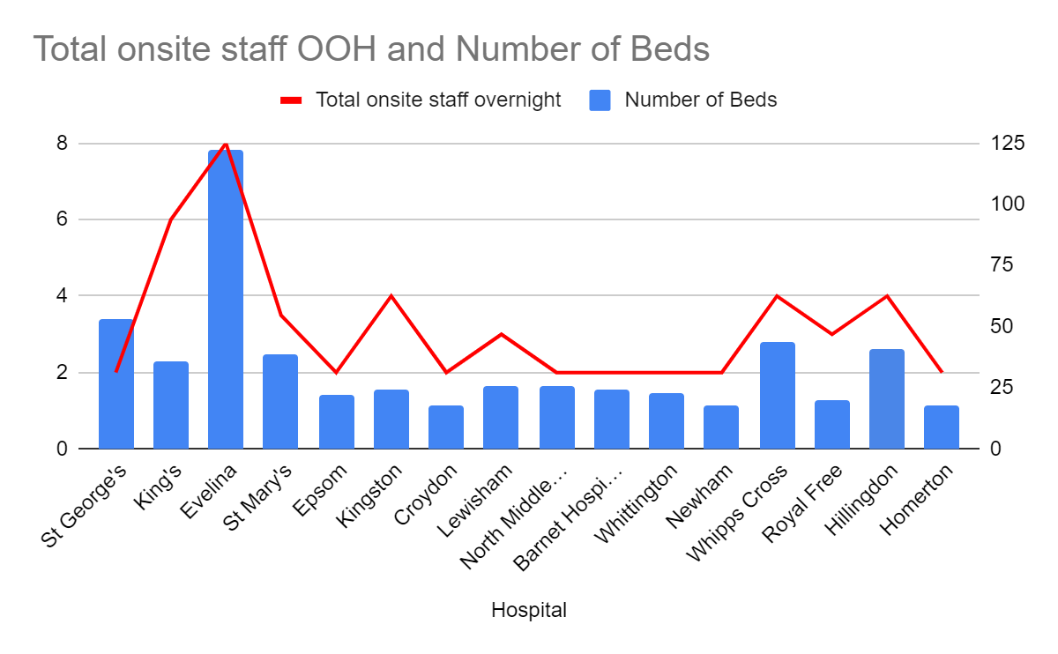
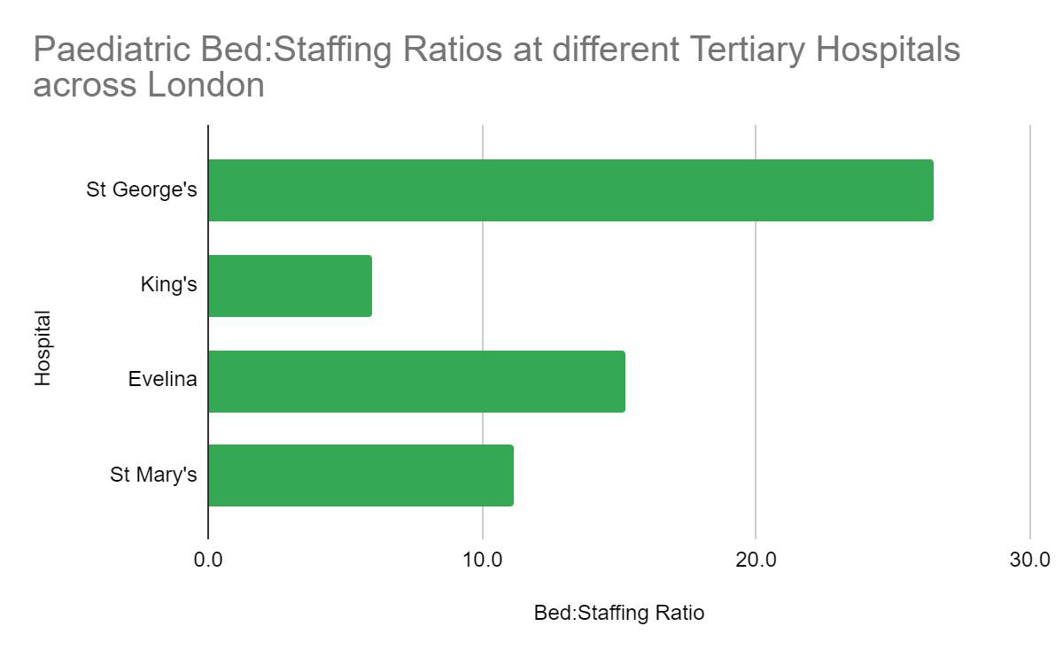
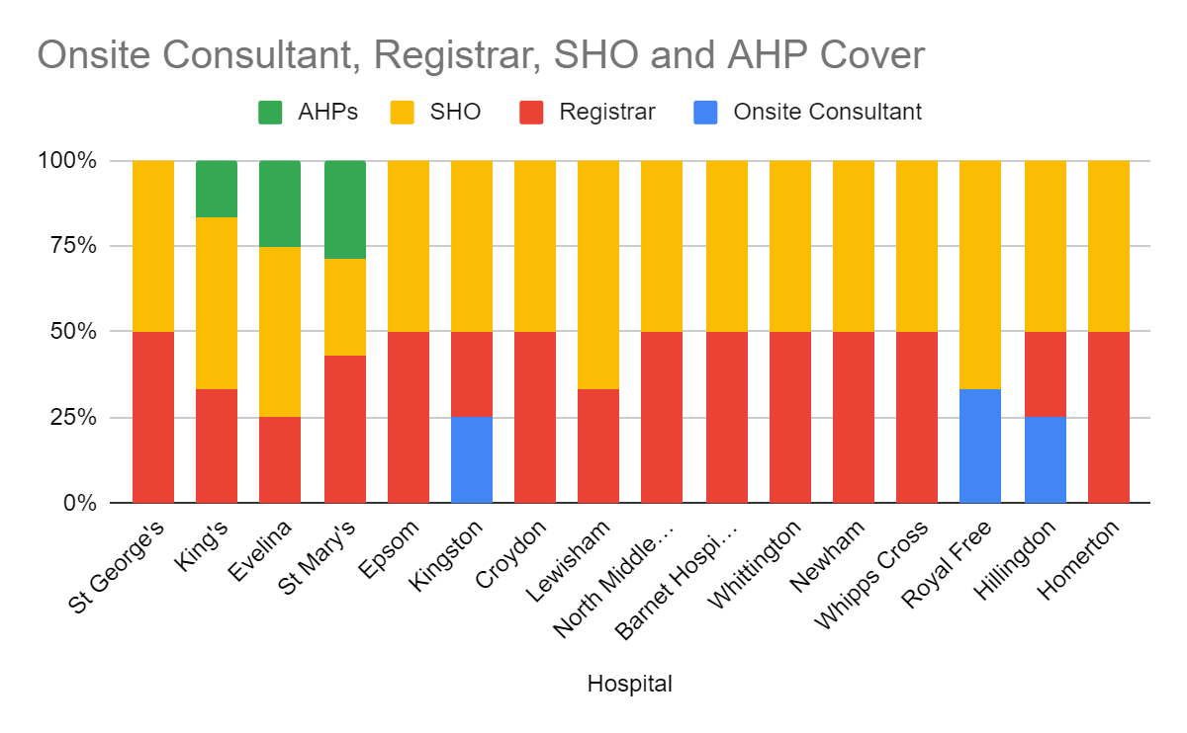
Paediatric Out of Hours Staffing Across London Hospitals Dr Ella Neil, Dr Kirti Singhal, Dr Nicholas Prince
Introduction
There is evidence that higher levels of medical staffing are associated with reduced mortality for medical patients.(1) There are, however, no current benchmarks against which to judge safe medical staffing levels, particularly with regards to out-of-hours work.(2) We hypothesized that there is significant variation in levels of paediatric medical staffing across London which could consequently have impacts for the safety of children and young people.
Aim
We set out to establish what level of staffing was being provided out of hours (OOH) across various comparable London Trusts. By doing this we hoped to create a benchmark for safe out of hours staffing levels in Paediatrics.
Method
We designed a questionnaire to send out to Training Programme Directors across secondary and tertiary hospitals in London. We collected data on the grade of doctors out of hours and whether there were other AHPs supporting these staff. We also collected data on how many inpatient beds these staff were covering, whether there was a separate team covering NICU and whether they were assessing all patients in ED or referrals only.
Results
There was a wide variation in staffing ratio’s OOHs across hospitals. Ranging from 1 staff member to 26.5 beds at St George’s to 1:6 at Kingston and King’s Hospitals.
From our respondents only Lewisham and Evelina saw all CYPs in A&E. Epsom, Kingston and Hillingdon did not have a separate NICU team.
At the four tertiary hospitals that responded to our survey the make-up of the OOHs team is as follows:
St George’s: one registrar and one SHO
King’s: two registrar’s, two SHOs and one nurse practitioner
Evelina: two registrar’s, four SHOs and two nurse practitioners
St Mary’s: one Registrar, one SHO, and one nurse practitioner.
Discussion
St George’s Hospital has lower medical staff to patient ratio. than all other hospitals that responded to our questionnaire. This has potential consequences for patient safety (1). This difference was still notable when compared directly with other tertiary hospitals with more comparable bed numbers and specialist work loads. The OOHs team at Evelina reviews all patients in A&E which may explain their improved staff:bed ratio however King’s and St Mary’s see referrals only, as at St George’s. St George’s was also an outlier among tertiary hospitals in not utilising AHPs to work within the out of hours team.
Further work could be done to see the volume of referrals to Paediatrics at these different sites to see if this explains the variation in staffing levels. It may also be interesting to look at weekend levels of staffing to see if this variation is also seen.
References
1) Griffiths P, Ball J, Murrells T, Jones S, Rafferty AM. Registered nurse, healthcare support worker, medical staffing levels and mortality in English hospital trusts: a cross-sectional study. BMJ Open 2016;6:e008751. doi:10.1136/bmjopen-2015-008751.
2) Royal College of Physicians. Guidance on safe medical staffing. Report of a working party. London: RCP, 2018.

