Slide 1


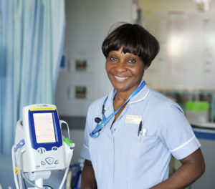

Development Pathway B5 -7
DRAFT
Structured pathway and career development for B5 nurses

Slide 2




Nursing Development Pathway
B5 – B7
Welcome and Support
Consolidating Your Nursing Skills
Developing new skills
Continuous
Professional and Personal Development
( CPPD)

Slide 3

Emphasis on Core Skills and Support
Local induction
In house training e.g. IV administration/Venepuncture /Cannulation
Consolidation and role clarification via trust competencies
Future roles
Changes
Emphasis on gradual development
Emphasis on pastoral support and appropriate education and development

Slide 4
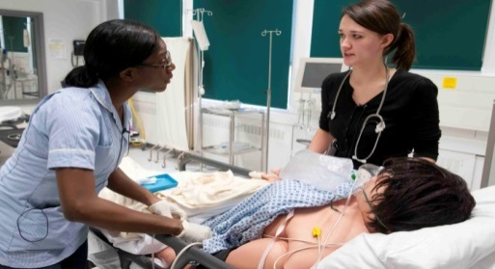

Band 5
Support & Development of Clinical Skills
☐ IV administration
☐ Venepuncture & Cannulation training
☐ Specialist training e.g. tracheostomy care
☐ Complete MEERKATS course in designated acute settings
This is a flexible development guide and can be individualised and adapted after discussion with line manager
Support and Development of Communication skills
☐Complete ½ day Sage and Thyme course on communication skills
☐ Complete Assertive Communication study day
The following are mandatory ⬇
☐Competencies
☐MAST
☐Appraisal
Support and Development of Leadership skills
☐Complete Nurse in Charge competencies with support from senior nurse/manager
☐ Introduction to Leadership and Management course and /or
☐ The Essentials – Leadership and Management
Examples of other additional opportunities
☐Free access to Nursing Times eLearning modules and over 6000 articles
☐Opportunity to apply to complete a NMC approved Mentorship course at Level 6 or 7
☐May be opportunity to complete accredited specialist course at Level 6 or 7
Opportunity to move to another clinical area to gain experience and new skills via the internal transfer process

Slide 5
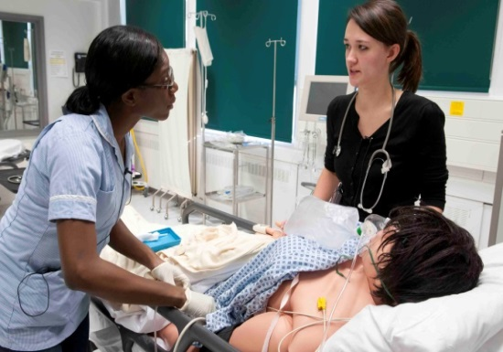
Band 6
Support & Development of Clinical Skills
☐ Complete MEERKATS course in designated
acute settings
☐ Opportunity to apply for course at
Level 6 or 7 e.g. Acutely Unwell
module /specialist course
This is a flexible development guide and can be individualised and adapted after discussion with line manager
The following are mandatory ⬇
☐MAST
☐Appraisal
Support and Development of Communication skills
☐ Appraise your Staff study day
☐ Conflict Management Skills for Leaders study day
Support and Development of Leadership Skills
☐ Introduction to Leadership and Management course I day
☐ The Essentials of Leadership and Management 2 days
☐ Management Coaching and Mentoring Conversations 1 day
☐ Passport to Effective People Management 1 day
☐ Enhanced Leadership and Management 3 days
Free access to Nursing Times eLearning modules and over 6000 articles
Opportunity to move to another clinical area to gain experience and new skills via the internal transfer process
Notes:
www.learn.stgeorges.nhs.uk)

Slide 6
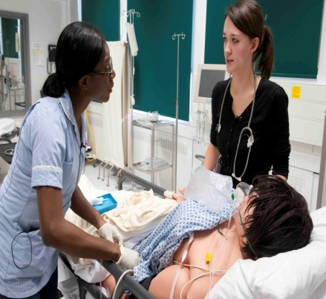

Band 7
Support & Development of Clinical Skills
☐ Complete MEERKATS course in designated
acute settings
☐ Opportunity to apply for course at
Level 6 or 7 Acutely Unwell module /specialist
course including ANP MSc /non medical
prescribing
This is a flexible development guide and can be individualised and adapted after discussion with line manager
The following are mandatory ⬇
☐MAST
☐Appraisal
Support and Development of Communication skills
☐ Appraise your Staff study day
☐ Assertive Communication study day
☐ Conflict Management Skills for Leaders study day
Support and Development of Leadership Skills
☐ Complete Band 7 programme
☐ Introduction to Leadership and Management course I day
☐ The Essentials – Leadership and Management – 2 days
☐ Management Coaching and Mentoring Conversation – 1 day
☐ Passport to Effective People Management – I day
☐ Enhanced Leadership and Management Skills – 3 days
☐ Access 360 feedback / coaching /shadowing
Free access to NT eLearning modules and over 6000 articles
Opportunity to move to another clinical area to gain experience and new skills via the internal transfer process

Slide 7

What does your free Nursing Times subscription give you access to?
Nearly 6000 double-blind peer-reviewed articles within the clinical archive
Daily news – keeping you up-to-date on what’s happening in the world of nursing
Online learning units on fundamental aspects of nursing care
Your personal NT portfolio – an online e-portfolio to store all revalidation and CPD activity

Slide 8

We look forward to working with you at St Georges

