Slide 1
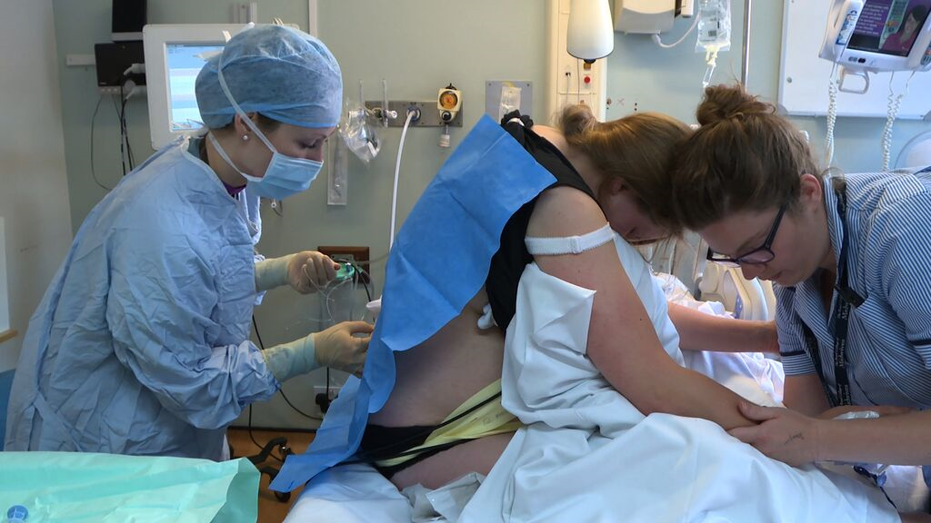
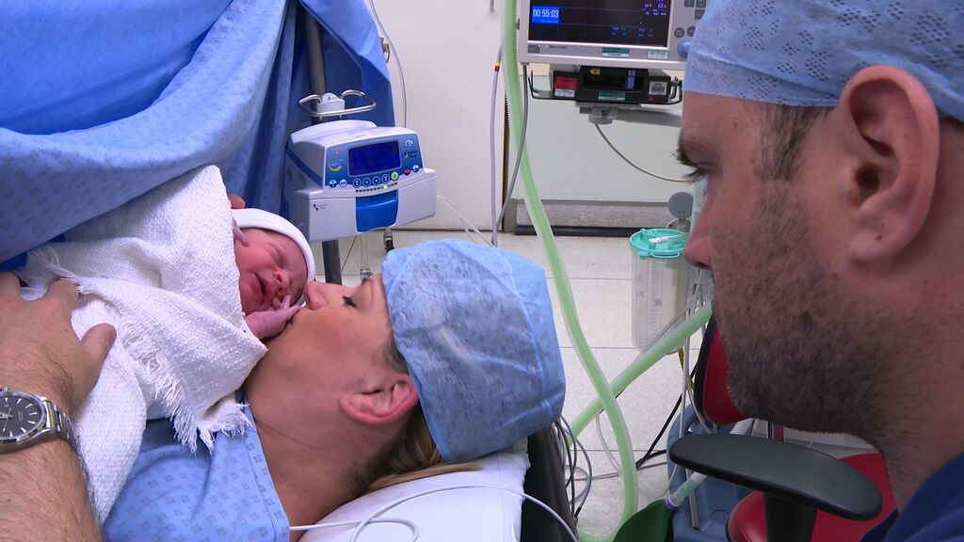
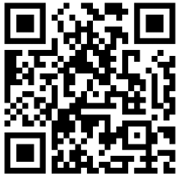
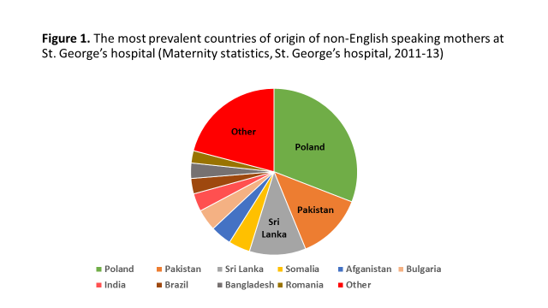
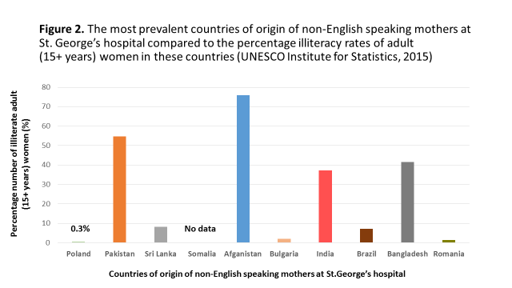
Crossing borders with an innovative epidural information film: our experience
M. Butcher, E. Evans, C. Johnston.
Department of Anaesthesia, St. George’s Hospital, London, UK
This project was generously sponsored by St George’s Hospital charity
QR code link to English language video:
Introduction
It is challenging to discuss choices for labour analgesia with women who understand little or no English.
Typically, multi-lingual information leaflets and interpreters are used to solve this problem.
However, literacy rates in some of our patients’ homelands are low and often worse for women¹; interpreters are costly and not always immediately available.
As a solution to this growing problem, we sought to create a readily accessible educational film that provides a visual and auditory foundation for informed decision making.
Results
The video lasts approximately eight minutes and is currently translated into several languages.
It was uploaded on to a portable tablet and trust YouTube site to allow free, easy and instant access inside and outside the hospital.
Formal feedback of the film from mothers is currently in progress in addition to monitoring downloads, views and comments on You tube.
Weblink to videos: https://www.youtube.com/channel/UCkeIQzek_ZjJAplqLANIq6Q
Discussion
This project highlights the value of creating reliable and immediate information for mothers so they are able to make informed and dynamic decisions about their care.
As a direct result of our educational film, our regional maternity clinical network and the OAA are creating a similar project to improve patient communication and reduce incidences of clinical risk.
We are continuing with wider language translations, and we aim to collaborate with other maternity units to promulgate this local venture nationwide.
Method
We developed an information video on epidural analgesia with the aid of funding from St. George’s Hospital Charity, and the filming expertise of Dr. H. Smith at Invasive Films Ltd.
After informed consent, healthcare volunteers and patients were recruited as actors and translators.
With approval from the Obstetric Anaesthetists’ Association, we created a film dialogue based on it’s Pain Relief in Labour script², which was translated into languages most prevalent in our region.
Feedback from our Patient Information Department and Maternity Liaison Group was sought during the making of the film.
References
1. United Nations Educational, Scientific & Cultural Organization (UNESCO) Institute for Statistics. Adult literacy 2015.
http://data.uis.unesco.org/Index.aspx?DataSetCode=EDULIT_DS&popupcustomise=true&lang=en
2. Obstetric Anaesthetists’ Association. Pain relief in labour 2013.
http://www.labourpains.com/ui/content/content.aspx?ID=332
Thank you to the patients and staff at St George’s hospital for their help in making this video

